Slide 1
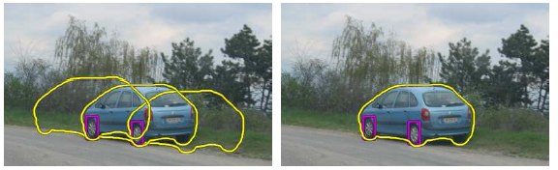
Fitting:
Voting and the Hough Transform
Monday, Feb 14
Prof. Kristen Grauman
UT-Austin

Slide 2
Last time: Grouping
Bottom-up segmentation via clustering
  To find mid-level regions, tokens
  General choices -- features, affinity functions, and clustering algorithms
  Example clustering algorithms
    Mean shift and mode finding: K-means, Mean shift
    Graph theoretic: Graph cut, normalized cuts
Grouping also useful for quantization
  Texton histograms for texture within local region

Slide 3
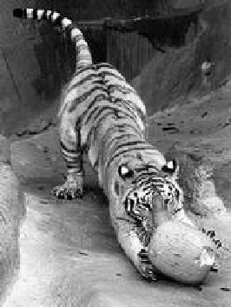
Recall: Images as graphs
q
w_{pq}
w
p
Fully-connected graph
  node for every pixel
  link between every pair of pixels, p,q
  similarity w_{pq} for each link
      similarity is inversely proportional to difference in color and position
Slide by Steve Seitz

Slide 4
Goal: Segmentation by Graph Cuts
w
A
B
C
Break graph into segments
  Delete links that cross between segments
  Easiest to break links that have low similarity
    similar pixels should be in the same segments
    dissimilar pixels should be in different segments

Slide 5
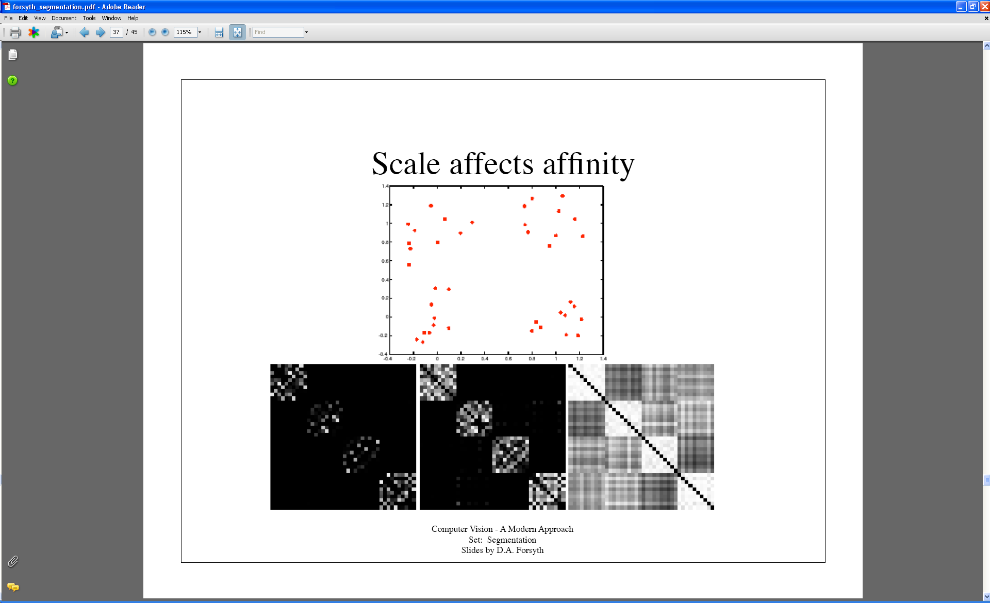
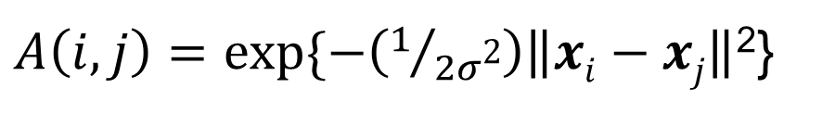
Last time: Measuring affinity
Points x₁…x₁₀
40 data points
40 x 40 affinity matrix A
x₁
.
.
.
x₄₀
Points x₃₁…x₄₀
x_{1 . . .} x₄₀
$A\left(i,j\right)=exp⁡\{−\left(1/{2σ\text{2}}\right)\left\|xi−xj\right\|$²}
What do the blocks signify?
What does the symmetry of the matrix signify?
How would the matrix change with larger value of σ?

Slide 6
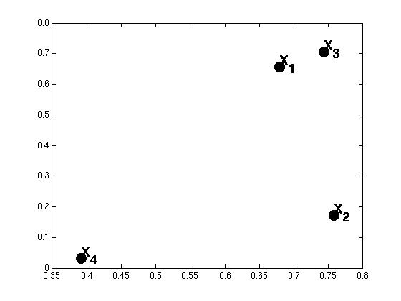
Example: weighted graphs
Suppose we have a 4-pixel image
(i.e., a 2 x 2 matrix)
Each pixel described by 2 features
Feature dimension 2
Feature dimension 1
Dimension of data points : d = 2
Number of data points : N = 4
Kristen Grauman

Slide 7
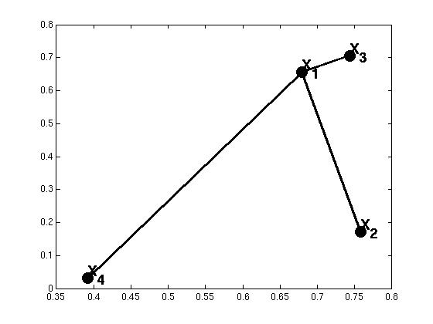

Example: weighted graphs
Computing the distance matrix:
D(:,1)=
0.01
D(1,:)=
(0)
0.24
0.01
0.47
0.24
0.47
for i=1:N
for j=1:N
D(i,j) = ||x_{i}- x_{j}||²
end
end
Kristen Grauman

Slide 8
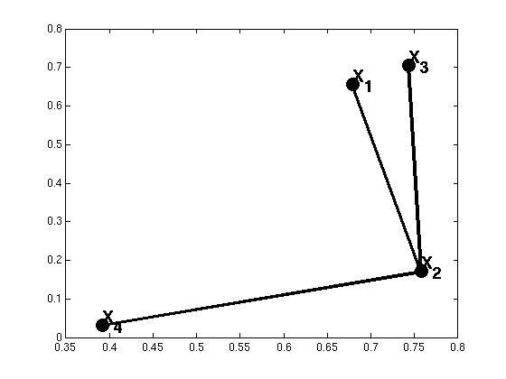
Example: weighted graphs
Computing the distance matrix:
D(:,1)=
D(1,:)=
(0)
0.24
0.01
0.47
0.29
0.24
(0)
0.29
0.15
0.24
0.15
for i=1:N
for j=1:N
D(i,j) = ||x_{i}- x_{j}||²
end
end
Kristen Grauman

Slide 9
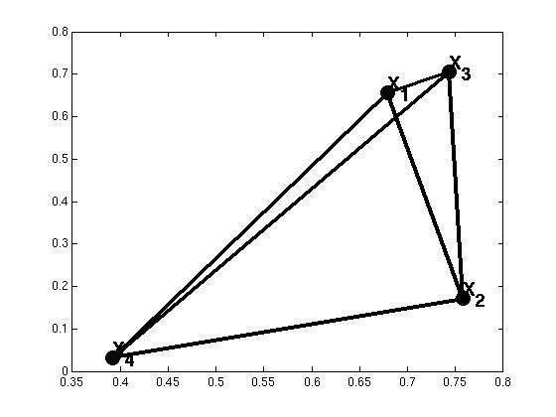
Example: weighted graphs
Computing the distance matrix:
for i=1:N
for j=1:N
D(i,j) = ||x_{i}- x_{j}||²
end
end
N x N matrix
Kristen Grauman

Slide 10
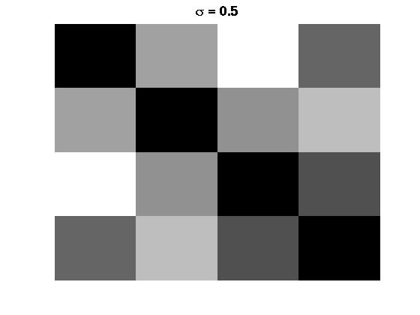
Distances→affinities
Example: weighted graphs
D
A
for i=1:N
for j=i+1:N
A(i,j) = exp(-1/(2*σ^2)*||x_{i}- x_{j}||²);
A(j,i) = A(i,j);
end
end
for i=1:N
for j=1:N
D(i,j) = ||x_{i}- x_{j}||²
end
end
Kristen Grauman

Slide 11
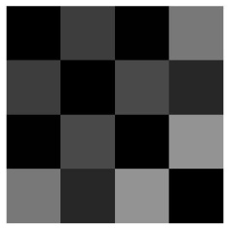
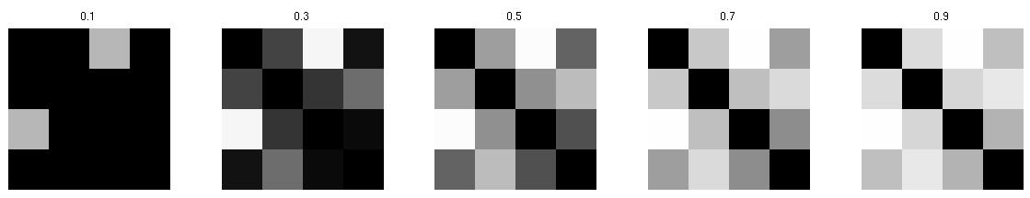
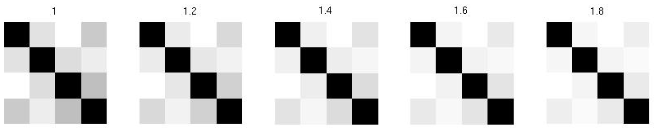
Scale parameter σ affects affinity
Distance matrix
D=
Affinity matrix with increasing σ:
Kristen Grauman

Slide 12

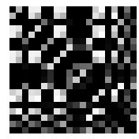
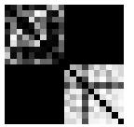
Visualizing a shuffled affinity matrix
If we permute the order of the vertices as they are referred to in the affinity matrix, we see different patterns:
Kristen Grauman

Slide 13
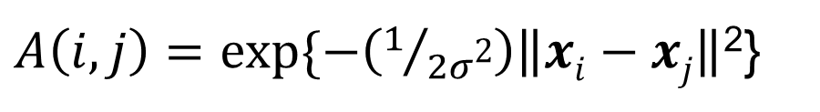
Putting these two aspects together
Points x₁…x₁₀
Data points
Points x₃₁…x₄₀
σ=.1 σ=.2 σ=1
Affinity matrices
$A\left(i,j\right)=exp⁡\{−\left(1/{2σ\text{2}}\right)\left\|xi−xj\right\|$²}
Kristen Grauman

Slide 14
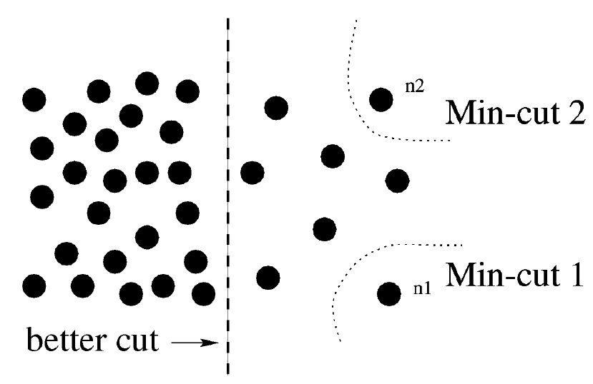
Cuts in a graph: Min cut
B
A
Weakness of Min cut
Link Cut
  set of links whose removal makes a graph disconnected
  cost of a cut:
Find minimum cut
  gives you a segmentation
  fast algorithms exist
Source: Steve Seitz

Slide 15
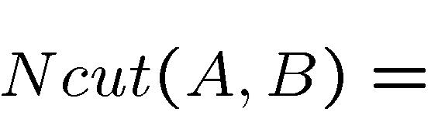
Cuts in a graph: Normalized cut
B
A
  Fix bias of Min Cut by normalizing for size of segments:
  assoc(A,V) = sum of weights of all edges that touch A
  Ncut value is small when we get two clusters with many edges with high weights, and few edges of low weight between them.
  Approximate solution: generalized eigenvalue problem.
      J. Shi and J. Malik, Normalized Cuts and Image Segmentation, CVPR, 1997
Steve Seitz

Slide 16
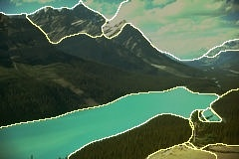
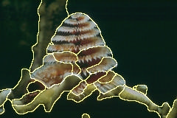
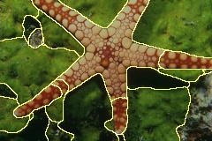
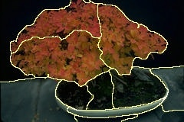
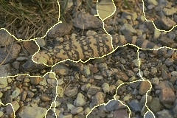
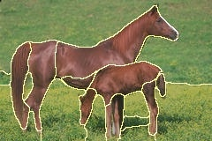
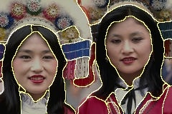
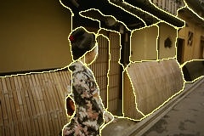
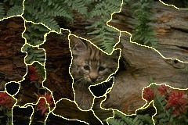
Example results: segments from Ncuts

Slide 17
Normalized cuts: pros and cons
Pros:
Generic framework, flexible to choice of function that computes weights (“affinities”) between nodes
Does not require model of the data distribution
Cons:
Time complexity can be high
  Dense, highly connected graphs → many affinity computations
  Solving eigenvalue problem
Preference for balanced partitions
Kristen Grauman

Slide 18
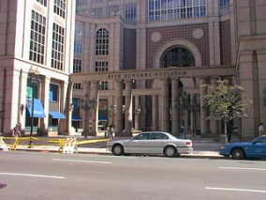
Segments as primitives for recognition
Multiple segmentations
B. Russell et al., “Using Multiple Segmentations to Discover Objects and their Extent in Image Collections,” CVPR 2006
Slide credit: Lana Lazebnik

Slide 19
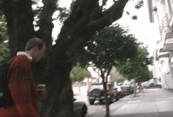
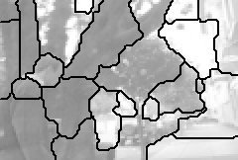
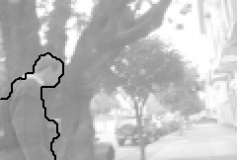
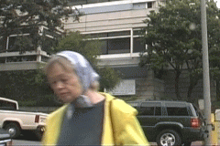
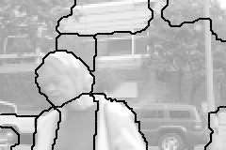
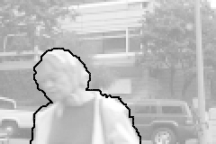
Motion segmentation
Input sequence
Image Segmentation
Motion Segmentation
Input sequence
Image Segmentation
Motion Segmentation
Barbu, S.C. Zhu. Generalizing Swendsen-Wang to sampling arbitrary posterior probabilities, IEEE Trans. PAMI, August 2005.

Slide 20
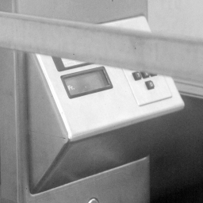
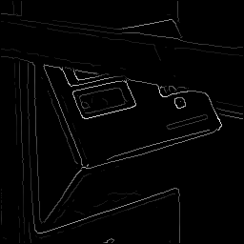
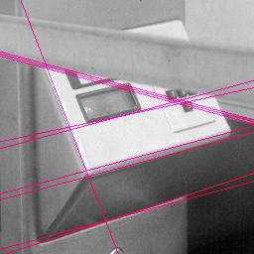
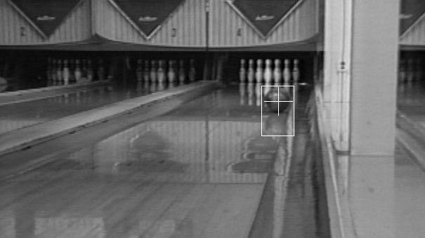
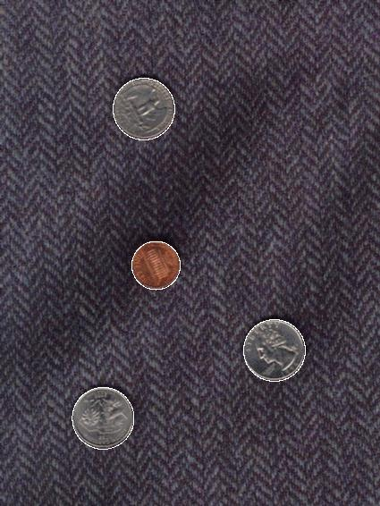
Now: Fitting
Want to associate a model with observed features
[Fig from Marszalek & Schmid, 2007]
For example, the model could be a line, a circle, or an arbitrary shape.
Kristen Grauman

Slide 21
Fitting: Main idea
Choose a parametric model to represent a set of features
Membership criterion is not local
  Can’t tell whether a point belongs to a given model just by looking at that point
Three main questions:
  What model represents this set of features best?
  Which of several model instances gets which feature?
  How many model instances are there?
Computational complexity is important
  It is infeasible to examine every possible set of parameters and every possible combination of features
Slide credit: L. Lazebnik

Slide 22
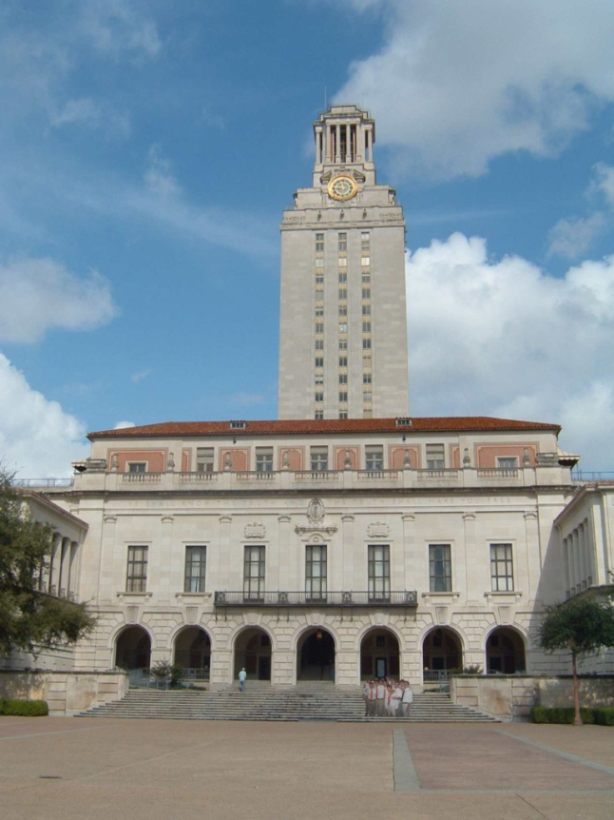
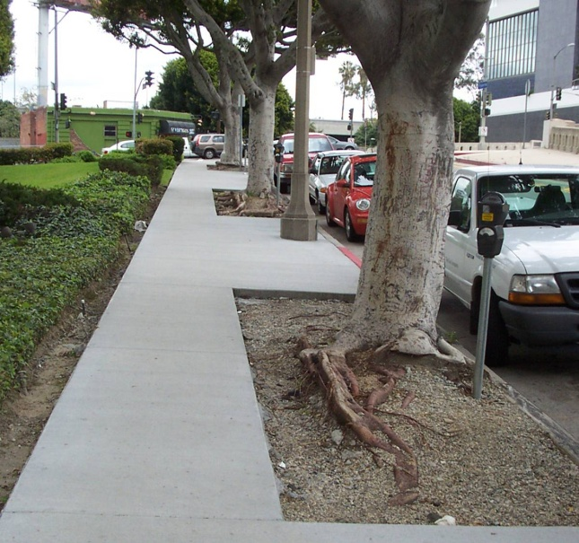
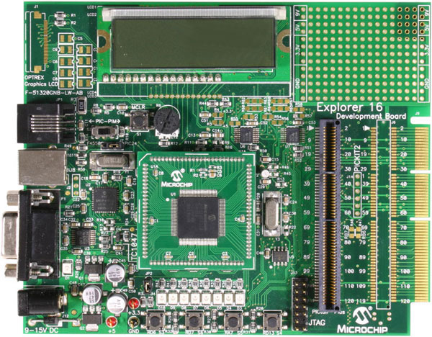
Example: Line fitting
Why fit lines?
Many objects characterized by presence of straight lines
Wait, why aren’t we done just by running edge detection?
Kristen Grauman

Slide 23
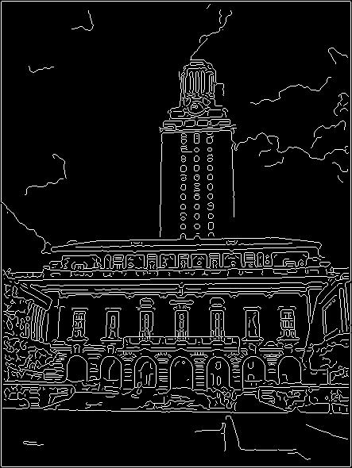
Difficulty of line fitting
Extra edge points (clutter), multiple models:
  which points go with which line, if any?
Only some parts of each line detected, and some parts are missing:
  how to find a line that bridges missing evidence?
Noise in measured edge points, orientations:
  how to detect true underlying parameters?
Kristen Grauman

Slide 24
Voting
It’s not feasible to check all combinations of features by fitting a model to each possible subset.
Voting is a general technique where we let the features vote for all models that are compatible with it.
  Cycle through features, cast votes for model parameters.
  Look for model parameters that receive a lot of votes.
Noise & clutter features will cast votes too, but typically their votes should be inconsistent with the majority of “good” features.
Kristen Grauman

Slide 25
Fitting lines: Hough transform
Given points that belong to a line, what is the line?
How many lines are there?
Which points belong to which lines?
Hough Transform is a voting technique that can be used to answer all of these questions.
  Main idea:
  1. Record vote for each possible line on which each edge point lies.
  2. Look for lines that get many votes.
Kristen Grauman

Slide 26

Finding lines in an image: Hough space
y
b
b₀
x
m₀
m
image space
Hough (parameter) space
Connection between image (x,y) and Hough (m,b) spaces
  A line in the image corresponds to a point in Hough space
  To go from image space to Hough space:
    given a set of points (x,y), find all (m,b) such that y = mx + b
Slide credit: Steve Seitz

Slide 27

Finding lines in an image: Hough space
y
b
y₀
x₀
x
m
image space
Hough (parameter) space
Connection between image (x,y) and Hough (m,b) spaces
  A line in the image corresponds to a point in Hough space
  To go from image space to Hough space:
    given a set of points (x,y), find all (m,b) such that y = mx + b
  What does a point (x₀, y₀) in the image space map to?
    Answer: the solutions of b = -x₀m + y₀
    this is a line in Hough space
Slide credit: Steve Seitz

Slide 28
Finding lines in an image: Hough space
y
b
(x₁, y₁)
y₀
(x₀, y₀)
b = –x₁m + y₁
x₀
x
m
image space
Hough (parameter) space
What are the line parameters for the line that contains both (x₀, y₀) and (x₁, y₁)?
  It is the intersection of the lines b = –x₀m + y₀ and
  b = –x₁m + y₁

Slide 29
Finding lines in an image: Hough algorithm
y
b
x
m
image space
Hough (parameter) space
How can we use this to find the most likely parameters (m,b) for the most prominent line in the image space?
Let each edge point in image space vote for a set of possible parameters in Hough space
Accumulate votes in discrete set of bins; parameters with the most votes indicate line in image space.

Slide 30
Polar representation for lines
Issues with usual (m,b) parameter space: can take on infinite values, undefined for vertical lines.
Image columns
[0,0]
: perpendicular distance from line to origin
: angle the perpendicular makes with the x-axis
Image rows
Point in image space → sinusoid segment in Hough space
Kristen Grauman

Slide 31
Hough line demo
http://www.dis.uniroma1.it/~iocchi/slides/icra2001/java/hough.html

Slide 32
Hough transform algorithm
Using the polar parameterization:
Basic Hough transform algorithm
  Initialize H[d, θ]=0
  for each edge point I[x,y] in the image
    for θ = [θ_{min} to θ_{max} ] // some quantization
      H[d, θ] += 1
  Find the value(s) of (d, θ) where H[d, θ] is maximum
  The detected line in the image is given by
H: accumulator array (votes)
d
θ
Time complexity (in terms of number of votes per pt)?
Source: Steve Seitz

Slide 33

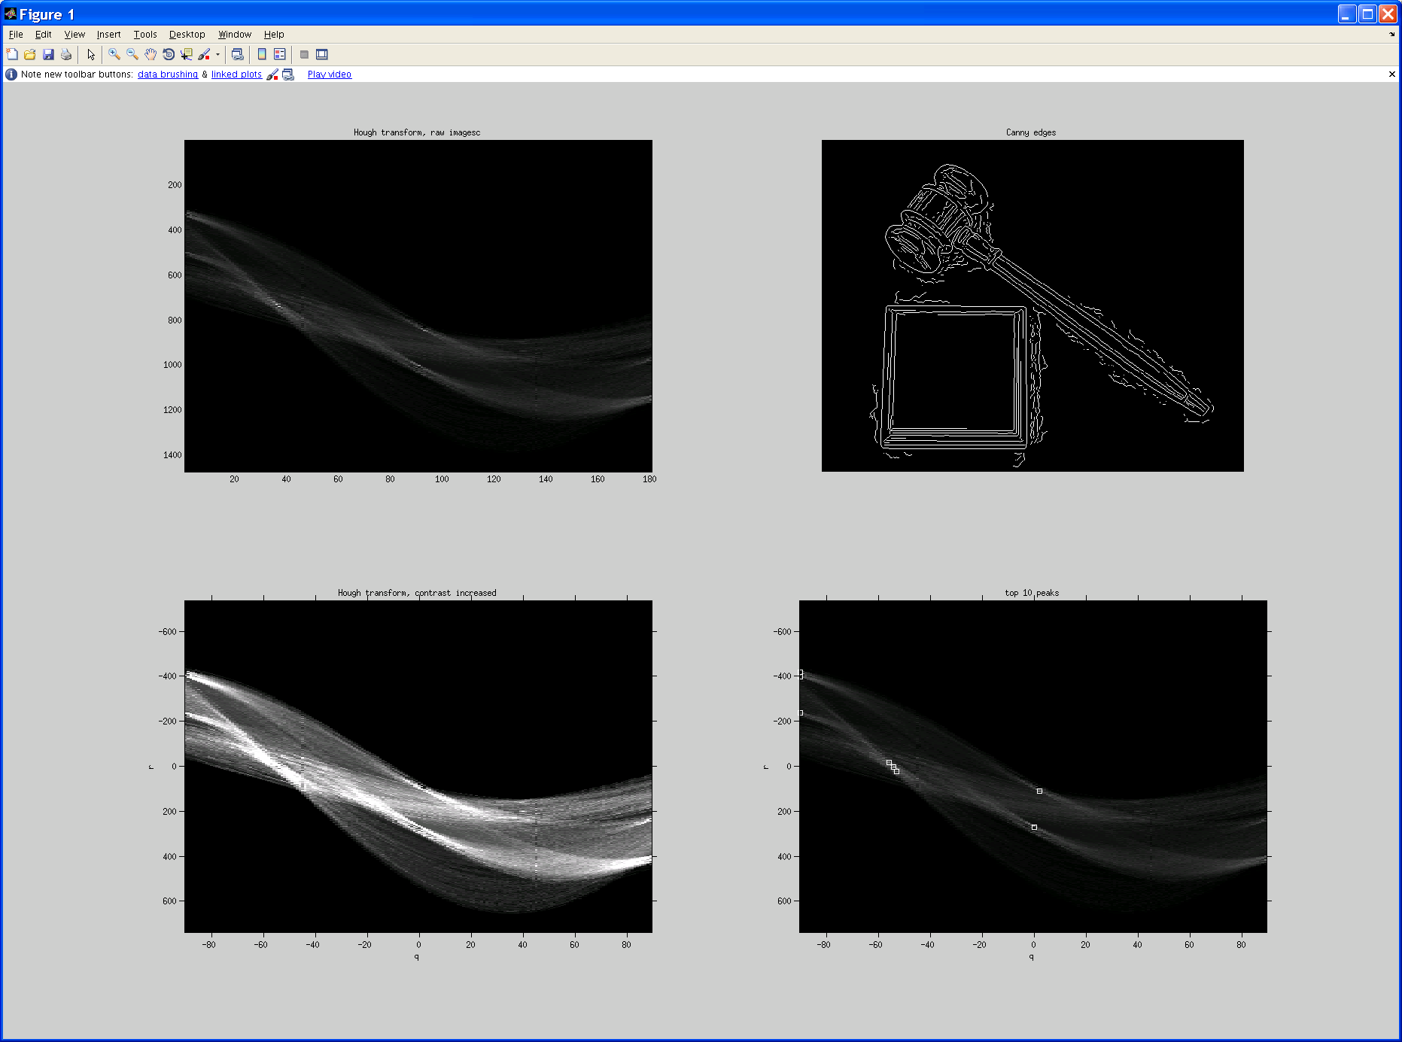
Original image
Canny edges
Vote space and top peaks
Kristen Grauman

Slide 34
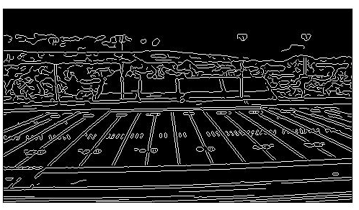
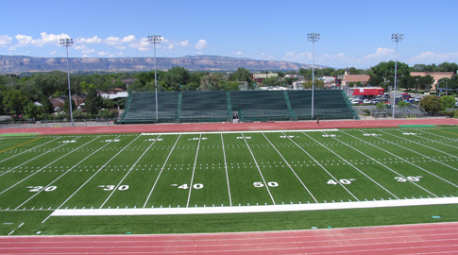
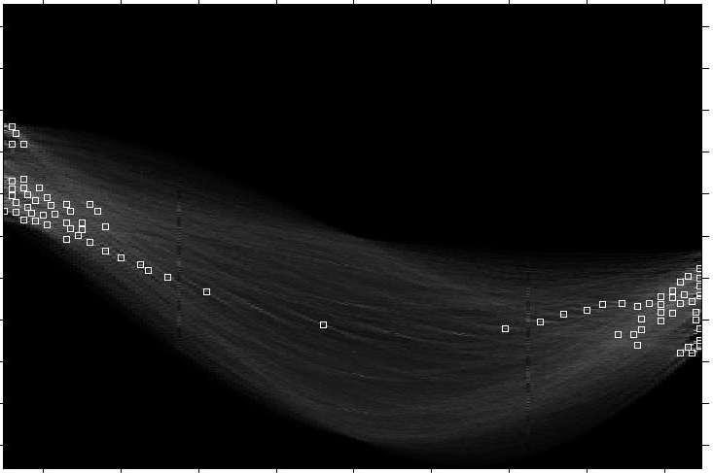
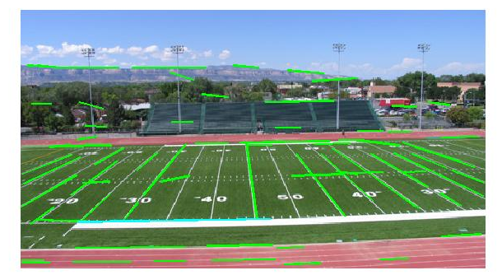
Showing longest segments found
Kristen Grauman

Slide 35
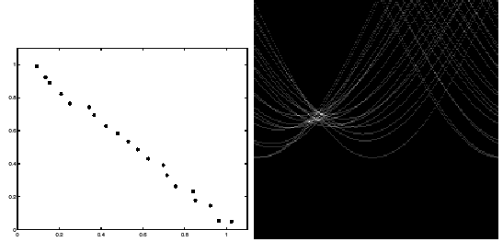
Impact of noise on Hough
y
d
x
θ
Image space
edge coordinates
Votes
What difficulty does this present for an implementation?

Slide 36
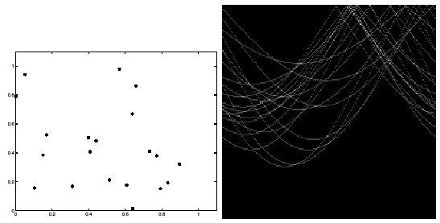
Impact of noise on Hough
Image space
edge coordinates
Votes
Here, everything appears to be “noise”, or random edge points, but we still see peaks in the vote space.

Slide 37


Extensions
Extension 1: Use the image gradient
  same
  for each edge point I[x,y] in the image
    θ = gradient at (x,y)
    H[d, θ] += 1
  same
  same
(Reduces degrees of freedom)
Extension 2
  give more votes for stronger edges
Extension 3
  change the sampling of (d, θ) to give more/less resolution
Extension 4
  The same procedure can be used with circles, squares, or any other shape

Slide 38
Extensions
Extension 1: Use the image gradient
  same
  for each edge point I[x,y] in the image
    compute unique (d, θ) based on image gradient at (x,y)
      H[d, θ] += 1
  same
  same
(Reduces degrees of freedom)
Extension 2
  give more votes for stronger edges (use magnitude of gradient)
Extension 3
  change the sampling of (d, θ) to give more/less resolution
Extension 4
  The same procedure can be used with circles, squares, or any other shape…
Source: Steve Seitz

Slide 39
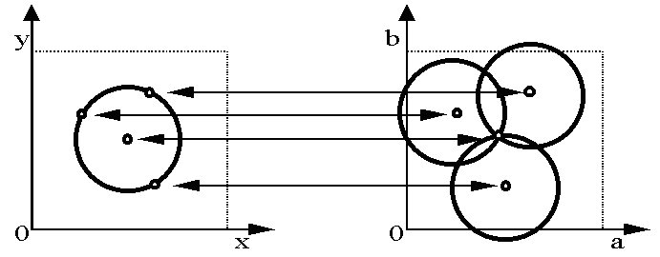
Hough transform for circles
Circle: center (a,b) and radius r
For a fixed radius r, unknown gradient direction
Image space
Hough space
Kristen Grauman

Slide 40
Hough transform for circles
Circle: center (a,b) and radius r
For a fixed radius r, unknown gradient direction
Intersection: most votes for center occur here.
Image space
Hough space
Kristen Grauman

Slide 41
Hough transform for circles
Circle: center (a,b) and radius r
For an unknown radius r, unknown gradient direction
r
?
b
a
Image space
Hough space
Kristen Grauman

Slide 42

Hough transform for circles
Circle: center (a,b) and radius r
For an unknown radius r, unknown gradient direction
r
b
a
Image space
Hough space
Kristen Grauman

Slide 43

Hough transform for circles
Circle: center (a,b) and radius r
For an unknown radius r, known gradient direction
x
θ
Image space
Hough space
Kristen Grauman

Slide 44
Hough transform for circles
For every edge pixel (x,y) :
For each possible radius value r:
For each possible gradient direction θ:
// or use estimated gradient at (x,y)
a = x – r cos(θ) // column
b = y + r sin(θ) // row
H[a,b,r] += 1
end
end
Time complexity per edgel?
Check out online demo : http://www.markschulze.net/java/hough/
Kristen Grauman

Slide 45



Example: detecting circles with Hough
Original
Edges
Votes: Penny
Note: a different Hough transform (with separate accumulators) was used for each circle radius (quarters vs. penny).

Slide 46
Example: detecting circles with Hough
Original
Combined detections
Edges
Votes: Quarter
Coin finding sample images from: Vivek Kwatra

Slide 47




Example: iris detection
Gradient+threshold
Hough space (fixed radius)
Max detections
Hemerson Pistori and Eduardo Rocha Costa http://rsbweb.nih.gov/ij/plugins/hough-circles.html
Kristen Grauman

Slide 48


Example: iris detection
An Iris Detection Method Using the Hough Transform and Its Evaluation for Facial and Eye Movement, by Hideki Kashima, Hitoshi Hongo, Kunihito Kato, Kazuhiko Yamamoto, ACCV 2002.
Kristen Grauman

Slide 49
Voting: practical tips
Minimize irrelevant tokens first
Choose a good grid / discretization
Vote for neighbors, also (smoothing in accumulator array)
Use direction of edge to reduce parameters by 1
To read back which points voted for “winning” peaks, keep tags on the votes.
Too fine
?
Too coarse
Kristen Grauman

Slide 50
Hough transform: pros and cons
Pros
All points are processed independently, so can cope with occlusion, gaps
Some robustness to noise: noise points unlikely to contribute consistently to any single bin
Can detect multiple instances of a model in a single pass
Cons
Complexity of search time increases exponentially with the number of model parameters
Non-target shapes can produce spurious peaks in parameter space
Quantization: can be tricky to pick a good grid size
Kristen Grauman

Slide 51
Generalized Hough Transform
What if we want to detect arbitrary shapes?
Intuition:
Displacement vectors
x
x
x
Ref. point
x
x
Model image
Novel image
Vote space
Now suppose those colors encode gradient directions…
Kristen Grauman

Slide 52
Generalized Hough Transform
Define a model shape by its boundary points and a reference point.
Offline procedure:
x
a
At each boundary point, compute displacement vector: r = a – p_{i}.
Store these vectors in a table indexed by gradient orientation θ.
θ
θ
p₁
p₂
Model shape
θ
…
θ
…
…
[Dana H. Ballard, Generalizing the Hough Transform to Detect Arbitrary Shapes, 1980]
Kristen Grauman

Slide 53
Generalized Hough Transform
Detection procedure:
x
For each edge point:
Use its gradient orientation θ to index into stored table
Use retrieved r vectors to vote for reference point
x
θ
x
x
x
θ
θ
p₁
θ
θ
Novel image
θ
…
θ
…
…
Assuming translation is the only transformation here, i.e., orientation and scale are fixed.
Kristen Grauman

Slide 54

Generalized Hough for object detection
Instead of indexing displacements by gradient orientation, index by matched local patterns.
“visual codeword” with
displacement vectors
training image
B. Leibe, A. Leonardis, and B. Schiele, Combined Object Categorization and Segmentation with an Implicit Shape Model, ECCV Workshop on Statistical Learning in Computer Vision 2004
Source: L. Lazebnik

Slide 55

Generalized Hough for object detection
Instead of indexing displacements by gradient orientation, index by “visual codeword”
test image
B. Leibe, A. Leonardis, and B. Schiele, Combined Object Categorization and Segmentation with an Implicit Shape Model, ECCV Workshop on Statistical Learning in Computer Vision 2004
Source: L. Lazebnik

Slide 56
Summary
  Grouping/segmentation useful to make a compact representation and merge similar features
    associate features based on defined similarity measure and clustering objective
Fitting problems require finding any supporting evidence for a model, even within clutter and missing features.
  associate features with an explicit model
Voting approaches, such as the Hough transform, make it possible to find likely model parameters without searching all combinations of features.
  Hough transform approach for lines, circles, …, arbitrary shapes defined by a set of boundary points, recognition from patches.
Kristen Grauman

