Slide 1
😺 CaT-Bench: Benchmarking Language Model Understanding of Causal and Temporal Dependencies in Plans
Nathanael Chambers
Yash Kumar Lal*
Vanya Cohen*
Niranjan
Balasubramanian
Raymond Mooney
Notes:
Hi, I’m Yash Kumar Lal presenting the paper - CaT-Bench: Benchmarking Language Model Understanding of Causal and Temporal Dependencies in Plans. This is joint work with the help of these wonderful collaborators.

Slide 2
Plans are ubiquitous
Goal: Bake Almond and Chocolate Cake
Goal: Navigate to Empire State Building
Goal: Study Stock Market to Sell Gold Options
…
Step 6: Add in ground almonds.
Step 7: Add half flour and half milk.
Step 8: Use wooden spoon to stir.
…
Step 12: Whip cream till stiff peaks
…
…
Step 3: Enter the 72 St station.
Step 4: Take Q train downtown.
Step 5: Get off at 34 St station.
…
Step 8: Walk east to the building.
…
…
Step 2: Collate gold ETF history.
Step 3: Study for patterns in it.
Step 4: Find the highs and lows.
…
Step 7: Extrapolate trends...
…
Notes:
Plans, such as recipes, directions, and instruction sets are ubiquitous. We use sequences of steps to achieve goals as simple as baking a cake to something as complicated as analyzing stock market trends to figure out when to sell gold options.

Slide 3
LLMs generate fluent plans
How do we check correctness of these plans?
Notes:
Slowly but steadily, we are starting to use LLMs more and more to create plans for us, be it road trip options or cooking recipes. But we have no idea whether these plans are correct or not. We cannot go around executing them in the real world safely or without cost. Instead, as a proxy, we can test whether they understand different aspects of these plans.

Slide 4
Plans contain dependencies
Goal: Bake Almond and Chocolate Cake
…
Step 6: Add in ground almonds.
Step 7: Add half flour and half milk.
Step 8: Use wooden spoon to stir.
…
Step 12: Whip cream till stiff peaks
…
Notes:
Let’s consider a sequence of steps to bake an almond and chocolate cake. Part of the recipe would be stirring in ground almonds, adding flour and milk and stirring the mixture. Towards the end, we might want to whip some cream as icing and add it on top.

Slide 5
Plans contain dependencies
Goal: Bake Almond and Chocolate Cake
…
Step 6: Add in ground almonds.
Step 7: Add half flour and half milk.
Step 8: Use wooden spoon to stir.
…
Step 12: Whip cream till stiff peaks
…
Dependent
Steps
Notes:
While plans manifest as a simple sequence of steps, these steps actually encode complex dependencies between them. We can test whether LLMs understand such causal relationships as a way to test their plan understanding capabilities.

Slide 6
Plans contain dependencies
Q: Must Step 6 happen before Step 8?
Preconditions
Goal: Bake Almond and Chocolate Cake
A: Yes, all ingredients have to be in bowl before stirring
…
Step 6: Add in ground almonds.
Step 7: Add half flour and half milk.
Step 8: Use wooden spoon to stir.
…
Step 12: Whip cream till stiff peaks
…
Questions about dependent steps
Notes:
For instance, if we want to reason about whether Step 6 must happen before Step 8, we can use our knowledge of preconditions to come up with reasoning that all the ingredients must be in the bowl before we stir them together. So, there is a dependency here.

Slide 7
Plans contain dependencies
Q: Must Step 6 happen before Step 8?
Preconditions
Goal: Bake Almond and Chocolate Cake
A: Yes, all ingredients have to be in bowl before stirring
…
Step 6: Add in ground almonds.
Step 7: Add half flour and half milk.
Step 8: Use wooden spoon to stir.
…
Step 12: Whip cream till stiff peaks
…
Questions about dependent steps
Q: Must Step 7 happen after Step 6?
Parallel Steps
A: No, almonds can be added after flour and milk
Questions about non-dependent steps
Notes:
Similarly, if we want to answer whether Step 7 must happen after Step 6, we understand that adding in ground almonds or flour and milk can be done interchangeably or in parallel. So, there is no dependency here. We use this simple intuition to create CaT-Bench, a benchmarking dataset for plan-based reasoning.

Slide 8
Prior Work
Goal: Bake Almond and Chocolate Cake
…
Step 6: Add in ground almonds.
Step 7: Add half flour and half milk.
Step 8: Use wooden spoon to stir.
…
Step 12: Whip cream till stiff peaks
…
Notes:
Prior work has focused on evaluating model understanding of different aspects of plans.

Slide 9
Prior Work
Goal: Bake Almond and Chocolate Cake
Before Step 6, what is the state of almonds?
ground
…
Step 6: Add in ground almonds.
Step 7: Add half flour and half milk.
Step 8: Use wooden spoon to stir.
…
Step 12: Whip cream till stiff peaks
…
After Step 7, what is the state of the flour?
mixed
After Step 12, what is the state of the cream?
whipped
OpenPI (Tandon et al, 2020)
Notes:
One line of work focuses on evaluating the state changes of entities after actions are performed on it. For example, what is the state of almonds after Step 6? Clearly, they are ground. There are other similar questions aimed at entities.

Slide 10
Prior Work
Goal: Bake Almond and Chocolate Cake
Goal: Bake Almond and Chocolate Cake
Select the right candidate step for the goal
…
Step 6: Add in ground almonds.
Step 7: Add half flour and half milk.
Step 8: Use wooden spoon to stir.
…
Step 12: Whip cream till stiff peaks
…
Stir in almonds
Turn right
Eat your protein
Step: Add in almonds
Select the right goal for the given step
Bake Chocolate Cake
Lip Sync
Navigate Home
Step-Goal Inference (Zhang et al, 2020)
Notes:
Another line of work focuses on making different types of inferences about the steps of a plan. For example, models are required to pick the most relevant step towards a certain goal or given a step, they are required to pick the most likely goal.

Slide 11
Prior Work
Goal: Bake Almond and Chocolate Cake
Goal: Bake Almond and Chocolate Cake
…
Step 6: Add in ground almonds.
Step 7: Add half flour and half milk.
Step 8: Use wooden spoon to stir.
…
Step 12: Whip cream till stiff peaks
…
If you have non-stick utensils, what do you do after Step 7?
Use wooden spoon to stir
Use your metal spatula to stir
Choice-75 (Hou et al, 2023)
Notes:
Yet another line of work tests whether models can pick the correct next step given a constraint in the plan.

Slide 12
Creating 😺 CaT-Bench
Goal: Bake Almond and Chocolate Cake
…
Step 6: Add in ground almonds.
Step 7: Add half flour and half milk.
Step 8: Use wooden spoon to stir.
…
Step 12: Whip cream till stiff peaks
…
Recipe Flow Graph Corpus (Yamakata et al, 2020)
Notes:
We start with the Recipe Flow Graph corpus from Yamakata et al.

Slide 13
Creating 😺 CaT-Bench
Goal: Bake Almond and Chocolate Cake
6
7
11
…
Step 6: Add in ground almonds.
Step 7: Add half flour and half milk.
Step 8: Use wooden spoon to stir.
…
Step 12: Whip cream till stiff peaks
…
8
12
15
Recipe Flow Graph Corpus (Yamakata et al, 2020)
Notes:
This corpus contains annotations about relations between steps in cooking recipes. Using these dependencies, we are able to create such causal dependency graphs for each recipe.

Slide 14
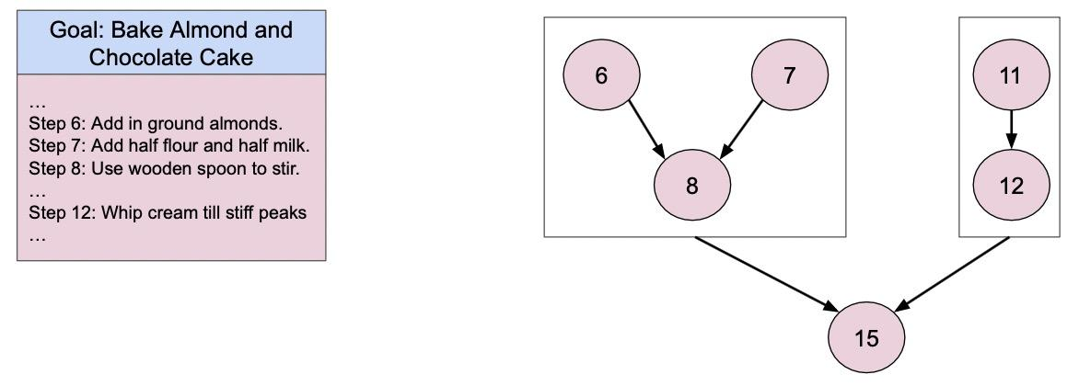
Creating 😺 CaT-Bench
710
Q: Must Step 6 happen before Step 8?
Q: Must Step 12 happen after Step 6?
710
710
Q: Must Step 8 happen after Step 6?
Q: Must Step 6 happen before Step 12?
710
1420
Questions about dependent steps
Questions about non-dependent steps
1420
Notes:
We use these causal dependency graphs to create simple questions related to the temporal order of steps. This leads to questions about two types of pairs of steps - dependent and non-dependent ones. CaT-Bench is created to be a balanced set of questions. We use F1 score to measure how well models answer these questions.

Slide 15
Benchmarking Models
GPT-3.5
GPT-4-Turbo
GPT-4o
Llama-3-8B
Claude-3.5-Sonnet
Gemini-1.0-Pro
Gemini-1.5-Pro
Gemini-1.5-Flash
Notes:
We benchmark a whole host of models on this simple task of predicting whether one step happened before or after another in a plan

Slide 16
Experiments - Answer Only (A)
Binary Prediction
Notes:
First, we simply ask models to provide binary judgments - a simple yes or no answer. 50% chance of getting it right and 50% chance of getting it wrong

Slide 17
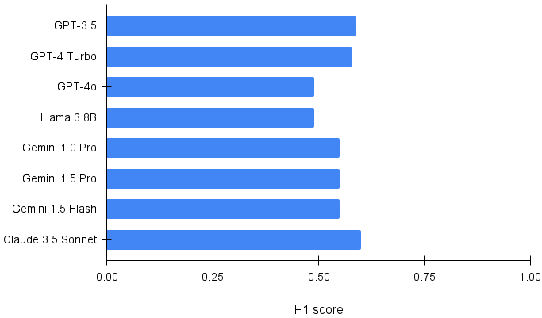
Models Struggle at Predicting Step Order
Notes:
Models struggle at predicting step order, with even the best of them barely performing over random chance.

Slide 18
Models Struggle at Predicting Step Order
Notes:
Surprisingly, GPT-4o actually performs the worst

Slide 19
Experiments - Answer + Explanation (A+E)
Binary Prediction and Post-hoc Explanation
Notes:
Next, we also prompt models to add an explanation to their answers. Prior work has shown that this usually helps model reasoning.

Slide 20
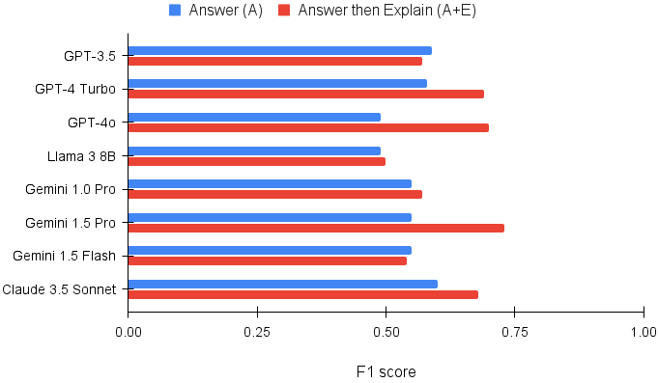
Generating explanations help!
Notes:
And, very obviously, generating explanations always helps.

Slide 21
Generating explanations help!
Notes:
The biggest improvement is seen in GPT-4o, which goes from the worst performing model to the second best one.

Slide 22
Generating explanations help!
Notes:
But, overall, Gemini-1.5-Pro is the best model for this task. Even so, the performance is under 75%. On such a simple task, this is low, showing that models do not necessarily understand causal knowledge encoded in plans.

Slide 23
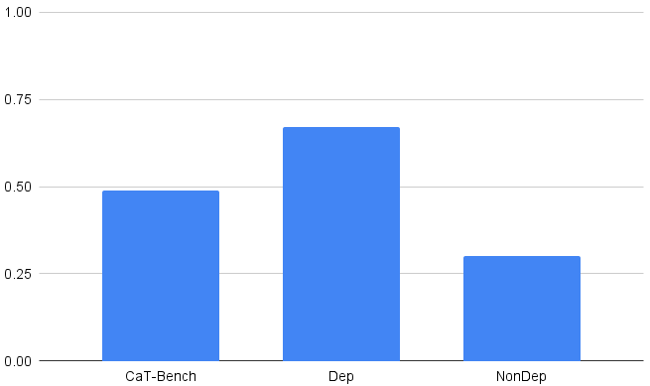
Intermediate Reasoning or Post-Hoc Explanation?
Notes:
Now that we know that generating explanations help, let’s see what happens when we try using chain of thought reasoning, a paradigm that has been shown to work widely. Let’s look at GPT-4o performance more closely. This is the Answer-Only (A) setting.

Slide 24
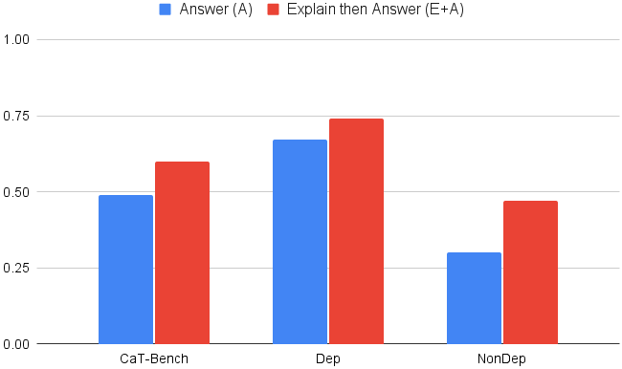
Chain of Thought Improves over Zero-Shot
Notes:
When we prompt GPT-4o to produce intermediate steps as its reasoning before coming up with the answer, we find that there is a significant improvement over zero-shot performance. This is line with all the previous findings.

Slide 25
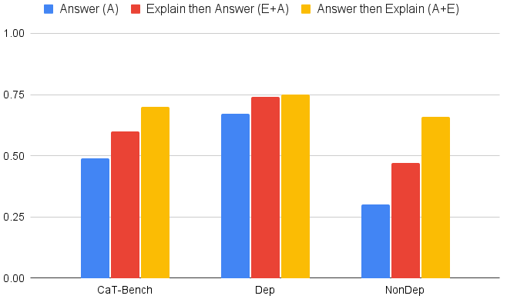
Post-Hoc Explanations are Better than Chain of Thought
Notes:
And this is what happens when we prompt models for post-hoc explanations, i.e., the (A+E) setting. Remember, the red bar is CoT and yellow is A+E. Post-hoc explanations turn out to be much better than chain of thought reasoning overall. We also tried few-shot prompting and self-consistency but they are not better than using post-hoc explanations in a zero-shot setting.

Slide 26
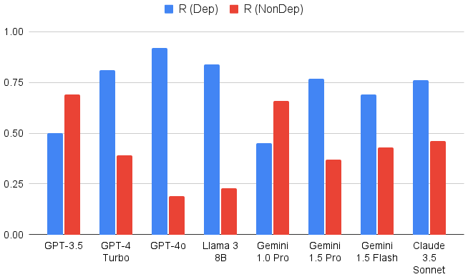
Models are Biased towards Predicting Dependence
Notes:
When we compare model performance on dependent pair of steps to that on nondependent pair of steps, we note there is a huge discrepancy. According to the recall, models are just more likely to predict that two steps are dependent on each other rather than the opposite. This also forms the basis of their overall performance.

Slide 27
How Good are the Generated Explanations?
Model Explanation: All ingredients must be in the bowl to be mixed well together.
The answer contains the relevant details to address the question.
Likert Scale
Strongly Disagree
(1)
Disagree
(2)
Neutral
(3)
Agree
(4)
Strongly Agree
(5)
Average Likert Score
Notes:
Next, we look at the quality of model explanations. We use human evaluation to judge them. Each explanation is rated on a Likert scale of 1 to 5 by 3 distinct human annotators. We then use the average of their scores to rate a model.

Slide 28
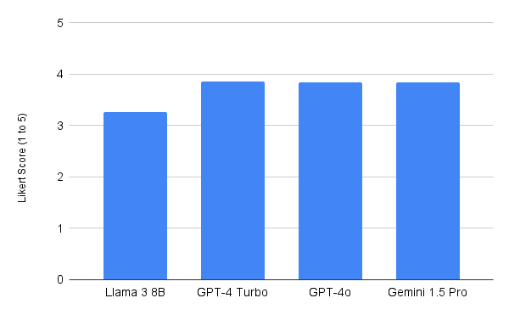
How Good are the Generated Explanations?
4 (+1)
Notes:
From this graph, it looks like model explanations are pretty good, almost reaching a +1 score. The smaller Llama model is clearly worse than its larger closed source counterparts. Due to cost, we only evaluate a subset of explanations from the best models. We measure inter annotator agreement using Weighted Fleiss Kappa, which is 0.76.

Slide 29
How Good are the Generated Faithful Explanations?
Model Answer: No
Model Explanation: All ingredients must be in the bowl to be mixed well together.
The answer contains the relevant details to address the question.
Likert Scale
Strongly Disagree
(1)
Disagree
(2)
Neutral
(3)
Agree
(4)
Strongly Agree
(5)
= 0
Average Likert Score
Notes:
We also add a joint metric of model correctness and the quality of its explanations, rather than just its explanation quality. We modify the previous average by zeroing out human judgments for explanations where the corresponding prediction is incorrect. Basically, this penalizes cases where the model explanation is not faithful to its dependency prediction.

Slide 30
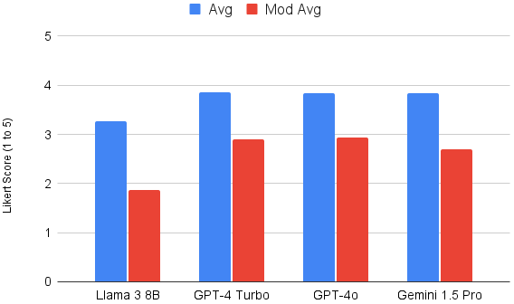
How Good are the Generated Faithful Explanations?
3 (0)
Notes:
On this modified, stricter metric, models are even worse. They barely get to a neutral score on this Likert scale. Clearly, their explanations are more fluent than they are really explanatory. They cannot really be used reliably in critical systems. Let’s look at some other

Slide 31
How Robust are Models: Temporal Consistency
Goal: Bake Almond and Chocolate Cake
…
Step 6: Add in ground almonds.
Step 7: Add half flour and half milk.
Step 8: Use wooden spoon to stir.
…
Step 12: Whip cream till stiff peaks
…
Q: Must Step 6 happen before Step 8?
Before
Q: Must Step 8 happen after Step 6?
After
The model answer to the ‘before’ and ‘after’ questions should be the same.
Notes:
Before we can use them as part of any critical systems, we also need to understand how robust these models are. We use the notion of temporal consistency to evaluate the same. Remember, for each pair of steps, CaT-Bench contains two questions, one tests whether Step X must happen before Step Y and the other which tests whether Step Y happens after Step X. The answer to both questions should be the same. So, using temporal consistency, we measure the percentage of times when that is true.

Slide 32
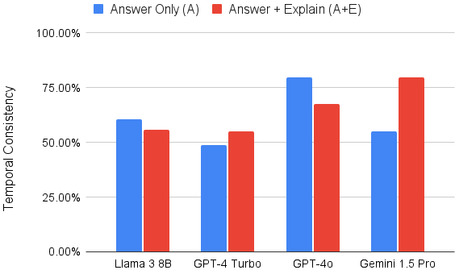
How Robust are Models?
Notes:
In the answer only setting, GPT-4o is the most robust when we look at temporal consistency. But really, it’s barely over 75%. All other best models are much lower. Surprisingly, GPT-4 turbo, a comparable model is much worse, not even crossing 50%

Slide 33
How Robust are Models?
Notes:
I only show some models here but for most of them, prompting for explanations helps. The jump is particularly high for Gemini 1.5 Pro, which incidentally also shows the best overall performance. Answering before and after questions about the same pair of steps requires using slightly different types of causal knowledge but really, it should be simple enough for these large models.

Slide 34
Conclusion
We introduce an easy-to-evaluate plan based reasoning benchmark
SOTA LLMs struggle with this simple task but post-hoc explanations help
Models are inconsistent and biased towards predicting step dependence
Contact: ylal@cs.stonybrook.edu
Notes:
To look back, we introduce a pretty easy to evaluate plan based reasoning benchmark - predict whether one step must happen before another, or the opposite. We benchmark a whole host of LLMs and find that even the best models are far from great on this simple task. But prompting for post-hoc explanations helps them significantly. Even so, models are biased towards just predicting that, for a pair of steps, one step is dependent on the other. We also find that they are not robust as measured by two metrics of consistency, and there is work to be done before they can be used reliably as part of critical systems.

