Slide 1
Mobile (Android) Computing CS371M
Concepts

Slide 2
Android, a mobile OS
Android is the world’s most popular mobile OS
Controls phones, tablets, wearable

Slide 3
Working with a programming language
What does it mean to write idiomatic code?
In Kotlin, try to avoid explicit null checks
highScores.sortWith(compareByDescending<Score>{it.score}.thenBy{it.name})
File("file.txt").copyTo(File("target_file.txt"));
Lateinit

Slide 4
How to succeed at programming
Start with casting spells
Fake it till you make it
Pattern match from other code
Manage your frustration
Keep trying new angles
Write notes
Explain your problem in an email (don’t have to send it)
Am I doing things correctly and efficiently?
Get something working quickly, then improve
Move from one working version to the next (you can always roll back)
Add functionality bit by bit

Slide 5
Android Project Checklist
Code up to date
Layout files up to date
Gradle file up to date, has proper dependences
AndroidManifest.xml
Drawables
Values, like strings and colors, styles, etc.

Slide 6
Widgets
https://kb.wpbeaverbuilder.com/article/81-margins-and-padding

Slide 7
Starting a new Activity
Activities in Android control the screen
Apps typically have several screens
E.g., Game play, high scores, settings
Starting an activity > calling a function
Android runtime constructs the new activity
Eventually calls onCreate
How do we pass parameters?
Returning from an activity isn’t a function return
Where do we return to?

Slide 8
Intents: Specifying operations
An intent is an abstract description of an operation to be performed (Android docs)
Implicit intent: abstract action (e.g., dial this number)
Explicit intent: execute this class
Provides a mechanism to pass parameters
Key/value bundles
Used on entry and exit of Activities
// Get the Intent that called for this Activity to open val activityThatCalled = intent // Get the data that was sent val callingBundle = activityThatCalled.extras callingTV.text = callingBundle?.getString("callingActivity")

Slide 9
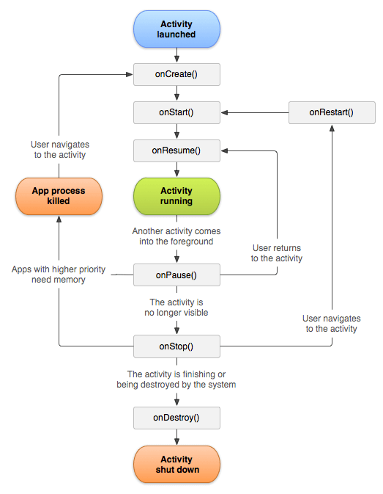
Activity lifetime
State machine for activities
Android tells you about significant events
Your app might want to clean up when it goes to the background
Trend away from explicit callbacks

Slide 10
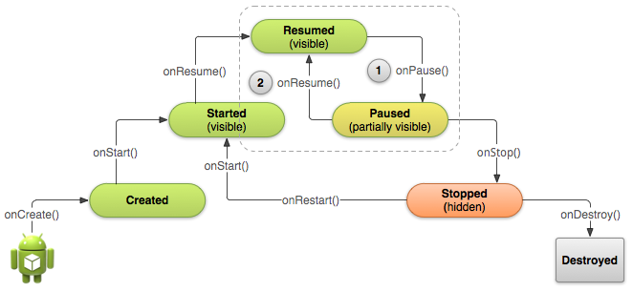
Activity lifecycle

Slide 11
Lists
Simple case: One widget == one program state
A button has one onClickListener
A slider is on or off
A TextView contains a string
Everything about these widgets is visible all the time
Lists
Lists contain many elements
Only some of them are on the screen at any time
How do we deal with many items?
How do we display lists efficiently?

Slide 12
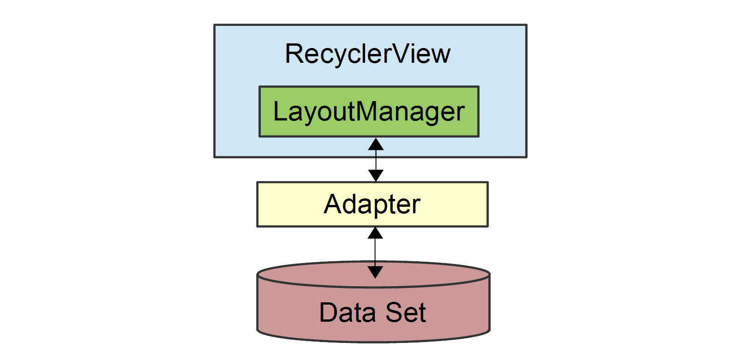
Recycler View
Recycler Views display lists
Recycler View contains a LayoutManager
Examples: Linear Layout, Grid Layout, etc.
Managers can nest, e.g., horizontal layout inside a vertical
Recycler Views only displays part of the list
An Adapter sees the full list and the part of the list currently on screen
Efficiency via ViewHolders
If 6 list elements are visible on the screen at once, we have 6 ViewHolders
Many images from
https://learn.microsoft.com/en-us/xamarin/android/user-interface/layouts/recycler-view/parts-and-functionality

Slide 13
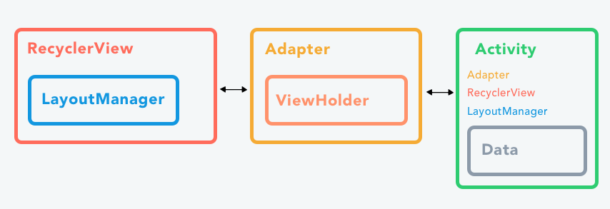
Can’t I just have a simple list?
Before Recycler View was List View
Tried to be simple but failed
To avoid API fatigue, we are jumping straight to RVs

Slide 14
Life is short, lists are long
Layout up to this point has been simple
A TextView object might have some default text
Then we change the text in our program
textView.text = “Watch this space”
But how to we display a scrollable list of 100 items?
recyclerView.list[1] = “Item 1” ????
list = {“Item 0”, “Item 1”}; ???? screenView[1] = list[1] ????
Spoiler alert, not like this, but using the same concepts

Slide 15
Managing on-screen rows
What is a list on screen?
A sequence of rows
How do I lay out a row?
Use an XML file
How do I draw a row on screen?
Inflate a view binding object
E.g., row.xml becomes RowBinding
Inflation is expensive though, so recycle
Put view binding in ViewHolder & recycle them as user scrolls

Slide 16
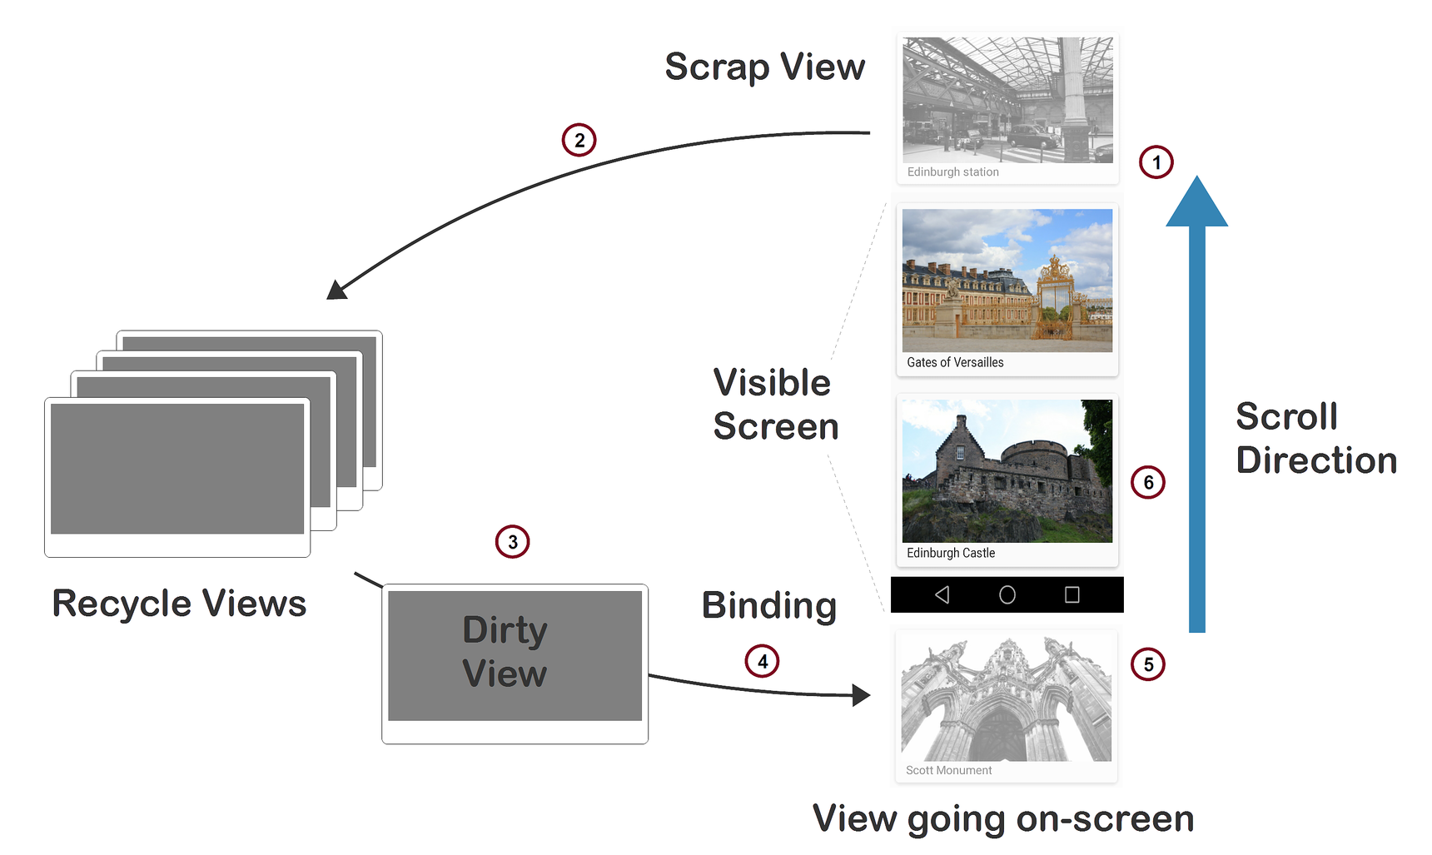
Limited pool of inflated views
Only inflate enough views to fill screen
ViewHolder

Slide 17
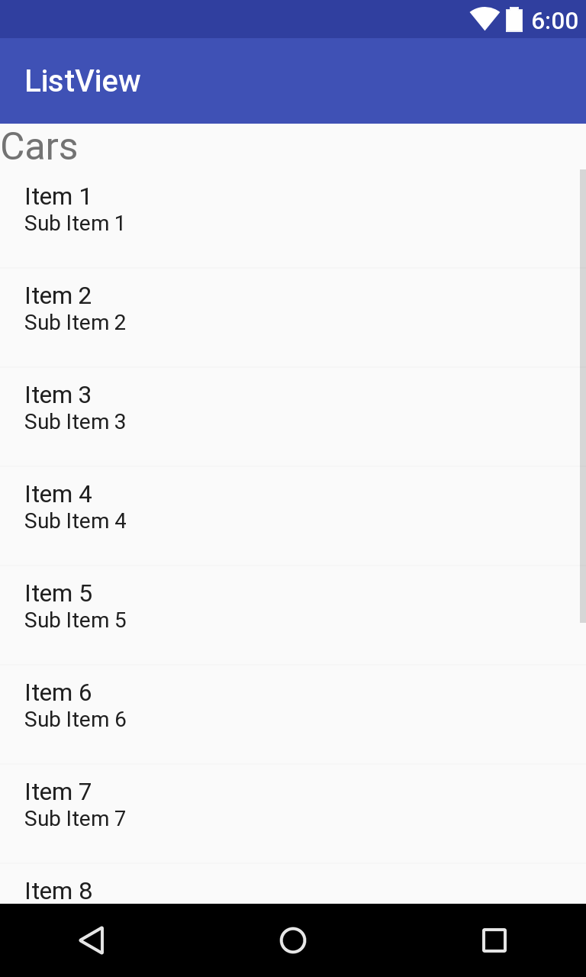
Adapting a list to your screen
The list is long and is in your code
val list = List<Data>(100) {it}
val list = repository.fetchData()
Some elements are on the screen
E.g., 8 items in screen over here
The adapter marries your list to screen
Manage 8 on-screen row views
Inflate: create a view for an on-screen row
Bind: Put list element 9 into a view holder
This bind is different from view binding

Slide 18
Recycler View APIs
row.xml has the row layout
Compiler generated RowBinding object via view binding
Inherit from RecyclerView.Adapter
class RecyclerViewAdapter : RecyclerView.Adapter <RecyclerViewAdapter.VH>()
But now must define inner VH class
ViewHolder holds view, which is in binding class
inner class VH(val rowBinding: RowBinding) : RecyclerView.ViewHolder(rowBinding.root)
Inflate enough rows to fit on screen, no more
onCreateViewHolder
Set holder.rowBinding to contents in list[position]
onBindViewHolder(holder: VH, position: Int)

Slide 19
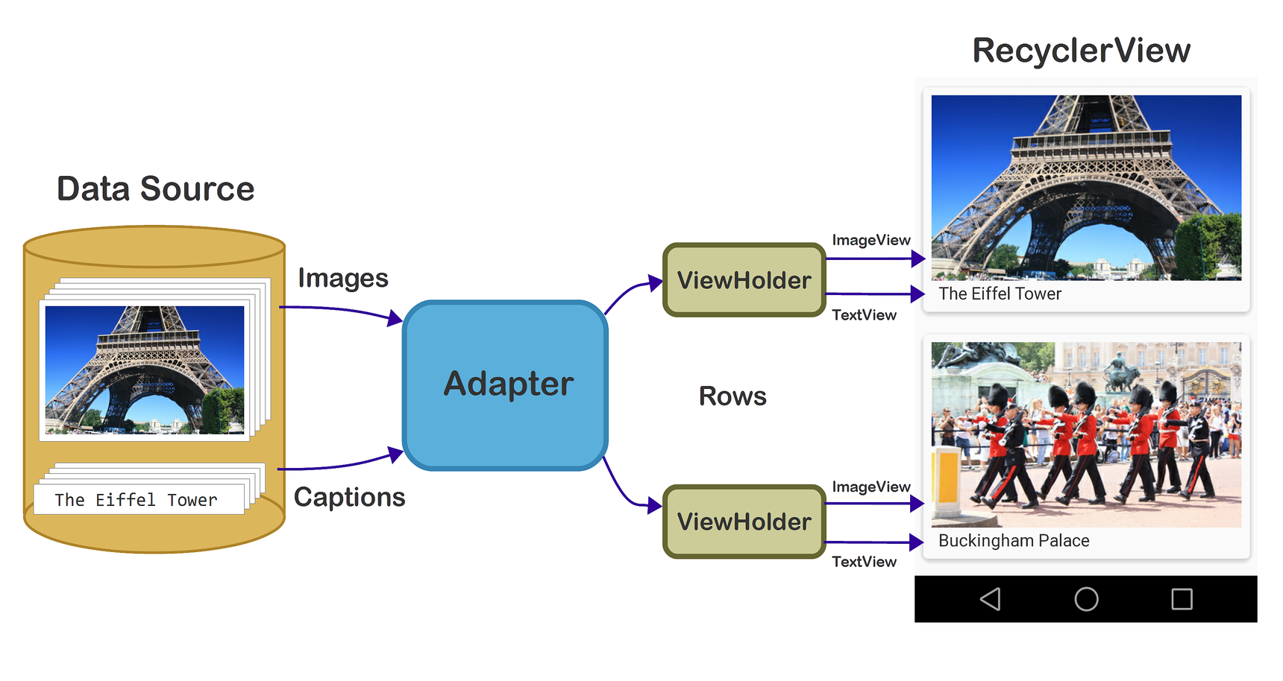
One more zoomed-out view

Slide 20
RecyclerView glossary
Row layout: XML file describing a row
Adapter: Views for on-screen rows from full list
Position: The position of a data item within the list
Inflate: XML→ View (uses view binding)
ViewHolder: View/binding for one on-screen row
Binding view holder: Put data for list element X into view holder when user scrolls to item X
Recycle: ViewHolders are reused as the user scrolls. Minimize inflation, which requires lots of CPU & memory

Slide 21
Why is activity/fragment killed?
1. You meant to navigate away permanently: The user navigates away or explicitly closes the activity — say by pushing the back button or triggering some code that calls finish(). The activity is permanently gone.
2. There is a configuration change: The user rotates the device or does some other configuration change. The activity needs to be immediately rebuilt.
3. The app is put in the background and its process is killed: This happens when the device is running low on memory and needs to quickly free some up. When the user navigates back to your app, the activity will need to be rebuilt.
https://medium.com/androiddevelopers/viewmodels-with-saved-state-jetpack-navigation-data-binding-and-coroutines-df476b78144e

Slide 22
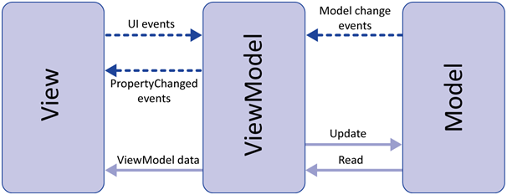
View, ViewModel, Model (MVVM)
View is your fragment
It manages the screen, inflates XML
Observes LiveData, reflects changes to the display
Observes display, feeds events to ViewModel
ViewModel manages LiveData, exports it.
Contains most of the application logic.
Model is the data
Source from network or database/files
Might feel weird at first, but wisdom becomes clear

Slide 23
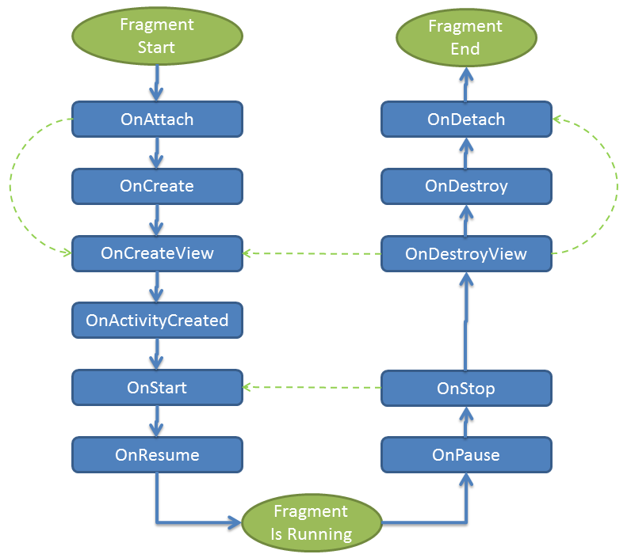
Fragments
Fragment lifetime

Slide 24
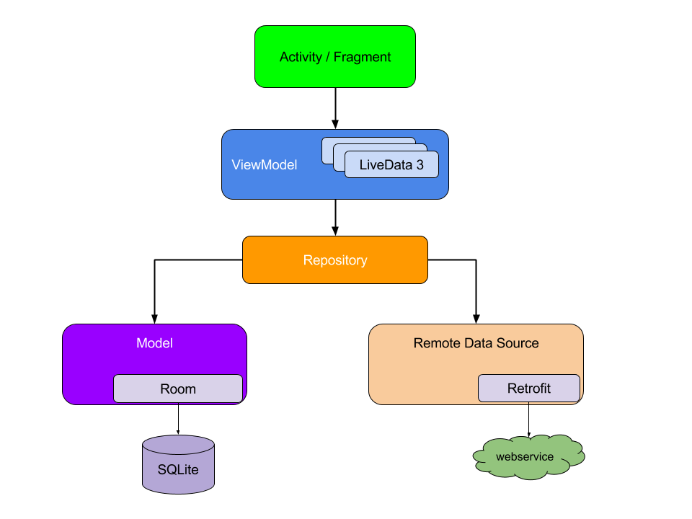
ViewModels, MVVM(model, view, viewModel)
Separate logic from display
Display in activity/fragment (View)
“Application logic” goes in ViewModel (ViewModel)
Model holds the “real data” (Model)
Encourages an app style
Raises the level of abstraction
Enables powerful apps quickly

Slide 25
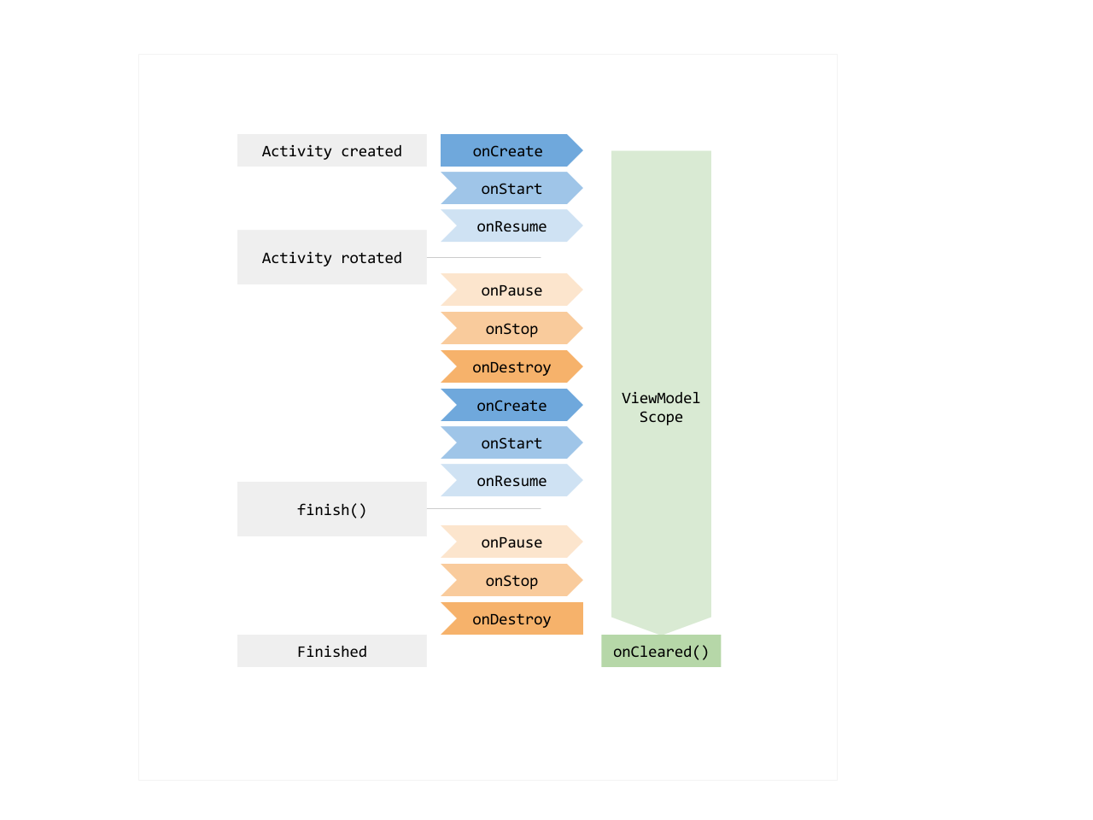
ViewModels have long lifetimes
Data in a ViewModel is in memory even if device rotates or is paused
Fewer surprises at runtime!
You still sometimes need onSaveInstanceState() for persistence

Slide 26
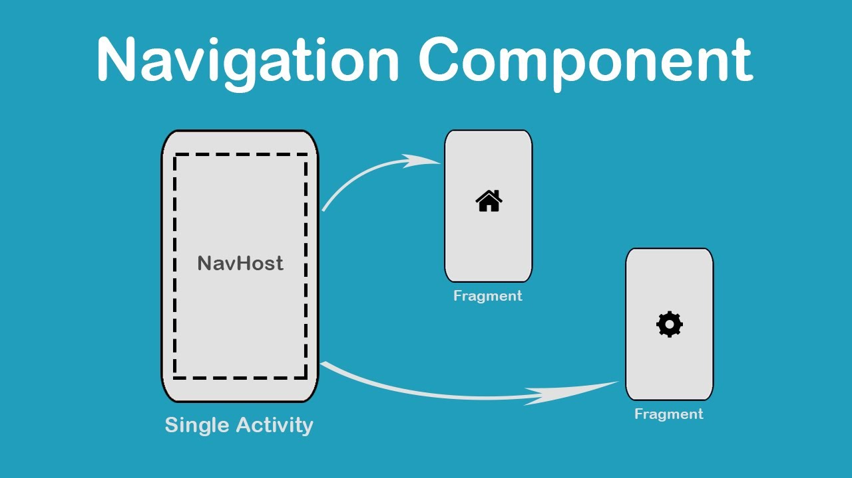
Navigation
One activity moves among fragments

Slide 27
Navigation key ideas
Fragments and actions in a single graph
Actions transition among fragments
In a fragment: findNavController()
In an activity it is more complicated
There can be multiple controllers
findNavController(R.id.nav_host_fragment_activity_main)- ID of <fragment>
view.findNavController() – use view
Exit a fragment: findNavController().popBackStack()
All fragments form a stack

Slide 28
Navigation: moving around
To move to another fragment
view.findNavController().navigate(R.id.targetFragment)
findNavController(R.id.view).navigate(R.id.targetFragment)
Where targetFragment is an id in your nav graph
Nav graph is in navigation/nav_graph.xml
To pass arguments use a Directions objects
Compiler generates them from nav graph—type safe!
An action carries the parameters
val action = SpecifyAmountFragmentDirections
.actionSpecifyAmountFragmentToConfirmationFragment(foo)
findNavController().navigate(action)

Slide 29
Live data
View models contain the state of your app
Views get the state from view model
What is the problem?
How does the view know when state changes?
Could provide explicit callbacks
But what happens if view listening to changes dies?
Register callback on create, degregister on destroy
Bugs!

Slide 30
Live data
Live data lives in view model
View observes live data
Modifies view model state based on user actions
Repository/model also has live data
View model updates its data from repository
App responds to data changes minimal coupling

Slide 31
Live data
// In the view model private var liveList = MutableLiveData() fun observeLiveQuotes(): LiveData<List<Quote>> { return liveList }
// In the view viewModel.observeLiveQuotes().observe(viewLifecycleOwner) { quoteList -> adapter.submitList(quoteList) adapter.notifyDataSetChanged() }

Slide 32
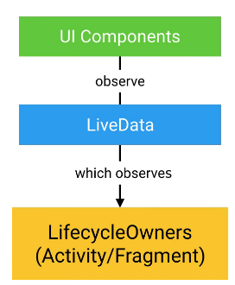
MVVM, lifetime and scope
LiveData allows communication without dependence
Multiple observers ok
Observers can die, be reborn, no code changes
ViewModels live as long as application
Fragment (can die when goes off screen)
Activity (longer than fragment, but can die off screen)
Application (activities can share state and communicate)

Slide 33
Networking(!)
What “language” do we speak with servers?
Representational state transfer (REST)
Use text (JSON)
Servers are “stateless”
Requests give them all the context they need
What tools do we need in Android
Retrofit2: Talk to servers
Gson: parse JSON
Coroutines & Dispatchers: Fetch on background thread
Glide: display & cache images given a URL
Glide is independent, but fetching images is common

Slide 34
Coroutine dispatchers
Dispatcher.Main
Main thread
Must be quick: required if you have to update the UI
Dispatcher.Default
Background thread, possibly on other processor
For background work, like diffing lists, image filters
Dispatcher.IO
Background thread, possibly on other processor
For network access or file system access

Slide 35
Specifying coroutine dispatchers
withContext – allows you to switch dispatchers
withContext(Dispatchers.Main) {
textView.text = “hi there” }
This also works!
runOnUiThread {...}
Launch with
scope
Live data works with threads
Main thread can use setValue or .value
Background threads must use postValue
viewModelScope.launch( context = viewModelScope.coroutineContext + Dispatchers.IO) {

Slide 36
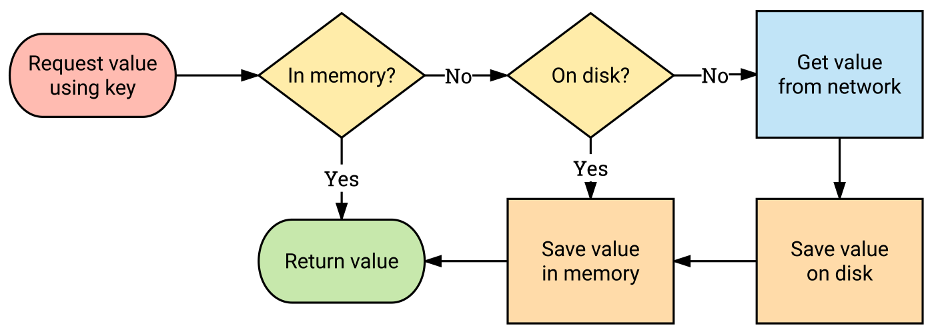
Glide for caching images
Use a key, like the image URL
Library handles storing images locally

Slide 37
Retrofit2 for web services
Retrofit2 turns your HTTP API into a Kotlin interface.
interface GitHubApi {
@GET("users/{user}/repos") listRepos(@Path("user") String user) : List<Repo>
Retrofit2 generates the implementation of listRepos (not you!)
Bridge between Kotlin interface (listRepos)
And http call (https://api.github.com/users/octocat/repos)

Slide 38
Retrofit2 for web services
interface GitHubApi {
@GET("users/{user}/repos&sort=updated")
listRepos(@Path("user") String user) : List<Repo>
@GET
Defines the path of the URL
Retrofit2 can plug in values (user, above)
String can contain parameters (sort=updated, above)
@Path fills in path component from parameter
You need to define return type
Look at JSON given by the web service

Slide 39
Retrofit2 for web services
interface GitHubApi{
@GET("users/{user}/repos&sort=updated")
listRepos(@Path("user") String user) : List<Repo>
companion object Factory {
fun create(): GitHubApi {
val retrofit: Retrofit = Retrofit.Builder()
.addConverterFactory(GsonConverterFactory.create())
// Must end in /!
.baseUrl("https://api.github.com/")
.build()
return retrofit.create(GitHubApi::class.java)
}
}

Slide 40
JSON (JavaScript Object Notation) Example
{
"Title": "The Cuckoo's Calling",
"Author": "Robert Galbraith",
"Detail": { "Pages": 494 },
"Price": [
{ "type": "Hardcover",
"price": 16.65 },
{ "type": "Kidle Edition",
"price": 7.03 }
]
}
http://www.w3resource.com/JSON/introduction.php

Slide 41
Elements of JSON
Four basic and built-in data types in JSON.
Strings, numbers, Booleans (i.e true and false) and null.
These can be used as values
Two structured data types
Objects are wrapped within '{' and '}'.
Objects are list of label-value pairs.
Arrays are enclosed by '[' and ']'.
Arrays are list of values.
Both objects and arrays can be nested.

Slide 42
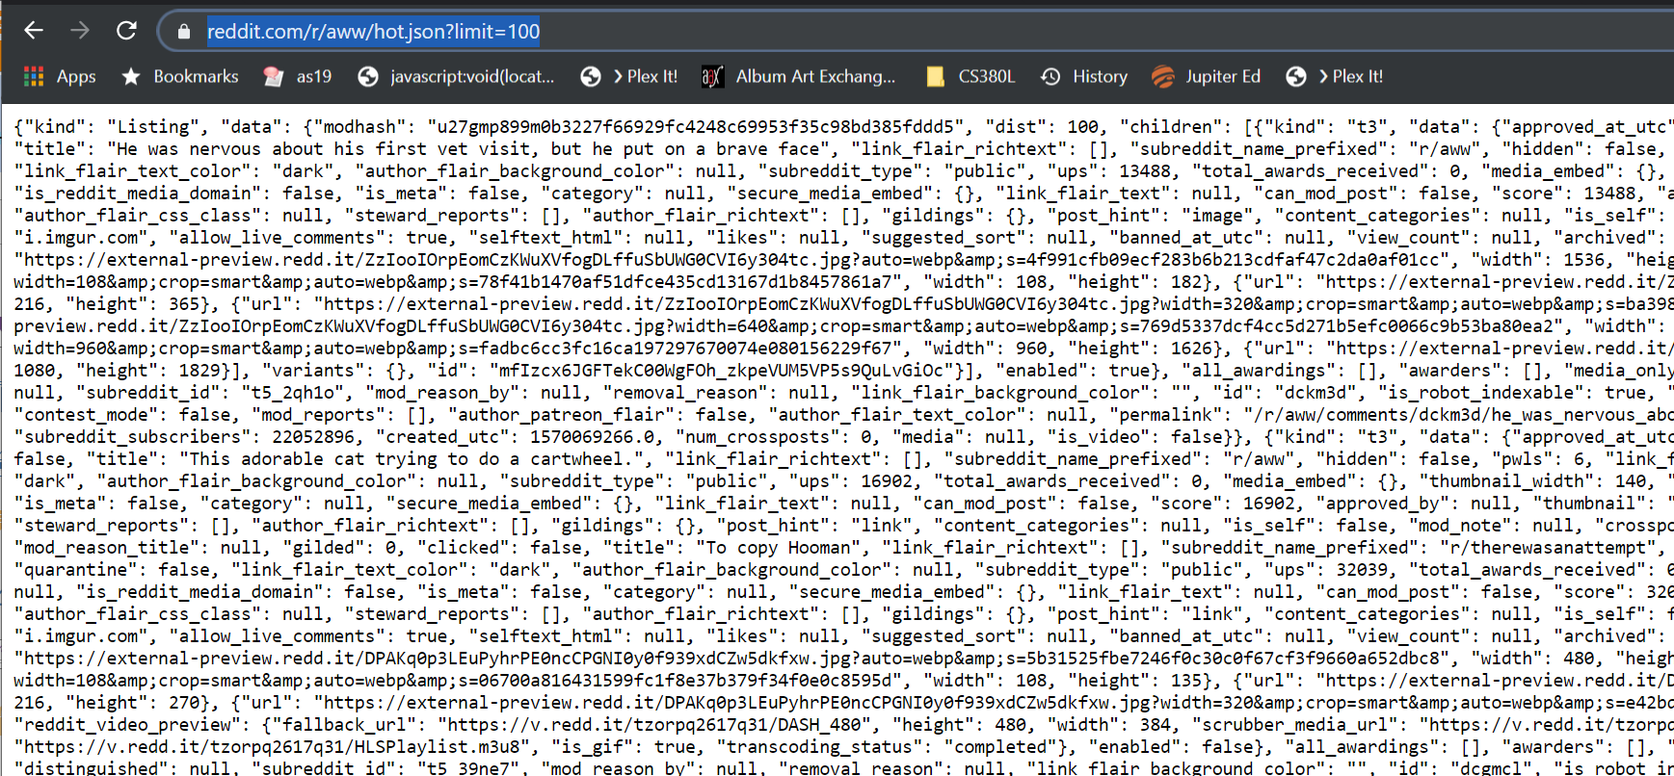
Web services often return JSON

Slide 43
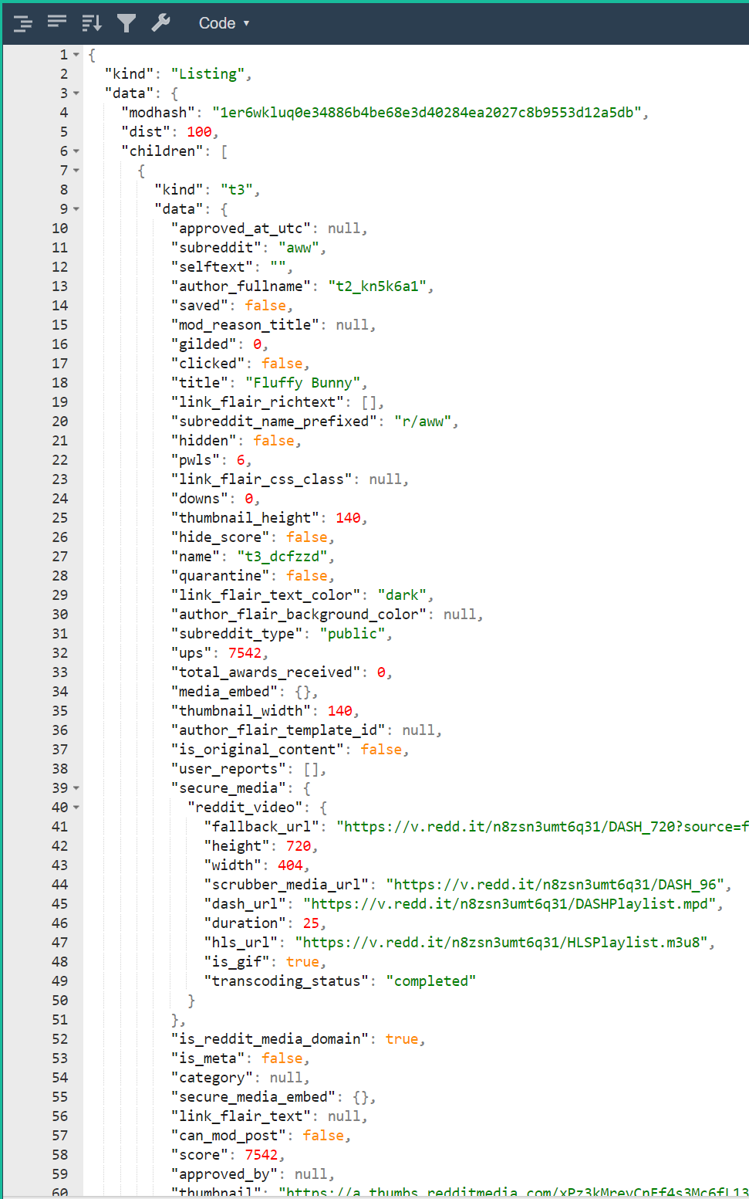
Web pretty-printers
https://jsonformatter.org/json-pretty-print

Slide 44
Network services for mobile
User authentication
Anonymous users
Email/Password
Google/facebook/phone number,…
Storage
Files (e.g., images, video)
Structured data (e.g., documents, collections)
Access control
Cloud functions (not in this class)
Code executes on your behalf in the cloud. No VMs

Slide 45
Authentication
How do you prove you are who you say you are?
Know a secret (e.g., password)
Possess a token (e.g., phone number)
Vouched for by third party (e.g., goole or facebook)
Firebase authentication
Manages multiple users without a server
Configure a web-based console
Open source activity that does best practices login

Slide 46
Google firestore
Store data in a flexible format in the cloud
No server, web console
Collections and documents
Documents are key/value pairs and sub-collections
Alternate collection/document/collection/document…
Real-time updates!
Cool for features like chat
Works well with live data

Slide 47
Working with a database
Know what parts of your model are written by client code and what by the db/server
E.g., timestamps, ids are often db/server only
Expose fetched data via your viewModel
LiveData super useful if update is asynchronous
Understand how items are cached/modified
Generalize your notion of pointer
A pathname to an image is a “pointer.”
If pathname is in database, file better exist (referential integrity)
A foreign key points from one table to row of another

Slide 48
Taking pictures
Your app can control the camera
Lots of control (filters, etc.)
Complex code
You can launch an intent to take a picture
Much like an implicit intent
Input: URI location to store picture
File name must end in .jpg
Output: success Boolean
Problem: Output callback does not know location!
If you have other metadata, like a tag, that is lost

Slide 49
Taking pictures, problems
private val tag: String = “”
private val location: String = “”
private val cameraLauncher = registerForActivityResult(
ActivityResultContracts.TakePicture()) { success ->
// use tag and location freely
// Here we use the above declarations
tag = “funny”
location = “foobar.jpg”
cameraLauncher.launch(uri)
What is the problem here?
Our code probably in fragment (view) that can be killed
Especially because we are launching a camera activity
If killed, we lose tag and location!

Slide 50
Taking pictures, solutions
private val cameraLauncher = registerForActivityResult(
ActivityResultContracts.TakePicture()) { success ->
// use viewModel.tag and viewModel.location freely
// Here we use the above declarations
viewModel.tag = “funny”
viewModel.location = “foobar.jpg”
cameraLauncher.launch()
Store state in the view model
Safe even if camera activity kills our fragment
View model holds strings—simple data type

Slide 51
Taking pictures, details
Just remember the last component of the file name
timestamp in Notebook
Universally unique identifier (UUID) for cloud database
We call it fileName and it is a string
Useful functions
fileNameToFile(fileName: String): File
There is a way to create a URI from a File object
Application manages permissions via URI
Each app gets its own area to write for security
Example (fileName, absolute path, URI)
35751550-1edd-4738-afd1-fbf41cc918a7
/storage/emulated/0/Pictures/35751550-1edd-4738-afd1-fbf41cc918a7.jpg
content://edu.utap.firechat/my_images/Pictures/35751550-1edd-4738-afd1-fbf41cc918a7.jpg

Slide 52
Notes: dealing with dependences
Consider a simple note.
text: String
imageFiles: List<String>
imageFiles is a list of path names
Each path name refers to an image
Image might be a local file (sqlite)
Image might be a cloud file (firebase)
Note depends on images
Danger: a note that refers to a non-existent image

Slide 53
How to create/edit a note (sqlite)
In-memory note has list of image files (newList)
In-DB note has list of image files (oldList)
Algorithm to modify image table
Leave members shared between oldList & newList
In oldList and not in newList -> delete file
In newList and not in oldList -> add row

Slide 54
How to create a note (firestore)
For list of image files -> start upload
Write note
What is wrong with this picture?
note.pictureUUIDs = [ffjsjsjsj-sjfjfj]
storage/images/ffjsjsjsj-sjfjfj does not exist
Violates referential integrity!
Error when displaying new note (via live data)

Slide 55
How to create a note (firestore)
Take a picture
Start file upload
When file successfully uploaded…
Delete local file
Update note to have new pictureUUID
Write note to server
Maintains referential integrity!
Write data before writing pointers to it
Might be user-visible delay for their picture to show up

