Slide 1
Anon-Pass: Practical Anonymous Subscriptions
Michael Z. Lee†, Alan M. Dunn†,
Jonathan Katz*, Brent Waters†, Emmett Witchel†
† University of Texas at Austin
* University of Maryland

Slide 2
Media Subscriptions
Unlimited access subscriptions
Notes:
The Netflix logo is a trademark of Netflix.
Source: https://signup.netflix.com/MediaCenter/ImagesLogo, Accessed: May 18
The Spotify logo is a trademark of Spotify
Source: https://spotify.box.com/s/0k0e4odpf0on7tr9ji4p, Accessed: May 18
The New York Times is a trademark of The New York Times.
Source: http://commons.wikimedia.org/wiki/File:The_New_York_Times_logo.png, Accessed: May 18

Slide 3
Let’s build a service
X
♫♪♬♩
♫ ♪♩♬
♫♪ ♩♬
1234…
♪♩♬
♫♪♩♬
♫♪♩♬
♪
♬♪♫♩
♫♪♩♬
1234…
♫♪♩♬
♫♪♫♩♪♩
2345…
Sharing Resistance (admission control)

Slide 4
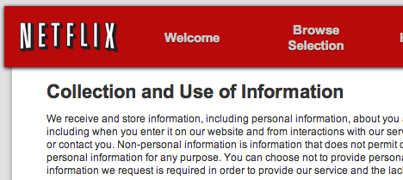
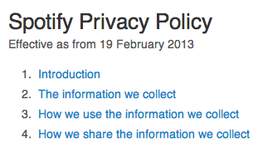
They are collecting information about you.
Notes:
Source: https://signup.netflix.com/PrivacyPolicy, accessed: May 14, 2013
Source: https://www.spotify.com/us/legal/privacy-policy/, accessed: May 14, 2013
Source: http://www.nytimes.com/content/help/rights/privacy/policy/privacy-policy.html, accessed: May 14, 2013

Slide 5
Anonymous Media
Accesses can’t be correlated
Song 1
Song 2
time
1234…
8720…
Unlinkability
Notes:
For anonymity, we need to unlinkability and pseudonyms. Pseudonyms aren’t so difficult, but unlinkability is.

Slide 6
Linked accesses could deanonymize users
Access patterns for enough time could help deanonymize clients
The Netflix Prize dataset [Narayanan, Shmatikov 2008]
Social networks [Narayanan, Shmatikov 2009]

Slide 7
But even if tokens are unlinkable…
♫♪♬♩
♫ ♪♩♬
♫♪ ♩♬
1234…
♪♩♬
♫♪♩♬
♫♪♩♬
141.212.15.125
♬♪♫♩
128.83.122.105
♫♪♩♬
♫♪♩♬
8720…
128.83.122.105
37.130.227.133
We assume clients are using a network anonymity service
Notes:
Use Tor, it’s good for the world.

Slide 8
Anonymous Music Service
Straw Man
♫♪♬♩
♫ ♪♩♬
♫♪ ♩♬
♪
♪♩♬
♫♪♩♬
♫♪♩♬
1234…
♬♪♫♩
♫♪♩♬
♫♪♩♬
♩
8720…
7964…
8739…
♫
1910…
Unlinkability but not sharing resistance
2372…
3141…

Slide 9
How do we get both?
Unlinkable Serial Transactions [Syverson et al. 1997]
Sharing resistance, unlinkability
but needs unbounded storage
Anonymous Blacklisting Systems [Tsang et al. 2008]
Sharing resistance, unlinkability
but computationally expensive

Slide 10
And also be practical?
Unlinkable Serial Transactions [Syverson et al. 1997]
Sharing resistance, unlinkability
but needs unbounded storage
Anonymous Blacklisting Systems [Tsang et al. 2008]
Sharing resistance, unlinkability
but computationally expensive
Anon-Pass
Sharing resistance, unlinkability, and efficiency
Example: over 12,000 concurrent clients

Slide 11
How?
How is Anon-Pass built?
How is Anon-Pass used?
How does Anon-Pass perform?

Slide 12
How is it built?
Split up time into epochs
Each user has a unique token
for an epoch
t–1
t
t+1
t+2
time
1234…
Each epoch allows a new, unpredictable token

Slide 13
How is it built?
Split up time into epochs
Each user has a unique token for an epoch
t–1
t
t+1
t+2
time
PRF
1234…
<-
PRF (t)
Each epoch allows a new, unpredictable token
Use a pseudorandom function (PRF)
Notes:
Punch-line: PRF

Slide 14
High Level Protocols
Register
Get a blinded signature on a secret
Login
Prove the token used the signed secret (in zero knowledge)

Slide 15
Anonymous Music Service
Song 1
Song 2
t–1
t
t+1
t+2
time
1234…
8720…
PRF (t)
PRF (t+2)
Notes:
Alex can create a new token and then prove to the service provider that he should be allowed access.
How? He needs to prove that this token is correctly computed using his secret.
To keep his secret actually secret, he can prove correctness in zero knowledge.

Slide 16
Anonymous Music Service
But songs don’t always fit in one epoch
Song 1
t–1
t
t+1
t+2
time
PRF (t)
PRF (t+1)
PRF (t+2)
1234…
5629…
8720…

Slide 17
Anonymous Music Service
But songs don’t always fit in one epoch
And these accesses are implicitly linked
t–1
t
t+1
t+2
time
1234…
5629…
8720…
Conditional Linkability

Slide 18
Accesses can be implicitly linked
Baby+ 0s Baby+15s Baby+30s
Baby+45s
Baby+60s
Baby+75s
Baby+90s ….
The service knows when the same song is repeatedly accessed
Client is implicitly linked while accessing the same media
And unlinkability costs the service provider
(and therefore harms the system)
Notes:
Why is conditional linkability alright? Because accessing the same song implicitly links the user.

Slide 19
Re-Up
Our way of getting conditional linkability
Prove the current token and the next token are linked
Trades unlinkability for efficiency
But the client already lost unlinkability while accessing the same media

Slide 20
Re-Up is more efficient
Login proves you should be allowed access
Re-Up proves you logged in before
Login takes 10 expensive operations
Re-Up takes only 2

Slide 21
Using Login and Re-Up
A client must Login to start a new song
And Re-Up to continue playing the same song
t–1
t
t+1
t+2
time
Re-Up
Re-Up
To be unlinkable again, the client must wait until the next epoch

Slide 22
Epoch Lengths: Long vs. Short
A short epoch means less time to be unlinkable And less delay between client actions Happy Clients
A long epoch means fewer client requests And lower server load Happy Server
Choosing an epoch length depends on the service (e.g., 15 seconds for music, 5 minutes for movies)

Slide 23
Re-Up helps balance this tension
Short epochs means less wait between unlinkable actions
Re-Up instead of Login
reduces server load

Slide 24
And Anon-Pass is formally proven
Formal proof of security holds under the DDHI assumption
Formal proof of soundness holds under the LRSW assumption
Stated and proved in the paper
Notes:
Decisional Diffie-Hellman Inversion assumption
Lysyanskaya, Rivest, Sahai, and Wolf assumption
Full version can be found at:
http://zweb.cs.utexas.edu/users/osa/anon-pass/

Slide 25
How?
How is Anon-Pass built?
How is Anon-Pass used?
How does Anon-Pass perform?

Slide 26
How could it be used?
Anonymous Music Streaming
Music download over normal HTTP
15 second epoch
Unlimited-use Subway Pass
NYC’s “unlimited” pass
6 minute epoch
Account Proxy
Multiplex accounts to news sites
1 minute epoch
Notes:
Bread and butter – service needs to provide some support.
We’ve already talked about this
This is interesting use of epochs
The trick is rate limiting users
This means services don’t really need to modify their system, we’ll do it for you.

Slide 27
System Architecture
my laptop
subscription service
Application
Server
Client Application
♪

Slide 28
System Architecture
my laptop
subscription service
Application
Server
Client Application
Authentication Server
♪
User Agent

Slide 29
System Architecture
my laptop
subscription service
Application
Server
Client Application
♪
Gateway
Authentication Server
3rd party service
User Agent

Slide 30
User Agent
Purpose: minimize changes to client applications
Job: Create Login and Re-Up requests
Keep the user secret secure
Modified VLC to anonymously stream (54 LoC)
No modifications to support browsers

Slide 31
Authentication Server
Purpose: enforce sharing resistance
Job: Verify tokens and token uniqueness Record active tokens
Runs on the service or as a 3rd party

Slide 32
Gateway
Purpose: enforce access control with minimal change to existing services
Job: Prevent unauthorized access and responses
Remove verification from the critical path
Runs on the service as a front end server

Slide 33
How?
How is Anon-Pass built?
How is Anon-Pass used?
How does Anon-Pass perform?

Slide 34
Evaluation Environment
quad-core 2.66 GHz Intel Core 2 CPU
8GB RAM 1 Gbps network
10 client machine to evaluate the streaming music service
An HTC Evo 3D to evaluate the anonymous subway pass
Notes:
We use a commodity server

Slide 35
Crypto Cost
■ Other
milliseconds
■ Verify
7.8x Faster
Notes:
Registration is non-recurring and hence don’t display it’s measurement.
The careful reader might realize that some numbers may be different than what appears in the IEEE version.
This is because we ran further experiments and are showing an updated number.

Slide 36
Music Service Scaling
HTTP server to stream music 15 second epoch
Add clients until we run out of resources
Used 10 client machines

Slide 37
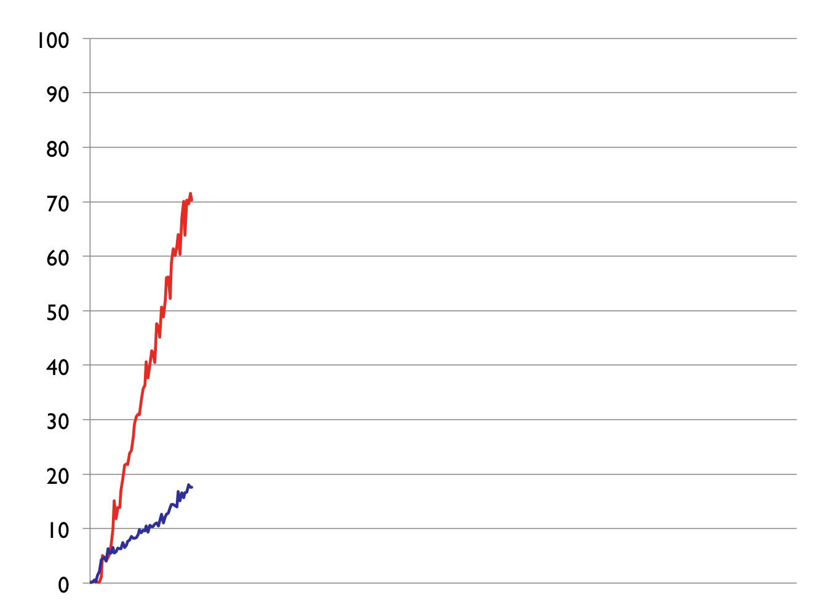
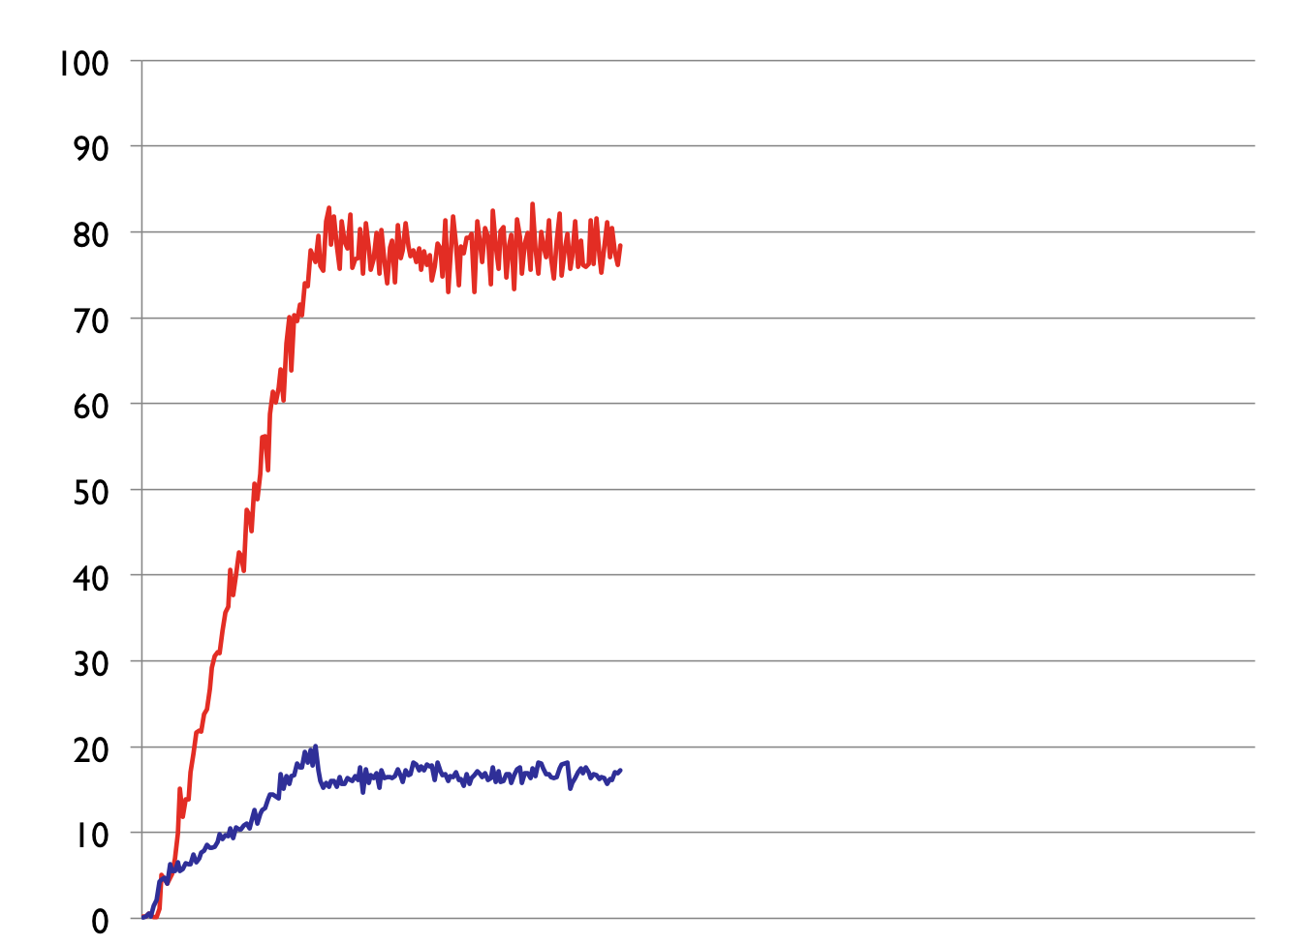
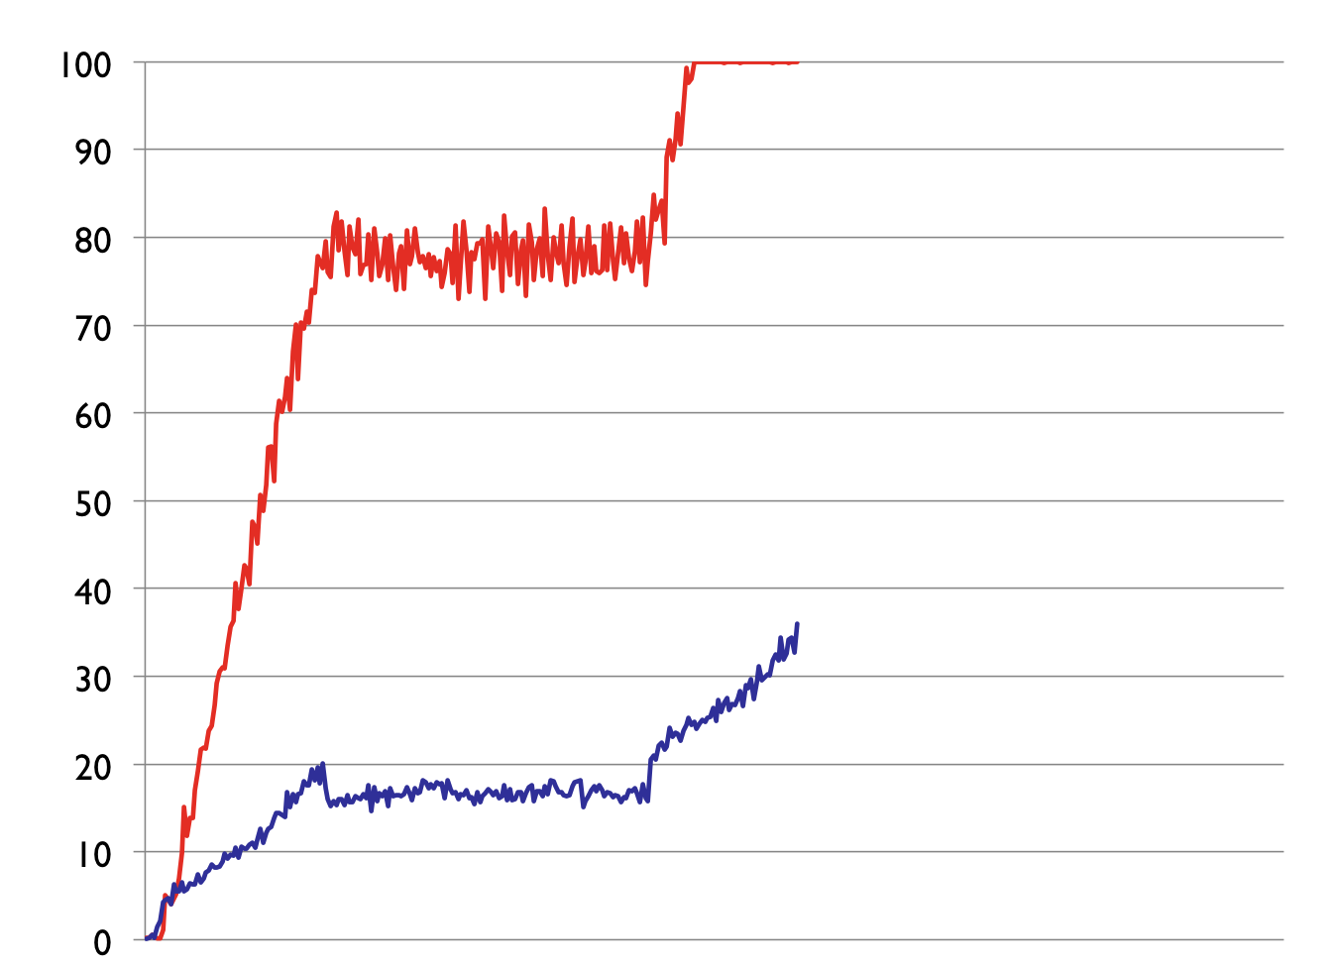
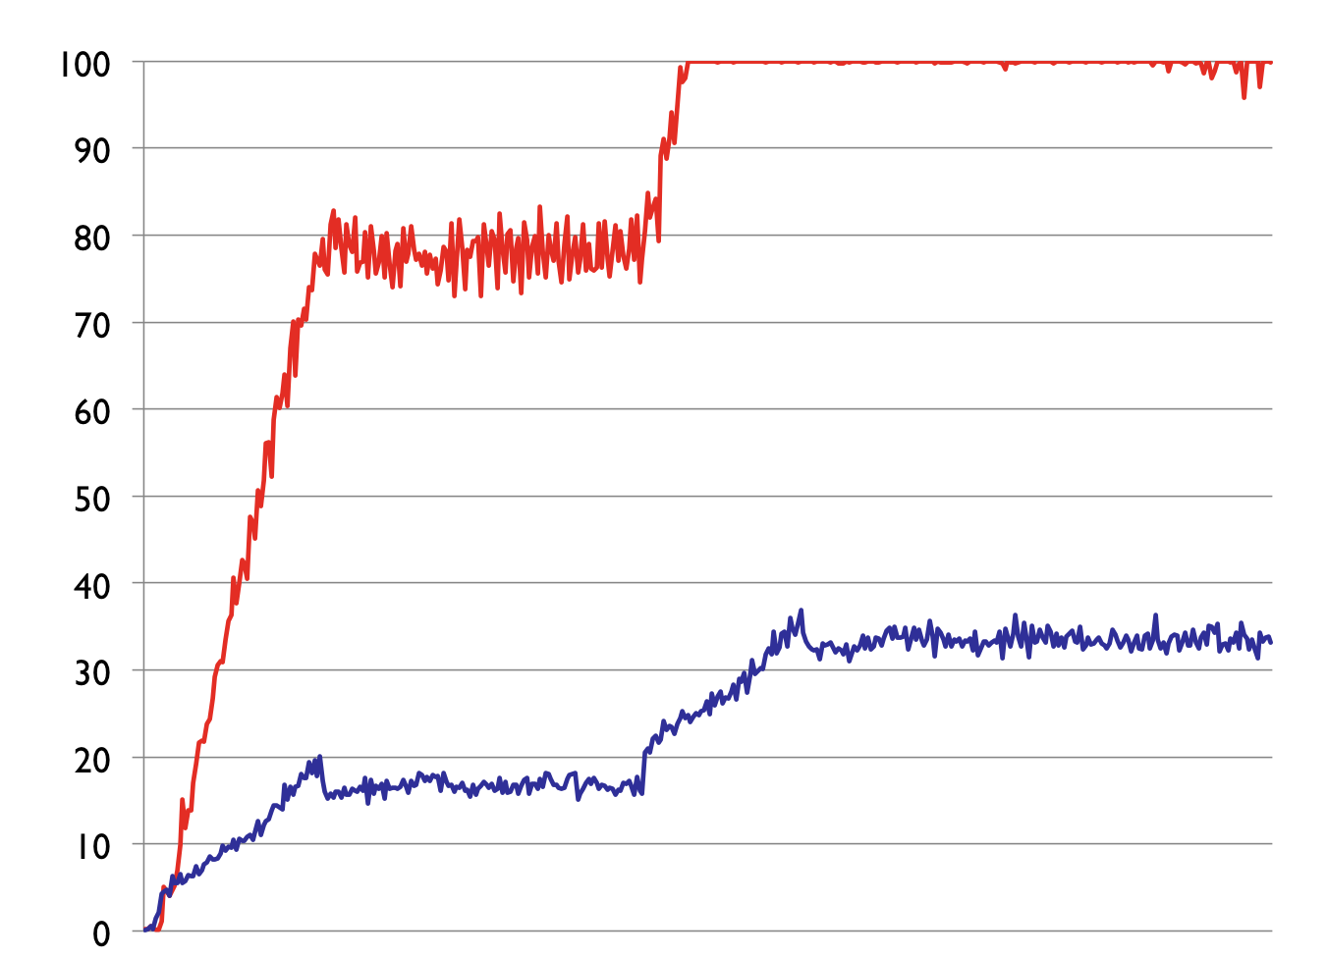
Music Service Scaling
Login Only vs. Anon-Pass
Steady
8,000 Clients
■ Login Only
12,000 Clients
■ Anon-Pass
% CPU
6,000 Clients
Time
Notes:
Login vs. Login + Re-Up

Slide 38
Anonymous Subway Pass
Problem: Need to rate limit between swipes
A long epoch can simulate that timeout
But sharing is still possible…
t
t+1

Slide 39
Anonymous Subway Pass
Solution: Login and Re-Up at the same time
Accesses during later epochs are linkable
t–1
t
t+1
t+2
time
X

Slide 40
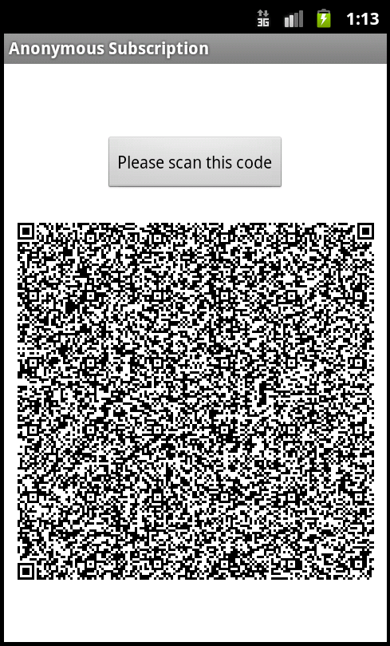
Anonymous Subway Pass
Implemented as an Android application
Clients Login and Re-Up twice (18 minute NYC policy)
Takes only 0.2 seconds
(on an HTC Evo 3D)
Notes:
And yes, this is an actual QR code.
There is potential for sharing. How do we stop this?

Slide 41
Anon-Pass
Practical – efficient enough to scale
Flexible – works with different services
Deployable – minimizes service changes

