Slide 1
Please sit by section. Look at your schedule to find your section number.
Welcome!
Front of Room
50720 | 50725
50730 | 50735
Back of Room
Sit close together, without empty seats or rows in-between.

Slide 2
Please sit by section. Look at your schedule to find your section number.
Welcome!
Front of Room
50740 | 50745
50750 | 50755
Back of Room
Sit close together, without empty seats or rows in-between.

Slide 3
Announcements
TBD

Slide 4
2.1 Basic Data Concepts
PROFESSOR RAMSEY
ramsey@cs.utexas.edu
Notes:
change practice to pull from self check 2.3 ints, 2.4 double and 2.5 string

Slide 6
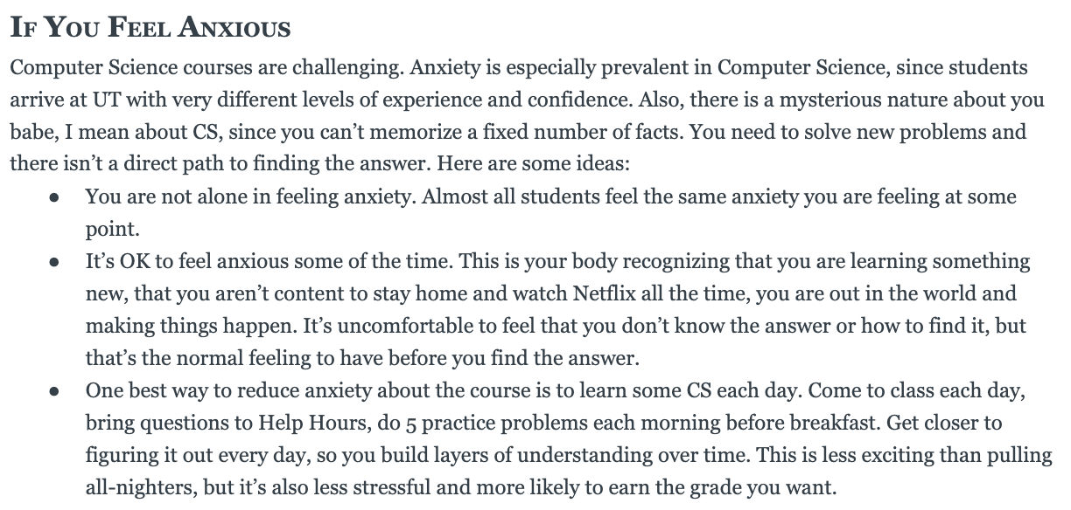
Syllabus One Day at a Time

Slide 7
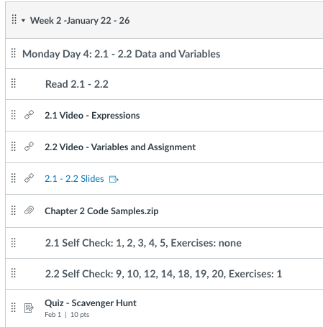
Check Canvas Each Week/Day
Scavenger Hunt Quiz starts today in Section.

Slide 8
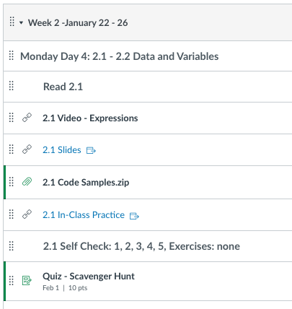
Announcements
First in-class quiz on Wednesday. Question is a version of one of these
First assignment due Thursday at 11pm. Or use slip days for final turn in date of Saturday at 11pm. No extensions.

Slide 9
2.1
Basic Data Concepts
Notes:
Session Title: Project Based Learning (PBL) for Equity in CS classes
Session Description: If you are teaching a survey course like Computer Science Principles, or a code intensive course like AP CS A, PBL can serve as a powerful tool to increase student interest and engagement. Learn about research that connects PBL to improved student outcomes, especially for girls and underrepresented minorities. Discover available PBL resources and understand PBL lesson components, so you can build your own.

Slide 10
It’s All 1s and 0s
Inside, it’s all 1s and 0s
h 01101000
"hi" 0110100001101001
104 01101000
How can the computer tell the difference between an h and 104?
In general, the earlier bits specify how to interpret the following bits.
In Java, we define a type for each data item: integer, decimal, String, character, etc.
‹#›

Slide 11
Primitive Types
Type | Description | Examples | Memory | Min and Max
int | positive and negative integers up to 2³¹ - 1 | 42, -3, 0, 387733 | 4 bytes | min: -2,147,483,648 max: 2,147,483,647 (but 32 1s equals 4,294,967,295)
double | positive and negative decimal numbers up to 10³⁰⁸ | 3.0, -0.0004, 14.81e3 | 8 bytes | min: 1.79769313486231570e+308 max: 2.2250738585072014e-308
char | single character | ‘a’, ‘X’, ‘?’ | 2 bytes | all characters in ASCII table
boolean | true or false | true, false | 1 byte (padded) | true or false
‹#›
Notes:
‹#›
We're basically going to manipulate letters and numbers.
We make the integer / real number distinction in English as well. We don't ask, "How many do you weigh?" or, "How much sisters do you have?"
Part of the int/double split is related to how a computer processor crunches numbers. A CPU does integer computations and a Floating Point Unit (FPU) does real number computations.
Why does Java separate int and double? Why not use one combined type called number?

Slide 12
Practice
Int or Double?
Temperature in degrees Celsius
The population of lemmings
Your grade point average
A person's age in years
A person's weight in pounds
Sum of integers
Average of integers
‹#›

Slide 13
Expressions
expression: A combination of values and/or operations that results in a single value.
Examples: 1 + 4 * 5
(7 + 2) * 6 / 3
42
"Hello, world!"
The simplest expression is a literal value.
A complex expression uses operators and parentheses.
‹#›

Slide 14
Arithmetic operators
operator: Combines multiple values or expressions.
+ addition
- subtraction (or negation)
* multiplication
/ division
% remainder (sometimes called modulus)
As a program runs, its expressions are evaluated.
1 + 1 evaluates to 2
System.out.println(3 * 4); prints 12
How would we print the text 3 * 4 ?
‹#›

Slide 15
Integer division with /
When we divide integers, the quotient is also an integer.
Euclidean division a.k.a. division with remainder.
14 / 4 is 3, not 3.5
3 4 52
4 ) 14 10 ) 45 27 ) 1425
12 40 135
2 5 75
54
21
More examples:
32 / 5 is 6 156 / 100 is 1 2 / 5 is 0
‹#›

Slide 16
Integer Remainder
The % operator computes the remainder from integer division.
14 % 4 is 2 218 % 5 is 3 2 % 5 is 2 3 43 If you have 2 cookies and 5 4 ) 14 5 ) 218 kids and you can’t divide 12 20 the cookies, each kid 2 18 gets 0 cookies and there 15 are 2 left over. 3
Applications of % operator:
Obtain last digit of a number: 230857 % 10 is 7
Obtain last 4 digits: 658236489 % 10000 is 6489
See whether a number is odd: 7 % 2 is 1, 42 % 2 is 0
‹#›
Notes:
‹#›
What is 8 % 20? It's 8, but students often say 0.

Slide 17
Remember PEMDAS?
Order of Operations: Order in which operators are evaluated.
Unary operators (-) have highest precedence.
* / % have a higher level of precedence than + - 1 + 3 * 4 = 13
6 + 8 / 2 * 3 = 18
6 + 4 * 3 = 18
Parentheses can force a certain order of evaluation: (1 + 3) * 4 is 16
‹#›

Slide 18
Demo
ExpressionExamples.java
//Expressions with Ints

Slide 19
Decimal Numbers - double
Examples: 6.022 , -42.0 , 2.143e17
A literal must have a decimal point.
Placing .0 or . after an integer makes it a double.
The operators + - * / % () work the same.
/ produces an exact answer: 15.0 / 2.0 is 7.5
Precedence is the same: () before * / % before + -
Within same precedence, order is left to right and this can change the result.
‹#›
Notes:
‹#›
Point out that it's odd for 42.0 to be considered a real number, but it is. Also point out that the 2.143e17 is scientific notation and means (2.143 * 10^17).

Slide 20
Mixing types
When int and double are mixed, the result is a double.
4.2 * 3 is 12.6
The conversion is per-operator, affecting only its operands.
7 / 3 * 1.2 + 3 / 2
\_/ | 2 * 1.2 + 3 / 2
\___/ | 2.4 + 3 / 2
\_/ | 2.4 + 1
\________/ | 3.4
2.5 + 10 / 3 * 2.5 - 6 / 4
\___/ | 2.5 + 3 * 2.5 - 6 / 4
\_____/ | 2.5 + 7.5 - 6 / 4
\_/ | 2.5 + 7.5 - 1
\_________/ | 10.0 - 1
\______________/ | 9.0 (not 9!)
‹#›

Slide 21
Demo
ExpressionExamples.java
// Demo 2
// Expressions with Ints and Doubles

Slide 22
ExpressionExamples.java
// Demo 3
// Ints and Doubles Quirks
With Math functions, ints and doubles sometimes aren’t what you expect.
Doubles can lose precision. Different fractions repeat in different bases. Repeating fractions lose precision.
Know how precise the application needs to be.
Precision applies to significant digits (very large and very small numbers).
Use special types like BigDecimal.
In the same level of precedence, operators are evaluated left to right. This changes the result when mixing types.
Demo
Interesting article - https://javaranch.com/journal/2003/07/newsletterjuly2003.jsp#a4

Slide 23
Type Casting
‹#›

Slide 24
Type Casting, Take II
type cast: A conversion from one type to another.
To promote an int into a double for floating point division
To truncate a double from a real number to an integer
ExpressionExamples.java
// Demo 4
// Int and Double type casting
Demo
‹#›

Slide 25
String concatenation
string concatenation: Using + between a string and another value to make a longer string.
"hello" + 42 is "hello42"
1 + "abc" + 2 is "1abc2"
"abc" + 1 + 2 is "abc12"
"abc" + 9 * 3 is "abc27"
"1" + 1 is "11"
4 - 1 + "abc" is "3abc"
Use + to print a string and an expression's value together.
System.out.println("Grade: " + (95.1 + 71.9) / 2);
Output: Grade: 83.5
‹#›

Slide 26
Main Idea
Within one level of precedence, must evaluate left to right, because the interpreter does.
Example 1:
5 / 4 * 2.5 = 2.5 (L->R) or 0.56 (R->L)
Example 2:
“wow” + 1 + 5 = wow15 (L->R) or wow6 (R->L)

Slide 27
Demo
ExpressionExamples.java
// Demo 5
// Expressions with Ints, Doubles and Strings
// Common Errors

Slide 28
In-Class Practice
2.1 In-Class Practice

Slide 29
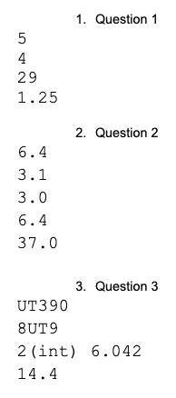
In-Class Practice Answers

Slide 30
Remember
TBD
It’s fun to meet new people.

Slide 31
Monday CS Tip
Make friends. They will your social and emotional group!
Yugam Goyal

