Slide 1
Welcome!
‹#›
Notes:
Notes - Do square cap practice on day 3.

Slide 2
2.2 Variables
PROFESSOR RAMSEY
ramsey@cs.utexas.edu
Notes:
change practice to pull from self check 2.3 ints, 2.4 double and 2.5 string

Slide 3
Syllabus One Day at a Time
UT Counseling and Mental Health Center (CMHC) website: https://cmhc.utexas.edu/

Slide 4
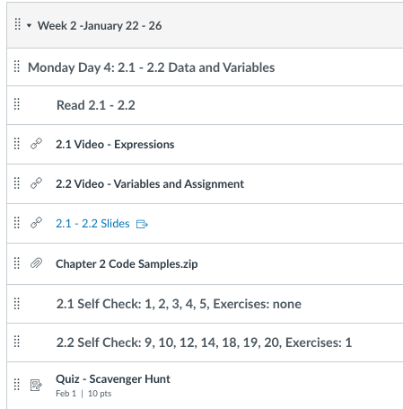
Check Canvas Each Week/Day

Slide 5
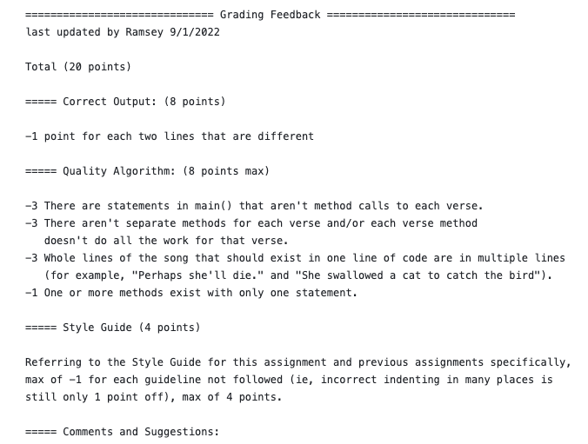
Announcements
First assignment due Thursday at 11pm. Or use slip days for final turn in date of Saturday at 11pm. No extensions.
Sneak peak, one time only, grading rubric:

Slide 6
2.2
Variables

Slide 7
Receipt Example
What's bad about the following code? public class Receipt { public static void main(String[] args) { // Calculate total owed, assuming 8% tax / 15% tip System.out.println("Subtotal:"); System.out.println(38 + 40 + 30); System.out.println("Tax:"); System.out.println((38 + 40 + 30) * .08); System.out.println("Tip:"); System.out.println((38 + 40 + 30) * .15); System.out.println("Total:"); System.out.println(38 + 40 + 30 + (38 + 40 + 30) * .08 + (38 + 40 + 30) * .15); } }
‹#›

Slide 8
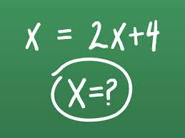
Let’s Borrow From Algebra - The Variable
In algebra, we gave a value a name, like X.

Slide 9
The Variable in Programming
We give values at name.
The same as variables in algebra:
A value is given a name.
The value can change.
The name can have only one value at a time.
Different:
We use meaningful names.
Each value must also have a type: int, double, string, char or boolean.

Slide 10
Variables
variable: A piece of the computer's memory that is given a name and type, and can store a value.
Steps for using a variable:
Declare - state its name and type
Initialize - put the first value into the variable
Assign - put a value into the variable
Use - print it or use it
0 + 1 = 1
Local Memory
n | 0
1
Output
n = 1
‹#›
Notes:
‹#›

Slide 11
Declaring and Initializing a Variable
type
variable name
initialize (optional)

Slide 12
Beware
The Assignment operator is very different in programming and algebra.

Slide 13
The Assignment!
variable name
assignment operator
expression that evaluates to a value of the variable’s type
student = “Pranitha”;
“Pranitha”

Slide 14
What is NOT like Algebra
In algebra:
Each side of the equal sign can be expressions.
Each side of the equal sign are equal in value.
In programming:
Left side of the equal sign is one variable. Right side of the equal sign is an expression that evaluates to a single value of the variable’s type.
Each side of the equal sign aren’t equal in value, because they are different things.
expression that evaluates to a value of the variable’s type,
all kinds of crazy business can be on the right side
variable name
assignment operator
number = 7 * average + Math.pow(5, 2) / total;

Slide 15
Demo
VariablesExamples.java
// DEMO 1
// DEMO 2 - Common Errors

Slide 16
More NOT like Algebra
Counter Pattern
Accumulator Pattern
count on the right looks inside count to find what is there.
count on the left changes the value of count.
Steps:
Must initialize the counter variable.
Evaluate right side
see what is in count
add 1 to it
put that value into count, deleting what was there before
Same as above, sum on left and right mean different things.
Steps:
Must initialize the accumulator variable.
Evaluate right side
see what is in sum now
add the new number to that
put that value into sum, deleting what was there before
count = 0;
count = count + 1;
sum = 0;
sum = sum + newNumber;

Slide 17
The Swap
How do you switch the two milks between the two glasses?

Slide 18
Demo
VariablesExamples.java
// DEMO 3 - The Swap

Slide 19
In-Class Practice
2.2 In-Class Practice

Slide 20
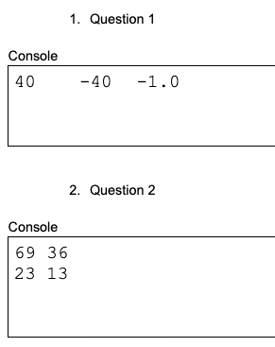
In-Class Practice Answers

Slide 21
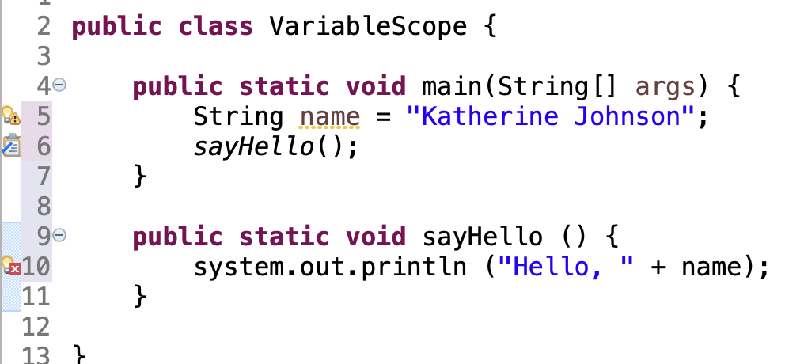
Variable Limitation
Idea: Make a variable to represent a name. Use a method to say “Hello”.
Problem: A variable in one method can't be seen in others.
‹#›
Notes:
‹#›

Slide 22
Variable Scope
scope: The part of a program where a variable exists. A variable exists from its declaration to the end of the {} in which it was declared.
name exists in main() only
sayHello() can’t see it
‹#›

Slide 23
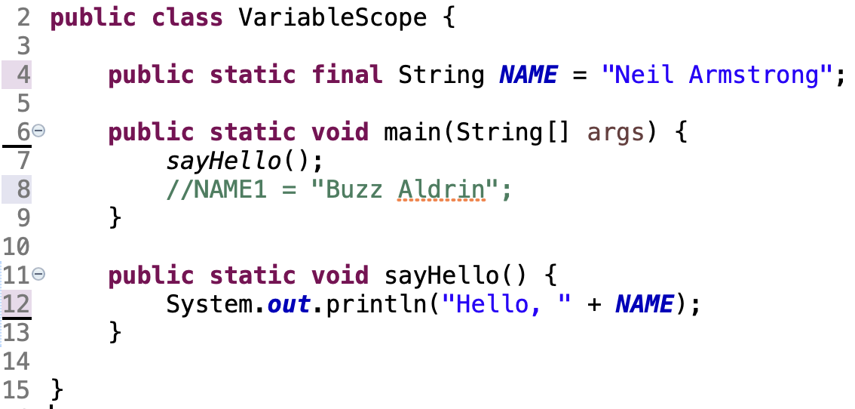
Constants
constant: A fixed value visible to the whole program.
Value can be set only at declaration.
It can be accessed anywhere in the class.
‹#›

Slide 24
Receipt Revisited
public class Receipt {
public static void main(String[] args) {
// Calculate total owed, assuming 8% tax / 15% tip
int subtotal = 38 + 40 + 30;
double tax = subtotal * .08;
double tip = subtotal * .15;
double total = subtotal + tax + tip;
System.out.println("Subtotal: " + subtotal);
System.out.println("Tax: " + tax);
System.out.println("Tip: " + tip);
System.out.println("Total: " + total);
}
}
‹#›

Slide 25
Remember
TBD
It’s fun to meet new people.

Slide 26
Wednesday UT News
TBD

Slide 27
Pattern - Accumulator
An accumulator can be int, double or String, and is typically initialized to 0, 0.0 or “”.
The right side of an assignment is evaluated first, then placed in the variable on the left side.
sum on the left side of an assignment means this is where the new value will be stored.
sum on the right side of an assignment is a reference to the current value of the variable.
put 0 in sum 2. evaluate right side of assignment 3. put result of right side into variable on left
previous contents of this variable are deleted
0 + 7 = 7
sum | 0
sum | 0
sum | 7

Slide 28
Pattern - Counter
A counter is and integer and must be initialized, typically to 0.
The right side of an assignment is evaluated first, then placed in the variable on the left side.
n on the left side of an assignment means this is where the new value will be stored.
n on the right side of an assignment is a reference to the current value of the variable.
put 0 in n 2. evaluate right side of assignment 3. put result of right side into variable on left
previous contents of this variable are deleted
0 + 1 = 1
n | 0
n | 0
n | 1

Slide 29
Blueprint - Assignment
left side is always a single variable
This isn’t math! It is assignment, not equality.
variables are typically assigned new values multiple times while a program runs
an expression, this can be one literal value, a long complicated expression, method calls, beginning of a rocket launch sequence, etc.

Slide 30
Blueprint - Constant
For now, always public and static.
Keyword final indicates it is a constant.
Must be assigned as part of the declaration.
Constants can be ints and doubles. (Strings and character literals are by nature constants already.)
By convention, names have all caps with underscores between words.

Slide 31
Blueprint - Variables
declare
initialize
Memory
grade | 90
myGPA | 3.4
letterGrade | ‘B’
passing | true
Output
use

Slide 32
Practice
Write a code segment to calculate the day of the week given the year, month (1 = January, 2 = February, etc.) and day, using these calculations:
x = year - (14 - month) / 12
y = x + x / 4 - x / 100 + x / 400
z = month + 12 * ((14 - month) / 12) - 2
dayOfWeek = (day + x + (31 * z) / 12) % 7
The value of d is the day of the week: 0 = Sunday, 1 = Monday, 2 = Tuesday

