Slide 1
A Sampling of World War One Posters

Slide 2
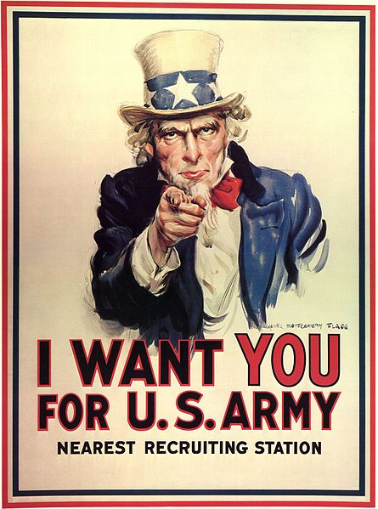
The Original Uncle Sam Image
James Montgomery Flag drew himself as Uncle Sam

Slide 3
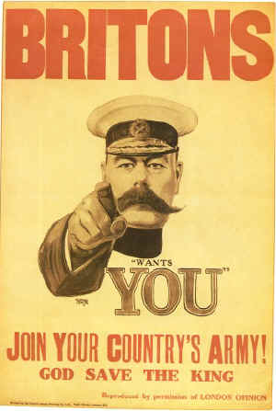
The inspiration for the original Uncle Sam poster
Field Martial Horatio Herbert Kitchener, British Secretary of State for War

Slide 4
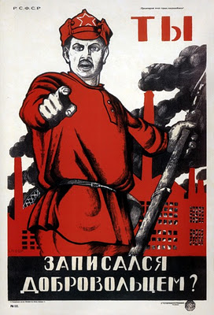
Russia

Slide 5
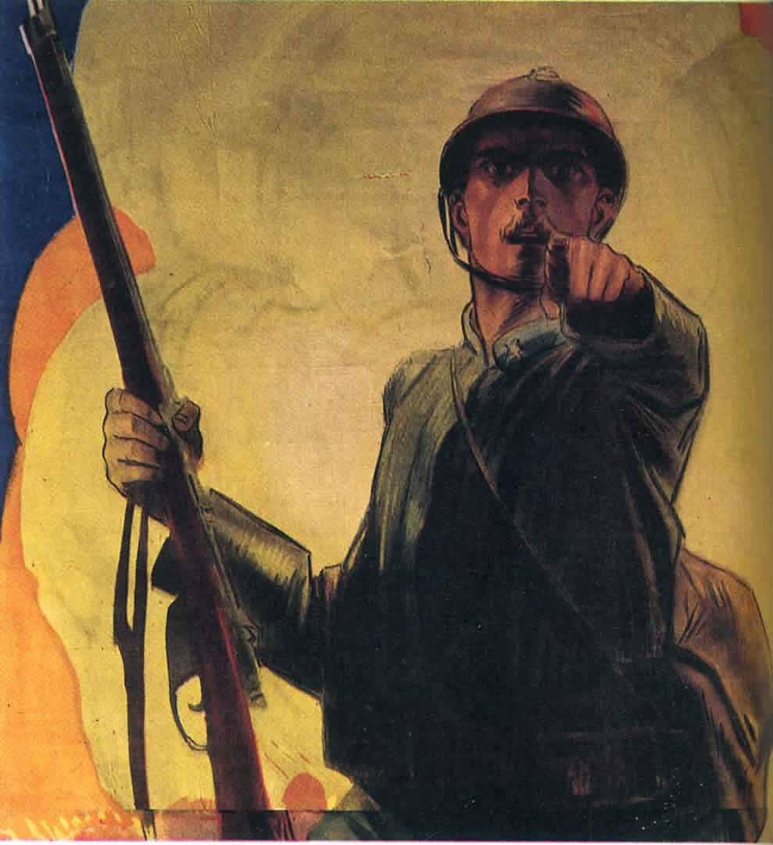
France

Slide 6
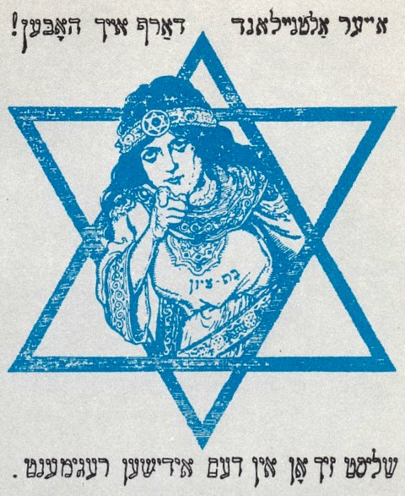
Jewish Legion - a unit in the British Army

Slide 7
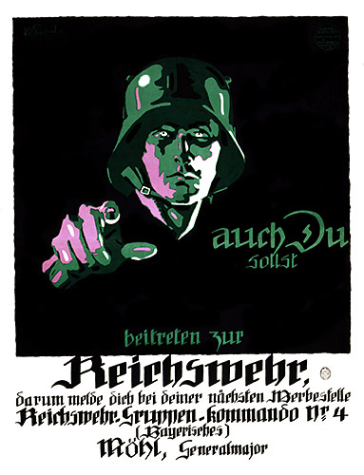
… even Germany

Slide 8
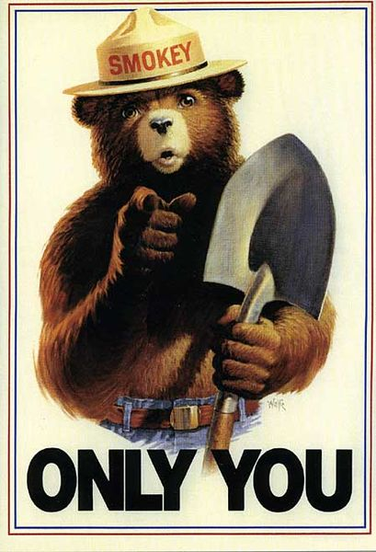
and the U. S. Forest Service

Slide 9
The Enemy is a Monster

Slide 10
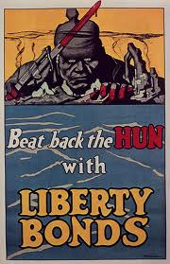
… not even called Germans, they are “the Hun”

Slide 11
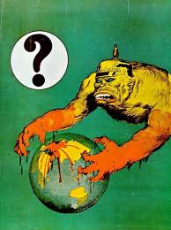

Slide 12
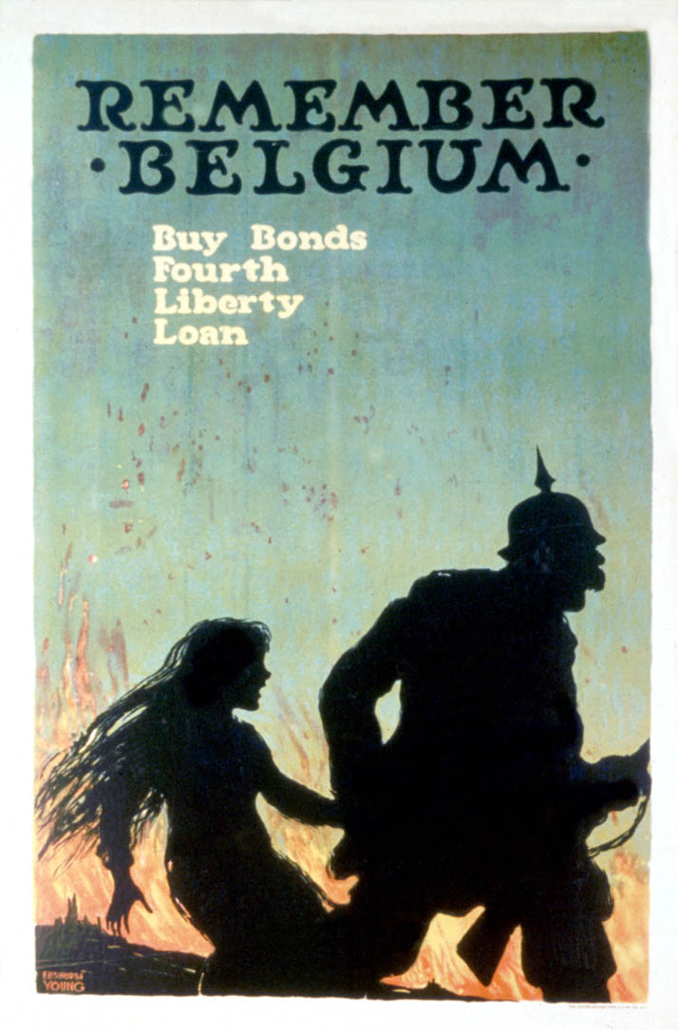
“Remember Belgium” is short for “Remember the Rape of Belgium”. This image makes it clear.

Slide 13
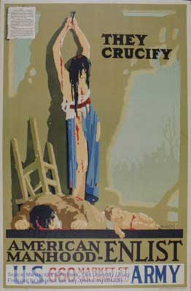
Another reference to Belgium.

Slide 14
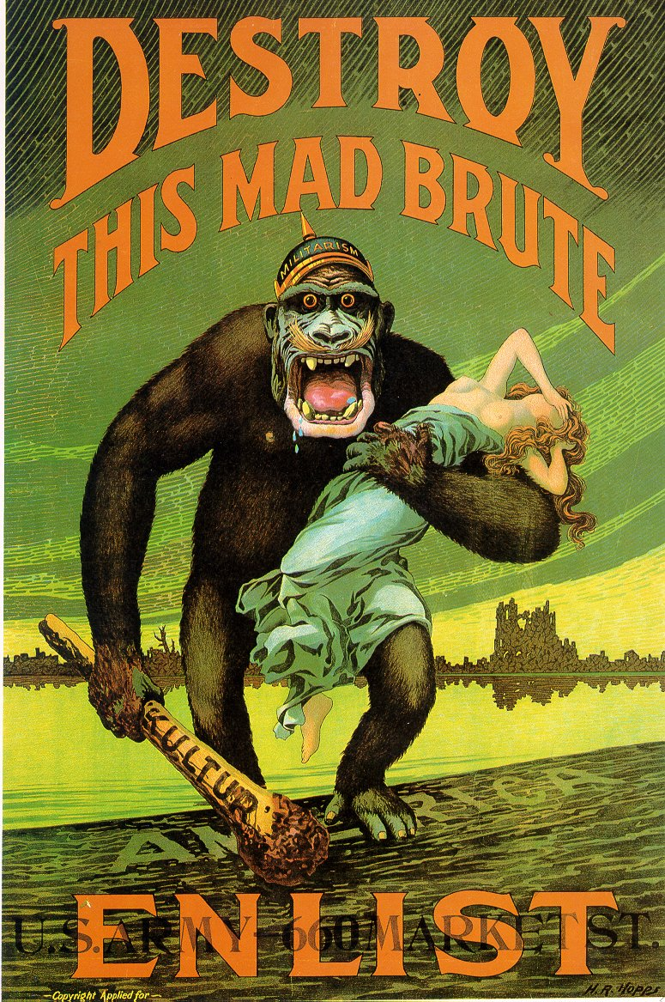
Sex always helps get attention. This image preceded the movie “King Kong” by 15 years.

Slide 15
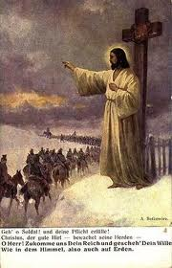
… and by the way, God is always on your side.

Slide 16
Pressure to Enlist

Slide 17
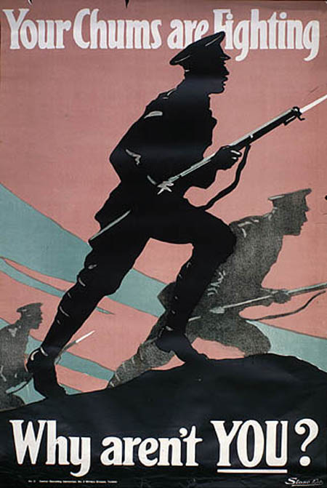
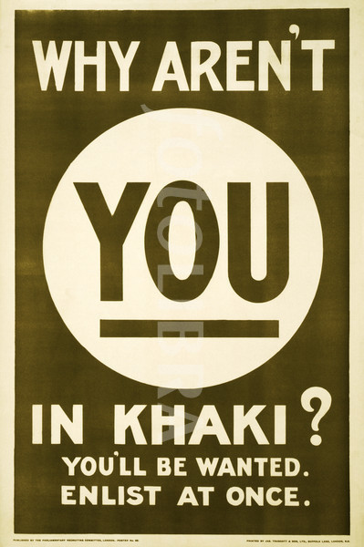

Slide 18
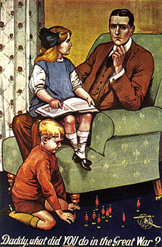
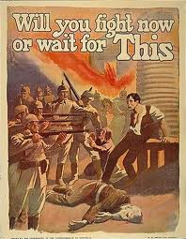

Slide 19
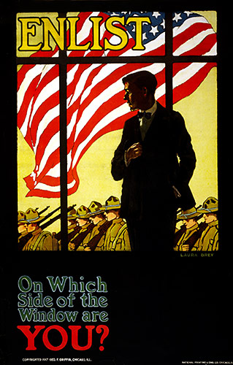
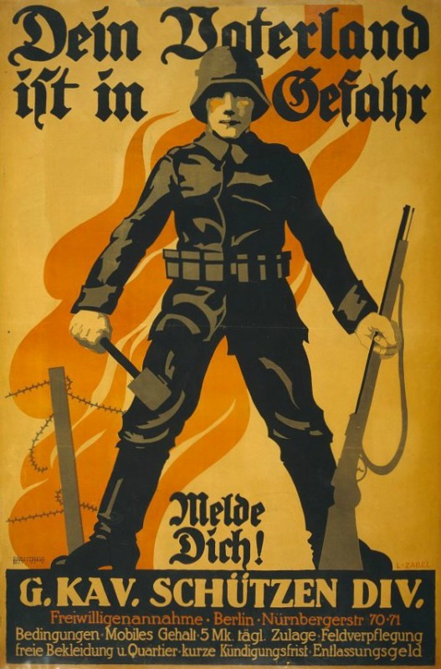

Slide 20
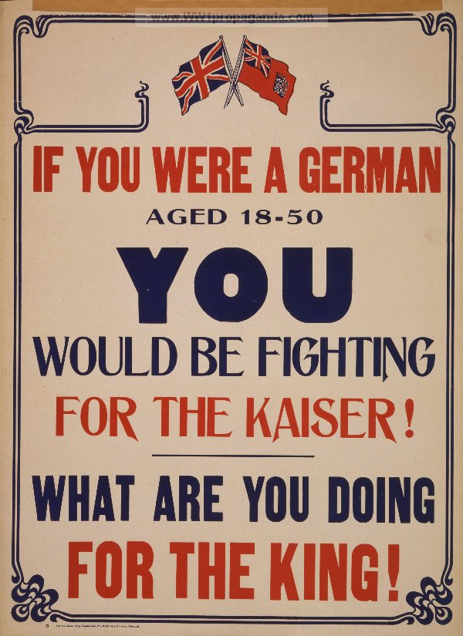
Is fighting for King or Kaiser or Emperor what this war was about?

Slide 21
Is fighting for King or Kaiser or Emperor what this war was about? Sadly, Yes.

Slide 22
The Movie Endings

Slide 23
1979

Slide 25
1930

Slide 27
All quiet on the western front.

Slide 28
Im Westen nichts neues.

Slide 29
For us lads of eighteen they ought to have been mediators and guides to the world of maturity . . . to the future . . . in our hearts we trusted them. The idea of authority, which they represented, was associated in our minds with a greater insight and a more humane wisdom. But the first death we saw shattered this belief. We had to recognize that our generation was more to be trusted than theirs. . . . The first bombardment showed us our mistake, and under it the world as they had taught it to us broke in pieces.
All Quiet on the Western Front

