Slide 1
Algorithms and Software
Chapter 7
Some of Chapter 8
Sections 17.2, 17.3
Notes:
Get algorithms.xls for list of all the problems and what the points are.

Slide 2
What is an Algorithm?
An algorithm for solving a problem is:
an unambiguous set of instructions
that can be executed in a finite amount of time and
that, when finished, has solved the problem.

Slide 3
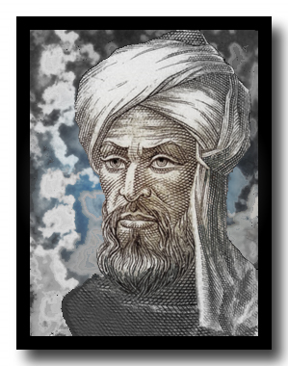
What a Strange Word
Abū ʿAbdallāh Muḥammad ibn Mūsā al-Khwārizmī was born around 780 and died around 850. His name comes from the fact that he he belonged to Khwârazm (modern Khiwa) situated in Turkistan but he carried on his scientific career in Baghdad and all his works are in Arabic language.
Notes:
http://www.mathsisgoodforyou.com/people/alkhwarizmi.htm

Slide 4
Long Division
24 45687
Notes:
Get students to do it. Point here is that it’s actually quite complicated if you cover for all conditions.

Slide 5
Long Division
24 45687
24 12687
n
m
quotient(n, m, desired digits):
place decimal point in correct place in answer
while n != 0 and number of iterations < desired digits:
# find the shortest prefix of n into which m goes.
# divide m into it.
write the result as the next digit of answer
n = remainder concatenated with remaining part of m
return(answer)

Slide 6
Long Division
24 45687
24 12687
n
m
quotient(n, m, desired digits):
place decimal point in correct place in answer
# find the shortest prefix of n into which m goes.
for i in range(1, desired digits):
first chunk = the first i digits of n padded with 0 if necessary
if first chunk >= m: break
write 0 as the next digit of answer if after decimal point
while n != 0 and number of iterations < desired digits:
# divide m into it.
for i in range(10):
if (i+1)*m > first chunk:
i is the result break
write the result as the next digit of answer
digits = number of digits in remainder (or 0 if remainder is 0)
n = remainder (if not 0) concatenated with remaining part of m
# find the shortest prefix of n into which m goes.
for i in range(digits+1, desired digits):
first chunk = the first i digits of n padded with 0 if necessary
if first chunk >= m: break
write 0 as the next digit of answer
return(answer)

Slide 7
Preconditions
When we specify a problem, we specify conditions that the programmer may assume hold at the time that the program begins.
Preconditions for our division program:
n
m
quotient(n, m):
while n != 0:
divide m into the shortest prefix of n into which it goes:
for i in range(10):
if (i+1)*m > first chunk:
i is the result break
write the result as the next digit of answer
n = remainder
return(answer)
Notes:
If m is 0, answer will be undefined. Program will infinite loop. If n is negative, the program will crash because of the character -. So reasonable precondition is n,m > 0 and integer.
What about n < m? Works fine.

Slide 8
Swapping Two Values
X:
35
Y:
12
An algorithm to swap the values:
Notes:
Point out that we need a third location.

Slide 9
Swapping Two Values
X:
35
Z:
Y:
12
An algorithm to swap the values:
Notes:
Point out that we need a third location.

Slide 10
Swapping Two Values
X:
35
Z:
Y:
12
An algorithm to swap the values:
z = x
x = y
y = z
Notes:
Point out that we need a third location.

Slide 11
Swapping Two Values – First Example of “Cleverness”
X:
110110
Y:
101100
X = (X XOR Y) XOR X
Y = (X XOR Y) XOR Y
Notes:
Maybe skip this.
Show it. Talk about when cleverness might be a good idea.

Slide 12
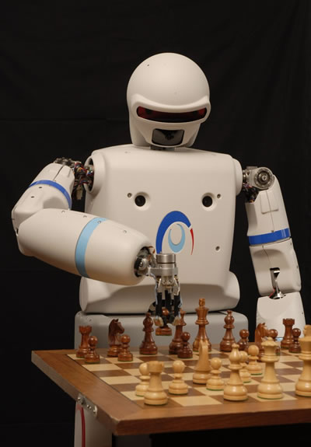
Divide and Conquer
def chess(board):
while game_on:
internal_board = scan(board)
move = choose(internal_board)
play(move, board)
Recall the idea: decompose into pieces that make sense.
Notes:
Recall this one. We broke it apart into its major pieces.

Slide 13
Divide and Conquer
Guacamole
Salsa
Chips
Smoked brisket
Cole slaw
Potato salad
Chocolate cake
Apple pie
Moolenium crunch
Joe
Bill
Sarah
Jim
Casey
Allison
Notes:
Here’s another example. Note that by splitting it up, we not only make each task manageble. In this case we also have the chance to exploit parallelism.

Slide 14
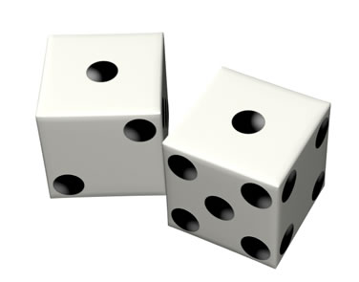
Rolling Dice
What is the frequency of each total?
0 | 1 | 2 | 3 | 4 | 5 | 6 | 7 | 8 | 9 | 10 | 11 | 12
Notes:
Could do a Monte Carlo approach. That’s in dice.py also.
Or: First make a 6 x 6 array that contains the total value of the roll of a pair of dice.
Then make a vector of length 13 that indicates the relative frequencies of each possible total.

Slide 15
Rolling Dice
 | 1 | 2 | 3 | 4 | 5 | 6
1
2
3
4
5
6
How can we fill in the table with the totals?
0 | 1 | 2 | 3 | 4 | 5 | 6 | 7 | 8 | 9 | 10 | 11 | 12
Notes:
First make a 6 x 6 array that contains the total value of the roll of a pair of dice.
Then make a vector of length 13 that indicates the relative frequencies of each possible total.

Slide 16
Rolling Dice
 | 1 | 2 | 3 | 4 | 5 | 6
1
2
3
4
5
6
dice = [ [ 0 for i in range(6) ] for j in range(6) ]
for i in range(6):
for j in range(6):
dice[i][j] = i + j + 2
Notes:
Dice.py
First make a 6 x 6 array that contains the total value of the roll of a pair of dice.
Then make a vector of length 13 that indicates the relative frequencies of each possible total.

Slide 17
Rolling Dice
 | 1 | 2 | 3 | 4 | 5 | 6
1 | 2 | 3 | 4 | 5 | 6 | 7
2 | 3 | 4 | 5 | 6 | 7 | 8
3 | 4 | 5 | 6 | 7 | 8 | 9
4 | 5 | 6 | 7 | 8 | 9 | 10
5 | 6 | 7 | 8 | 9 | 10 | 11
6 | 7 | 8 | 9 | 10 | 11 | 12
What is the frequency of each total?
0 | 1 | 2 | 3 | 4 | 5 | 6 | 7 | 8 | 9 | 10 | 11 | 12
Notes:
First make a 6 x 6 array that contains the total value of the roll of a pair of dice.
Then make a vector of length 13 that indicates the relative frequencies of each possible total.

Slide 18
Rolling Dice
 | 1 | 2 | 3 | 4 | 5 | 6
1 | 2 | 3 | 4 | 5 | 6 | 7
2 | 3 | 4 | 5 | 6 | 7 | 8
3 | 4 | 5 | 6 | 7 | 8 | 9
4 | 5 | 6 | 7 | 8 | 9 | 10
5 | 6 | 7 | 8 | 9 | 10 | 11
6 | 7 | 8 | 9 | 10 | 11 | 12
0 | 1 | 2 | 3 | 4 | 5 | 6 | 7 | 8 | 9 | 10 | 11 | 12
0 | 0 | 0 | 0 | 0 | 0 | 0 | 0 | 0 | 0 | 0 | 0 | 0
freqs = [0] * 13
for i in range(6):
for j in range(6):
tot = dice[i][j]
freqs[tot] += 1
Notes:
First make a 6 x 6 array that contains the total value of the roll of a pair of dice.
Then make a vector of length 13 that indicates the relative frequencies of each possible total.

Slide 19
Rolling Dice
 | 1 | 2 | 3 | 4 | 5 | 6
1 | 2 | 3 | 4 | 5 | 6 | 7
2 | 3 | 4 | 5 | 6 | 7 | 8
3 | 4 | 5 | 6 | 7 | 8 | 9
4 | 5 | 6 | 7 | 8 | 9 | 10
5 | 6 | 7 | 8 | 9 | 10 | 11
6 | 7 | 8 | 9 | 10 | 11 | 12
0 | 1 | 2 | 3 | 4 | 5 | 6 | 7 | 8 | 9 | 10 | 11 | 12
0 | 0 | 1 | 2 | 3 | 4 | 5 | 6 | 5 | 4 | 3 | 2 | 1
freqs = [0] * 13
for i in range(6):
for j in range(6):
tot = dice[i][j]
freqs[tot] += 1
Notes:
First make a 6 x 6 array that contains the total value of the roll of a pair of dice.
Then make a vector of length 13 that indicates the relative frequencies of each possible total.

Slide 20
Rolling Dice
 | 1 | 2 | 3 | 4 | 5 | 6
1 | 2 | 3 | 4 | 5 | 6 | 7
2 | 3 | 4 | 5 | 6 | 7 | 8
3 | 4 | 5 | 6 | 7 | 8 | 9
4 | 5 | 6 | 7 | 8 | 9 | 10
5 | 6 | 7 | 8 | 9 | 10 | 11
6 | 7 | 8 | 9 | 10 | 11 | 12
0 | 1 | 2 | 3 | 4 | 5 | 6 | 7 | 8 | 9 | 10 | 11 | 12
0 | 0 | 1 | 2 | 3 | 4 | 5 | 6 | 5 | 4 | 3 | 2 | 1
Do we believe this answer?
Count the totals.
Notes:
First check: There are 36 squares of the first matrix and each holds a number. So we’d expect the sum of all the counts to be 36. They are.
Next: Count the totals from the first matrix. But suppose we don’t believe those numbers.

Slide 21
Rolling Dice
 | 1 | 2 | 3 | 4 | 5 | 6
1 | 2 | 3 | 4 | 5 | 6 | 7
2 | 3 | 4 | 5 | 6 | 7 | 8
3 | 4 | 5 | 6 | 7 | 8 | 9
4 | 5 | 6 | 7 | 8 | 9 | 10
5 | 6 | 7 | 8 | 9 | 10 | 11
6 | 7 | 8 | 9 | 10 | 11 | 12
0 | 1 | 2 | 3 | 4 | 5 | 6 | 7 | 8 | 9 | 10 | 11 | 12
0 | 0 | 1 | 2 | 3 | 4 | 5 | 6 | 5 | 4 | 3 | 2 | 1
Do we believe this answer?
Count the totals.
Simulate throwing a lot of dice.
Notes:
Second check: Do Monte Carlo. If dice.py is loaded, run monte_carlo(1000) then monte_carlo(10000).

Slide 22
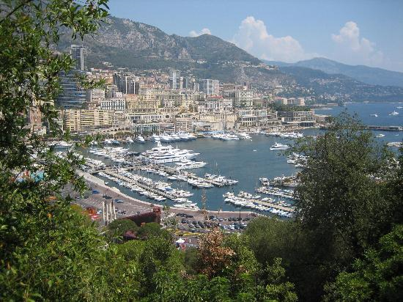
Monte Carlo Methods
Notes:
Why do we call them Monte Carlo methods?
Monte carlo: http://www.tripadvisor.com/Tourism-g190409-Monte_Carlo-Vacations.html

Slide 23
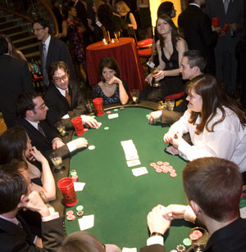
Monte Carlo Methods
Notes:
More on this idea later.
Monte carlo: http://www.tripadvisor.com/Tourism-g190409-Monte_Carlo-Vacations.html
Blackjack: http://www.rhsmith.umd.edu/news/stories/2009/montecarlonight.aspx
http://www.montecarloarcade.com/About_Us.html

Slide 24
Finding the Maximum
45
5
67
3
4
90
23
31
4
96
2
16
96
5
Notes:
Create a variable biggest. Load maximum.py

Slide 25
Finding the Maximum
45
5
67
3
4
90
23
31
4
96
2
16
96
5
def find_max(seq):
"Find the largest number in the sequence"
max = "" # This means empty.
for i in range(len(seq)):
if max == "": # First time.
max = seq[i]
elif seq[i] > max:
max = seq[i]
return(max)
Notes:
Create a variable biggest. Load maximum.py

Slide 26
Finding the Maximum
45
5
67
3
4
90
23
31
4
96
2
16
96
5
def find_max(seq):
"Find the largest number in the sequence"
max = "" # This means empty.
for i in range(len(seq)):
if max == "": # First time.
max = seq[i]
elif seq[i] > max:
max = seq[i]
return(max)
Search, keeping track of best so far.
Notes:
Create a variable max. Load maximum.py. Note that this program works if seq is empty. Also, it can contain negative numbers, which is why we couldn’t initialize to something like 0.

Slide 27
Finding the Maximum
45
5
67
3
4
90
23
31
4
96
2
16
96
5
def find_max(seq):
"Find the largest number in the sequence"
max = "" # This means empty.
for i in range(len(seq)):
if max == "": # First time.
max = seq[i]
elif seq[i] > max:
max = seq[i]
return(max)
Why not just set max to the first item and then compare from there?
Notes:
Answer: Then we’d need the precondition that the list isn’t empty.

Slide 28
Finding the Two Biggest
45
5
67
3
4
90
23
31
4
96
2
16
96
5
def find_max_2(seq):
"Find the two largest numbers"
max1 = ""
max2 = ""
for i in range(len(seq)):
if max1 == "":
max1 = seq[i]
continue
elif max2 == "":
max2 = seq[i]
elif seq[i] > max2:
max2 = seq[i]
if max2 > max1: #Swap them
z = max1
max1 = max2
max2 = z
return((max1, max2))
Notes:
Load maximum.py Talk about finding the n biggest, but then we’ll need to sort, which we’ll do later.

Slide 29
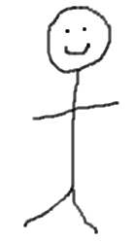
Finding the Oldest
Let’s find the oldest person in a group.
Notes:
Get 32 people to stand in the front of the room. I can solve the problem sequentially as our program did. Have them, in order call out their ages and keep track of largest so far on the board.
But now, give them each a sequence number. Every even person turns left to next odd person. Compare ages. Younger one sit down. Older one keep larger sequence number. Now if you’re divisible by 4, look left. Younger one sit down. Older one keep larger seq number. Repeat. If you didn’t get looked at last time, you should look left this time. (This handles non power of 2 cases.) How many total compares? Total is the same, but if done in parallel, takes only 5 time steps.
Idea from David Reed p. 139

Slide 30
Finding the Oldest
Let’s find the oldest person in a group.
“even” look left
First round: 16
Second round: 8
Third round: 4
Fourth round: 2
Fifth round: 1
31
Notes:
Get 32 people to stand in the front of the room. I can solve the problem sequentially as our program did.
But now, give them each a sequence number. Every odd person turns to next even person. Compare ages. Younger one sit down.
Repeat.
How many total compares? Total is the same, but if done in parallel, takes only 5 time steps.

Slide 31
Finding the Oldest
Let’s find the oldest person in a group.
First round: 16
Second round: 8
Third round: 4
Fourth round: 2
Fifth round: 1
Single Instruction Stream Multiple Data Stream (SIMD) parallelism
Notes:
Recall SIMD parallelism as in insurance clerks.
Get 32 people to stand in the front of the room. I can solve the problem sequentially as our program did.
But now, give them each a sequence number. Every odd person turns to next even person. Compare ages. Younger one sit down. Repeat. How many total compares? Total is the same, but if done in parallel, takes only 5 time steps.

Slide 32
Obvious Way Clever, Better Way
But, first, how do we measure “better”?

Slide 33
Big-O Notation
Big-O notation is a convenient tool for describing how efficient an algorithm (or program) is.
Suppose that we want to know how long it will take a program to run. The first thing we notice about most programs is that they take more time to run on bigger inputs than on smaller ones.

Slide 34
Big-O Notation
for i in range(n):
do something simple
O(n)
Notes:
If n is 5, we execute the loop 5 times. If n is 100, we execute it 100 times. If it takes some constant amount of time to do the simple thing, then we'll say that the time required is O(n). When we do an analysis like this, we don't generally care about constant factors. So we don't care if it takes 3 steps or 30 steps to do the simple thing. We do care that, as n increases, the amount of time required grows, ignoring constants like 3 or 30, as fast as n does.

Slide 35
Big-O Notation
for i in range(n):
for i in range(n):
do something simple
O(n²)
Notes:
Now how long does it take for our program to run? It must execute the outer (first) loop n times. But now, how much work must it do each time? It's not a constant. It's another loop. That loop must be executed n times. So we have that the inner loop takes O(n) steps. And must execute it n times. So now the total amount of time grows as o(n^2).

Slide 36
Big-O Notation
A
B C D
E F G H I J K L M
(8) (-6) (0) (0) (2) (5) (-4) (10) (5)
O(3^{n})
Notes:
Now suppose that we have a program that searches a tree of possibilities. For example, suppose we want to play chess. Let's say that, at each move, there are on average 35 choices. For each of them, there are 35 choices at the next level. So 35^2 paths of length 2. But now, at the next level, each of them has 35 choices. So, to explore 3 moves ahead we must explore 35*35*35 or 35^3 moves. Let n be the number of moves we must look ahead in an arbitrary game like this. Then the number of moves is O(34^n). Obviously, as n gets even slightly large, it becomes impossible to run our program.

Slide 37
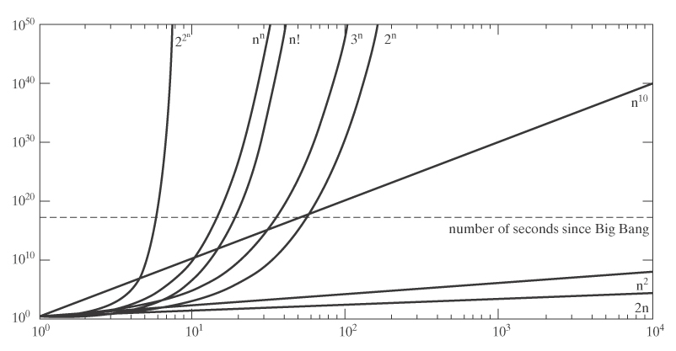
Growth Rates of Functions
So big-O notation helps us see whether our programs will be practical to run.
Notes:
Did this one too.

Slide 38
Sum of Digits
Problem: What is the sum of the digits from 1 to n?
Example: Let n = 5.
How many operations?
Notes:
Do it on the board the obvious way with a loop. Tractable.

Slide 39
Sum of Digits
Problem: What is the sum of the digits from 1 to n?
Example: Let n = 45.
How many operations?
Notes:
Do it the obvious way with a loop. Now it gets tedious.

Slide 40
Sum of Digits
Problem: What is the sum of the digits from 1 to n?
Example: Let n = 45.
How many operations?
O(n)
Notes:
Do it the obvious way with a loop. Now it gets tedious.

Slide 41
Sum of Digits
Problem: What is the sum of the digits from 1 to n?
Is there a better way?
Notes:
Sum = n * (n+1) / 2 See: http://www.cs4fn.org/algorithms/triangular.php for Gauss’s trick.

Slide 42
Sum of Digits
Problem: What is the sum of the digits from 1 to n?
Let n = 10:
1 2 3 4 5 6 7 8 9 10
10 9 8 7 6 5 4 3 2 1
11 11 11 11 11 11 11 11 11 11
10 * 11
2
More generally:
n * (n + 1)
2
Notes:
Write the list a second time, going backwards. Every column sums to n+1. There are n columns. So the grand total is n(n+1), but it’s doubled, so cut it in half.
Sum = n * (n+1) / 2 See: http://www.cs4fn.org/algorithms/triangular.php for Gauss’s trick.

Slide 43
Sum of Digits
Problem: What is the sum of the digits from 1 to n?
Let n = 11:
1 2 3 4 5 6 7 8 9 10 11
11 10 9 8 7 6 5 4 3 2 1
12 12 12 12 12 12 12 12 12 12 12
$\frac{(n+1)(n−1)}{2}$ + $\frac{(n+1)}{2}$ =
$\frac{\left(n+1\right)\left(n−1\right)+1}{2} =$ $\frac{n (n+1)}{2}$
Notes:
So we have (n+1)/2 * 12. Plus we need to add 6, which is (n+1)/2.

Slide 44
Sum of Digits
Problem: What is the sum of the digits from 1 to n?
def gauss_sum(n):
return(n * (n+1) // 2)
Notes:
Note use of // (integer divide). Why are we sure that we’ll get an integer?
See: http://www.cs4fn.org/algorithms/triangular.php for Gauss’s trick.

Slide 45
Sum of Digits
Problem: What is the sum of the digits from 1 to n?
def easy_sum(n):
sum = 0
for i in range(1,n+1):
sum += i
return(sum)
def gauss_sum(n):
return(n * (n+1) // 2)
How many operations does each execute?

Slide 46
Sum of Digits
Problem: What is the sum of the digits from 1 to n?
def easy_sum(n):
sum = 0
for i in range(1,n+1):
sum += i
return(sum)
O(n)
def gauss_sum(n):
return(n * (n+1) // 2)
O(3)
How many operations does each execute?

Slide 47
Finding Prime Numbers
Why do we care:
Notes:
Public key encryption
http://msdn.microsoft.com/en-us/library/ff647097.aspx

Slide 48
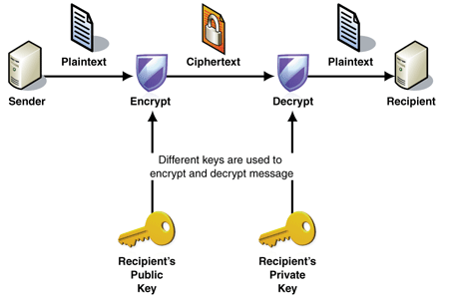
Finding Prime Numbers
Why do we care:
Notes:
Public key encryption
http://msdn.microsoft.com/en-us/library/ff647097.aspx

Slide 49
Finding Prime Numbers
The obvious way to find which of these are prime:
1 2 3 4 5 6 7 8 9 10 11 12 13 14 15 16 17 18 19 20 21 22 23 24 25

Slide 50
Finding Prime Numbers
The obvious way to find which of these are prime:
1 2 3 4 5 6 7 8 9 10 11 12 13 14 15 16 17 18 19 20 21 22 23 24 25
Check each of them, one at a time.
To check one:
Try its possible factors, one at a time.

Slide 51
Finding Prime Numbers
import math
def primes_elaine(n):
primes = []
for i in range(2, n+1):
if prime(i):
primes = primes + [i]
return(primes)
def prime(n):
for i in range(2, int(math.sqrt(n) + 1)):
if n % i == 0:
return(False)
return(True)
Notes:
Import primes.py

Slide 52
Finding Prime Numbers
import math
def primes_elaine(n):
primes = []
for i in range(2, n+1):
if prime(i):
primes = primes + [i]
return(primes)
def prime(n):
for i in range(2, int(math.sqrt(n) + 1)):
if n % i == 0:
return(False)
return(True)
O(n ⋅ sqrt(n))
Notes:
Import primes.py

Slide 53
Finding Prime Numbers
import math
def primes_elaine(n):
primes = []
for i in range(2, n+1):
if prime(i):
primes = primes + [i]
return(primes)
def prime(n):
for i in range(2, int(math.sqrt(n) + 1)):
if n % i == 0:
return(False)
return(True)
Do we need the precondition that n be positive?
What about that n be a number?
Notes:
Import primes.py If n is negative, it returns the empty sequence, so that is okay.

Slide 54
Finding Prime Numbers - Better Way
The Sieve of Eratosthenes (c. 276-196 BCE, Alexandria):
0 | 1 | 2 | 3 | 4 | 5 | 6 | 7 | 8 | 9 | 10 | 11 | 12 | 13 | 14 | 15 | 16 | 17 | 18 | 19
0 | 0 | 2 | 3 | 4 | 5 | 6 | 7 | 8 | 9 | 10 | 11 | 12 | 13 | 14 | 15 | 16 | 17 | 18 | 19
0 | 0 | 2 | 3 | 0 | 5 | 0 | 7 | 0 | 9 | 0 | 11 | 0 | 13 | 0 | 15 | 0 | 17 | 0 | 19
0 | 0 | 2 | 3 | 0 | 5 | 0 | 7 | 0 | 0 | 0 | 11 | 0 | 13 | 0 | 0 | 0 | 17 | 0 | 19
0 | 0 | 2 | 3 | 0 | 5 | 0 | 7 | 0 | 0 | 0 | 11 | 0 | 13 | 0 | 0 | 0 | 17 | 0 | 19
Notes:
Import primes.py run primes_Greek_trace
Note that we rule out 1 by definition. Then replace by red 0’s as we determine that a number is composite.

Slide 55
Finding Prime Numbers – Better Way
The Sieve of Eratosthenes (c. 276-196 BCE, Alexandria):
def primes_Greek(n):
primes = [i for i in range(n+1)] # Initial list.
primes[1] = 0 # By definition, 1 not prime.
for i in range(2, int(math.sqrt(n) + 1)):
if primes[i] !=0: # No need for 4, 9, …
for j in range(2*i,n+1,i):
primes[j] = 0
result = [i for i in range(n+1) if primes[i] != 0]
return(result)
Notes:
Import primes.py

Slide 56
Finding Prime Numbers – Better Way
The Sieve of Eratosthenes (c. 276-196 BCE, Alexandria):
def primes_Greek(n):
primes = [i for i in range(n+1)] # Initial list.
primes[1] = 0 # By definition, 1 not prime.
for i in range(2, int(math.sqrt(n) + 1)):
if primes[i] !=0: # No need for 4, 9, …
for j in range(2*i,n+1,i):
primes[j] = 0
result = [i for i in range(n+1) if primes[i] != 0]
return(result)
O(n ⋅ sqrt(n))
So why is it better?
Notes:
Faster. No divides. So sometimes big-O doesn’t tell the whole story. Try it yourself. Hand out the worksheet. Which would you rather do?

Slide 57
Finding Prime Numbers – Better Way
The Sieve of Eratosthenes (c. 276-196 BCE, Alexandria):
0 | 1 | 2 | 3 | 4 | 5 | 6 | 7 | 8 | 9 | 10 | 11 | 12 | 13 | 14 | 15 | 16 | 17 | 18 | 19
20 | 21 | 22 | 23 | 24 | 25 | 26 | 27 | 28 | 29 | 30 | 31 | 32 | 33 | 34 | 35 | 36 | 37 | 38 | 39
40 | 41 | 42 | 43 | 44 | 45 | 46 | 47 | 48 | 49 | 50 | 51 | 52 | 53 | 54 | 55 | 56 | 57 | 58 | 59
60 | 61 | 62 | 63 | 64 | 65 | 66 | 67 | 68 | 69 | 70 | 71 | 72 | 73 | 74 | 75 | 76 | 77 | 78 | 79
80 | 81 | 82 | 83 | 84 | 85 | 86 | 87 | 88 | 89 | 90 | 91 | 92 | 93 | 94 | 95 | 96 | 97 | 98 | 99
100 | 101 | 102 | 103 | 104 | 105 | 106 | 107 | 108 | 109 | 110 | 111 | 112 | 113 | 114 | 115 | 116 | 117 | 118 | 119
120 | 121 | 122 | 123 | 124 | 125 | 126 | 127 | 128 | 129 | 130 | 131 | 132 | 133 | 134 | 135 | 136 | 137 | 138 | 139
140 | 141 | 142 | 143 | 144 | 145 | 146 | 147 | 148 | 149 | 150 | 151 | 152 | 153 | 154 | 155 | 156 | 157 | 158 | 159
160 | 161 | 162 | 163 | 164 | 165 | 166 | 167 | 168 | 169 | 170 | 171 | 172 | 173 | 174 | 175 | 176 | 177 | 178 | 179
180 | 181 | 182 | 183 | 184 | 185 | 186 | 187 | 188 | 189 | 190 | 191 | 192 | 193 | 194 | 195 | 196 | 197 | 198 | 199
Notes:
Try it yourself. Hand out the worksheet. Which would you rather do?

Slide 58
Correctness
How do we know that our loops will halt?
def primes_Greek(n):
primes = [i for i in range(n+1)]
primes[1] = 0 # By definition, 1 not prime.
for i in range(2, int(math.sqrt(n) + 1)):
if primes[i] !=0: # No need for 4, 9, …
for j in range(2*i,n+1,i):
primes[j] = 0
result = [i for i in range(n+1) if primes[i] != 0]
return(result)
Notes:
Argue why it must. We’ll do 3n+1 later.

Slide 59
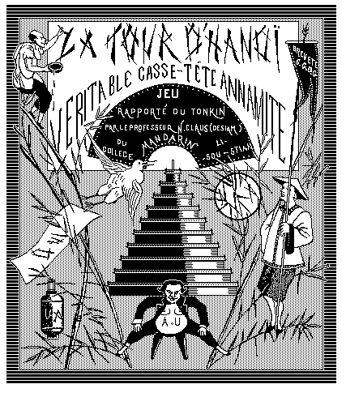
Recursion
Édouard Lucas, 1883.
Notes:
http://www.cs.wm.edu/~pkstoc/toh.html

Slide 60
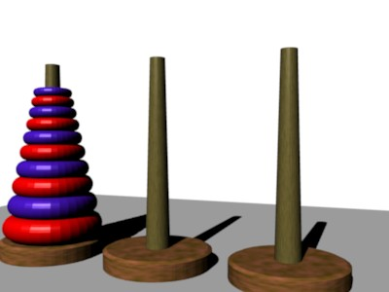
Towers of Hanoi
http://www.mazeworks.com/hanoi/index.htm
Notes:
First use mine. Then run the simulation.

Slide 61
Towers of Hanoi
Let’s play.

Slide 62
A Simple Recursive Algorithm
def towers(n, post1, post2):
if n == 1:
move disk n from post1 to post2
else:
postmiddle = free(post1, post2)
towers(n-1, post1, postmiddle)
move disk n from post1 to post2)
towers(n-1, postmiddle, post2)
def towers(n, post1, post2, indent=0):
if n == 1:
print(indent*" ", "Moving disk ", n, " from
", post1, "to ", post2)
else:
postmiddle = free(post1, post2)
towers(n-1, post1, postmiddle, indent+1)
print(indent*" ", "Moving disk ", n, " from
", post1, "to ", post2)
towers(n-1, postmiddle, post2, indent+1)
Notes:
Load hanoi.py

Slide 63
Using a Stack to Keep Track
def towers(n, post1, post2):
if n == 1:
move disk n from post1 to post2
else:
postmiddle = free(post1, post2)
towers(n-1, post1, postmiddle)
move disk n from post1 to post2)
towers(n-1, postmiddle, post2)
towers
move
towers
5, 1, 3
Notes:
Try it for n = 5 and show what goes on in the stack.

Slide 64
Using a Stack to Keep Track
def towers(n, post1, post2):
if n == 1:
move disk n from post1 to post2
else:
postmiddle = free(post1, post2)
towers(n-1, post1, postmiddle)
move disk n from post1 to post2)
towers(n-1, postmiddle, post2)
towers
move
towers
4, 1, 2
✓towers
move
towers
5, 1, 3
Notes:
Try it for n = 5 and show what goes on in the stack. Point out that this is quite simple for computers. But people are very bad at manipulating stacks.

Slide 65
Using a Stack to Keep Track
def towers(n, post1, post2):
if n == 1:
move disk n from post1 to post2
else:
postmiddle = free(post1, post2)
towers(n-1, post1, postmiddle)
move disk n from post1 to post2)
towers(n-1, postmiddle, post2)
towers
move
towers
3, 1, 3
✓towers
move
towers
4, 1, 2
✓towers
move
towers
5, 1, 3
Notes:
Try it for n = 5 and show what goes on in the stack. Point out that this is quite simple for computers. But people are very bad at manipulating stacks.

Slide 66
Using a Stack to Keep Track
def towers(n, post1, post2):
if n == 1:
move disk n from post1 to post2
else:
postmiddle = free(post1, post2)
towers(n-1, post1, postmiddle)
move disk n from post1 to post2)
towers(n-1, postmiddle, post2)
towers
move
towers
2, 1, 2
✓towers
move
towers
3, 1, 3
✓towers
move
towers
4, 1, 2
✓towers
move
towers
5, 1, 3
Notes:
Try it for n = 5 and show what goes on in the stack. Point out that this is quite simple for computers. But people are very bad at manipulating stacks.

Slide 67
Using a Stack to Keep Track
def towers(n, post1, post2):
if n == 1:
move disk n from post1 to post2
else:
postmiddle = free(post1, post2)
towers(n-1, post1, postmiddle)
move disk n from post1 to post2)
towers(n-1, postmiddle, post2)
1, 1, 3
✓towers
move
towers
2, 1, 2
✓towers
move
towers
3, 1, 3
✓towers
move
towers
4, 1, 2
✓towers
move
towers
5, 1, 3
Notes:
Try it for n = 5 and show what goes on in the stack. Point out that this is quite simple for computers. But people are very bad at manipulating stacks.

Slide 68
Using a Stack to Keep Track
def towers(n, post1, post2):
if n == 1:
move disk n from post1 to post2
else:
postmiddle = free(post1, post2)
towers(n-1, post1, postmiddle)
move disk n from post1 to post2)
towers(n-1, postmiddle, post2)
✓towers
✓move
towers
2, 1, 2
✓towers
move
towers
3, 1, 3
✓towers
move
towers
4, 1, 2
✓towers
move
towers
5, 1, 3
Notes:
Try it for n = 5 and show what goes on in the stack. Point out that this is quite simple for computers. But people are very bad at manipulating stacks. Let them try to do it this way.

Slide 69
Using a Stack to Keep Track
def towers(n, post1, post2):
if n == 1:
move disk n from post1 to post2
else:
postmiddle = free(post1, post2)
towers(n-1, post1, postmiddle)
move disk n from post1 to post2)
towers(n-1, postmiddle, post2)
1, 3, 2
✓towers
✓ move
✓ towers
2, 1, 2
✓towers
move
towers
3, 1, 3
✓towers
move
towers
4, 1, 2
✓towers
move
towers
5, 1, 3
Notes:
Try it for n = 5 and show what goes on in the stack. Point out that this is quite simple for computers. But people are very bad at manipulating stacks.

Slide 70
Using a Stack to Keep Track
def towers(n, post1, post2):
if n == 1:
move disk n from post1 to post2
else:
postmiddle = free(post1, post2)
towers(n-1, post1, postmiddle)
move disk n from post1 to post2)
towers(n-1, postmiddle, post2)
✓towers
✓ move
✓ towers
2, 1, 2
✓towers
move
towers
3, 1, 3
✓towers
move
towers
4, 1, 2
✓towers
move
towers
5, 1, 3
Notes:
Try it for n = 5 and show what goes on in the stack. Point out that this is quite simple for computers. But people are very bad at manipulating stacks.

Slide 71
Using a Stack to Keep Track
def towers(n, post1, post2):
if n == 1:
move disk n from post1 to post2
else:
postmiddle = free(post1, post2)
towers(n-1, post1, postmiddle)
move disk n from post1 to post2)
towers(n-1, postmiddle, post2)
✓towers
✓move
towers
3, 1, 3
Total number of moves in the shortest sequence:
2^{n}-1
✓towers
move
towers
4, 1, 2
✓towers
move
towers
5, 1, 3
Notes:
Try it for n = 5 and show what goes on in the stack. Point out that this is quite simple for computers. But people are very bad at manipulating stacks.

Slide 72
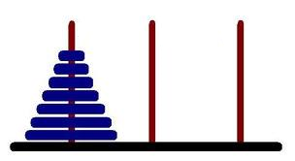
Doing It Without a Stack
To move n disks from A to C:
Set direction: If n is odd, move to the left, else right.
Until done:
Move smallest disk one step in direction.
Make the only legal move with some other disk
A B C
Notes:
View it as a loop, so if you try to move right from C, you go to A. Let them try to do it this way.
http://www.alper.net/tag/tower-of-hanoi/

Slide 73
Comparing Recursive and Iterative Solutions
Which one is easier to see the correctness of?
Which one is easier for a person to execute?
Notes:
Recursive is much easier to see the correctness of.
But people can’t do it. People can get very fast at the iterative one.

Slide 74
Any Way to Parallelize?
We are staring at having to make 2^{n}-1 moves.
A B C
Notes:
No because total data dependence.

Slide 75
Greatest Common Divisor
The obvious way:
gcd(12, 30)
Notes:
Why do we care? Again, crypto. Try these examples the obvious way, where we find the prime factors of the two numbers.

Slide 76
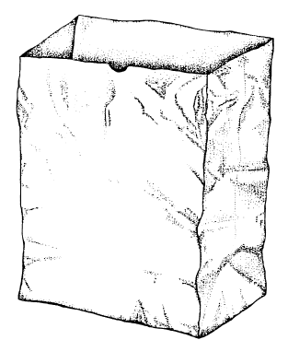
Greatest Common Divisor
The obvious way:
gcd(12, 30)
2, 2, 3
2, 3, 5
Notes:
Why do we care? Again, crypto. Try these examples the obvious way, where we find the prime factors of the two numbers.
Bag image: http://history.arizona.edu/events/

Slide 77
Greatest Common Divisor
The obvious way:
gcd(12, 30)
2, 2, 3
2, 3, 5
2, 3
Notes:
Why do we care? Again, crypto. Try these examples the obvious way, where we find the prime factors of the two numbers.
Bag image: http://history.arizona.edu/events/

Slide 78
Greatest Common Divisor
The obvious way:
gcd(12, 30)
2, 2, 3
2, 3, 5
2, 3
= 6
Notes:
Why do we care? Again, crypto. Try these examples the obvious way, where we find the prime factors of the two numbers.
Bag image: http://history.arizona.edu/events/

Slide 79
Greatest Common Divisor
The obvious way:
gcd(12, 30)
def gcd(n, m):
ns = factors(n)
ms = factors(m)
answer = multiset_intersect(ns, ms)
return(answer)
Notes:
Why do we care? Again, crypto. Try these examples the obvious way, where we find the prime factors of the two numbers.
Load my module gcd.py. It’s got Euclid’s method, but we can simulate this code and see what happens. Gcd_euclid just prints the answer (no tracing)

Slide 80
Greatest Common Divisor
The obvious way:
gcd(1345673,456782)
def gcd(n, m):
ns = factors(n)
ms = factors(m)
answer = multiset_intersect(ns, ms)
return(answer)
Notes:
Why do we care? Again, crypto. Try these examples the obvious way, where we find the prime factors of the two numbers.
Load my module gcd.py. It’s got Euclid’s method, but we can type in this example and see what happens. Gcd_euclid just prints the answer (no tracing)

Slide 81
Greatest Common Divisor
The obvious way:
gcd(1345673,456782)
def gcd(n, m):
ns = factors(n) # No efficient way known.
ms = factors(m) # No efficient way known.
answer = multiset_intersect(ns, ms)
return(answer)
Not O(n^{k}) for any k
Notes:
Why do we care? Again, crypto. Try these examples the obvious way, where we find the prime factors of the two numbers.
Load my module gcd.py. It’s got Euclid’s method, but we can type in this example and see what happens. Gcd_euclid just prints the answer (no tracing)

Slide 82
How Hard is Factoring?
RSA-768 = 12301866845301177551304949583849627207728535695953
34792197322452151726400507263657518745202199786469389956474
94277406384592519255732630345373154826850791702612214291346
1670429214311602221240479274737794080665351419597459856902143413
RSA-768 = 334780716989568987860441698482126908177047949837137685
68912431388982883793878002287614711652531743087737814467999489
× 36746043666799590428244633799627952632279158164343087642676032283815739666 511279233373417143396810270092798736308917
Factored in 2009 using hundreds of machines over 2 years.
SIMD parallelism helps.
But good enough to grab your credit card number?
Notes:
http://en.wikipedia.org/wiki/Integer_factorization

Slide 83
How Hard is Factoring?
RSA-240 = 12462036678171878406583504460810659043482037465167880
57548187888832896668011882108550360395702725087475098647684384
58621054865537970253930571891217684318286362846948405301614416
430468066875699415246993185704183030512549594371372159029236099
Not yet factored.
Notes:
http://en.wikipedia.org/wiki/Integer_factorization

Slide 84
Greatest Common Divisor
A better way:
def gcd_euclid(n,m):
if m == 0:
return(n)
else:
return(gcd_euclid(m, n%m))
Let’s try it: n = 24 m = 9
some bigger ones, for example 784, 8746450
Notes:
Load my module gcd.py. It’s got Euclid’s method, but we can type in this example and see what happens. gcd_euclid_trace traces the process.
Try 784,8746450 where the answer is 2.

Slide 85
Greatest Common Divisor
def gcd_euclid(n,m):
if m == 0:
return(n)
else:
return(gcd_euclid(m, n%m))
But is it correct?
Does it always halt?
Notes:
It must since m gets smaller every time (except possibly the first) and can’t ever go negative.
In particular, if m > 0, then n%m < m. N will be greater than m every time except possibly the first time for this reason.
Must halt in no more than 5 times the number of decimal digits steps.

Slide 86
Greatest Common Divisor
def gcd_euclid(n,m):
if m == 0:
return(n)
else:
return(gcd_euclid(m, n%m))
But is it correct?
Does it always halt?
O(log²(max(n, m)))
O(max(n, m))
Notes:
It must since m gets smaller every time (except possibly the first) and can’t ever go negative.
In particular, if n > m, then n%m < m. N will be greater than m every time except possibly the first time for this reason.
Must halt in no more than 5 times the number of decimal digits steps.

Slide 87
Greatest Common Divisor
def gcd_euclid(n,m):
if m == 0:
return(n)
else:
return(gcd_euclid(m, n%m))
But is it correct?
Does it always halt?
Does it get the right answer?
For some j: n = j*m + n%m

Slide 88
Greatest Common Divisor
def gcd_euclid(n,m):
if m == 0:
return(n)
else:
return(gcd_euclid(m, n%m))
But is it correct?
Does it always halt?
Does it get the right answer?
For some j: n = j*m + n%m
Suppose:
k k
divides divides
Notes:
Then k must divide n%m. Use k = 5 as an example. The key is that by trying smaller numbers we never throw any factors away.

Slide 89
The Beauty of an Algorithm
def gcd_euclid(n,m):
if m == 0:
return(n)
else:
return(gcd_euclid(m, n%m))
It’s not necessary to undertstand why it is correct in order to execute it. You can execute it without understanding . So can a computer.
Of course, someone has to prove once that it is correct or we wouldn’t trust our key systems to it.

