Slide 1
Easy, Hard, and Impossible

Slide 2
Easy

Slide 3
Tic Tac Toe
Notes:
Play a game or two.
At first, it appears we need to search to find a winning strategy. But quickly we realize that there’s exactly one optimal move. This game is trivial.

Slide 4
Hard

Slide 5
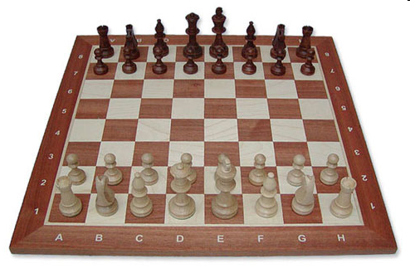
Chess
Notes:
Image from: http://www.polandchess.com/chess_sets_galleries/Staunton5_wb_chess_set/Staunton5_wb_chess_set.htm

Slide 6
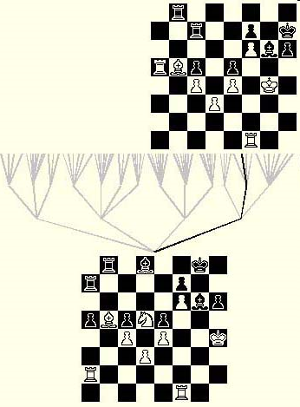
Recall the Approach - Search

Slide 7
Searching for the Best Move
A
B C D
E F G H I J K L M
(8) (-6) (0) (0) (2) (5) (-4) (10) (5)
Notes:
We did this already in Computational Thinking.
Remind that we don’t just want to pick D so that we can go to L because we don’t get to pick the move from D.
Note that the number of leaf nodes is 3 * 3. Ask how many there would be at the next level.

Slide 8
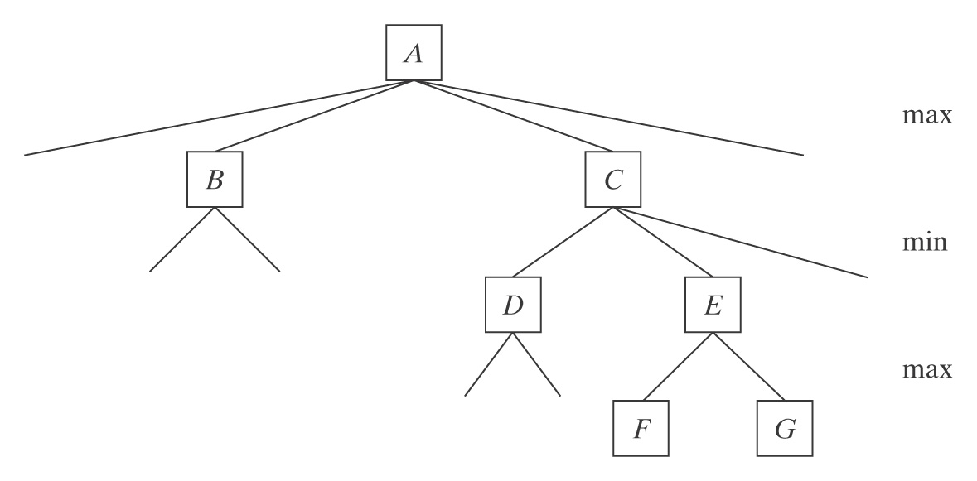
How Much Computation Does it Take?
Middle game branching factor ≈ 35
Lookahead required to play master level chess ≈ 8
35⁸ ≈
Notes:
Did this one too.

Slide 9
How Much Computation Does it Take?
Middle game branching factor ≈ 35
Lookahead required to play master level chess ≈ 8
35⁸ ≈ 2,000,000,000,000
Seconds in a year ≈

Slide 10
How Much Computation Does it Take?
Middle game branching factor ≈ 35
Lookahead required to play master level chess ≈ 8
35⁸ ≈ 2,000,000,000,000
Seconds in a year ≈ 31,536,000
Seconds since Big Bang ≈ 300,000,000,000,000,000

Slide 11
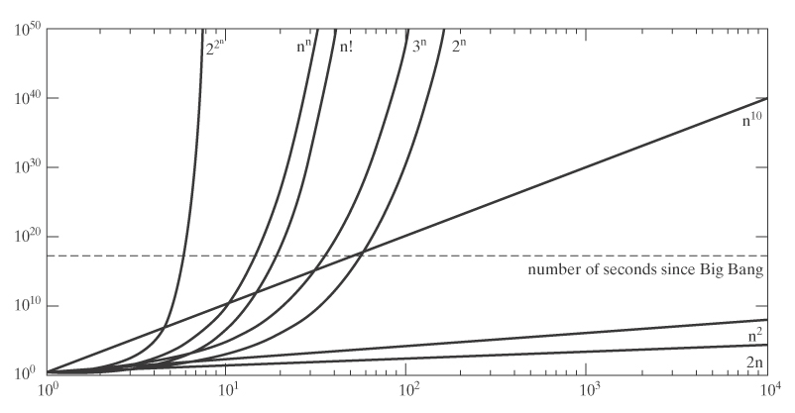
Growth Rates of Functions
Notes:
Did this one too.

Slide 12
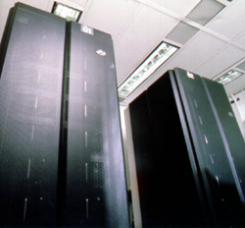
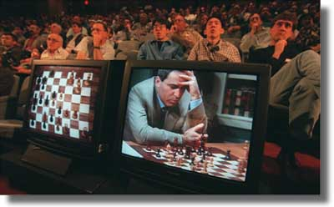
Yet Machines Can Do It
In 1997, Deep Blue beat Garry Kasparov.
Notes:
What about role playing games? Need a lot more knowledge.

Slide 13
Seems Hard But Really Easy

Slide 14
Nim
At your turn, you must choose a pile, then remove as many sticks from the pile as you like.
The player who takes the last stick(s) wins.
Notes:
Let folks play. It works to hand out a stack of toothpicks to each pair of students.
First player should remove one stick from either pile 1 or pile 2 or remove all sticks from pile 3. Then there is no guaranteed winning move for the other player.

Slide 15
Nim
Now let’s try:

Slide 16
Nim
Now let’s try:
Oops, now there are a lot of possibilities to try.

Slide 17
Nim
My turn:
10 (2)
10 (2)
11 (3)
11
For the current player:
Guaranteed loss if last row is all 0’s.
Guaranteed win otherwise.
Notes:
To form last row, XOR each column.
I should remove one stick from either pile one or pile two. Or all from pile three.

Slide 18
Nim
My turn:
100 (4)
010 (2)
101 (5)
011
For the current player:
Guaranteed loss if last row is all 0’s.
Guaranteed win otherwise.

Slide 19
Nim
Your turn:
100 (4)
001 (1)
101 (5)
000
For the current player:
Guaranteed loss if last row is all 0’s.
Guaranteed win otherwise.

Slide 20
Following Paths
Notes:
You can print this page and copy it and hand it out for the students to try. The file has it twice. Copy it front and back so they can use one before they see the trick and the other afterward.

Slide 21
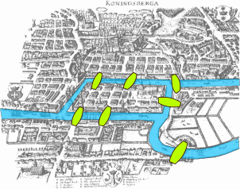
Seven Bridges of Königsberg
Notes:
Königsberg was the capital of eastern Prussia from the Late Middle Ages until 1945. Now in Russia, called Kaliningrad.

Slide 22
Seven Bridges of Königsberg
Seven Bridges of Königsberg:
1
3
4
2

Slide 23
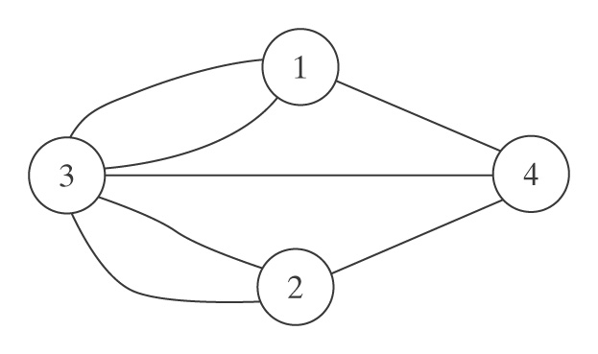
Seven Bridges of Königsberg
Seven Bridges of Königsberg:
1
3
4
2
As a graph:

Slide 24
For Any Graph
An Eulerian path : Cross every edge exactly once.
All these people care:
• Bridge inspectors
• Road cleaners
• Network analysts

Slide 25
Another Example
Notes:
Print this and let the students try.

Slide 26
Another Example
Define the degree of a
vertex to be the number
of edges with it as
an endpoint.

Slide 27
Euler’s Observation
Define the degree of a
vertex to be the number
of edges with it as
an endpoint.
Euler observed that:
● Eulerian path if and only if exactly two vertices of odd degree.
● Eulerian circuit if and only if all vertices have even degree.
Notes:
So what about this one?

Slide 28
An Efficient Algorithm
def eulerian_circuit(vertices, edges):
for v in vertices:
count = 0
for e in edges:
if e touches v:
count += 1
if odd(count):
return(False)
return(True)
How many steps does it take?

Slide 29
An Efficient Algorithm
def eulerian_circuit(vertices, edges):
for v in vertices:
count = 0
for e in edges:
if e touches v:
count += 1
if odd(count):
return(False)
return(True)
How many steps does it take?
O(|vertices| * |edges|)

Slide 30
Back to the Bridges
1
3
4
2
As a graph:
Notes:
So is there an Eulerian circuit?

Slide 31
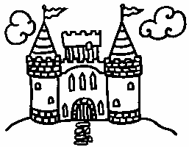
The Good King and the Evil King
The good king wants to build exactly one new bridge so that:
There’s an Eulerian path from the pub to his castle.
But there isn’t one from the pub to the castle of his evil brother on the other bank of the river.

Slide 32
Here’s What He Starts With
1
3
4
2
As a graph:
Notes:
Print this and hand it out. Let the students try it.

Slide 33
Here’s What He Starts With
1
3
4
2
As a graph:

Slide 34
Unfortuntately, There Isn’t Always a Trick
Suppose we need to visit every vertex exactly once.

Slide 35
The Traveling Salesman Problem
15
25
10
28
20
4
40
8
9
7
3
23
Find the shortest circuit that visits every city exactly once.

Slide 36
Visting Vertices Rather Than Edges
● A Hamiltonian path: visit every vertex exactly once.
● A Hamiltonian circuit: visit every vertex exactly once and end up where you started.
All these people care:
Salesmen,
Farm inspectors,
Network analysts

Slide 37
The Traveling Salesman Problem
15
25
10
28
20
4
40
8
9
7
3
23
Given n cities:
Choose a first city n
Choose a second n-1
Choose a third n-2
… n!

Slide 38
The Traveling Salesman Problem
Can we do better than n!
● First city doesn’t matter.
● Order doesn’t matter.
So we get (n-1)!/2.

Slide 39
The Growth Rate of n!
2 | 2 | 11 | 479001600
3 | 6 | 12 | 6227020800
4 | 24 | 13 | 87178291200
5 | 120 | 14 | 1307674368000
6 | 720 | 15 | 20922789888000
7 | 5040 | 16 | 355687428096000
8 | 40320 | 17 | 6402373705728000
9 | 362880 | 18 | 121645100408832000
10 | 3628800 | 19 | 2432902008176640000
11 | 39916800 | 36 | 3.6⋅10⁴¹

Slide 40
Putting it into Perspective
Speed of light | 3⋅10⁸ m/sec
Width of a proton | 10⁻¹⁵ m
At one operation in the time it takes light to cross a proton | 3⋅10²³ ops/sec
Since Big Bang | 3⋅10¹⁷ sec
Ops since Big Bang | 9⋅10⁴⁰ ops | 36! = 3.6⋅10⁴¹
Neurons in brain | 10¹¹
Parallel ops since Big Bang | 9⋅10⁵¹ | 43! = 6⋅10⁵²

Slide 41
Getting Close Enough
Use a technique that is guaranteed to find an optimal solution and likely to do so quickly.
Use a technique that is guaranteed to run quickly and find a “good” solution.
The Concorde TSP Solver found an optimal route that visits 24,978 cities in Sweden.
The World Tour Problem

Slide 42
Is This The Best We Can Do?
It is generally believed that there’s no efficient algorithm that finds an exact solution to:
The Traveling Salesman problem
The question of whether or not a Hamiltonian circuit exists.
Would you like to win $1M?
The Millenium Prize

Slide 43
Impossible

Slide 44
An Interesting Puzzle
 | List 1 | List 2
1 | b | bbb
2 | babbb | ba
3 | ba | a
4 | bbbaa | babbb
2
List 1 b a b b b
List 2 b a

Slide 45
An Interesting Puzzle
 | List 1 | List 2
1 | b | bbb
2 | babbb | ba
3 | ba | a
4 | bbbaa | babbb
2 1
List 1 b a b b b b
List 2 b a b b b

Slide 46
An Interesting Puzzle
 | List 1 | List 2
1 | b | bbb
2 | babbb | ba
3 | ba | a
4 | bbbaa | babbb
2 1 1
List 1 b a b b b b b
List 2 b a b b b b b b

Slide 47
An Interesting Puzzle
 | List 1 | List 2
1 | b | bbb
2 | babbb | ba
3 | ba | a
4 | bbbaa | babbb
2 1 1 3
List 1 b a b b b b b b a
List 2 b a b b b b b b a

Slide 48
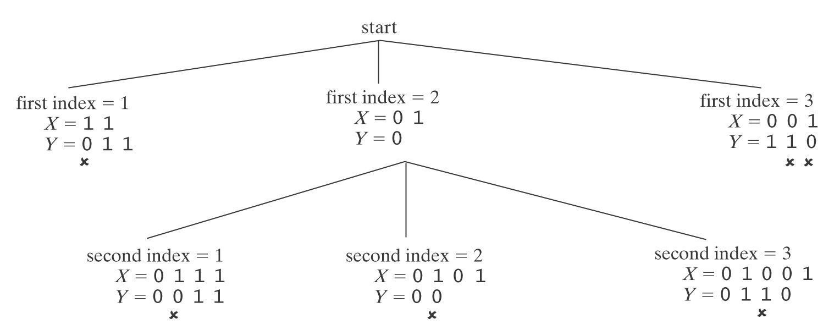
The Post Correspondence Problem
 | List 1 | List 2
1 | 11 | 011
2 | 01 | 0
3 | 001 | 110
Notes:
Easy to see that this one is impossible. We rule out all possibilities.

Slide 49
The Post Correspondence Problem
 | List 1 | List 2
1 | ab | a
2 | ab | ba
3 | aa | baa
Notes:
Let students try this one. 1,3 and 1,2,3 are solutions.

Slide 50
The Post Correspondence Problem
 | List 1 | List 2
1 | ba | bab
2 | abb | bb
3 | bab | abb
Notes:
Let the students try this one. No solution exists.

Slide 51
The Post Correspondence Problem
 | List 1 | List 2
1 | 1101 | 1
2 | 0110 | 11
3 | 1 | 110
Shortest solution has length 252.
http://webdocs.cs.ualberta.ca/~games/PCP/
Notes:
Tell them about this one. Its shortest solution has length 252

Slide 52
Can A Program Do This?
Can we write a program to answer the following question:
Given a PCP instance P, decide whether or not P has a solution.
Return:
True if it does.
False if it does not.

Slide 53
The Post Correspondence Problem
A program to solve this problem:
Until a solution or a dead end is found:
If dead end, halt and report no.
Generate the next candidate solution.
Test it. If it is a solution, halt and report yes.
So, if there are say 4 rows in the table, we’ll try:
1 2 3 4
1,1 1,2 1,3 1,4 1,5
2,1 ……
1,1,1 ….

Slide 54
Will This Work?
If there is a solution:
If there is no solution:
Notes:
If there is a solution, the program will find it. If there is not a solution, it is possible that the program will reach dead ends on all paths. But it is also possible that it will just keep on looking forever.

Slide 55
A Tiling Problem
Notes:
Explain the rules.

Slide 56
A Tiling Problem

Slide 57
A Tiling Problem

Slide 58
A Tiling Problem

Slide 59
A Tiling Problem

Slide 60
A Tiling Problem

Slide 61
A Tiling Problem

Slide 62
A Tiling Problem

Slide 63
A Tiling Problem

Slide 64
A Tiling Problem
Notes:
Now notice that we can tile forever because this 3 x 3 is the same top and bottom and right and left.

Slide 65
Another Tiling Problem
1 2 3
Notes:
This one can easily be shown not to work.

Slide 66
Another Tiling Problem
Notes:
Hand out cut out tiles and let the students try this one. There’s a 2 x 3 that is symmetric.

Slide 67
Another Tiling Problem

Slide 68
Can A Program Do This?
Can we write a program to answer the following question:
Given a tiling problem T, decide whether or not T can tile a plane.
Return:
True if it can.
False if it can not.

Slide 69
Deciding a Tiling Problem
A program to solve this problem:
Until the answer is clearly yes or a dead end is found:
If dead end, halt and report no.
Generate the next candidate solution.
Test it. If it is a solution, halt and report yes.

Slide 70
Will This Work?
If T can tile a plane:
If T can not tile a plane:
Notes:
If T cannot tile a plane, the program will eventually hit a dead end. But if it can tile, the program will loop forever.

Slide 71
Programs Debug Programs
Given an arbitrary program, can it be guaranteed to halt?
name = input(“Type your name: ”)
if name == “Elaine”:
print (“You win!!”)
else:
print (“You lose ☹”)
Notes:
Obviously halts. No loops.

Slide 72
Programs Debug Programs
Given an arbitrary program, can it be guaranteed to halt?
number = input(“Enter number: ”)
result = 1
counter = 2
while counter <= number:
result = result * counter
counter +=1
print (result)
Notes:
Easy to show this one halts because counter gets one step closer to number each time. Simulation on next slide.

Slide 73
Programs Debug Programs
Given an arbitrary program, can it be guaranteed to halt?
number = input(“Enter number: ”)
result = 1
counter = 2
while counter <= number:
result = result * counter
counter +=1
print (result)
Suppose number = 5:
result number counter
1 5 2
2 5 3
6 5 4
24 5 5
120 5 6
Notes:
Easy to show this one halts because counter gets one step closer to number each time.

Slide 74
Programs Debug Programs
Given an arbitrary program, can it be guaranteed to halt?
number = input(“Enter number: ”)
result = 1
counter = 2
while counter <= number:
number = number * counter
counter +=1
print (result)
Suppose number = 5:
result number counter
1 5 2
1 10 3
1 30 4
1 120 5
1 600 6
Notes:
Easy to show this one never halts. Mistake.

Slide 75
Programs Debug Programs
Given an arbitrary program, can it be guaranteed to halt?
Recall the 3n+1 problem:
def threen(value):
while value != 1:
if value % 2 == 0:
value = value//2
else:
value = 3 * value + 1
print(value)
Collatz Conjecture: This program always halts.
Notes:
Load module threenplus1.py. Try it. Or go to http://math.carleton.ca/%7Eamingare/mathzone/3n+1.html

Slide 76
The Impossible
The halting problem cannot be solved.
We can prove that no program can ever be written that can:
Look at an arbitrary program and decide whether or not it always halts.
Look at an arbitrary program and a specific input and decide whether or not the program will halt on that input.

Slide 77
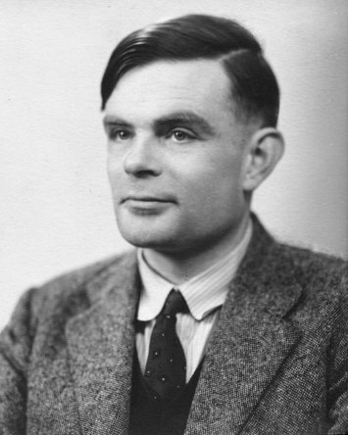
What is a Program?
A Python program
But before Python, before computers even, a simple mathematical model:
The Turing Machine
Alan Turing 1912- 1954
Notes:
Recall that we’ve already mentioned Turing. We said that he proved that there’s no algorithm to decide whether a formula of quantified logic is valid.

Slide 78
Turing Machines

Slide 79
Turing Machines
But we can prove that anything that any standard computer can do can also be done on a Turing machine.

Slide 80
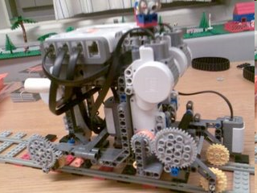
Watch One in Action
http://www.youtube.com/watch?v=cYw2ewoO6c4&eurl=http://www.google.com/ig?hl=en
Notes:
Picture from: http://legoofdoom.blogspot.com/

Slide 81
The Halting Problem is Not Solvable
Suppose, for the sake of argument, that the following program did exist:
def halts(string1,string2):
if string₁ would halt if run on string₂:
return(True)
else:
return(False)
Notes:
Key – we’ve said nothing about how halts would work. Only that it can do the job.

Slide 82
The Halting Problem is Not Solvable
Consider the following program:
def trouble(string):
if halts(string, string):
while 1 == 1:
pass # loop forever
else:
return
Now we invoke trouble(<trouble>)
What should halts(<trouble>,<trouble>) say? If it:
Returns True (trouble will halt): trouble
Returns False (trouble will not halt): trouble

Slide 83
The Halting Problem is Not Solvable
Consider the following program:
def trouble(string):
if halts(string, string):
while 1 == 1:
pass # loop forever
else:
return
Now we invoke trouble(<trouble>)
What should halts(<trouble>,<trouble>) say? If it:
Returns True (trouble will halt): trouble loops
Returns False (trouble will not halt): trouble

Slide 84
The Halting Problem is Not Solvable
Consider the following program:
def trouble(string):
if halts(string, string):
while 1 == 1:
pass # loop forever
else:
return
Now we invoke trouble(<trouble>)
What should halts(<trouble>,<trouble>) say? If it:
Returns True (trouble will halt): trouble loops
Returns False (trouble will not halt): trouble halts
So both answers lead to contradictions.

Slide 85
Recall the Tiling Problem

Slide 86
Other Unsolvable Problems
Tiling:
We can encode a <program>,<input> pair as an instance of a tiling problem so that there is an infinite tiling just in case <program> does not halt on <input>.
00010000111000000111110000000000000 00010000111010000111110000000000000
00010000111011000111110000000000000
…
So if the tiling problem were solvable then Halting would be.
But Halting isn’t. So neither is the tiling problem.

Slide 87
Recall the Post Correspondence Problem
 | List 1 | List 2
1 | ab | a
2 | ab | ba
3 | aa | baa
Notes:
Let students try this one. 1,3 and 1,2,3 are solutions.

Slide 88
Other Unsolvable Problems
PCP:
We can encode a <program>,<input> pair as an instance of PCP so that the PCP problem has a solution just in case <program> halts on <input>.
2 1 1
List 1 b a b b b b b
List 2 b a b b b b b b
So if PCP were solvable then Halting would be.
But Halting isn’t. So neither is PCP.

Slide 89
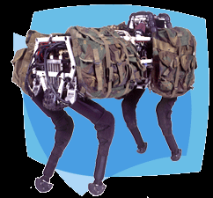
Which is Amazing
Given the things programs can do.
http://www.bdi.com/content/sec.php?section=BigDog
Notes:
Watch the video.

Slide 90
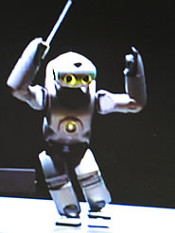
Which is Amazing
Given the things programs can do.
http://pc.watch.impress.co.jp/docs/2003/1218/sony_06.wmv
Notes:
Watch the video.

Slide 91
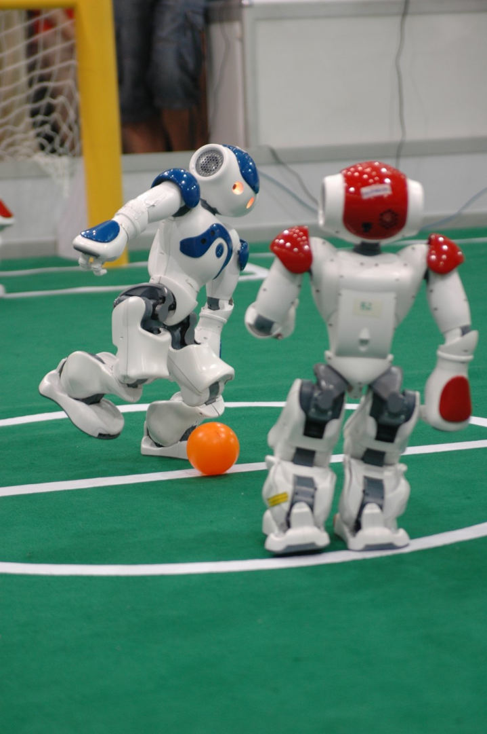
Which is Amazing
Given the things programs can do.
http://www.youtube.com/watch?v=4xuMadnoGl4&feature=results_video&playnext=1&list=PL4E939E14BFE1241F
Notes:
Watch the video or 2012 Nao league RoboCup qualification.
Picture from: http://www.ist.tugraz.at/staff/steinbauer/projects.html

Slide 92
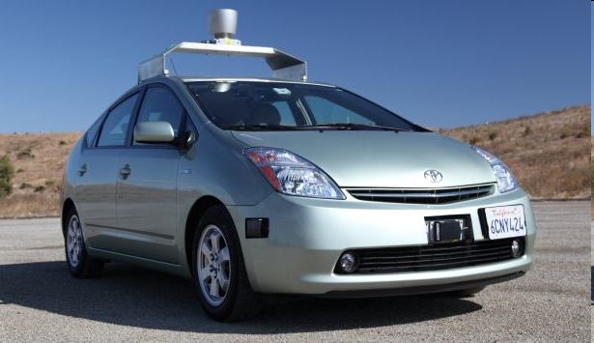
Which is Amazing
Given the things programs can do.
http://www.youtube.com/watch?v=Atmk07Otu9U
http://www.youtube.com/watch?v=cdgQpa1pUUE
Notes:
Watch the video.

Slide 93
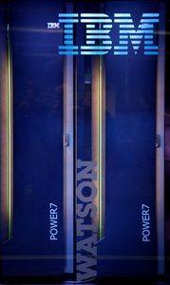
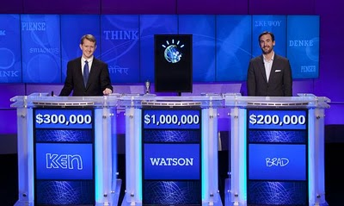
Which is Amazing
Given the things programs can do.
IBM’s site: http://www-03.ibm.com/innovation/us/watson/what-is-watson/index.html
Introduction: http://www.youtube.com/watch?v=FC3IryWr4c8
Watch a sample round: http://www.youtube.com/watch?v=WFR3lOm_xhE
From Day 1 of the real match: http://www.youtube.com/watch?v=seNkjYyG3gI
Bad Final Jeopardy: http://www.youtube.com/watch?v=mwkoabTl3vM&feature=relmfu
How does Watson win? http://www.youtube.com/watch?v=d_yXV22O6n4
Notes:
Start at 6:43 of the Day1 video to see the actual game.

