Slide 1
Recent Advances in Imitation Learning from Observation
Faraz Torabi*, Garrett Warnell^, Peter Stone*
*University of Texas at Austin,
^Army Research Laboratory

Slide 2
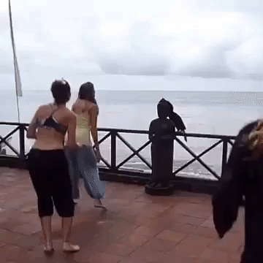
What is Imitation from Observation?

Slide 3
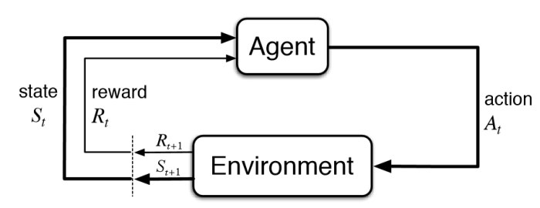
Reinforcement Learning (RL)

Slide 4
Markov Decision Process (MDP)
Formally, we model agent interaction as an MDP i.e.
Where,
S is the state space of the agent
A is the action space of the agent
T is transition probabilities i.e.
R is the scalar reward i.e.
is the discount factor
Goal:
where we want to find policy,
Drawback:
Requires extensive explorations
Designing reward functions are requires domain knowledge

Slide 5
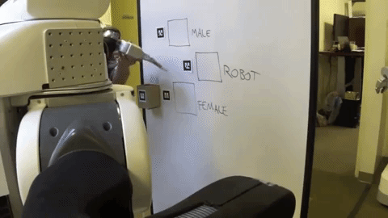
Imitation Learning
Goal:
Learn how to make decisions by trying to imitate another agent.
Observations of other agent (demonstrations) consist of state-action pairs.
Limitation:
Precludes using a large amount of demonstration data where action sequences are not given (e.g. YouTube videos).

Slide 6
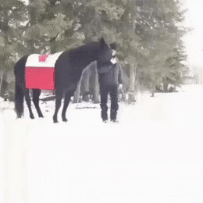
Imitation from Observation
Goal:
Learn how to perform a task given state-only demonstrations (visual demonstration).

Slide 7
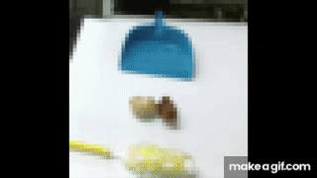
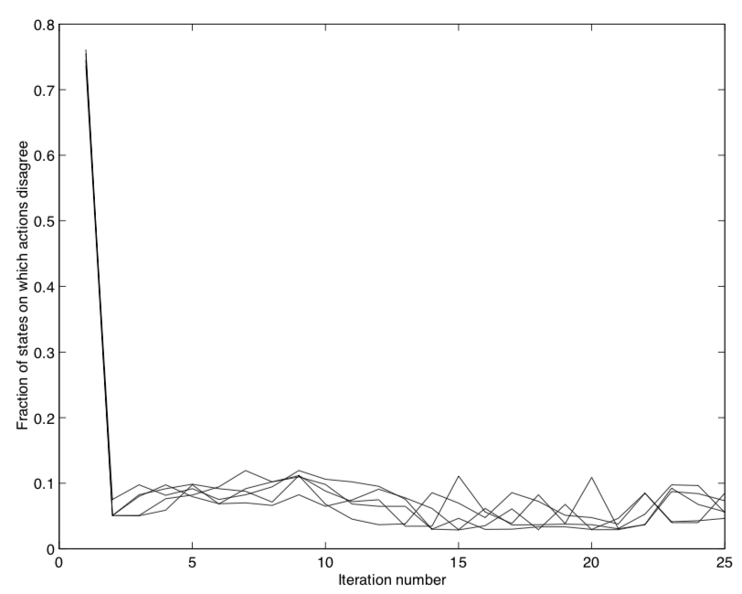
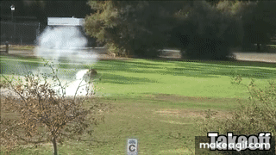
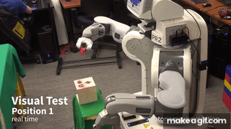
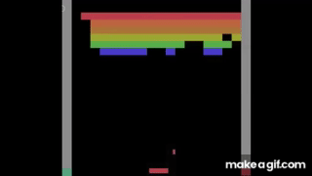
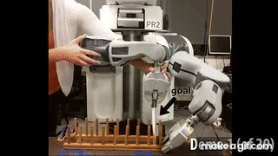
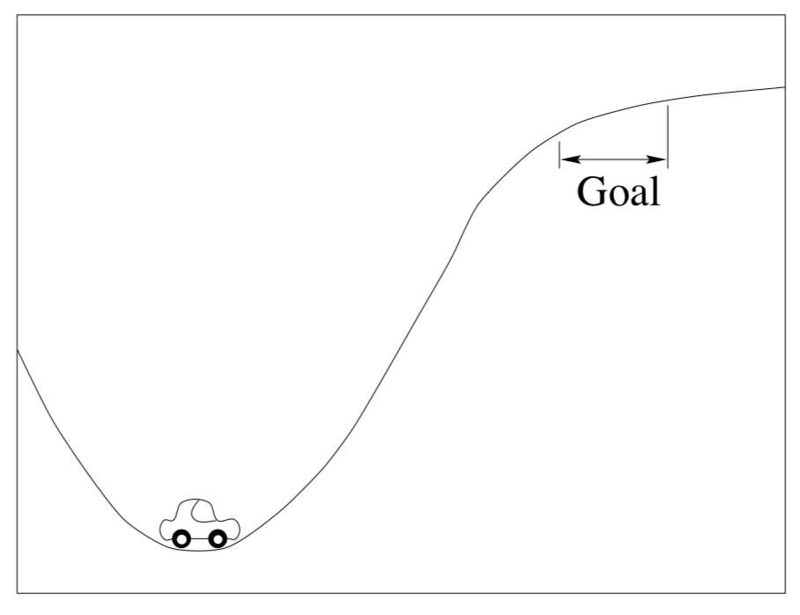
Timeline
Imitation Learning from Observation
Inverse Reinforcement Learning
Inverse Reinforcement Learning
Real World Application: End-to-End Training of Deep Visuomotor Policies
Human-level control through deep RL from pixels
Deep Learning in Imitation Learning
Liu et al 2018
Finn et al 2016
Levine et al 2016
Mnih et al 2015
Abbeel et al 2004
Ng et al 1998

Slide 8
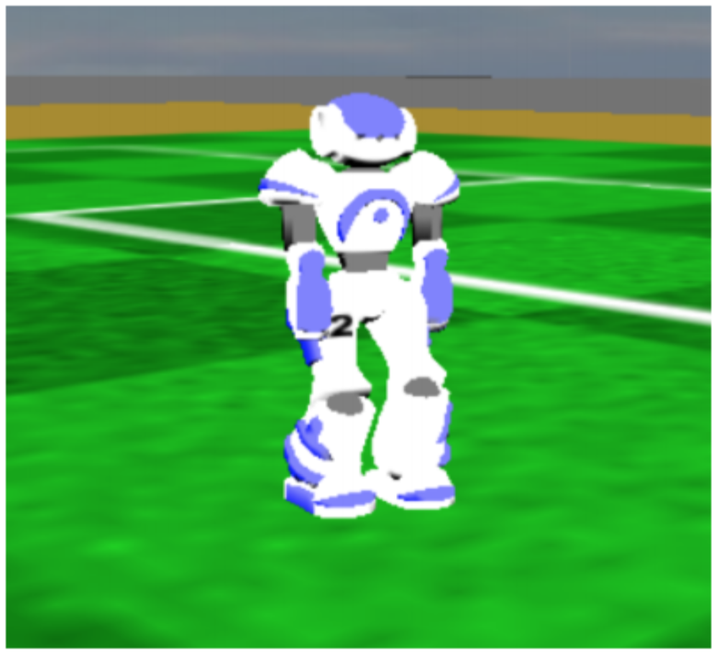
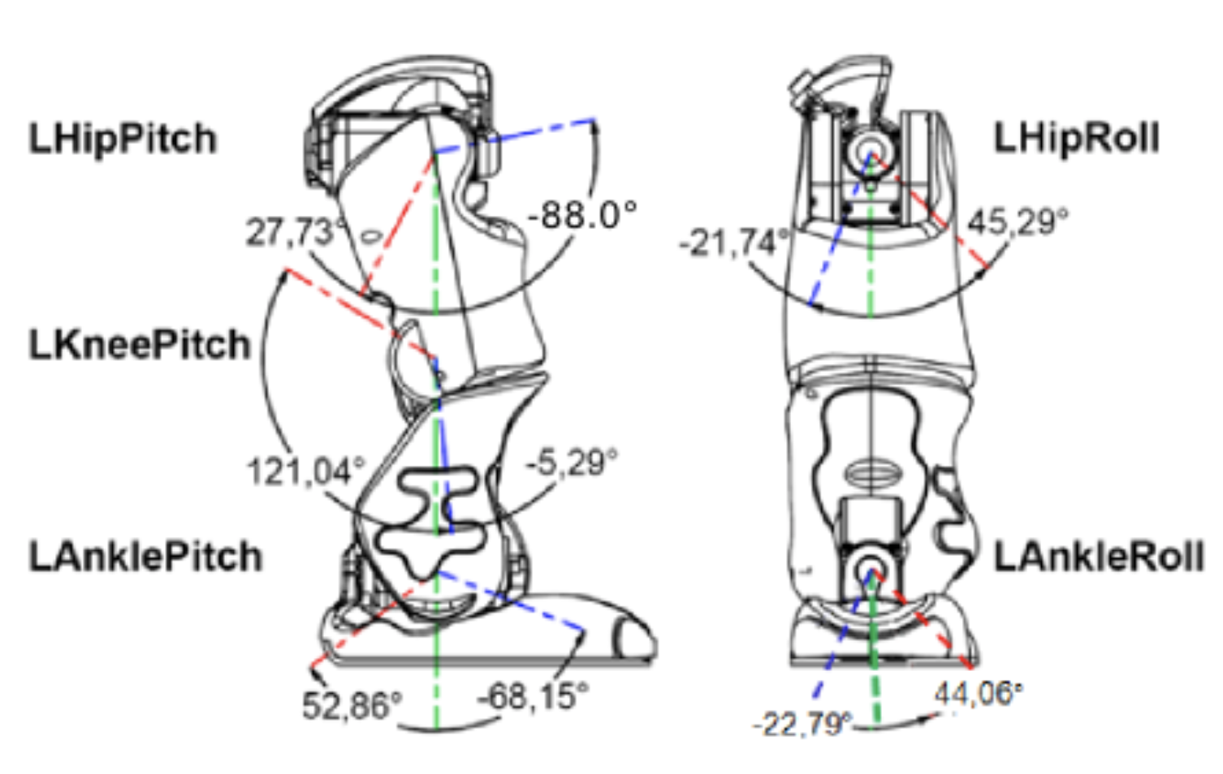
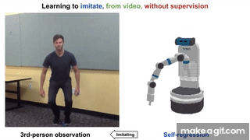
Challenges in Imitation from Observation
Perception
Simplified condition: Demos are a set of low-level features such as Joint angles (No need for perception)
General Condition: Demos comprise visual information
Embodiment mismatch
Viewpoint difference
http://doc.aldebaran.com/2-1/family/robots/joints_robot.html
Sermanet, Pierre, et al. "Time-contrastive networks: Self-supervised learning from video." 2018 IEEE International Conference on Robotics and Automation (ICRA). IEEE, 2018. APA
Liu, YuXuan, et al. "Imitation from observation: Learning to imitate behaviors from raw video via context translation." 2018 IEEE International Conference on Robotics and Automation (ICRA). IEEE, 2018.

Slide 9
Challenges in Imitation from Observation
Control
Formulation:
Given: the low-level features,
Learn: an imitation policy,
Algorithms

Slide 10
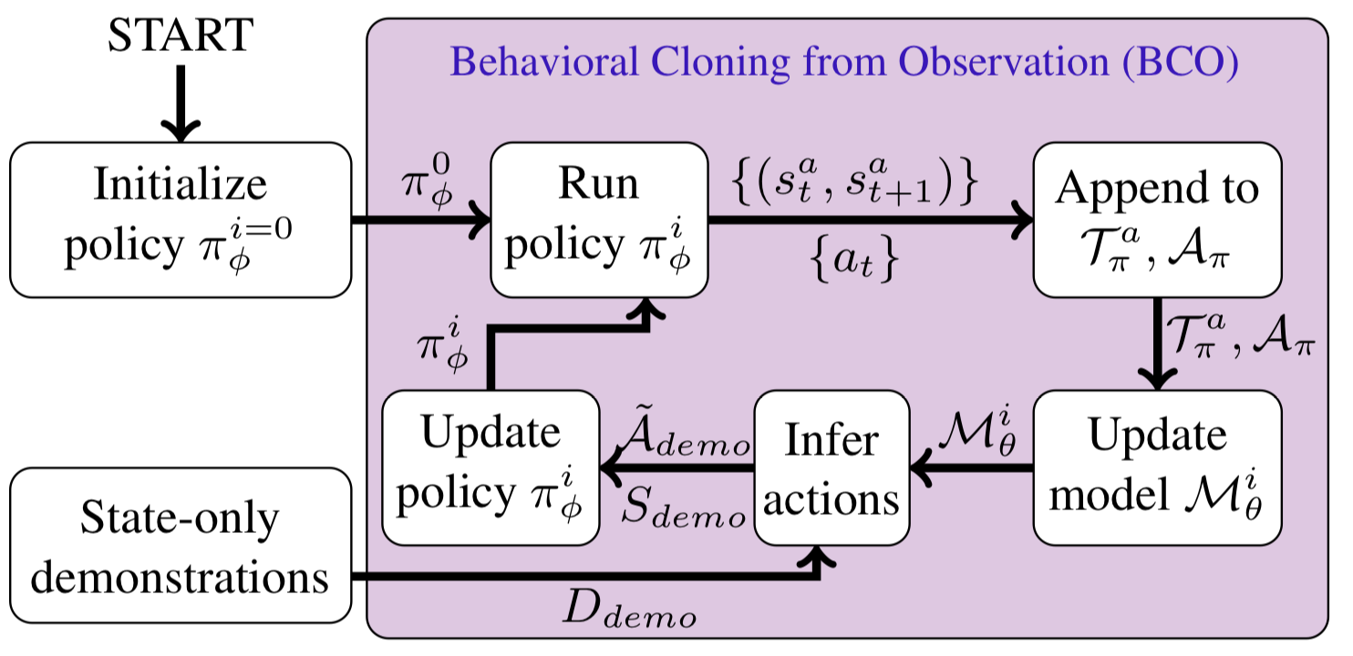
Control
Model-based
Learn a model of the environment in the process.
Inverse Model:
Forward Model:
Torabi, Faraz, Garrett Warnell, and Peter Stone. "Behavioral cloning from observation." Proceedings of the 27th International Joint Conference on Artificial Intelligence. AAAI Press, 2018.
Edwards, Ashley, et al. "Imitating Latent Policies from Observation." International Conference on Machine Learning. 2019.

Slide 11
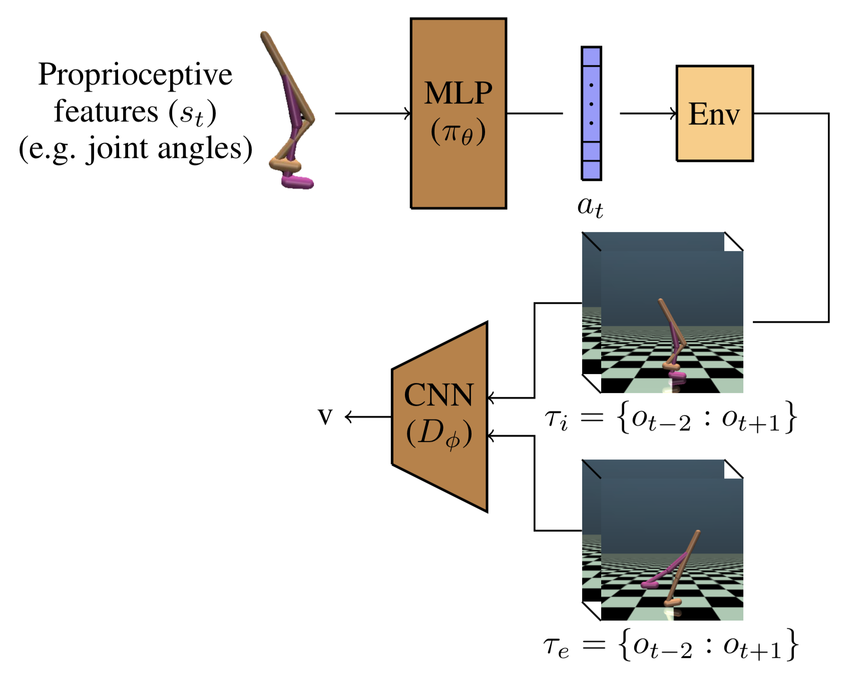
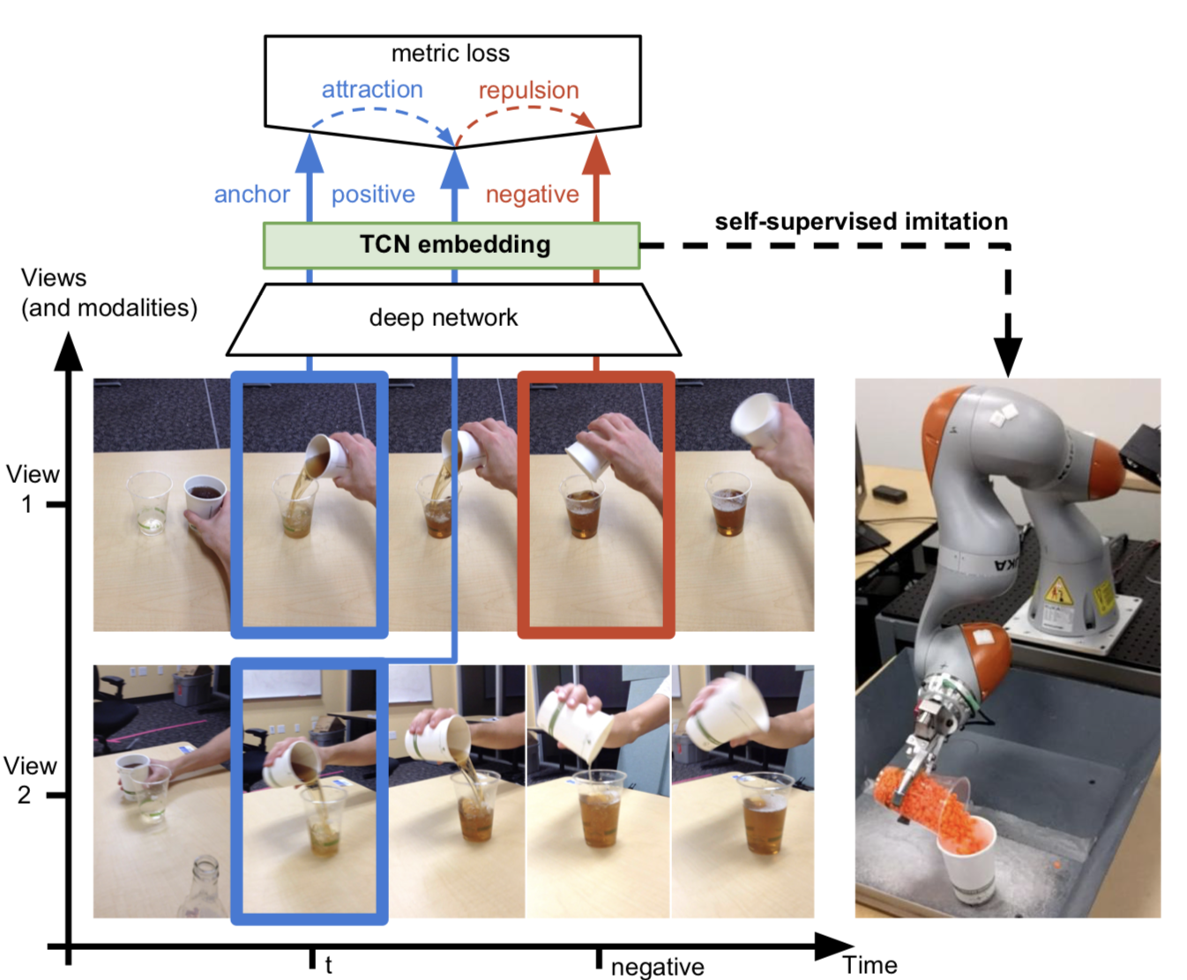
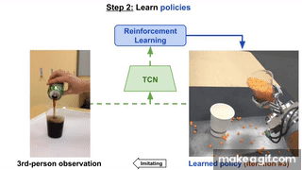
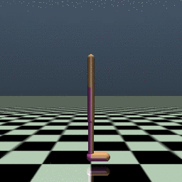
Control
Model-free
Learn the imitation policy without learning any models
Adversarial Methods
Reward Engineering
Demonstration
Learned Policy
Torabi, Faraz, Garrett Warnell, and Peter Stone. "Imitation Learning from Video by Leveraging Proprioception." Proceedings of the 28th International Joint Conference on Artificial Intelligence. AAAI Press, 2019.
Sermanet, Pierre, et al. "Time-contrastive networks: Self-supervised learning from video." 2018 IEEE International Conference on Robotics and Automation (ICRA). IEEE, 2018.

Slide 12
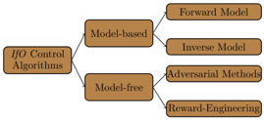
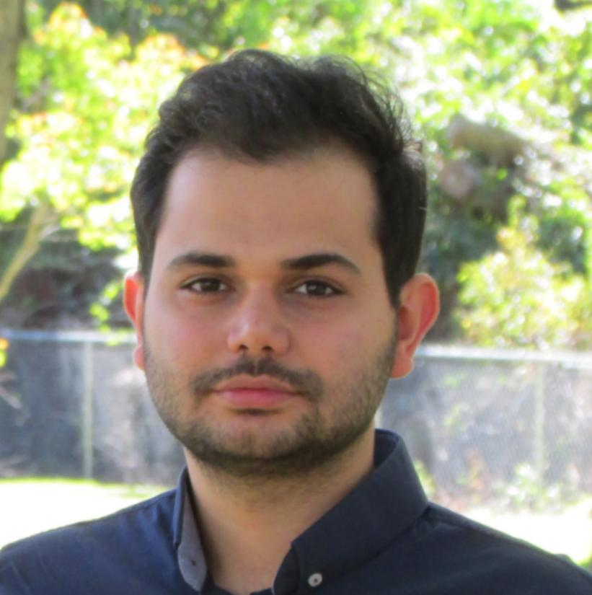
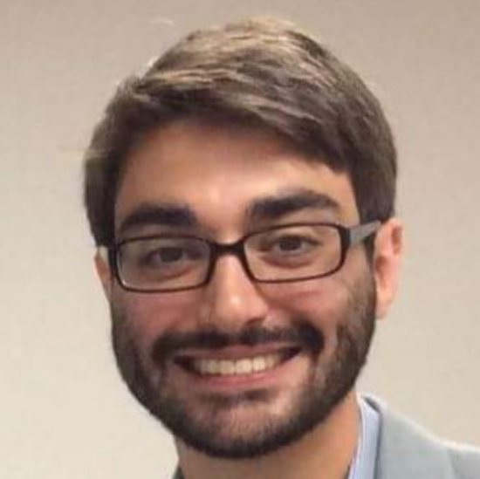
Summary
We surveyed and organized work that addresses the problem of Imitation from Observation.
Methods are being developed to address the two most important challenges in IfO:
Perception
Control
Collaborators
Faraz Torabi
Garrett Warnell

