Slide 1
Implementing Strassen-like Fast Matrix Multiplication Algorithms with BLIS
STRASSEN
Jianyu Huang, Leslie Rice
Joint work with Tyler M. Smith, Greg M. Henry, Robert A. van de Geijn
BLIS Retreat 2016

Slide 2
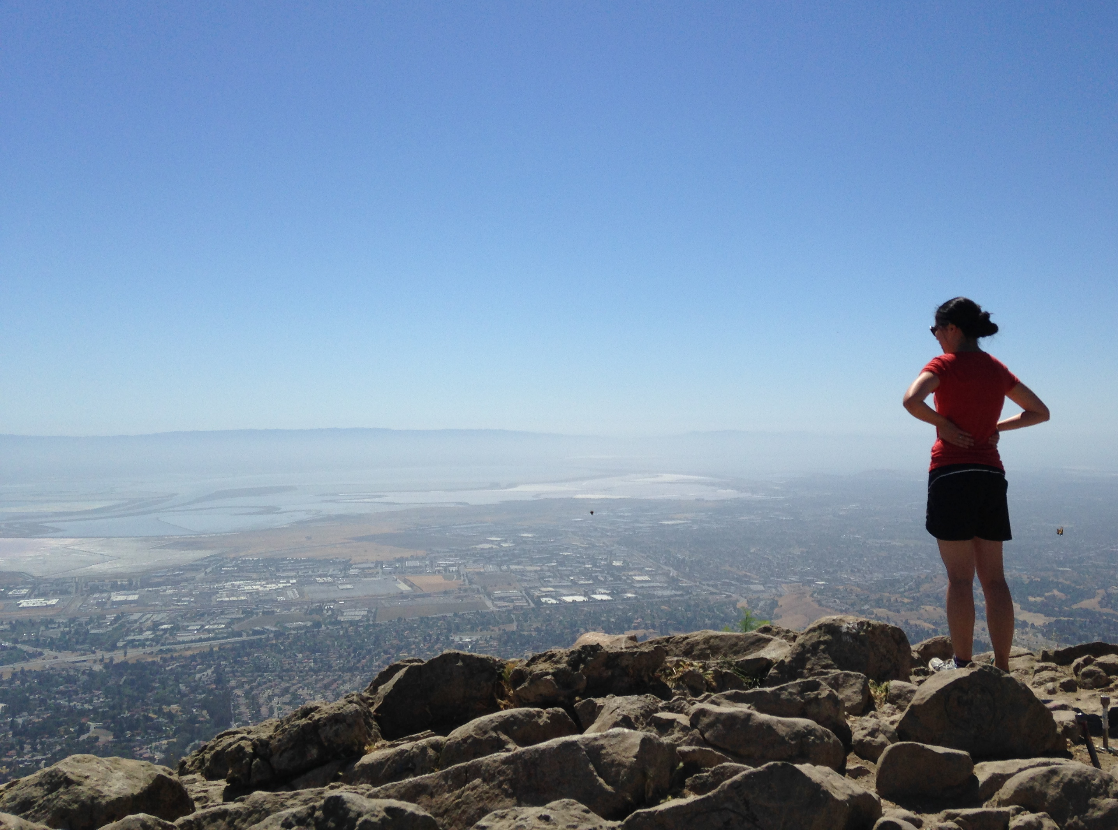
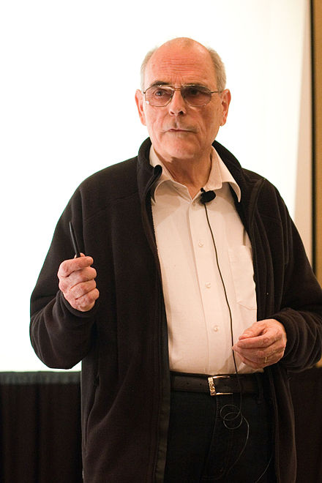
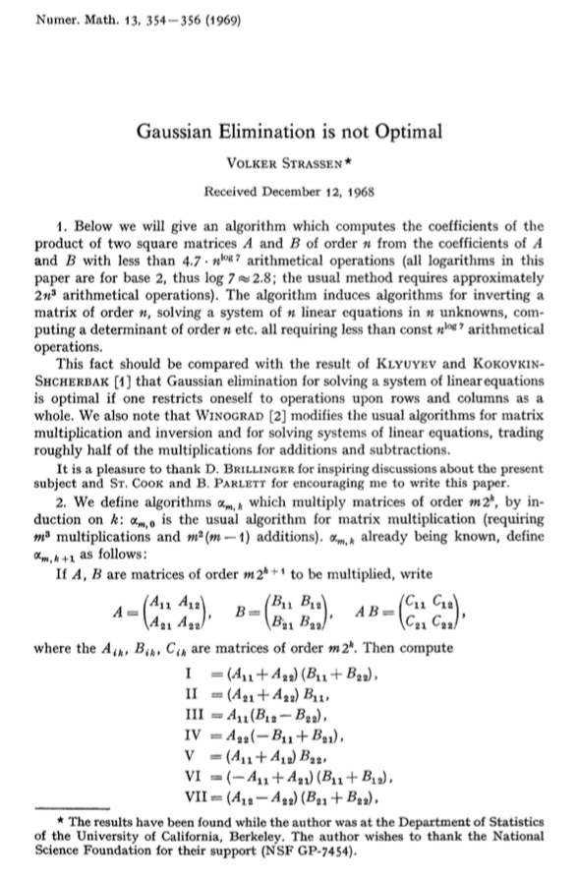
*Overlook of the Bay Area. Photo taken in Mission Peak Regional Preserve, Fremont, CA. Summer 2014.
STRASSEN, from 30,000 feet
Volker Strassen
(Born in 1936, aged 80)
Original Strassen Paper (1969)

Slide 3
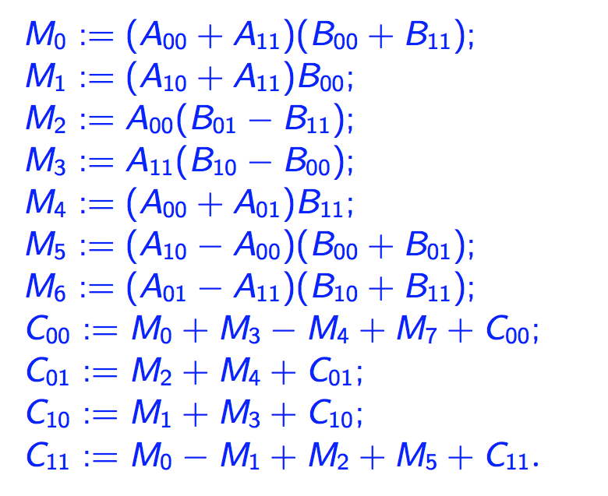
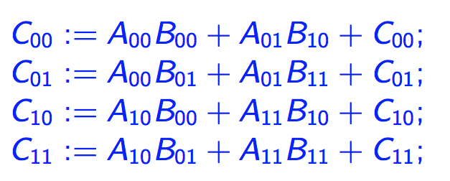
One-level Strassen’s Algorithm (In theory)
Direct Computation
Strassen’s Algorithm
8 multiplications, 8 additions
7 multiplications, 22 additions
*Strassen, Volker. "Gaussian elimination is not optimal." Numerische Mathematik 13, no. 4 (1969): 354-356.

Slide 4
Multi-level Strassen’s Algorithm (In theory)
M₀ := (A₀₀+A₁₁)(B₀₀+B₁₁);
M₁ := (A₁₀+A₁₁)B₀₀;
M₂ := A₀₀(B₀₁–B₁₁);
M₃ := A₁₁(B₁₀–B₀₀);
M₄ := (A₀₀+A₀₁)B₁₁;
M₅ := (A₁₀–A₀₀)(B₀₀+B₀₁);
M₆ := (A₀₁–A₁₁)(B₁₀+B₁₁);
C₀₀ += M₀ + M₃ – M₄ + M₆
C₀₁ += M₂ + M₄
C₁₀ += M₁ + M₃
C₁₁ += M₀ – M₁ + M₂ + M₅
One-level Strassen (1+14.3% speedup)
8 multiplications → 7 multiplications ;
Two-level Strassen (1+30.6% speedup)
64 multiplications → 49 multiplications;
d-level Strassen (n³/n^{2.803} speedup)
8^{d} multiplications → 7^{d} multiplications;

Slide 5
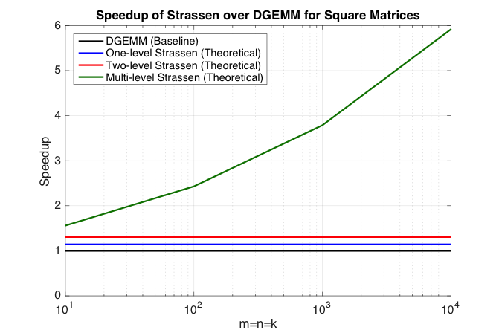
Multi-level Strassen’s Algorithm (In theory)
M₀ := (A₀₀+A₁₁)(B₀₀+B₁₁);
M₁ := (A₁₀+A₁₁)B₀₀;
M₂ := A₀₀(B₀₁–B₁₁);
M₃ := A₁₁(B₁₀–B₀₀);
M₄ := (A₀₀+A₀₁)B₁₁;
M₅ := (A₁₀–A₀₀)(B₀₀+B₀₁);
M₆ := (A₀₁–A₁₁)(B₁₀+B₁₁);
C₀₀ += M₀ + M₃ – M₄ + M₆
C₀₁ += M₂ + M₄
C₁₀ += M₁ + M₃
C₁₁ += M₀ – M₁ + M₂ + M₅
One-level Strassen (1+14.3% speedup)
8 multiplications → 7 multiplications ;
Two-level Strassen (1+30.6% speedup)
64 multiplications → 49 multiplications;
d-level Strassen (n³/n^{2.803} speedup)
8^{d} multiplications → 7^{d} multiplications;

Slide 6
Strassen’s Algorithm (In practice)
M₀ := (A₀₀+A₁₁)(B₀₀+B₁₁);
M₁ := (A₁₀+A₁₁)B₀₀;
M₂ := A₀₀(B₀₁–B₁₁);
M₃ := A₁₁(B₁₀–B₀₀);
M₄ := (A₀₀+A₀₁)B₁₁;
M₅ := (A₁₀–A₀₀)(B₀₀+B₀₁);
M₆ := (A₀₁–A₁₁)(B₁₀+B₁₁);
C₀₀ += M₀ + M₃ – M₄ + M₆
C₀₁ += M₂ + M₄
C₁₀ += M₁ + M₃
C₁₁ += M₀ – M₁ + M₂ + M₅

Slide 7
Strassen’s Algorithm (In practice)
T₀
T₁
M₀ := (A₀₀+A₁₁)(B₀₀+B₁₁);
M₁ := (A₁₀+A₁₁)B₀₀;
M₂ := A₀₀(B₀₁–B₁₁);
M₃ := A₁₁(B₁₀–B₀₀);
M₄ := (A₀₀+A₀₁)B₁₁;
M₅ := (A₁₀–A₀₀)(B₀₀+B₀₁);
M₆ := (A₀₁–A₁₁)(B₁₀+B₁₁);
C₀₀ += M₀ + M₃ – M₄ + M₆
C₀₁ += M₂ + M₄
C₁₀ += M₁ + M₃
C₁₁ += M₀ – M₁ + M₂ + M₅
T₂
One-level Strassen (1+14.3% speedup)
7 multiplications + 22 additions;
Two-level Strassen (1+30.6% speedup)
49 multiplications + 344 additions;
d-level Strassen (n³/n^{2.803} speedup)
Numerical unstable; Not achievable
T₃
T₄
T₅
T₆
T₇
T₈
T₉

Slide 8
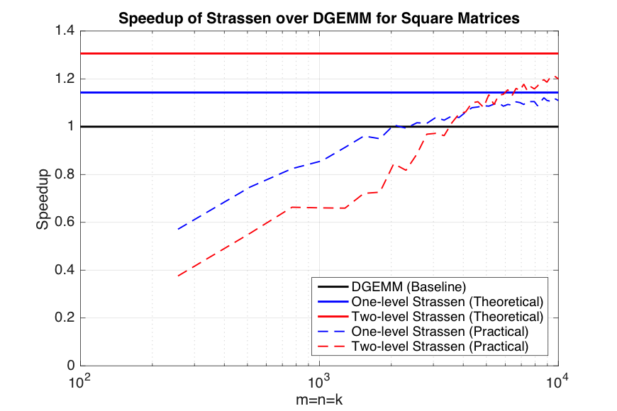
Strassen’s Algorithm (In practice)
T₀
T₁
M₀ := (A₀₀+A₁₁)(B₀₀+B₁₁);
M₁ := (A₁₀+A₁₁)B₀₀;
M₂ := A₀₀(B₀₁–B₁₁);
M₃ := A₁₁(B₁₀–B₀₀);
M₄ := (A₀₀+A₀₁)B₁₁;
M₅ := (A₁₀–A₀₀)(B₀₀+B₀₁);
M₆ := (A₀₁–A₁₁)(B₁₀+B₁₁);
C₀₀ += M₀ + M₃ – M₄ + M₆
C₀₁ += M₂ + M₄
C₁₀ += M₁ + M₃
C₁₁ += M₀ – M₁ + M₂ + M₅
T₂
One-level Strassen (1+14.3% speedup)
7 multiplications + 22 additions;
Two-level Strassen (1+30.6% speedup)
49 multiplications + 344 additions;
d-level Strassen (n³/n^{2.803} speedup)
Numerical unstable; Not achievable
T₃
T₄
T₅
T₆
T₇
T₈
T₉

Slide 9
To achieve practical high performance
of Strassen’s algorithm…...
Conventional Implementations
Our Implementations
Matrix Size
Must be large
Matrix Shape
Must be square
No Additional
Workspace
Parallelism

Slide 10
To achieve practical high performance
of Strassen’s algorithm…...
Conventional Implementations
Our Implementations
Matrix Size
Must be large
Matrix Shape
Must be square
No Additional
Workspace
Parallelism
Usually task parallelism

Slide 11
To achieve practical high performance
of Strassen’s algorithm…...
Conventional Implementations
Our Implementations
Matrix Size
Must be large
Matrix Shape
Must be square
No Additional
Workspace
Parallelism
Usually task parallelism
Can be data parallelism

Slide 12
Outline
Review of State-of-the-art GEMM in BLIS
Strassen’s Algorithm Reloaded
Theoretical Model and Practical Performance
Extension to Other BLAS-3 Operation
Extension to Other Fast Matrix Multiplication
Conclusion

Slide 13
Level-3 BLAS Matrix-Matrix Multiplication (GEMM)
(General) matrix-matrix multiplication (GEMM) is supported in the level-3 BLAS* interface as
Ignoring transa and transb, GEMM computes
We consider the simplified version of GEMM
*Dongarra, Jack J., et al. "A set of level 3 basic linear algebra subprograms."ACM Transactions on Mathematical Software (TOMS) 16.1 (1990): 1-17.

Slide 14
State-of-the-art GEMM in BLIS
BLAS-like Library Instantiation Software (BLIS) is a portable framework for instantiating BLAS-like dense linear algebra libraries.
BLIS provides a refactoring of GotoBLAS algorithm (best-known approach) to implement GEMM.
GEMM implementation in BLIS has 6-layers of loops. The outer 5 loops are written in C. The inner-most loop (micro-kernel) is written in assembly for high performance.
Partition matrices into smaller blocks to fit into the different memory hierarchy.
The order of these loops is designed to utilize the cache reuse rate.
BLIS opens the black box of GEMM, leading to many applications built on BLIS.
Field Van Zee, and Robert van de Geijn. “BLIS: A Framework for Rapidly Instantiating BLAS Functionality." ACM TOMS 41.3 (2015): 14.
Kazushige Goto, and Robert van de Geijn. "High-performance implementation of the level-3 BLAS." ACM TOMS 35.1 (2008): 4.
Kazushige Goto, and Robert van de Geijn. "Anatomy of high-performance matrix multiplication." ACM TOMS 34.3 (2008): 12.
Chenhan D. Yu, *Jianyu Huang, Woody Austin, Bo Xiao, and George Biros. "Performance optimization for the k-nearest neighbors kernel on x86 architectures." In SC’15, p. 7. ACM, 2015.
*Jianyu Huang, Tyler Smith, Greg Henry, and Robert van de Geijn. “Strassen’s Algorithm Reloaded.” In submission to SC’16.
Devin Matthews, Field Van Zee, and Robert van de Geijn. “High-Performance Tensor Contraction without BLAS.” In submission to SC’16

Slide 15
State-of-the-art GEMM in BLIS
BLAS-like Library Instantiation Software (BLIS) is a portable framework for instantiating BLAS-like dense linear algebra libraries.
BLIS provides a refactoring of GotoBLAS algorithm (best-known approach) to implement GEMM.
GEMM implementation in BLIS has 6-layers of loops. The outer 5 loops are written in C. The inner-most loop (micro-kernel) is written in assembly for high performance.
Partition matrices into smaller blocks to fit into the different memory hierarchy.
The order of these loops is designed to utilize the cache reuse rate.
BLIS opens the black box of GEMM, leading to many applications built on BLIS.
Field Van Zee, and Robert van de Geijn. “BLIS: A Framework for Rapidly Instantiating BLAS Functionality." ACM TOMS 41.3 (2015): 14.
Kazushige Goto, and Robert van de Geijn. "High-performance implementation of the level-3 BLAS." ACM TOMS 35.1 (2008): 4.
Kazushige Goto, and Robert van de Geijn. "Anatomy of high-performance matrix multiplication." ACM TOMS 34.3 (2008): 12.
Chenhan D. Yu, Jianyu Huang, Woody Austin, Bo Xiao, and George Biros. "Performance Optimization for the k-Nearest Neighbors Kernel on x86 Architectures." In SC’15.
Jianyu Huang, Tyler Smith, Greg Henry, and Robert van de Geijn. “Strassen’s Algorithm Reloaded.” To appear in SC’16.
Devin Matthews. “High-Performance Tensor Contraction without BLAS.”, arXiv:1607.00291
Paul Springer, Paolo Bientinesi. “Design of a High-performance GEMM-like Tensor-Tensor Multiplication”, arXiv:1607.00145

Slide 16
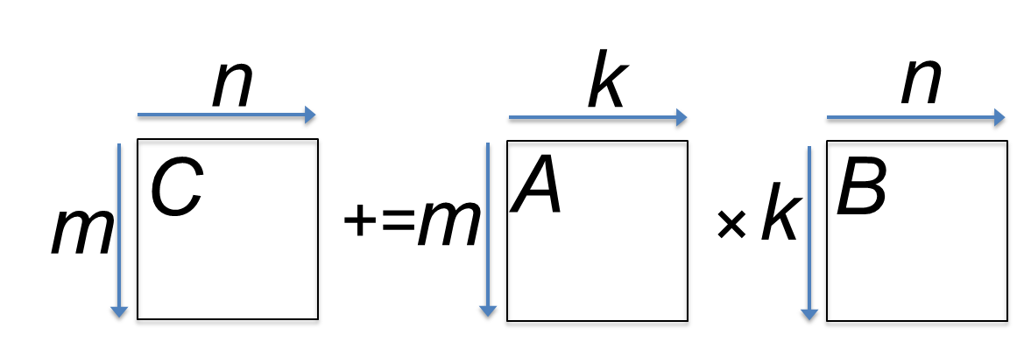
GotoBLAS algorithm for GEMM in BLIS
*Field G. Van Zee, and Tyler M. Smith. “Implementing high-performance complex matrix multiplication." In ACM Transactions on Mathematical Software (TOMS), accepted pending modifications.

Slide 17
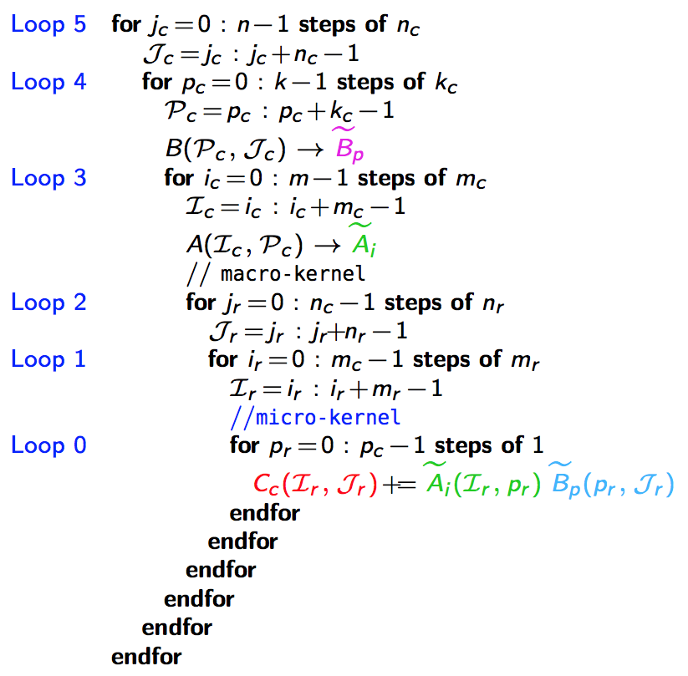
n_{C}
5th loop around micro-kernel
n_{C}
GotoBLAS algorithm for GEMM in BLIS
C_{j}
A
B_{j}
n_{C}
+=
n_{C}
main memory
*Field G. Van Zee, and Tyler M. Smith. “Implementing high-performance complex matrix multiplication." In ACM Transactions on Mathematical Software (TOMS), accepted pending modifications.

Slide 18
n_{C}
5th loop around micro-kernel
n_{C}
GotoBLAS algorithm for GEMM in BLIS
C_{j}
A
B_{j}
n_{C}
+=
n_{C}
4th loop around micro-kernel
C_{j}
A_{p}
k_{C}
B_{p}
+=
k_{C}
~
Pack B_{p} → B_{p}
~
B_{p}
main memory
L3 cache
*Field G. Van Zee, and Tyler M. Smith. “Implementing high-performance complex matrix multiplication." In ACM Transactions on Mathematical Software (TOMS), accepted pending modifications.

Slide 19
n_{C}
5th loop around micro-kernel
n_{C}
GotoBLAS algorithm for GEMM in BLIS
C_{j}
A
B_{j}
n_{C}
+=
n_{C}
4th loop around micro-kernel
C_{j}
A_{p}
k_{C}
B_{p}
+=
k_{C}
~
3rd loop around micro-kernel
Pack B_{p} → B_{p}
C_{i}
m_{C}
A_{i}
~
m_{C}
B_{p}
+=
~
Pack A_{i}→ A_{i}
~
A_{i}
m_{R}
k_{C}
main memory
L3 cache
L2 cache
*Field G. Van Zee, and Tyler M. Smith. “Implementing high-performance complex matrix multiplication." In ACM Transactions on Mathematical Software (TOMS), accepted pending modifications.

Slide 20
n_{C}
5th loop around micro-kernel
n_{C}
GotoBLAS algorithm for GEMM in BLIS
C_{j}
A
B_{j}
n_{C}
+=
n_{C}
4th loop around micro-kernel
C_{j}
A_{p}
k_{C}
B_{p}
+=
k_{C}
~
3rd loop around micro-kernel
Pack B_{p} → B_{p}
C_{i}
m_{C}
A_{i}
~
m_{C}
B_{p}
+=
~
Pack A_{i}→ A_{i}
n_{R}
2nd loop around micro-kernel
~
n_{R}
~
A_{i}
B_{p}
C_{i}
m_{R}
+=
k_{C}
main memory
L3 cache
L2 cache
*Field G. Van Zee, and Tyler M. Smith. “Implementing high-performance complex matrix multiplication." In ACM Transactions on Mathematical Software (TOMS), accepted pending modifications.

Slide 21
n_{C}
5th loop around micro-kernel
n_{C}
GotoBLAS algorithm for GEMM in BLIS
C_{j}
A
B_{j}
n_{C}
+=
n_{C}
4th loop around micro-kernel
C_{j}
A_{p}
k_{C}
B_{p}
+=
k_{C}
~
3rd loop around micro-kernel
Pack B_{p} → B_{p}
C_{i}
m_{C}
A_{i}
~
m_{C}
B_{p}
+=
~
Pack A_{i}→ A_{i}
n_{R}
2nd loop around micro-kernel
~
n_{R}
~
A_{i}
B_{p}
C_{i}
m_{R}
+=
k_{C}
1st loop around micro-kernel
n_{R}
m_{R}
+=
Update C_{ij}
k_{C}
main memory
L3 cache
L2 cache
L1 cache
*Field G. Van Zee, and Tyler M. Smith. “Implementing high-performance complex matrix multiplication." In ACM Transactions on Mathematical Software (TOMS), accepted pending modifications.
registers

Slide 22
n_{C}
5th loop around micro-kernel
n_{C}
GotoBLAS algorithm for GEMM in BLIS
C_{j}
A
B_{j}
n_{C}
+=
n_{C}
4th loop around micro-kernel
C_{j}
A_{p}
k_{C}
B_{p}
+=
k_{C}
~
3rd loop around micro-kernel
Pack B_{p} → B_{p}
C_{i}
m_{C}
A_{i}
~
m_{C}
B_{p}
+=
~
Pack A_{i}→ A_{i}
n_{R}
2nd loop around micro-kernel
~
n_{R}
~
A_{i}
B_{p}
C_{i}
m_{R}
+=
k_{C}
1st loop around micro-kernel
n_{R}
m_{R}
+=
Update C_{ij}
k_{C}
micro-kernel
main memory
1
L3 cache
+=
L2 cache
1
L1 cache
*Field G. Van Zee, and Tyler M. Smith. “Implementing high-performance complex matrix multiplication." In ACM Transactions on Mathematical Software (TOMS), accepted pending modifications.
registers

Slide 23
n_{C}
5th loop around micro-kernel
n_{C}
GotoBLAS algorithm for GEMM in BLIS
C_{j}
A
B_{j}
n_{C}
+=
n_{C}
4th loop around micro-kernel
C_{j}
A_{p}
k_{C}
B_{p}
+=
k_{C}
~
3rd loop around micro-kernel
Pack B_{p} → B_{p}
C_{i}
m_{C}
A_{i}
~
m_{C}
B_{p}
+=
~
Pack A_{i}→ A_{i}
n_{R}
2nd loop around micro-kernel
~
n_{R}
~
A_{i}
B_{p}
C_{i}
m_{R}
+=
k_{C}
1st loop around micro-kernel
n_{R}
m_{R}
+=
Update C_{ij}
k_{C}
micro-kernel
main memory
1
L3 cache
+=
L2 cache
1
L1 cache
*Field G. Van Zee, and Tyler M. Smith. “Implementing high-performance complex matrix multiplication." In ACM Transactions on Mathematical Software (TOMS), accepted pending modifications.
registers

Slide 24
Outline
Review of State-of-the-art GEMM in BLIS
Strassen’s Algorithm Reloaded
Theoretical Model and Practical Performance
Extension to Other BLAS-3 Operation
Extension to Other Fast Matrix Multiplication
Conclusion

Slide 25
One-level Strassen’s Algorithm Reloaded
M₀ := α(A₀₀+A₁₁)(B₀₀+B₁₁);
M₁ := α(A₁₀+A₁₁)B₀₀;
M₂ := αA₀₀(B₀₁–B₁₁);
M₃ := αA₁₁(B₁₀–B₀₀);
M₄ := α(A₀₀+A₀₁)B₁₁;
M₅ := α(A₁₀–A₀₀)(B₀₀+B₀₁);
M₆ := α(A₀₁–A₁₁)(B₁₀+B₁₁);
C₀₀ += M₀ + M₃ – M₄ + M₆
C₀₁ += M₂ + M₄
C₁₀ += M₁ + M₃
C₁₁ += M₀ – M₁ + M₂ + M₅
M₀ := α(A₀₀+A₁₁)(B₀₀+B₁₁); C₀₀ += M₀; C₁₁ += M₀;
M₁ := α(A₁₀+A₁₁)B₀₀; C₁₀ += M₁; C₁₁ –= M₁;
M₂ := αA₀₀(B₀₁–B₁₁); C₀₁ += M₂; C₁₁ += M₂;
M₃ := αA₁₁(B₁₀–B₀₀); C₀₀ += M₃; C₁₀ += M₃;
M₄ := α(A₀₀+A₀₁)B₁₁; C₀₁ += M₄; C₀₀ –= M₄;
M₅ := α(A₁₀–A₀₀)(B₀₀+B₀₁); C₁₁ += M₅;
M₆ := α(A₀₁–A₁₁)(B₁₀+B₁₁); C₀₀ += M₆;
M := α(X+Y)(V+W); C +=M; D +=M;
General operation for one-level Strassen:
M := α(X+δY)(V+εW); C += γ₀M; D += γ₁M;
γ₀, γ₁,δ,ε ∈ {-1, 0, 1}.

Slide 26
High-performance implementation of the general operation?
M := α(X+δY)(V+εW); C += γ₀M; D += γ₁M;
γ₀, γ₁,δ,ε ∈ {-1, 0, 1}.
*http://shpc.ices.utexas.edu/index.html

Slide 27
M := α(X+δY)(V+εW); C += γ₀M; D += γ₁M;
γ₀, γ₁,δ,ε ∈ {-1, 0, 1}.
*Jianyu Huang, Tyler Smith, Greg Henry, and Robert van de Geijn. “Strassen’s Algorithm Reloaded.” In SC’16.

Slide 28
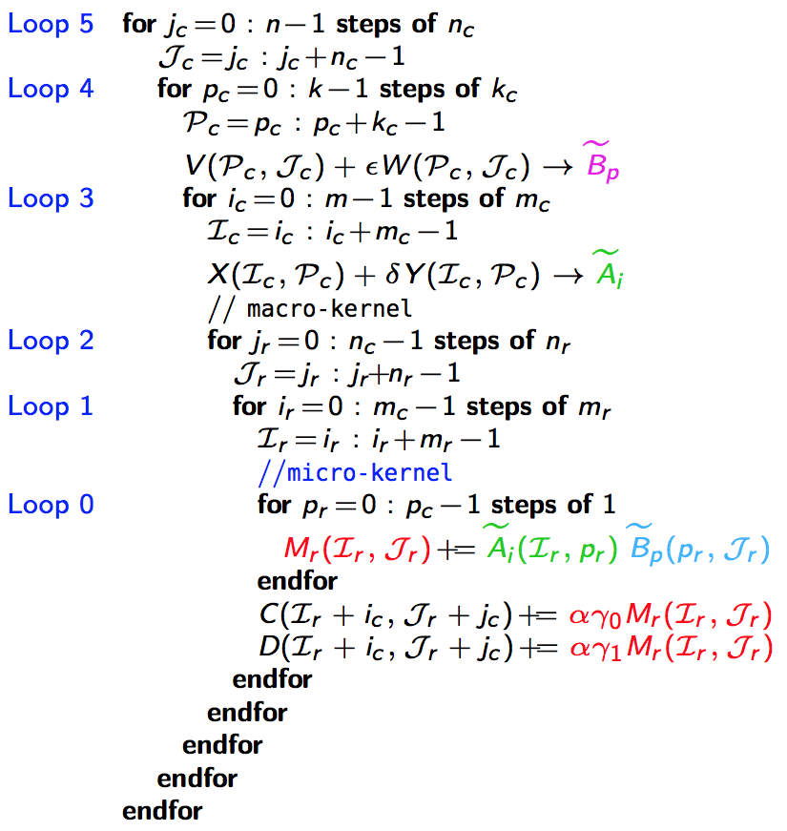
M := α(X+δY)(V+εW); C += γ₀M; D += γ₁M;
γ₀, γ₁,δ,ε ∈ {-1, 0, 1}.
5th loop around micro-kernel
n_{C}
n_{C}
D_{j}
Y
W
n_{C}
n_{C}
C_{j}
+=
X
V_{j}
main memory
*Jianyu Huang, Tyler Smith, Greg Henry, and Robert van de Geijn. “Strassen’s Algorithm Reloaded.” In SC’16.

Slide 29
M := α(X+δY)(V+εW); C += γ₀M; D += γ₁M;
γ₀, γ₁,δ,ε ∈ {-1, 0, 1}.
5th loop around micro-kernel
n_{C}
n_{C}
D_{j}
Y
W
n_{C}
n_{C}
C_{j}
+=
X
V_{j}
4th loop around micro-kernel
D_{j}
Y_{p}
k_{C}
W_{p}
C_{j}
+=
X_{p}
V_{p}
k_{C}
~
Pack V_{p} + εW_{p} → B_{p}
~
B_{p}
main memory
L3 cache
*Jianyu Huang, Tyler Smith, Greg Henry, and Robert van de Geijn. “Strassen’s Algorithm Reloaded.” In SC’16.

Slide 30
M := α(X+δY)(V+εW); C += γ₀M; D += γ₁M;
γ₀, γ₁,δ,ε ∈ {-1, 0, 1}.
5th loop around micro-kernel
n_{C}
n_{C}
D_{j}
Y
W
n_{C}
n_{C}
C_{j}
+=
X
V_{j}
4th loop around micro-kernel
D_{j}
Y_{p}
k_{C}
W_{p}
C_{j}
+=
X_{p}
V_{p}
k_{C}
~
3rd loop around micro-kernel
Pack V_{p} + εW_{p} → B_{p}
D_{i}
m_{C}
Y_{i}
~
C_{i}
X_{i}
B_{p}
m_{C}
+=
~
Pack X_{i} + δY_{i}→ A_{i}
~
A_{i}
m_{R}
k_{C}
main memory
L3 cache
L2 cache
*Jianyu Huang, Tyler Smith, Greg Henry, and Robert van de Geijn. “Strassen’s Algorithm Reloaded.” In SC’16.

Slide 31
M := α(X+δY)(V+εW); C += γ₀M; D += γ₁M;
γ₀, γ₁,δ,ε ∈ {-1, 0, 1}.
5th loop around micro-kernel
n_{C}
n_{C}
D_{j}
Y
W
n_{C}
n_{C}
C_{j}
+=
X
V_{j}
4th loop around micro-kernel
D_{j}
Y_{p}
k_{C}
W_{p}
C_{j}
+=
X_{p}
V_{p}
k_{C}
~
3rd loop around micro-kernel
Pack V_{p} + εW_{p} → B_{p}
D_{i}
m_{C}
Y_{i}
~
C_{i}
X_{i}
B_{p}
m_{C}
+=
~
Pack X_{i} + δY_{i}→ A_{i}
n_{R}
2nd loop around micro-kernel
~
n_{R}
~
A_{i}
B_{p}
D_{i}
m_{R}
+=
C_{i}
k_{C}
n_{R}
1st loop around micro-kernel
m_{R}
+=
Update C_{ij} , D_{ij}
k_{C}
micro-kernel
main memory
1
L3 cache
+=
L2 cache
1
L1 cache
*Jianyu Huang, Tyler Smith, Greg Henry, and Robert van de Geijn. “Strassen’s Algorithm Reloaded.” In SC’16.
registers

Slide 32
M := α(X+δY)(V+εW); C += γ₀M; D += γ₁M;
γ₀, γ₁,δ,ε ∈ {-1, 0, 1}.
5th loop around micro-kernel
n_{C}
n_{C}
D_{j}
Y
W
n_{C}
n_{C}
C_{j}
+=
X
V_{j}
4th loop around micro-kernel
D_{j}
Y_{p}
k_{C}
W_{p}
C_{j}
+=
X_{p}
V_{p}
k_{C}
~
3rd loop around micro-kernel
Pack V_{p} + εW_{p} → B_{p}
D_{i}
m_{C}
Y_{i}
~
C_{i}
X_{i}
B_{p}
m_{C}
+=
~
Pack X_{i} + δY_{i}→ A_{i}
n_{R}
2nd loop around micro-kernel
~
n_{R}
~
A_{i}
B_{p}
D_{i}
m_{R}
+=
C_{i}
k_{C}
n_{R}
1st loop around micro-kernel
m_{R}
+=
Update C_{ij} , D_{ij}
k_{C}
micro-kernel
main memory
1
L3 cache
+=
L2 cache
1
L1 cache
*Jianyu Huang, Tyler Smith, Greg Henry, and Robert van de Geijn. “Strassen’s Algorithm Reloaded.” In SC’16.
registers

Slide 33
n_{C}
5th loop around micro-kernel
n_{C}
n_{C}
5th loop around micro-kernel
n_{C}
C_{j}
A
B
D_{j}
Y
W
n_{C}
n_{C}
n_{C}
n_{C}
+=
C_{j}
+=
X
V_{j}
4th loop around micro-kernel
4th loop around micro-kernel
C_{j}
A_{p}
k_{C}
B_{p}
D_{j}
Y_{p}
k_{C}
W_{p}
+=
C_{j}
+=
X_{p}
V_{p}
k_{C}
k_{C}
~
~
3rd loop around micro-kernel
Pack B_{p} → B_{p}
3rd loop around micro-kernel
Pack V_{p} + εW_{p} → B_{p}
C_{i}
A_{i}
~
D_{i}
m_{C}
Y_{i}
~
m_{C}
m_{C}
B_{p}
C_{i}
X_{i}
B_{p}
m_{C}
+=
+=
~
~
Pack A_{i}→ A_{i}
Pack X_{i} + δY_{i}→ A_{i}
n_{R}
2nd loop around micro-kernel
~
n_{R}
~
n_{R}
2nd loop around micro-kernel
~
n_{R}
~
A_{i}
B_{p}
A_{i}
B_{p}
C_{i}
m_{R}
D_{i}
m_{R}
+=
+=
k_{C}
C_{i}
k_{C}
n_{R}
1st loop around micro-kernel
n_{R}
1st loop around micro-kernel
m_{R}
+=
m_{R}
+=
Update C_{ij}
k_{C}
Update C_{ij} , D_{ij}
k_{C}
micro-kernel
micro-kernel
main memory
1
main memory
1
L3 cache
+=
L3 cache
+=
L2 cache
1
L2 cache
1
L1 cache
L1 cache
registers
registers

Slide 34
Two-level Strassen’s Algorithm Reloaded

Slide 35
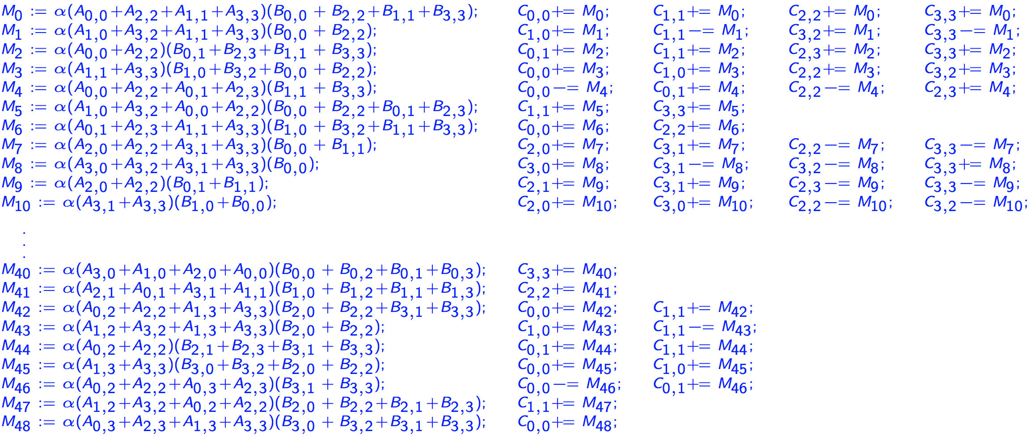
Two-level Strassen’s Algorithm Reloaded (Continue)
M := α(X₀+X₁+X₂+X₃)(V+V₁+V₂+V₃); C₀ += M; C₁ += M; C₂ += M; C₃ += M;
General operation for two-level Strassen:
M := α(X₀+δ₁X₁+δ₂X₂+δ₃X₃)(V+ε₁V₁+ε₂V₂+ε₃V₃); C₀ += γ₀M; C₁ += γ₁M; C₂ += γ₂M; C₃ += γ₃M;
γ_{i},δ_{i},ε_{i} ∈ {-1, 0, 1}.

Slide 36
Additional Levels of Strassen Reloaded
The general operation of one-level Strassen:
The general operation of two-level Strassen:
The general operation needed to integrate k levels of Strassen is given by
M := α(X+δY)(V+εW); C += γ₀M; D += γ₁M;
γ₀, γ₁,δ,ε ∈ {-1, 0, 1}.
M := α(X₀+δ₁X₁+δ₂X₂+δ₃X₃)(V+ε₁V₁+ε₂V₂+ε₃V₃);
C₀ += γ₀M; C₁ += γ₁M; C₂ += γ₂M; C₃ += γ₃M;
γ_{i},δ_{i},ε_{i} ∈ {-1, 0, 1}.

Slide 37
Building blocks
BLIS framework
Adapted to general operation
A routine for packing B_{p} into
C/Intel intrinsics
A routine for packing A_{i} into
C/Intel intrinsics
A micro-kernel for updating an m_{R}×n_{R} submatrix of C.
SIMD assembly (AVX, AVX512, etc)
Integrate the addition of multiple matrices V_{t} into
Integrate the addition of multiple matrices X_{s} into
Integrate the update of multiple submatrices of C.

Slide 38
Variations on a theme
Naïve Strassen
A traditional implementation with temporary buffers.
AB Strassen
Integrate the addition of matrices into and .
ABC Strassen
Integrate the addition of matrices into and .
Integrate the update of multiple submatrices of C in the micro-kernel.

Slide 39
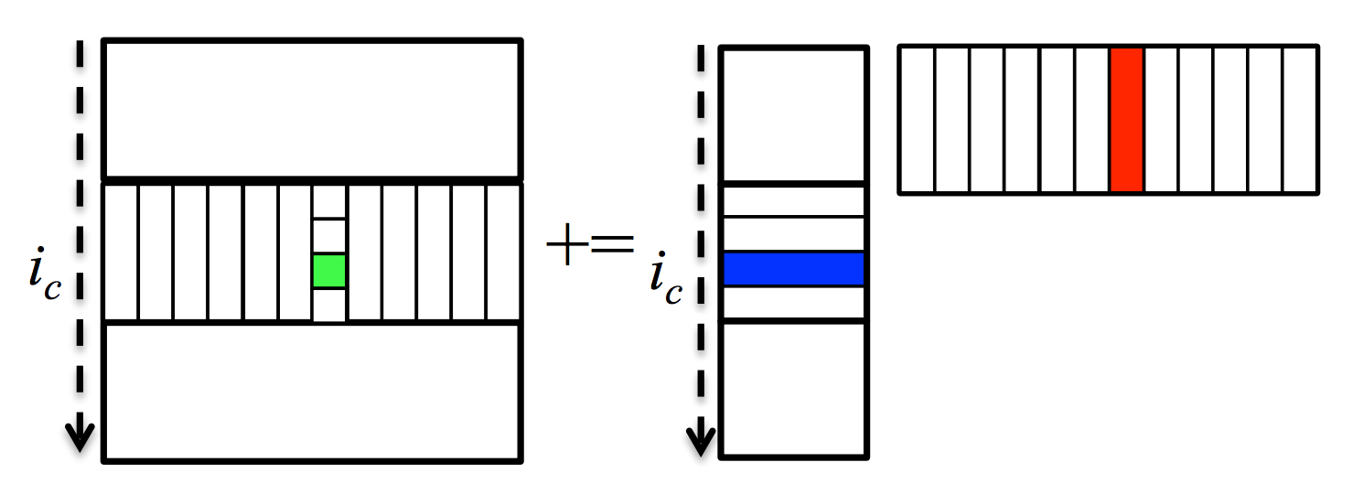
Parallelization
5th loop around micro-kernel
n_{C}
n_{C}
D_{j}
Y
W
n_{C}
n_{C}
C_{j}
+=
X
V_{j}
3rd loop (along m_{C} direction)
2nd loop (along n_{R} direction)
both 3rd and 2nd loop
4th loop around micro-kernel
D_{j}
Y_{p}
k_{C}
W_{p}
C_{j}
+=
X_{p}
V_{p}
k_{C}
~
3rd loop around micro-kernel
Pack V_{p} + εW_{p} → B_{p}
D_{i}
m_{C}
Y_{i}
~
C_{i}
X_{i}
B_{p}
m_{C}
+=
~
Pack X_{i} + δY_{i}→ A_{i}
n_{R}
2nd loop around micro-kernel
~
n_{R}
~
A_{i}
B_{p}
D_{i}
m_{R}
+=
C_{i}
k_{C}
n_{R}
1st loop around micro-kernel
m_{R}
+=
Update C_{ij} , D_{ij}
k_{C}
micro-kernel
main memory
1
L3 cache
+=
*Tyler M. Smith, Robert Van De Geijn, Mikhail Smelyanskiy, Jeff R. Hammond, and Field G. Van Zee. "Anatomy of high-performance many-threaded matrix multiplication." In Parallel and Distributed Processing Symposium, 2014 IEEE 28th International, pp. 1049-1059. IEEE, 2014.
L2 cache
1
L1 cache
registers

Slide 40
Outline
Review of State-of-the-art GEMM in BLIS
Strassen’s Algorithm Reloaded
Theoretical Model and Practical Performance
Extension to Other BLAS-3 Operation
Extension to Other Fast Matrix Multiplication
Conclusion

Slide 41
Performance Model
Performance Metric
Total Time Breakdown
Arithmetic
Operations
Memory
Operations

Slide 42
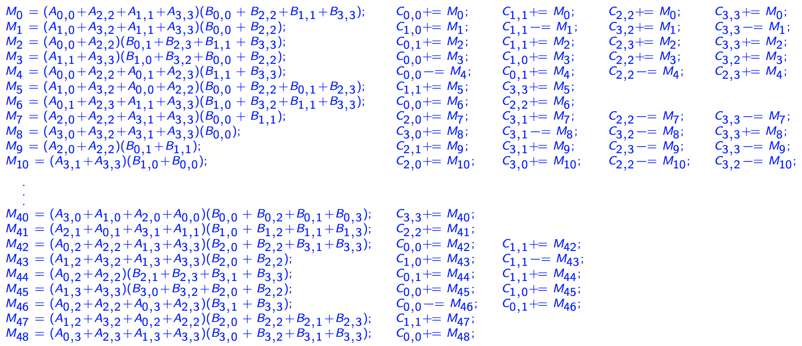
Arithmetic Operations
Submatrix
multiplication
Extra additions with submatrices of A, B, C, respectively
DGEMM
No extra additions
One-level Strassen (ABC, AB, Naïve)
7 submatrix multiplications
5 extra additions of submatrices of A and B
12 extra additions of submatrices of C
Two-level Strassen (ABC, AB, Naïve)
49 submatrix multiplications
95 extra additions of submatrices of A and B
154 extra additions of submatrices of C
M₀ := α(A₀₀+A₁₁)(B₀₀+B₁₁); C₀₀ += M₀; C₁₁ += M₀;
M₁ := α(A₁₀+A₁₁)B₀₀; C₁₀ += M₁; C₁₁ –= M₁;
M₂ := αA₀₀(B₀₁–B₁₁); C₀₁ += M₂; C₁₁ += M₂;
M₃ := αA₁₁(B₁₀–B₀₀); C₀₀ += M₃; C₁₀ += M₃;
M₄ := α(A₀₀+A₀₁)B₁₁; C₀₁ += M₄; C₀₀ –= M₄;
M₅ := α(A₁₀–A₀₀)(B₀₀+B₀₁); C₁₁ += M₅;
M₆ := α(A₀₁–A₁₁)(B₁₀+B₁₁); C₀₀ += M₆;

Slide 43
Memory Operations
DGEMM
One-level
ABC Strassen
AB Strassen
Naïve Strassen
Two-level
ABC Strassen
AB Strassen
Naïve Strassen

Slide 44
Modeled and Actual Performance on Single Core

Slide 45
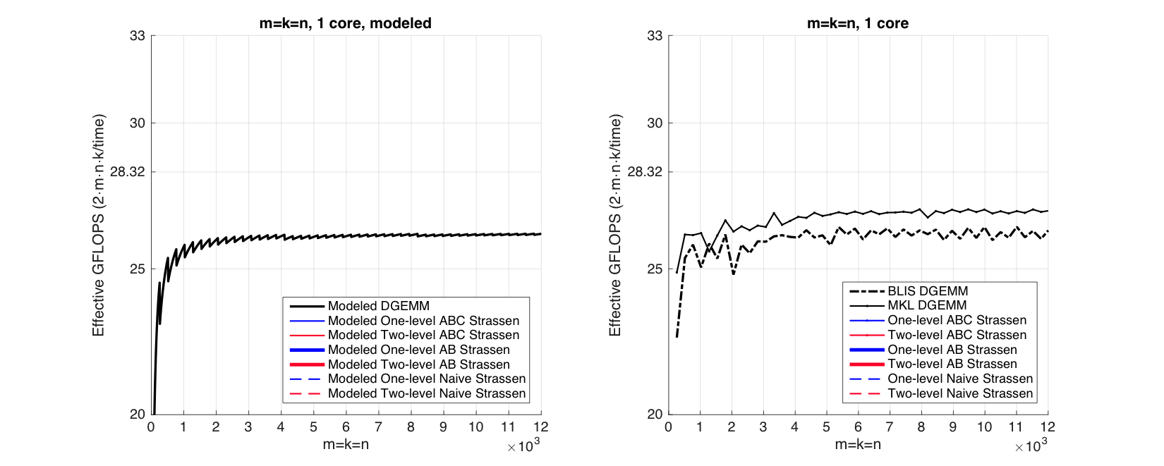
Observation (Square Matrices)
Modeled Performance
Actual Performance

Slide 46
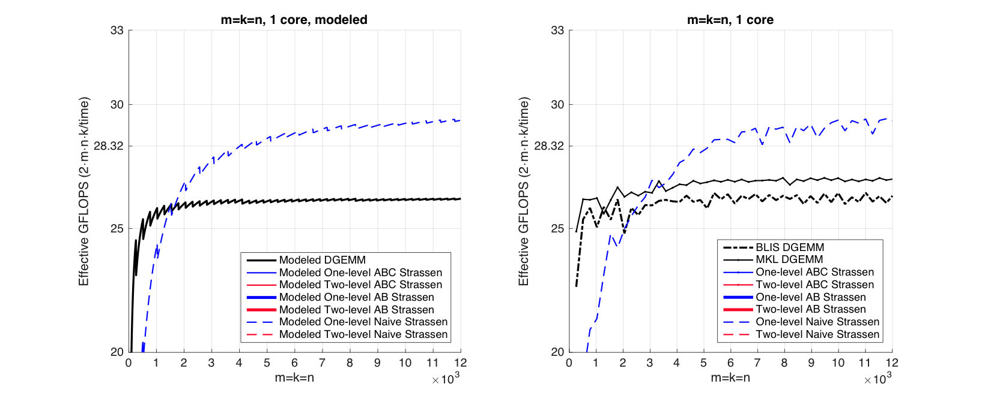
Observation (Square Matrices)
Modeled Performance
Actual Performance

Slide 47
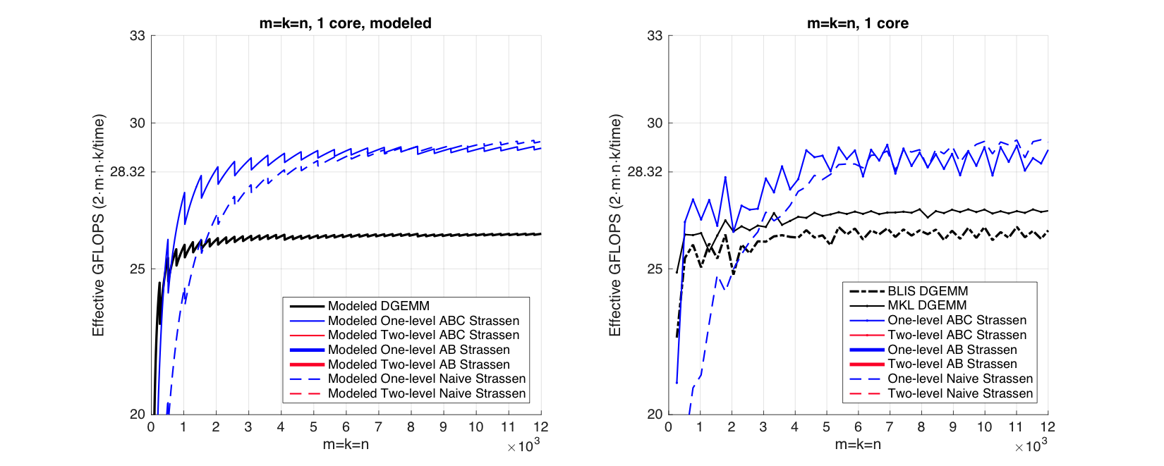
Observation (Square Matrices)
Modeled Performance
Actual Performance

Slide 48
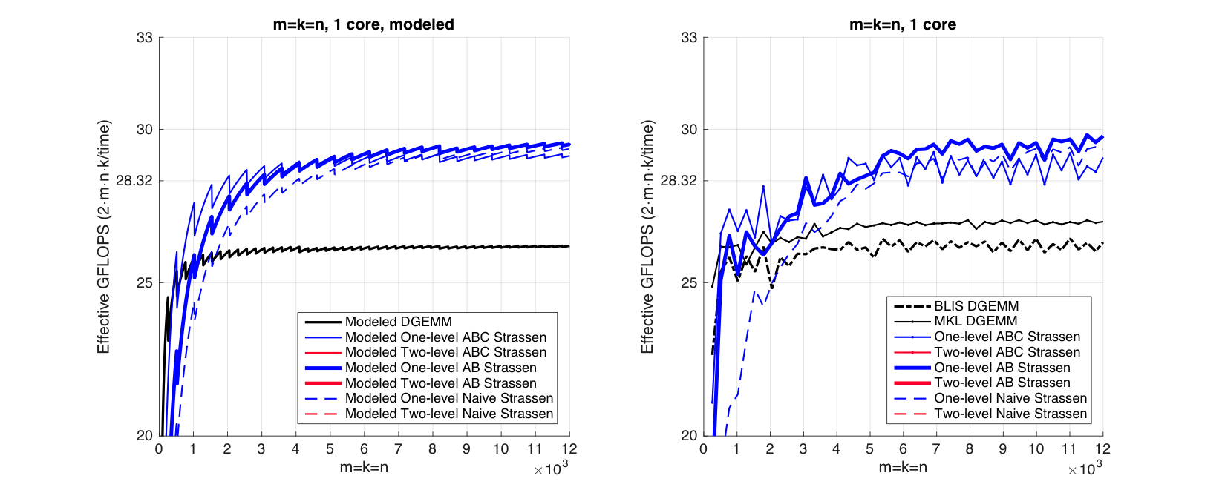
Observation (Square Matrices)
Modeled Performance
Actual Performance

Slide 49
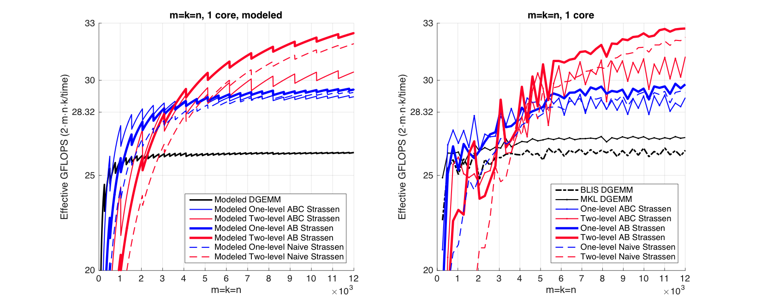
Observation (Square Matrices)
Modeled Performance
Actual Performance

Slide 50
Observation (Square Matrices)
Modeled Performance
Actual Performance
26.0%
13.1%
Theoretical Speedup over DGEMM
One-level Strassen (1+14.3% speedup)
8 multiplications → 7 multiplications;
Two-level Strassen (1+30.6% speedup)
64 multiplications → 49 multiplications;
Notes:
Practical speedup of 1-level and 2-level Strassen.
Recall theoretical speedup

Slide 51
Observation (Square Matrices)
Both one-level and two-level
For small square matrices, ABC Strassen outperforms AB Strassen
For larger square matrices, this trend reverses
Reason
ABC Strassen avoids storing M (M resides in the register)
ABC Strassen increases the number of times for updating submatrices of C

Slide 52
n_{C}
5th loop around micro-kernel
n_{C}
n_{C}
5th loop around micro-kernel
n_{C}
C_{j}
A
B
D_{j}
Y
W
n_{C}
n_{C}
n_{C}
n_{C}
+=
C_{j}
+=
X
V_{j}
4th loop around micro-kernel
4th loop around micro-kernel
C_{j}
A_{p}
k_{C}
B_{p}
D_{j}
Y_{p}
k_{C}
W_{p}
+=
C_{j}
+=
X_{p}
V_{p}
k_{C}
k_{C}
~
~
3rd loop around micro-kernel
Pack B_{p} → B_{p}
3rd loop around micro-kernel
Pack V_{p} + εW_{p} → B_{p}
C_{i}
A_{i}
~
D_{i}
m_{C}
Y_{i}
~
m_{C}
m_{C}
B_{p}
C_{i}
X_{i}
B_{p}
m_{C}
+=
+=
~
~
Pack A_{i}→ A_{i}
Pack X_{i} + δY_{i}→ A_{i}
n_{R}
2nd loop around micro-kernel
~
n_{R}
~
n_{R}
2nd loop around micro-kernel
~
n_{R}
~
A_{i}
B_{p}
A_{i}
B_{p}
C_{i}
m_{R}
D_{i}
m_{R}
+=
+=
k_{C}
C_{i}
k_{C}
n_{R}
1st loop around micro-kernel
n_{R}
1st loop around micro-kernel
m_{R}
+=
m_{R}
+=
Update C_{ij}
k_{C}
Update C_{ij} , D_{ij}
k_{C}
micro-kernel
micro-kernel
main memory
1
main memory
1
L3 cache
+=
L3 cache
+=
L2 cache
1
L2 cache
1
L1 cache
L1 cache
registers
registers

Slide 53
Observation (Square Matrices)
Both one-level and two-level
For small square matrices, ABC Strassen outperforms AB Strassen
For larger square matrices, this trend reverses
Reason
ABC Strassen avoids storing M (M resides in the register)
ABC Strassen increases the number of times for updating submatrices of C

Slide 54
Observation (Rank-k Update)
What is Rank-k update?
n
k
n
m
m

Slide 55
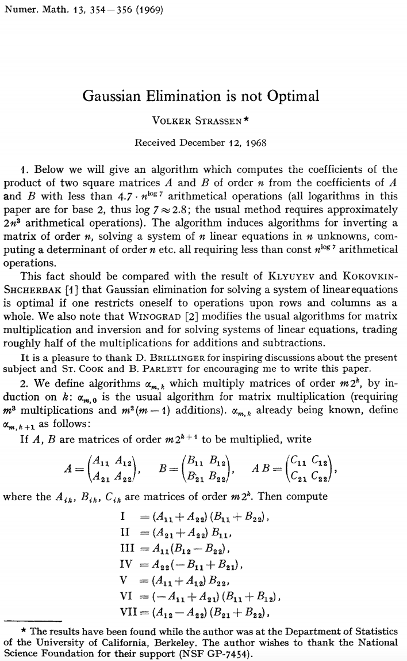
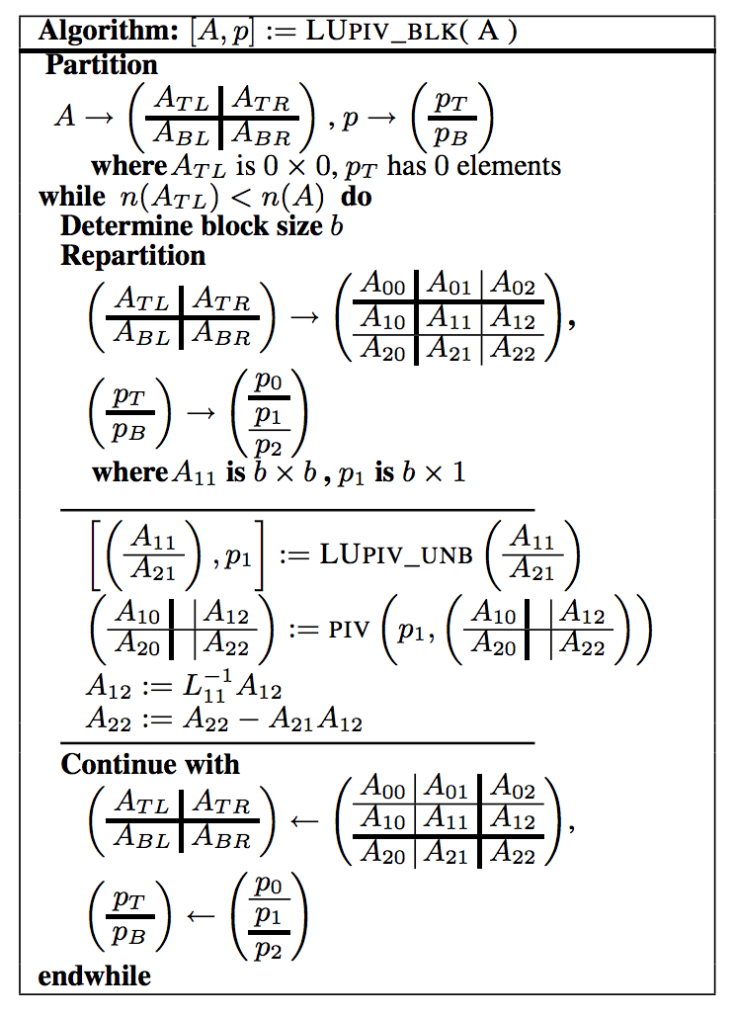
Observation (Rank-k Update)
Importance of Rank-k update
Blocked LU with partial pivoting (getrf)
A₁₂
A₂₁
A₂₂

Slide 56
Observation (Rank-k Update)
Importance of Rank-k update
A₁₂
+=
×
A₂₂
A₂₁

Slide 57
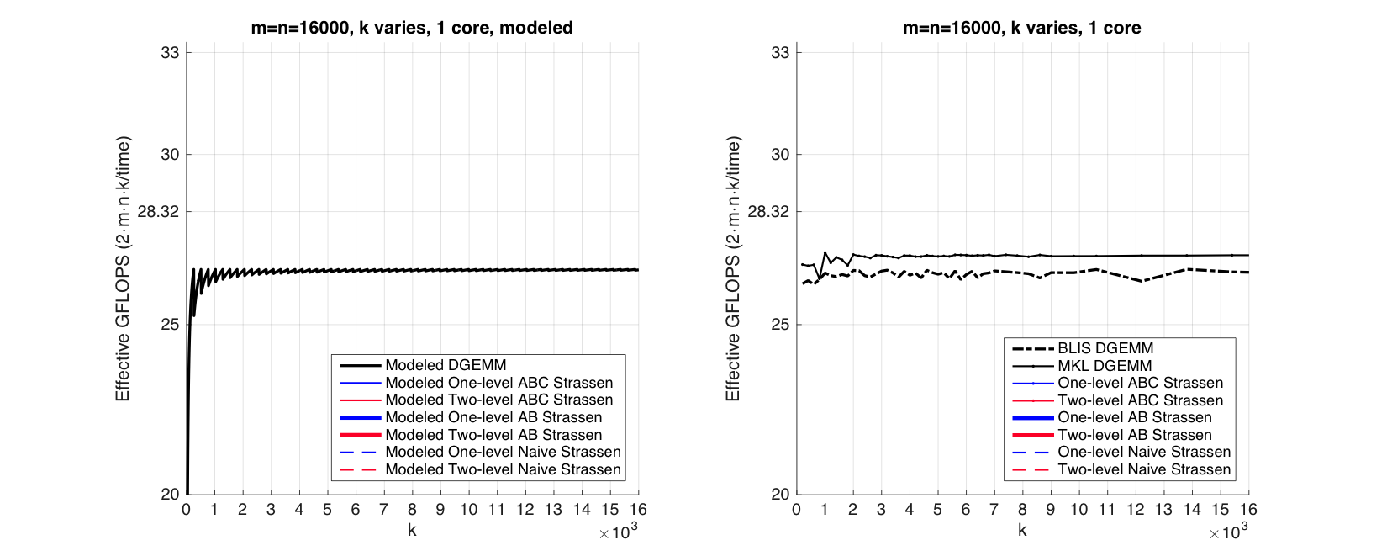
Observation (Rank-k Update)
Modeled Performance
Actual Performance

Slide 58
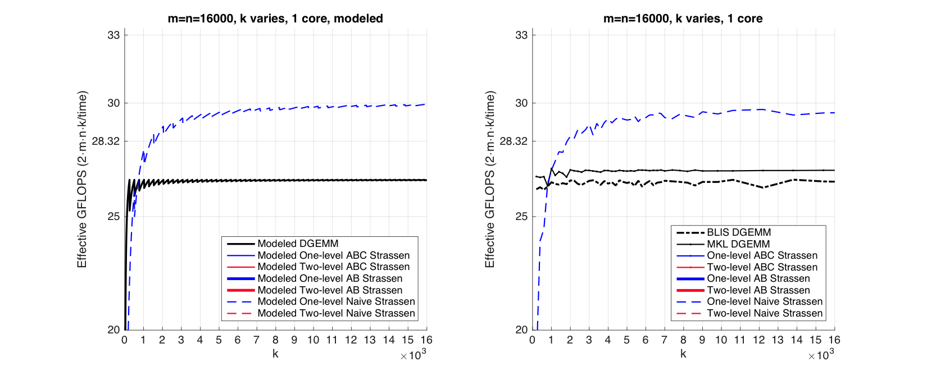
Observation (Rank-k Update)
Modeled Performance
Actual Performance

Slide 59
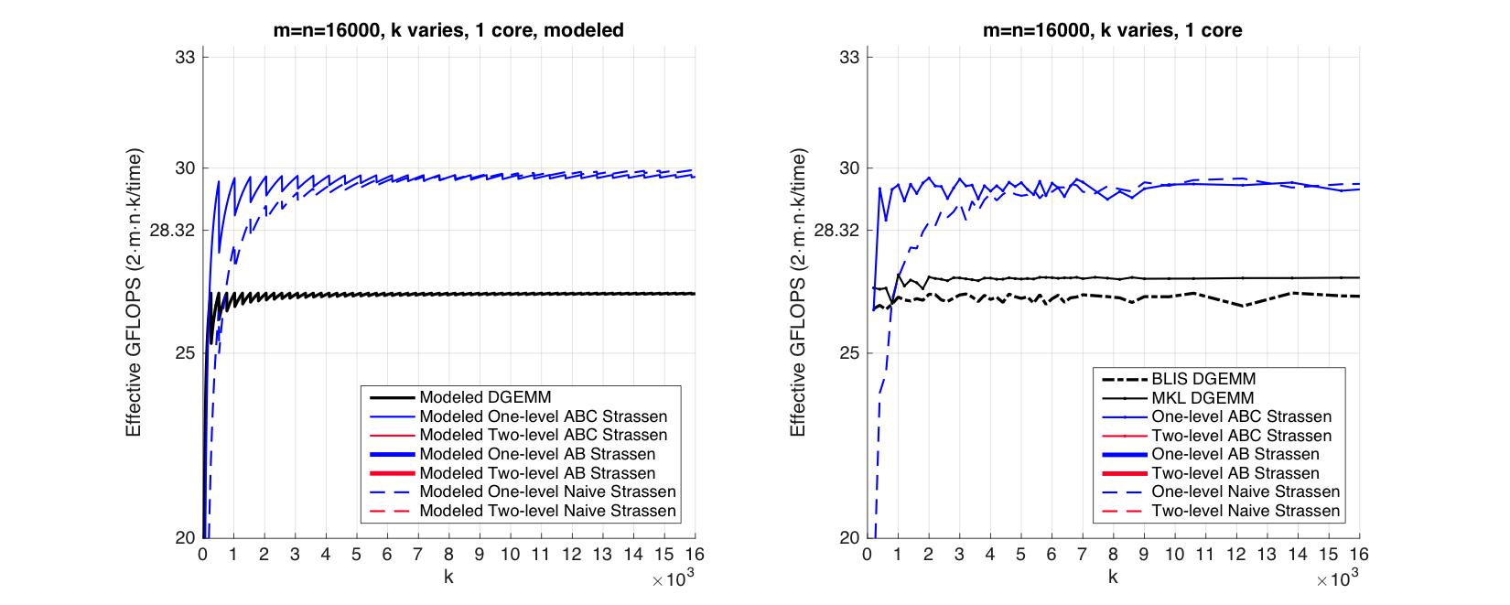
Observation (Rank-k Update)
Modeled Performance
Actual Performance

Slide 60
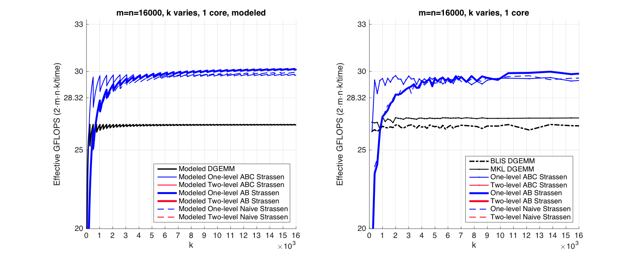
Observation (Rank-k Update)
Modeled Performance
Actual Performance

Slide 61
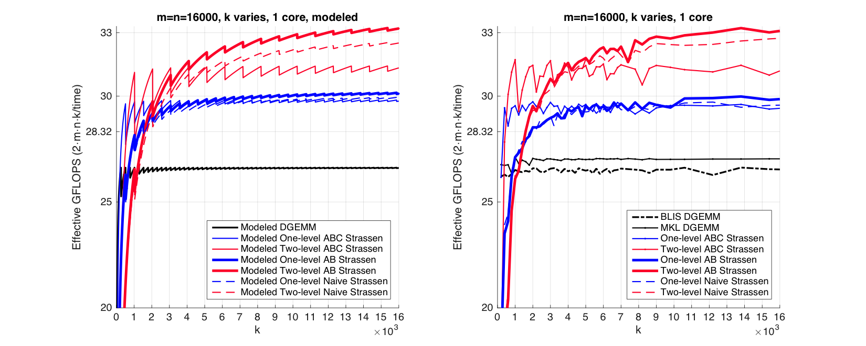
Observation (Rank-k Update)
Modeled Performance
Actual Performance

Slide 62
Observation (Rank-k Update)
Modeled Performance
Actual Performance
Reason:
ABC Strassen avoids forming the temporary matrix M explicitly in the memory (M resides in register), especially important when m, n >> k.

Slide 63
Single Node Experiment

Slide 64
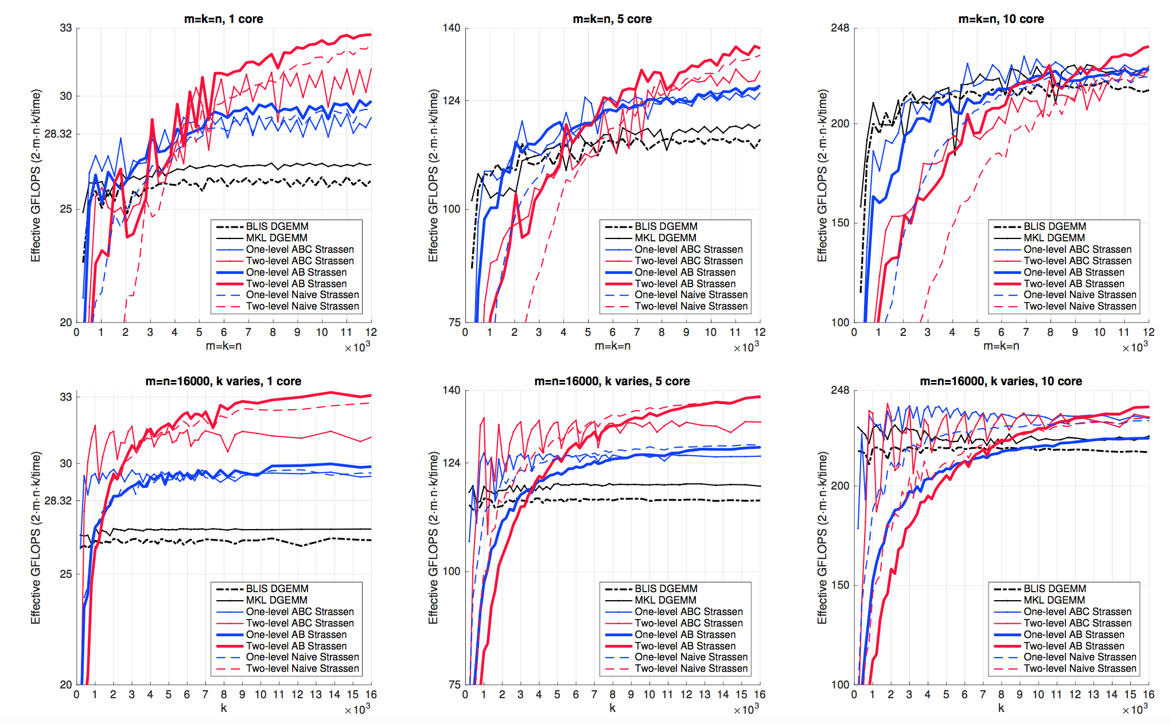
1 core
5 core
10 core
Square Matrices
Rank-k Update

Slide 65
Many-core Experiment

Slide 66
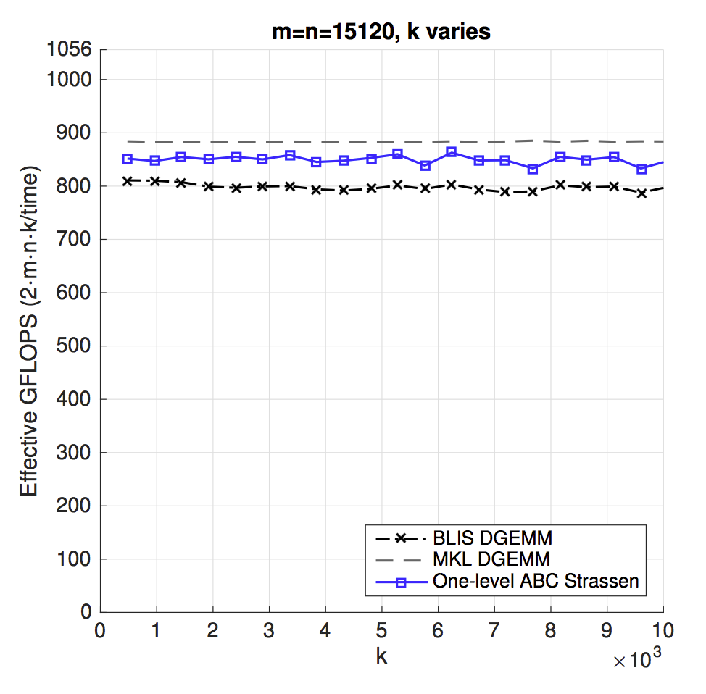
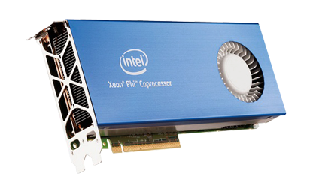
Intel® Xeon Phi™ coprocessor (KNC)

Slide 67
Distributed Memory Experiment

Slide 71
Outline
Review of State-of-the-art GEMM in BLIS
Strassen’s Algorithm Reloaded
Theoretical Model and Practical Performance
Extension to Other BLAS-3 Operation
Extension to Other Fast Matrix Multiplication
Conclusion

Slide 72
Level-3 BLAS Symmetric Matrix-Matrix Multiplication (SYMM)
Symmetric matrix-matrix multiplication (SYMM) is supported in the level-3 BLAS* interface as
SYMM computes
*Dongarra, Jack J., et al. "A set of level 3 basic linear algebra subprograms."ACM Transactions on Mathematical Software (TOMS) 16.1 (1990): 1-17.

Slide 73
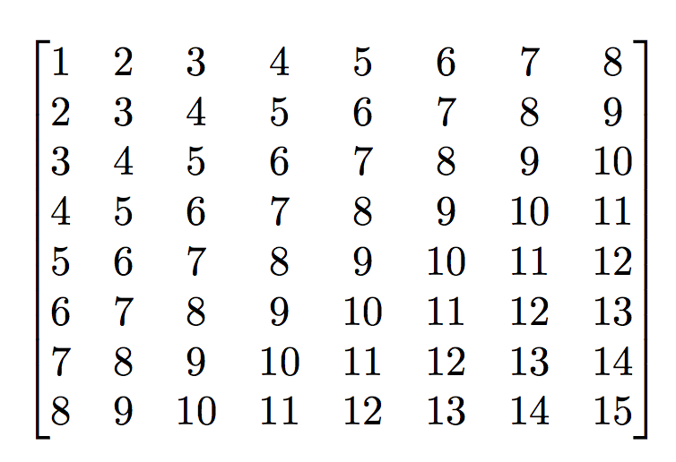
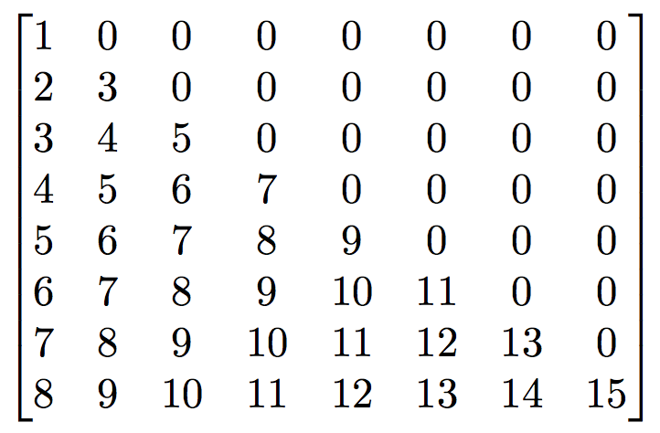
Level-3 BLAS Symmetric Matrix-Matrix Multiplication (SYMM)
A is a symmetric matrix (square and equal to its transpose);
Assume only the lower triangular half is stored;
Follow the same algorithm we used for GEMM by modifying the packing routine for matrix A to account for the symmetric nature of A.
Example Matrix A
is stored as

Slide 74
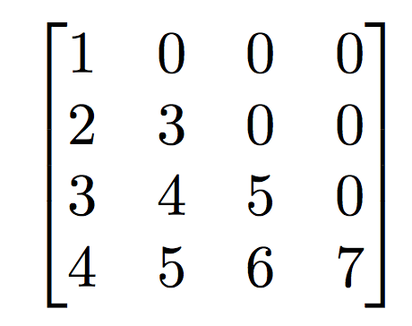
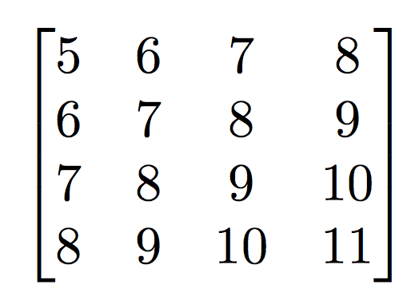
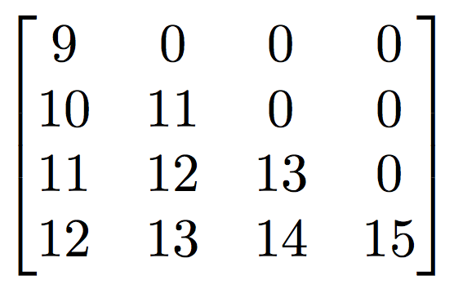
SYMM with One-Level Strassen
When partitioning A for one-level Strassen operations, we integrate the symmetric nature of A.
A₀₀
A₀₁
A₁₀
A₁₁

Slide 75
SYMM Implementation Platform: BLISlab*
What is BLISlab?
A Sandbox for Optimizing GEMM that mimics implementation in BLIS
A set of exercises that use GEMM to show how high performance can be attained on modern CPUs with hierarchical memories
Used in Prof. Robert van de Geijn’s CS 383C Numerical Linear Algebra
Contributions
Added DSYMM
Applied Strassen’s algorithm to DGEMM and DSYMM
3 versions: Naive, AB, ABC
Strassen improves performance in both DGEMM and DSYMM
* https://github.com/flame/blislab

Slide 76
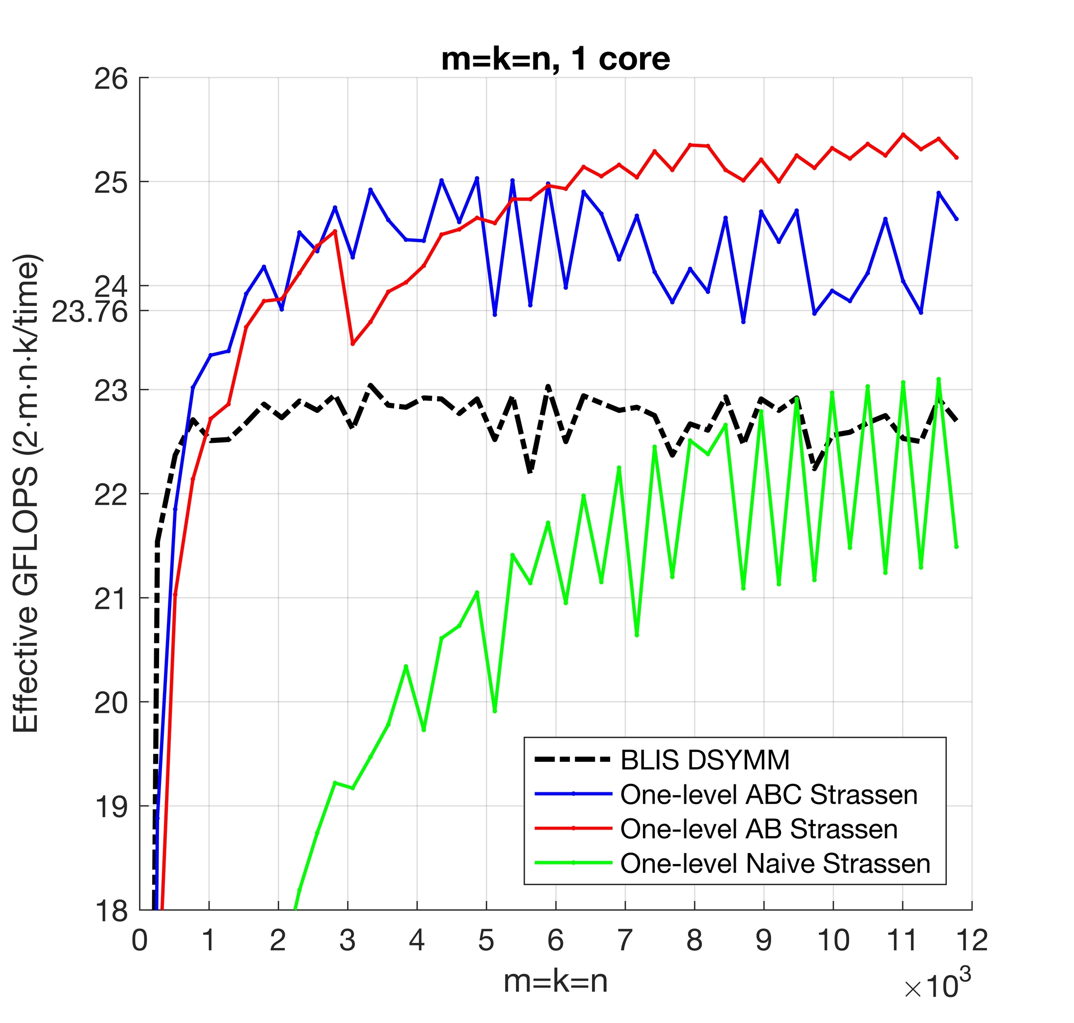
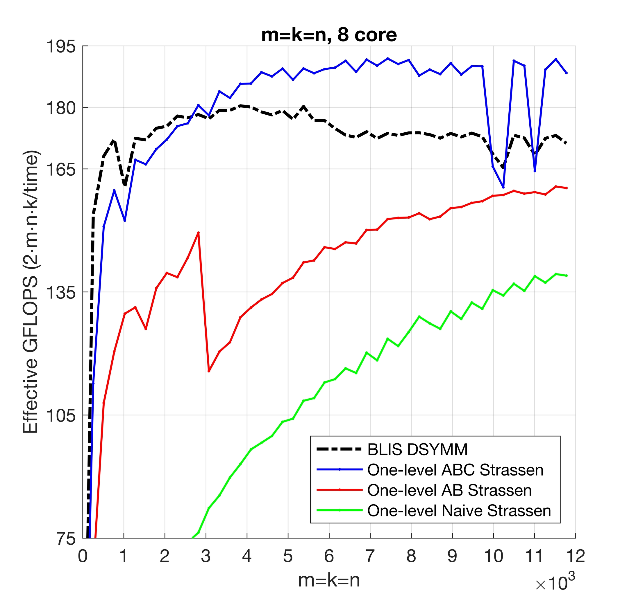
DSYMM Results in BLISlab

Slide 77
Outline
Review of State-of-the-art GEMM in BLIS
Strassen’s Algorithm Reloaded
Theoretical Model and Practical Performance
Extension to Other BLAS-3 Operation
Extension to Other Fast Matrix Multiplication
Conclusion

Slide 78
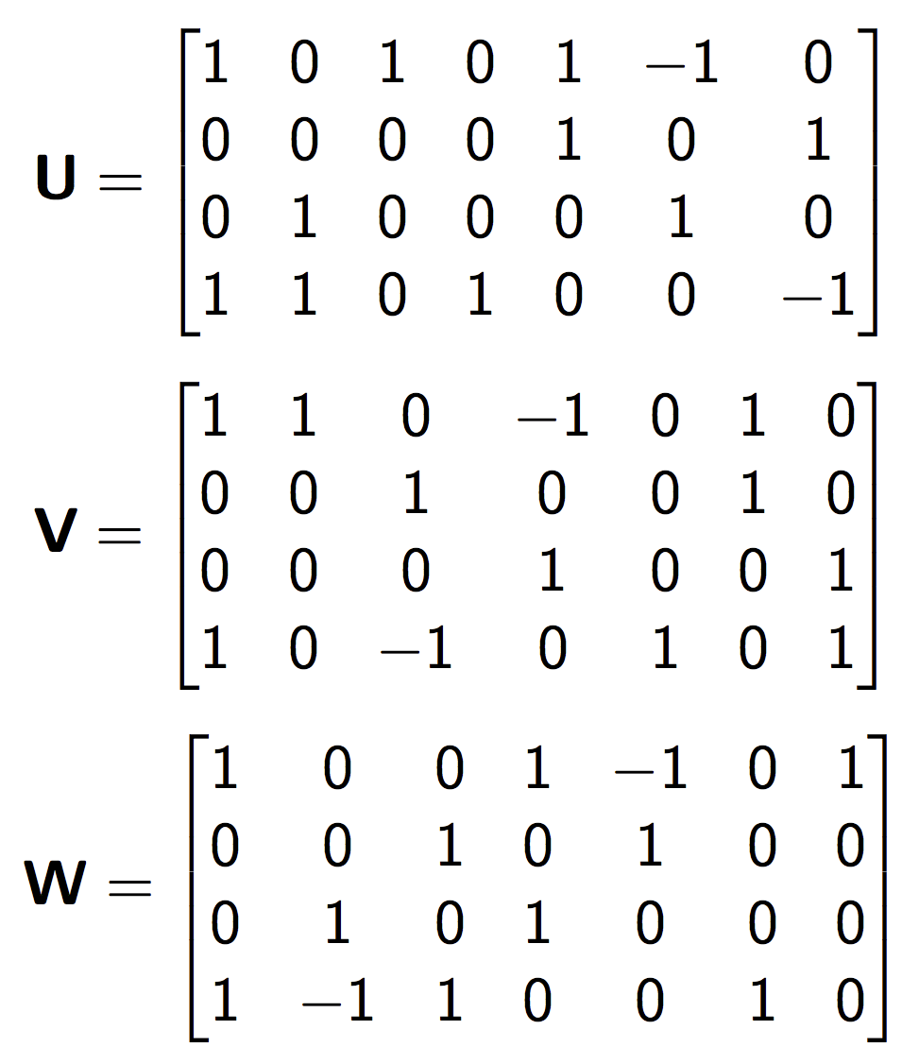
(2,2,2) Strassen Algorithm
M₀ := (A₀₀+A₁₁)(B₀₀+B₁₁); C₀₀ += M₀; C₁₁ += M₀;
M₁ := (A₁₀+A₁₁)B₀₀; C₁₀ += M₁; C₁₁ –= M₁;
M₂ := A₀₀(B₀₁–B₁₁); C₀₁ += M₂; C₁₁ += M₂;
M₃ := A₁₁(B₁₀–B₀₀); C₀₀ += M₃; C₁₀ += M₃;
M₄ := (A₀₀+A₀₁)B₁₁; C₀₁ += M₄; C₀₀ –= M₄;
M₅ := (A₁₀–A₀₀)(B₀₀+B₀₁); C₁₁ += M₅;
M₆ := (A₀₁–A₁₁)(B₁₀+B₁₁); C₀₀ += M₆;

Slide 79
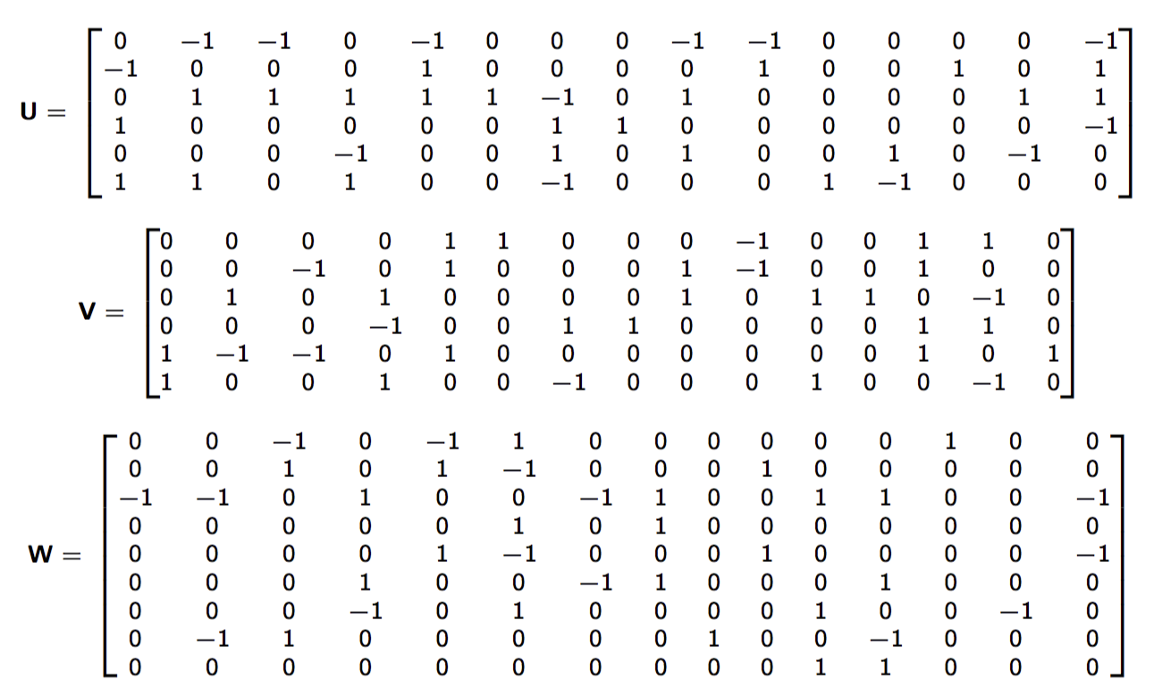
(3,2,3) Fast Matrix Multiplication
M₀ := (–A₀₁+A₁₁+A₂₁)(B₁₁+B₁₂); C₀₂ –= M₀;
M₁ := (–A₀₀+A₁₀+A₂₁)(B₀₀–B₁₂); C₀₂ –= M₁; C₂₁ –= M₁;
M₂ := ( –A₀₀+A₁₀ )( –B₀₁–B₁₁ ); C₀₀–=M₂;C₀₁+=M₂;C₂₁+=M₂;
M₃ := ( A₁₀–A₂₀+A₂₁ )( B₀₂–B₁₀+B₁₂ ); C₀₂+=M₃;C₁₂+=M₃;C₂₀–=M₃;
M₄ := ( –A₀₀+A₀₁+A₁₀ )( B₀₀+B₀₁+B₁₁ ); C₀₀–=M₄;C₀₁+=M₄;C₁₁+=M₄;
M₅ := ( A₁₀ )( B₀₀ ); C₀₀+=M₅;C₀₁–=M₅;C₁₀+=M₅;C₁₁–=M₅;C₂₀+=M₅;
M₆ := ( –A₁₀+A₁₁+A₂₀–A₂₁ )( B₁₀–B₁₂ ); C₀₂–=M₆;C₁₂–=M₆;
M₇ := ( A₁₁ )( B₁₀ ); C₀₂+=M₇;C₁₀+=M₇;C₁₂+=M₇;
M₈ := ( –A₀₀+A₁₀+A₂₀ )( B₀₁+B₀₂ ); C₂₁+=M₈;
M₉ := ( –A₀₀+A₀₁ )( –B₀₀–B₀₁ ); C₀₁+=M₉;C₁₁+=M₉;
M₁₀ :=( A₂₁ )( B₀₂+B₁₂ ); C₀₂+=M₁₀;C₂₀+=M₁₀;C₂₂+=M₁₀;
M₁₁ := ( A₂₀–A₂₁ )( B₀₂ ); C₀₂+=M₁₁;C₁₂+=M₁₁;C₂₁–=M₁₁;C₂₂+=M₁₁;
M₁₂ := ( A₀₁ )( B₀₀+B₀₁+B₁₀+B₁₁ ); C₀₀+=M₁₂;
M₁₃ := ( A₁₀–A₂₀ )( B₀₀–B₀₂+B₁₀–B₁₂ ); C₂₀–=M₁₃;
M₁₄ := ( –A₀₀+A₀₁+A₁₀–A₁₁ )( B₁₁ ); C₀₂–=M₁₄;C₁₁–=M₁₄;
*Austin R. Benson, Grey Ballard. "A framework for practical parallel fast matrix multiplication." PPOPP15.
M0=( -A(0,1)+A(1,1)+A(2,1) )( B(1,1)+B(1,2) );
C(0,2)-=M0;
M1=( -A(0,0)+A(1,0)+A(2,1) )( B(0,2)-B(1,1) );
C(0,2)-=M1;C(2,1)-=M1;
M2=( -A(0,0)+A(1,0) )( -B(0,1)-B(1,1) );
C(0,0)-=M2;C(0,1)+=M2;C(2,1)+=M2;
M3=( A(1,0)-A(2,0)+A(2,1) )( B(0,2)-B(1,0)+B(1,2) );
C(0,2)+=M3;C(1,2)+=M3;C(2,0)-=M3;
M4=( -A(0,0)+A(0,1)+A(1,0) )( B(0,0)+B(0,1)+B(1,1) );
C(0,0)-=M4;C(0,1)+=M4;C(1,1)+=M4;
M5=( A(1,0) )( B(0,0) );
C(0,0)+=M5;C(0,1)-=M5;C(1,0)+=M5;C(1,1)-=M5;C(2,0)+=M5;
M6=( -A(1,0)+A(1,1)+A(2,0)-A(2,1) )( B(1,0)-B(1,2) );
C(0,2)-=M6;C(1,2)-=M6;
M7=( A(1,1) )( B(1,0) );
C(0,2)+=M7;C(1,0)+=M7;C(1,2)+=M7;
M8=( -A(0,0)+A(1,0)+A(2,0) )( B(0,1)+B(0,2) );
C(2,1)+=M8;
M9=( -A(0,0)+A(0,1) )( -B(0,0)-B(0,1) );
C(0,1)+=M9;C(1,1)+=M9;
M10=( A(2,1) )( B(0,2)+B(1,2) );
C(0,2)+=M10;C(2,0)+=M10;C(2,2)+=M10;
M11=( A(2,0)-A(2,1) )( B(0,2) );
C(0,2)+=M11;C(1,2)+=M11;C(2,1)-=M11;C(2,2)+=M11;
M12=( A(0,1) )( B(0,0)+B(0,1)+B(1,0)+B(1,1) );
C(0,0)+=M12;
M13=( A(1,0)-A(2,0) )( B(0,0)-B(0,2)+B(1,0)-B(1,2) );
C(2,0)-=M13;
M14=( -A(0,0)+A(0,1)+A(1,0)-A(1,1) )( B(1,1) );
C(0,2)-=M14;C(1,1)-=M14;

Slide 80
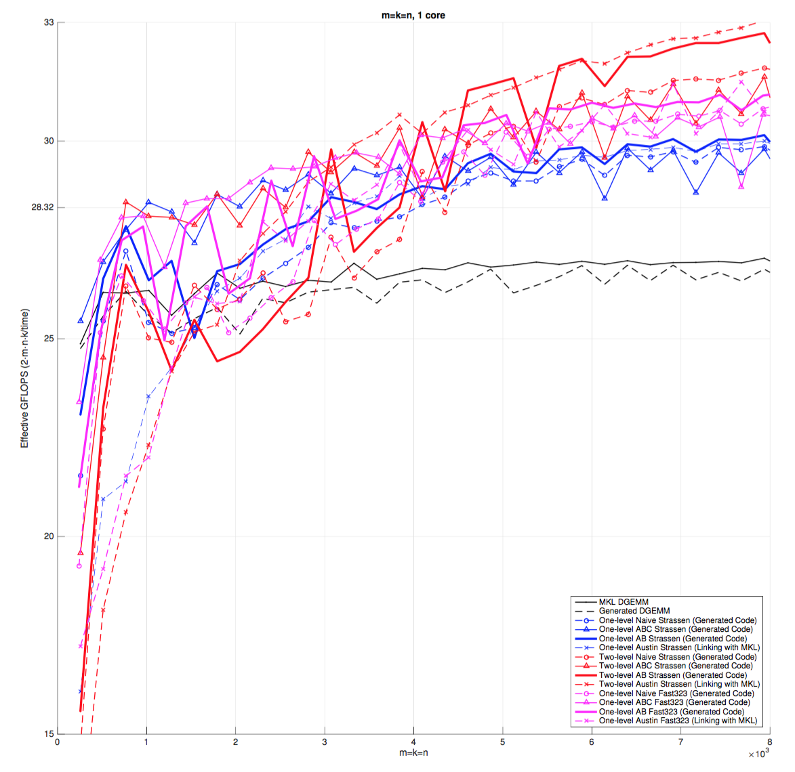

Slide 81
Outline
Review of State-of-the-art GEMM in BLIS
Strassen’s Algorithm Reloaded
Theoretical Model and Practical Performance
Extension to Other BLAS-3 Operation
Extension to Other Fast Matrix Multiplication
Conclusion

Slide 82
To achieve practical high performance
of Strassen’s algorithm…...
Conventional Implementations
Our Implementations
Matrix Size
Must be large
Matrix Shape
Must be square
No Additional
Workspace
Parallelism
Usually task parallelism
Can be data parallelism

Slide 83
Acknowledgement
- NSF grants ACI-1148125/1340293, CCF-1218483.
- Intel Corporation through an Intel Parallel Computing Center (IPCC).
- Access to the Maverick and Stampede supercomputers administered by TACC.
We thank Field Van Zee, Chenhan Yu, Devin Matthews, and the rest of the SHPC team (http://shpc.ices.utexas.edu) for their supports.
Any opinions, findings, and conclusions or recommendations expressed in this material are those of the author(s) and do not necessarily reflect the views of the National Science Foundation.

Slide 84
Thank you!

