Slide 1
CVPR 2019 Tutorial on Map Synchronization
Session on Theoretical Aspects

Slide 2
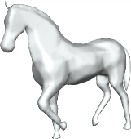
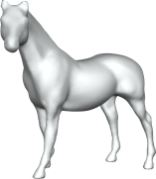
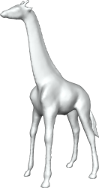
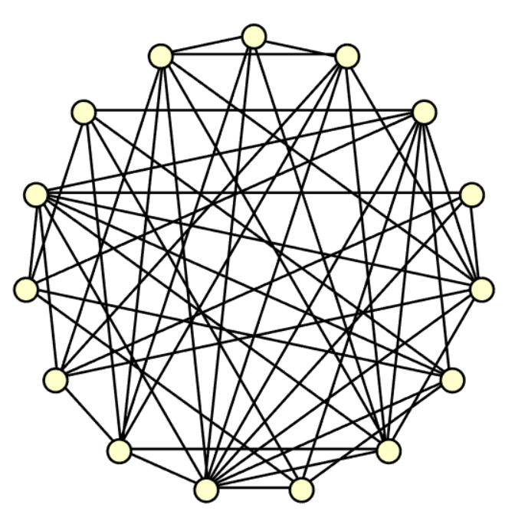
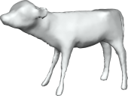
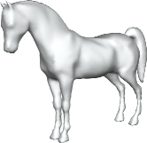
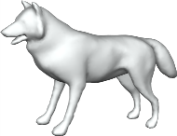
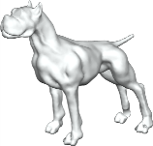
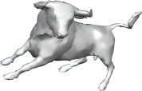
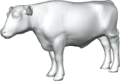
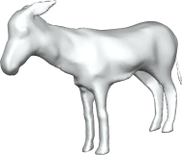
Pair-wise maps usually contain enough information
Network of approximately correct blended intrinsic maps
Notes:
Moving forward, even pair-wise matching may fail from time-to-time, if we look at the network of correct maps among an typical object collection. This network is usually strongly connected, which allows us to compute maps between all pairs of objects by map propagation.

Slide 3
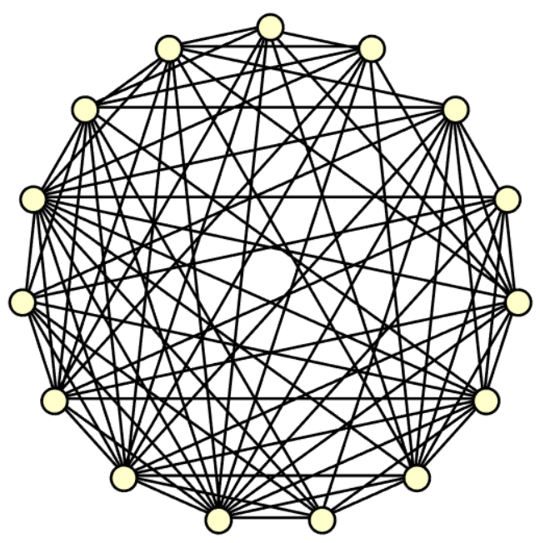
Map synchronization problem
Identify correct maps among a (sparse) network of maps
Notes:
This leads to the following map synchronization problem: We are given objects and a network of precomputed maps, how to identify the correct maps. Why this is promising or what additional information we can use?

Slide 4
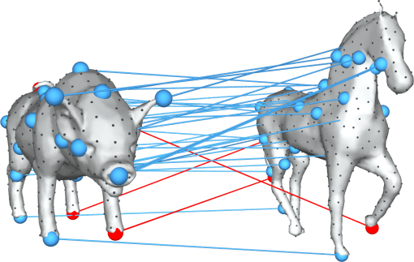
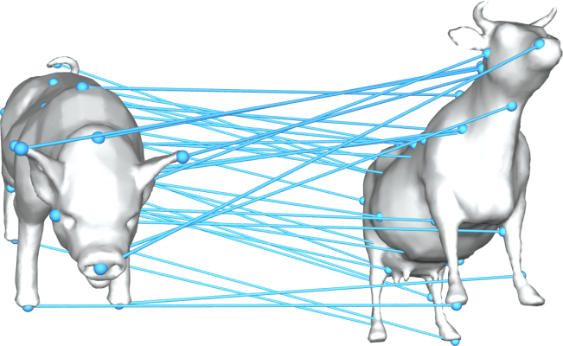
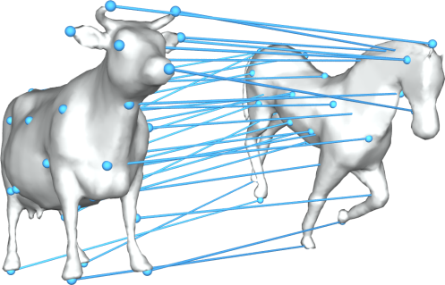
A natural constraint on maps is that they should be consistent along cycles
Inconsistent
Notes:
In turns out when considering maps among multiple objects. There is a natural cycle-consistency constraint, namely, composite maps along cycles should approximate the identify map. So in this case, these three maps are inconsistent.

Slide 5
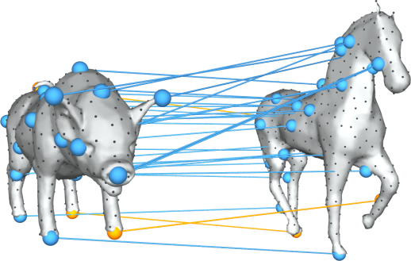
A natural constraint on maps is that they should be consistent along cycles
Consistent
Composite
Notes:
Are these three maps are consistent. Why consistency is useful is because if you find inconsistent cycles, then you know at least one map is incorrect, which maybe useful to prune incorrect maps.

Slide 6
Literature on utilizing the cycle-consistency constraint
Spanning tree optimization [Huber et al. 01, Huang et al. 06, Cho et al. 08, Crandel et al. 11, Huang et al. 12]
Sampling inconsistent cycles [Zach et al. 10, Nyugen et al. 11, Zhou et al. 15]
Notes:
People have studied how to utilize the cycle-consistency constraint for about decade, including optimizing a spanning tree. In particular, in Daniel Huber’s work, he studied several formulations and showed that the induced problems are NP-hard. This indicates the hardness of utilizing the cycle-consistency constraint. More recent ones are based on sampling inconsistent cycles, but the problem is that you do not know how to sample them efficiently.

Slide 7
Compressive sensing view of map synchronization
Cycle-consistency
Compressible
Input maps
Noisy observations
Notes:
What I propose is to look at the problem from a different perspective. Essentially if we look at the cycle-consistent maps, we can see that information is highly redundant. because a correspondence can be replaced by the composite correspondence along a cycle. Now the initail maps can be viewed observations. Now we arrive at a familiar setting, where we want to recover a highly compressible signal, and what we have are noisy observations of this signal.

Slide 8
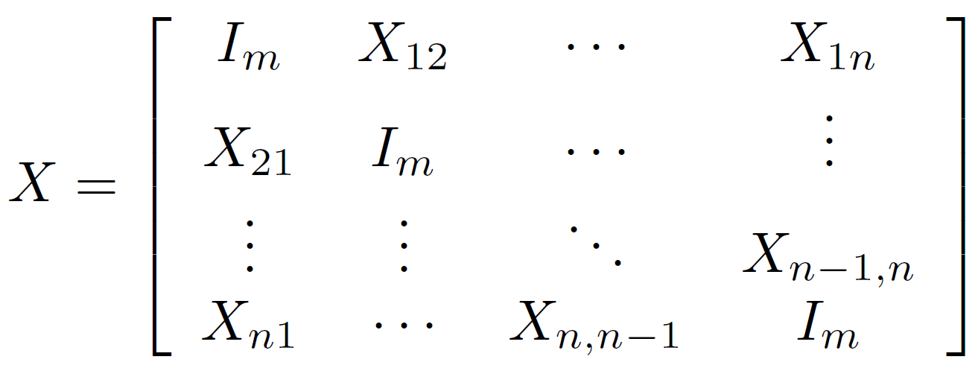
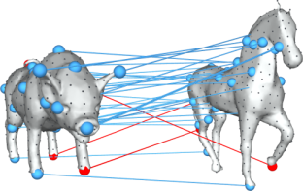
Map synchronization as constrained matrix optimization
Noisy measurements of matrix blocks
Notes:
What I am gonna to talk about today is to look at the map synchronization problem from a different perspective namely constrained matrix optimization. This slide shows the basic idea, we are gonna to consider matrix representations of maps, e.g., 0-1 matrixces for point-based maps, and introduce a big matrix X that stores pair-wise maps in blocks. We can show that the cycle-consistency correspond to the fact that this big matrix satisfy some properties, i.e., being SDP or low-rank. And the input maps can be viewed as noisy measurements of the matrix blocks. This leads to a familiar setting when we want to recovery a matrix that satisfies some propties and what we have are noisy measurement of the matrix blocks, something we can solve and analyze.

Slide 9
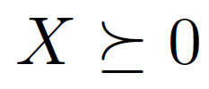
Example: permutation synchronization
Objective function:
minimize
Observation graph
Constraints:
cycle-consistency
mapping constraint

Slide 10
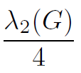
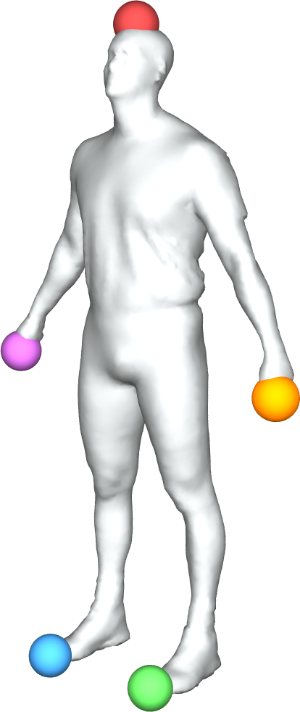
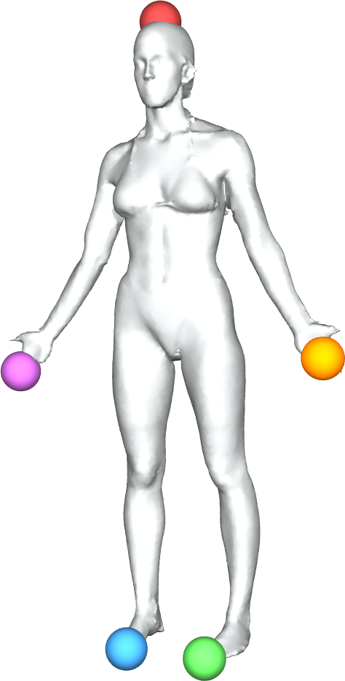
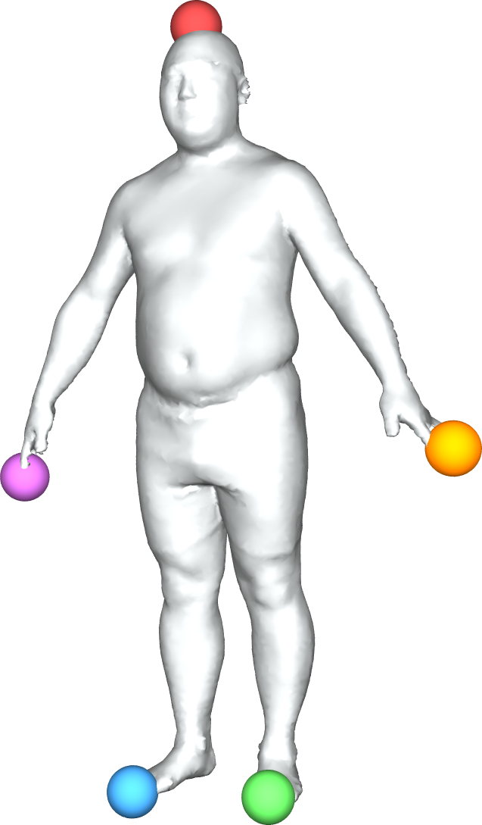
Deterministic guarantee
Theorem[HG13]: Given noisy input maps, permutation synchronization recovers the underlying maps if
#incorrect corres. of each point <
1
1
1
5
2
5
2
5
2
4
3
4
3
4
3

Slide 11
Optimality when the object graph G is a clique
25% incorrect correspondences
Worst-case scenario
Two clusters of objects of equal size
Wrong correspondences between objects of different clusters only (50%)

Slide 12
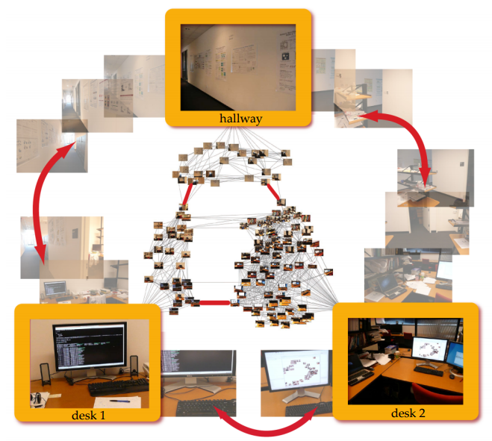
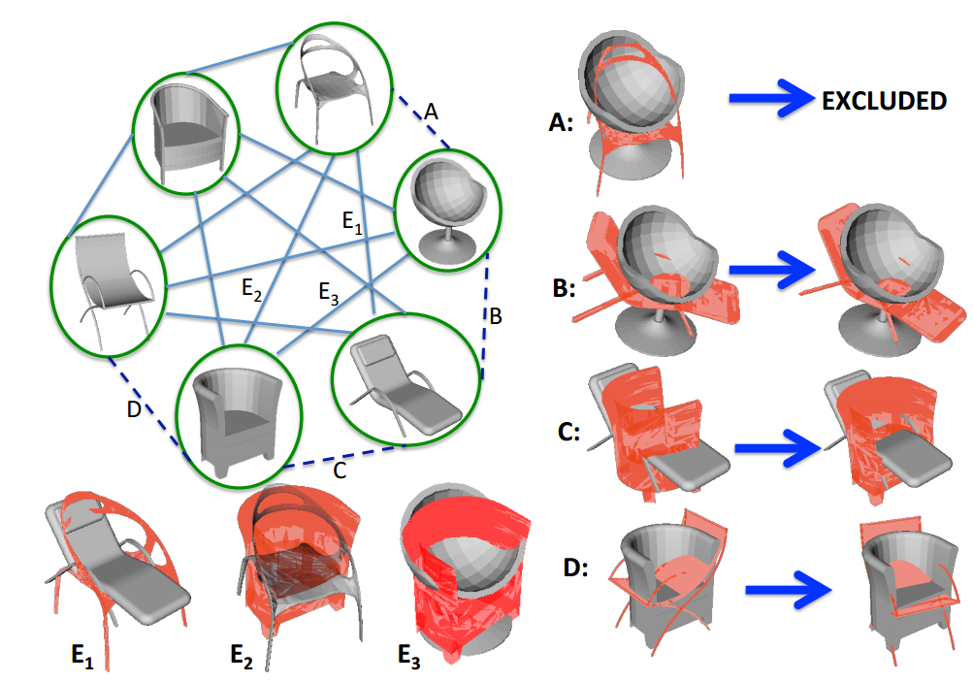
Justification of maximizing for map graph construction
Imageweb [Heath et al 10]
Fuzzy correspondences
on shapes [Kim et al 12]

Slide 13
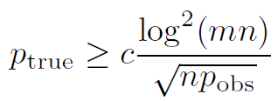
Randomized setting
Generalized Erdős–Rényi model:
p_{obs}: the probability that two objects connect
p_{true}: the probability that a pair-wise map is correct
Incorrect maps are random permutations
Theorem [CGH’14]: The underlying permutations can be recovered w.h.p if

Slide 14
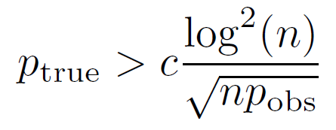
Optimality when m is a constant
Exact recovery condition:
Information theoretic limits [Chen et al 15]:
No method works if

Slide 15
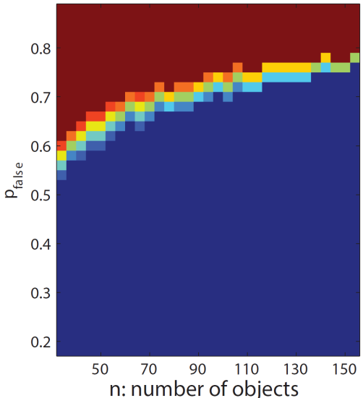
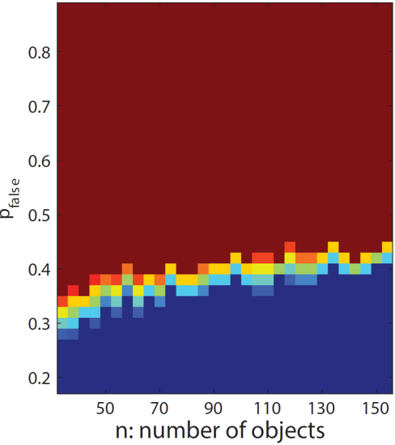
Comparison to a generic low-rank matrix recovery method
Permutation synchronization
RPCA
Phase transitions in empirical success probability
(p_{obs} =1)

Slide 16
Noise distribution when perturbing permutations
RPCA can handle dense corruption if the perturbations exhibit random sign pattern, yet
The map constraints incur a quotient space defined by
The expectation under this quotient space

Slide 17
How to handle partial maps?

Slide 18
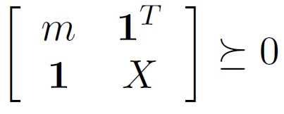
Reformulation
Q. Huang, Y. Chen, and L.Guibas, Scalable Semidefinite Relaxation for Maximum A Posterior Estimation, ICML’ 14

Slide 19
Partial point-based map synchronization
Step I: Spectral method:
m <= #dominant eigenvalues of X^{input} after trimming
Step II:
Size of the universe

Slide 20
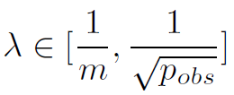
Exact recovery condition
Randomized model: n objects, universe size m
Each object contains a fraction p_{set} of m elements
Each pair is observed w.p. p_{obs}
Each observed is randomly corrupted w.p. 1 – p_{true}
Theorem. When , the underlying maps can be recovered with high probability if

Slide 21
Spectral Map Synchronization

Slide 22
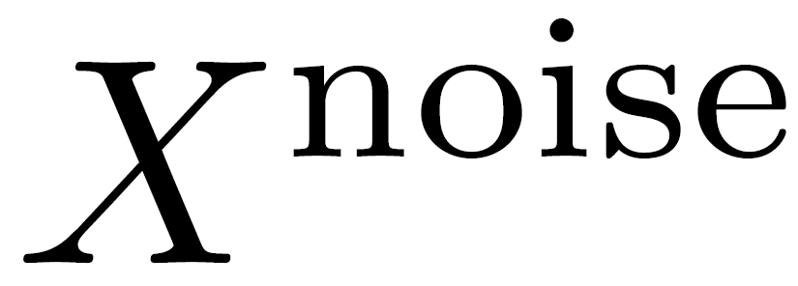
Intuition
=
+
David-Kham theorem:

Slide 23
Algorithm
[Pachauri et al 13, Shen et al 16]
Step I: Leading eigen-vector computation
Power method, which can be done very efficiently
Step II: Rounding via linear assignment
Hungarian algorithm

Slide 24
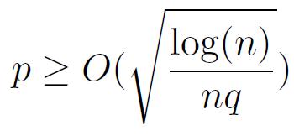
Theoretical Analysis
Deterministic setting
A constant fraction of noise [Huang et al. 19]
1/8 for clique graphs (a gap from SDP formulations)
Randomized setting [Bajaj et al. 18]
Fraction of correct maps
Sampling density

Slide 25
Non-Convex Optimization

Slide 26
Translation Synchronization
[Huang et al. 17]
Pair-wise differences along a graph
Convex optimization
Truncated least squares

Slide 27
Exact recovery condition
Deterministic
A constant fraction of noise (1/6 for clique graphs)
2/3 of the optimal ratio
Randomized
Exact recovery if

Slide 28
Summary of low-rank based techniques
=
+
Recovery if
In some reduced space
The constant depends on the optimization techniques being used
Many (non-convex) techniques require further understanding!

Slide 29
Further reading (a partial list)
Uncertainty quantification, Rotation/transformation synchronization, and lower bounds
1. T. Birdal, U. Simsekli. Probabilistic Permutation Synchronization using the Riemannian Structure of the Birkhoff Polytope. CVPR 2019, Oral Paper.
2. T. Birdal, U. Simsekli, M. Eken, S. Ilic. Bayesian Pose Graph Optimization via Bingham Distributions and Tempered Geodesic MCMC. In NIPS 2018.
3. A. Perry, J. Weed, A. S. Bandeira, P. Rigollet, A. Singer, “The sample complexity of multi-reference alignment”. SIAM Journal on Mathematics of Data Science
4. O. Özyeşil, N. Sharon, A. Singer, ``Synchronization over Cartan motion groups via contraction”, SIAM Journal on Applied Algebra and Geometry, 2 (2), pp. 207-241 (2018)
5. A. S. Bandeira, N. Boumal, A. Singer, ``Tightness of the maximum likelihood semidefinite relaxation for angular synchronization”, Mathematical Programming, series A, 163 (1):145-167 (2017).
6. A. Singer, H.-T. Wu, ``Spectral Convergence of the Connection Laplacian from Random Samples”, Information and Inference: A Journal of the IMA, 6 (1):58-123 (2017).

Slide 30
Further reading (a partial list)
Uncertainty quantification, Rotation/transformation synchronization, and lower bounds
7. K. N. Chaudhury, Y. Khoo, A. Singer, ``Global registration of multiple point clouds using semidefinite programming”, SIAM Journal on Optimization, 25 (1), pp. 468-501 (2015).
8. N. Boumal, A. Singer, P.-A. Absil and V. D. Blondel, ``Cramér-Rao bounds for synchronization of rotations”, Information and Inference: A Journal of the IMA, 3 (1), pp. 1--39 (2014).
9. A. Singer, ``Angular Synchronization by Eigenvectors and Semidefinite Programming'', Applied and Computational Harmonic Analysis, 30 (1), pp. 20-36 (2011).
10. SE-Sync: A Certifiably Correct Algorithm for Synchronization over the Special Euclidean Group David M. Rosen, Luca Carlone, Afonso S. Bandeira, and John J. Leonard. (2018)
11. Robust synchronization in SO (3) and SE (3) via low-rank and sparse matrix decomposition. Federica Arrigoni, Beatrice Rossi, Pasqualina Fragneto, Andrea Fusiello. Computer Vision and Image Understanding. 174. pp. 95-113 (2018)

Slide 31
Graph Theoretical Approach

Slide 32
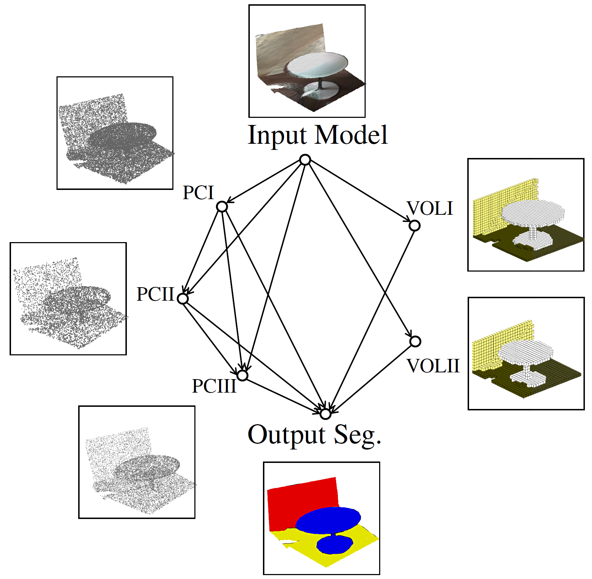
Limitations of low-rank approaches
Matrix representations
Neural networks
Undirected maps
Directed maps

Slide 33
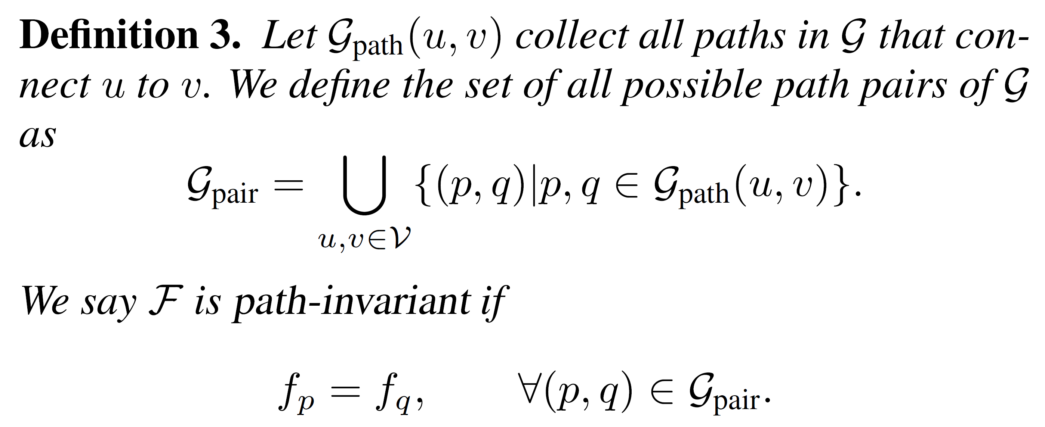
From cycle-consistency to path-invariance
Cycle-consistency
Path-invariance
Definition

Slide 34
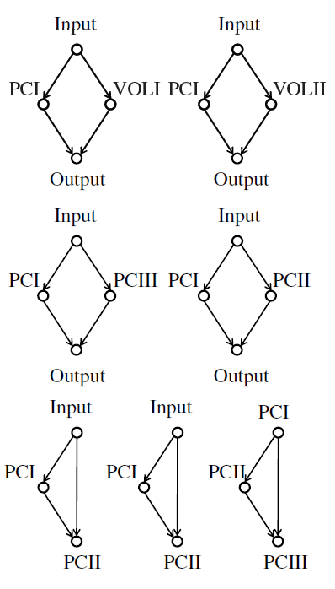
Path-invariance basis
Can induce the path-invariance property of the entire graph

Slide 35
Path-invariance provides a regularization for training neural networks
Supervised loss
Unsupervised loss

Slide 36
Main result
Theorem: Given a directed graph with n vertices and m edges, there exists a path-invariance basis with size at most O(nm)
Main idea for the proof
A directed graph is a directed acyclic graph (DAG) of strongly connected components
Use a vertex order to construct a path-invariance basis for DAG

Slide 37
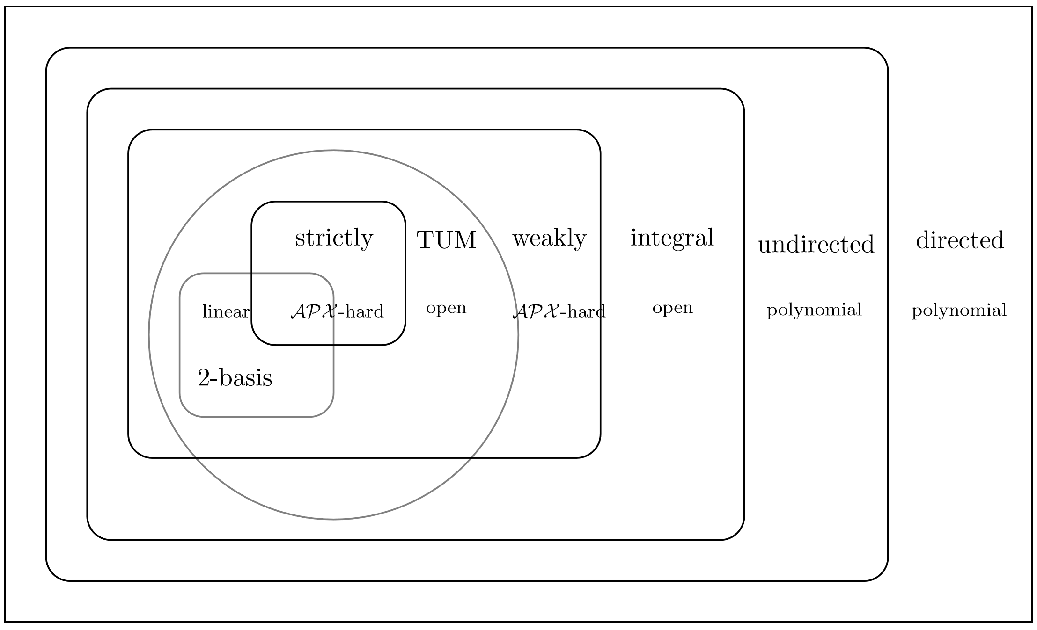
Cycle-basis
[Kavitha et al. 09]

Slide 38
Cycle basis/Cycle-consistency basis/Path-invariance basis
Undirected cycle basis generalizes to cycle-consistency basis
Size: #edges - #vertices + #components
It is an open question whether other bases generalize
The minimum size of a path-invariance basis is an open problem

Slide 39
Path-invariance basis vs Random Path pairs
Do not guarantee the path-invariance property over the entire graph
Sub-optimal convergence behavior
Random path pairs are long
There is always a cost for implementing a single pair

Slide 40
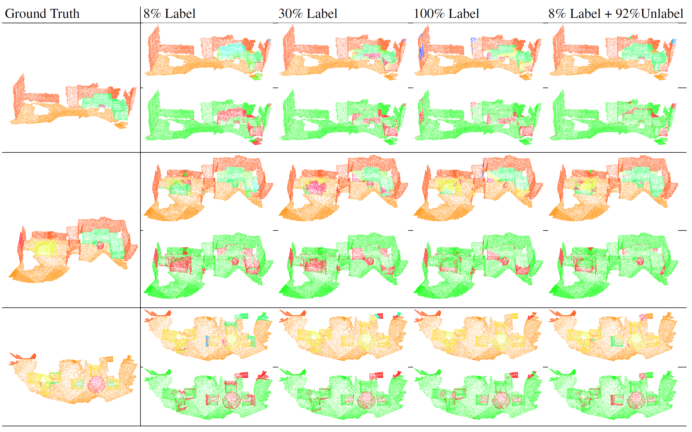
Semantic segmentation on ScanNet

