Slide 1
Dialog with Robots:
Perceptually Grounded Communication with Lifelong Learning
Raymond J. Mooney
University of Texas at Austin
Joint Work with:
Jesse Thomason, Aishwarya Padmakumar, Jivko Sinapov, Peter Stone, Shiqi Zhang, Justin Hart, Maxwell Svetlik
1
1
Notes:
1
1

Slide 2

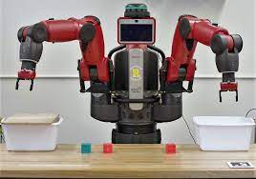
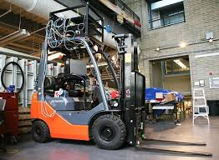
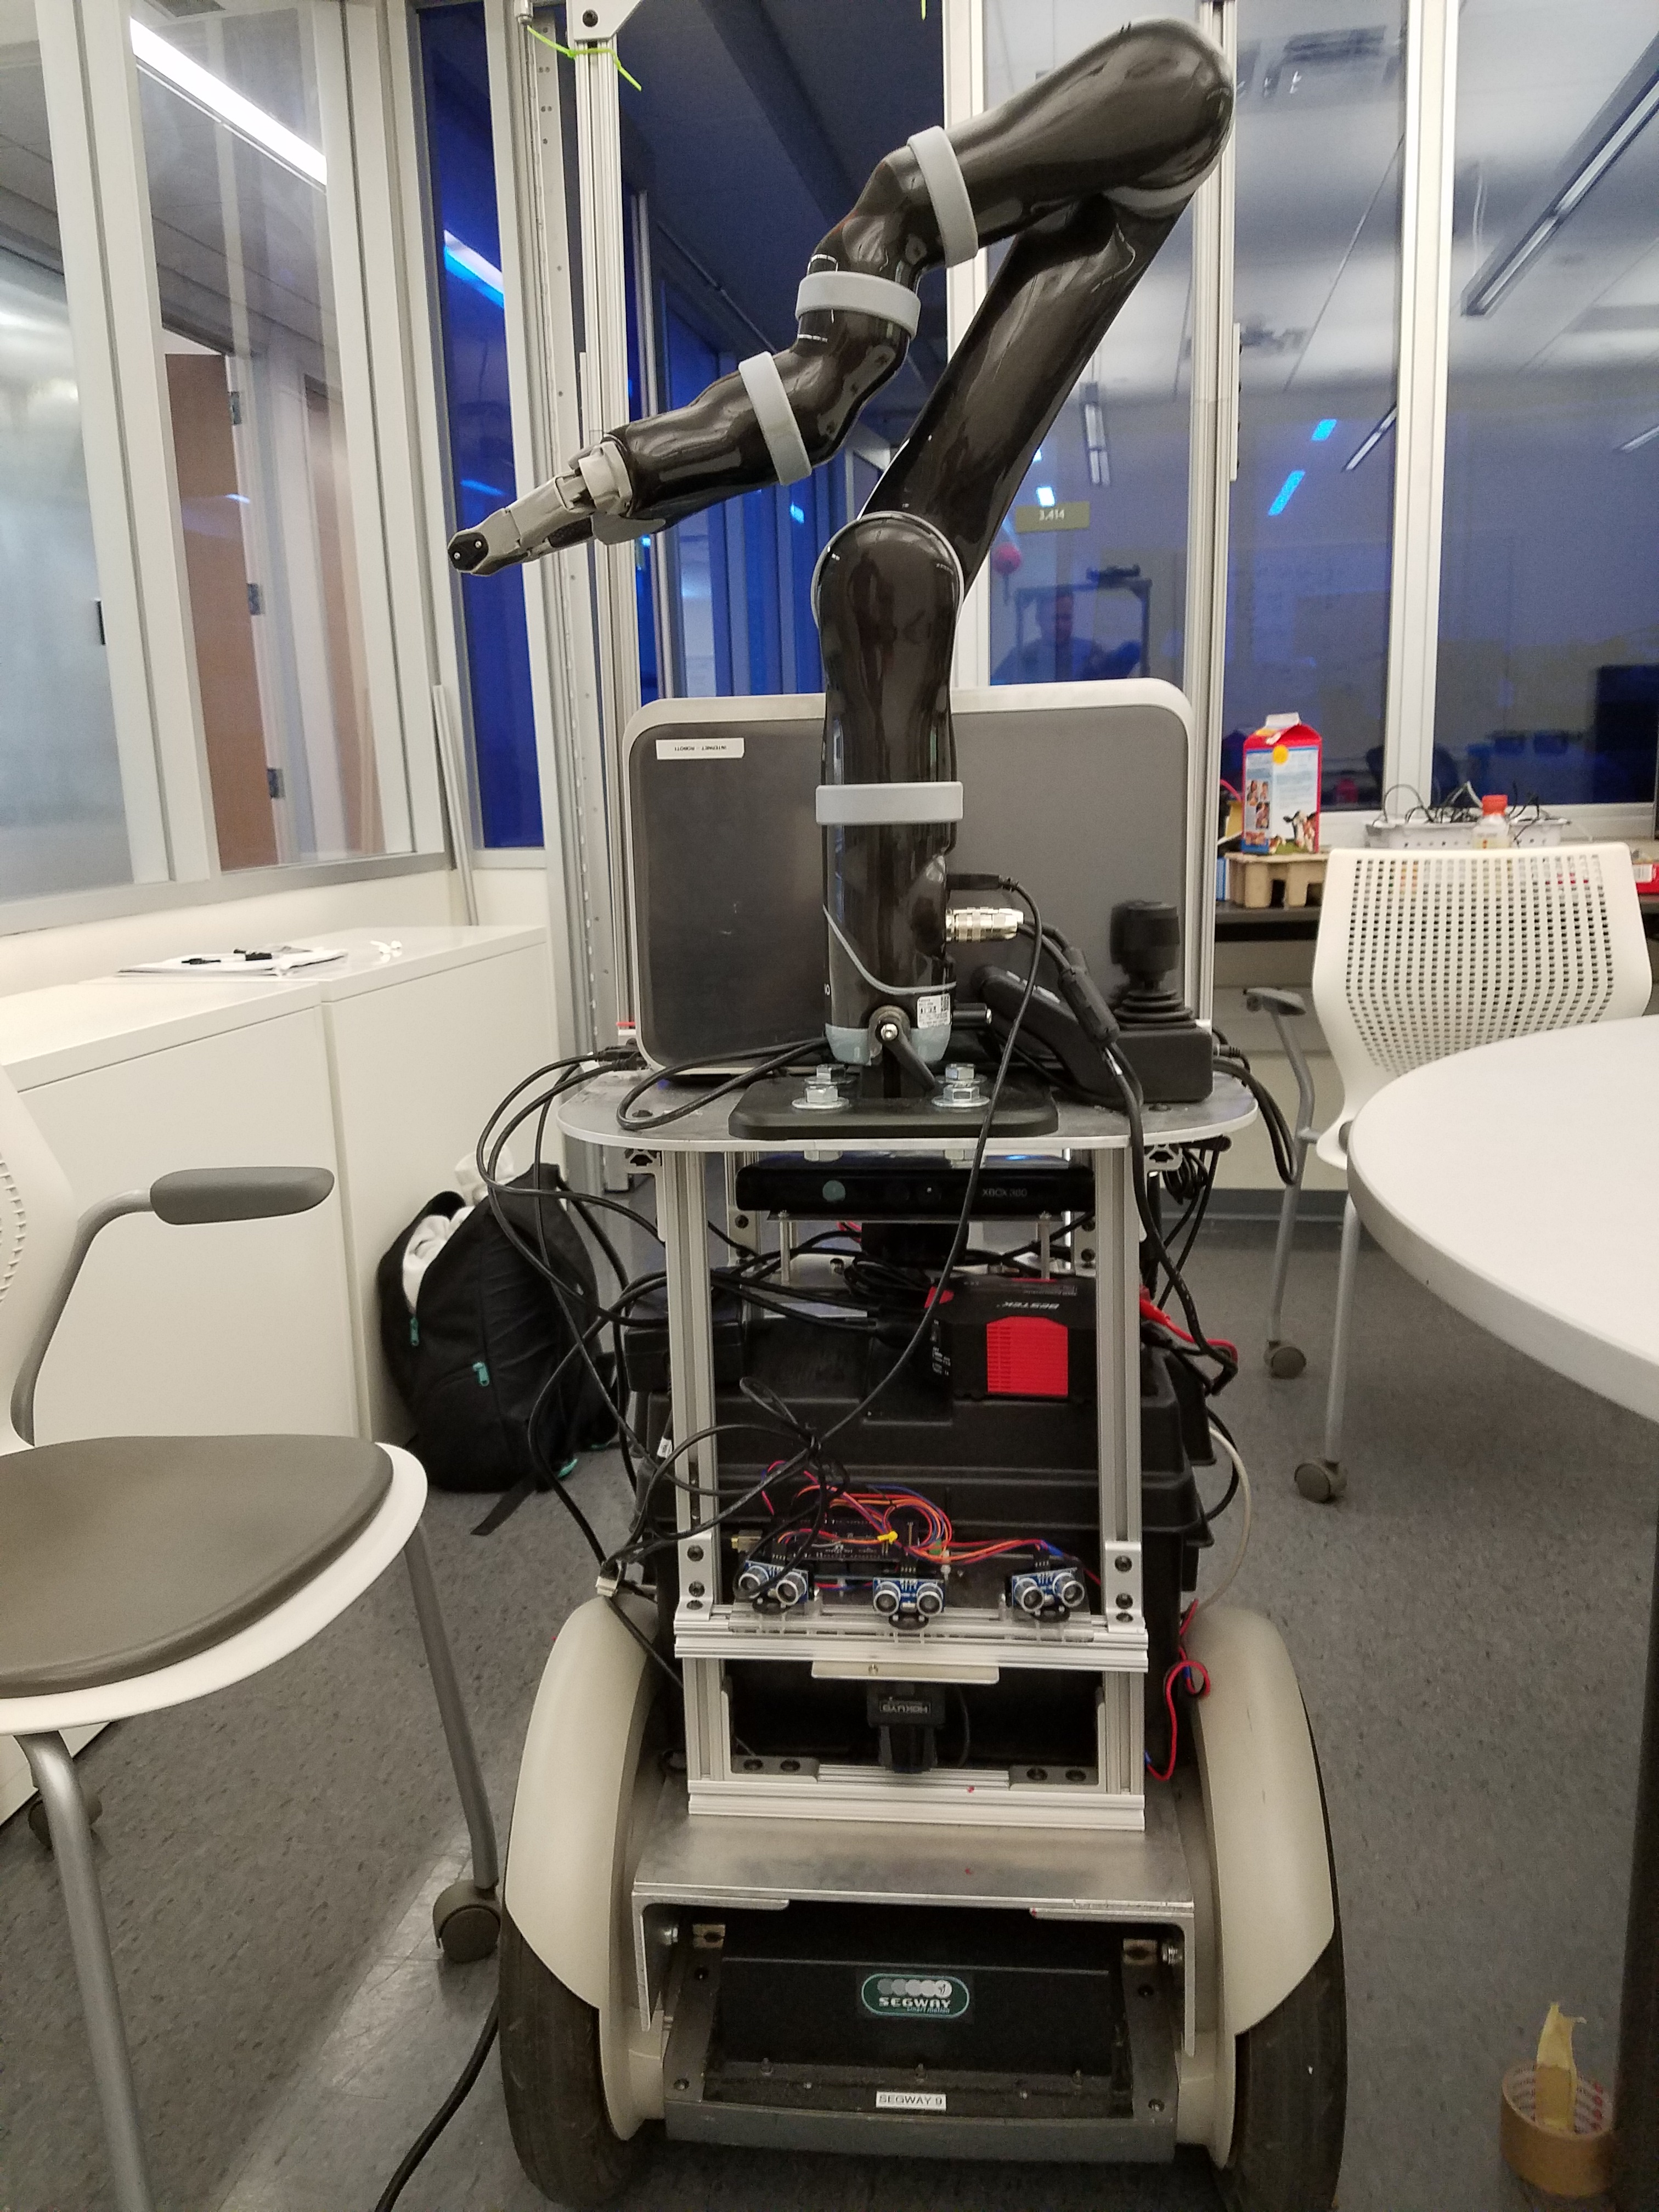
RoboNLP
Commanding, teaching, and collaborating with increasingly capable robots is greatly aided by humans being able to communicate with them in natural language.

Slide 3
Language Grounding
RoboNLP requires grounding language in relevant perception and action in the world.
Multimodal deep learning has resulted in significant recent progress on various language grounding tasks.

Slide 4
GNLP Explosion
I helped co-organized the first workshop on “Integrating Language and Vision,” at NIPS 2011, with about 30 participants.
Since the first work on deep learning for image captioning in fall 2014, the area has grown immensely.

Slide 5
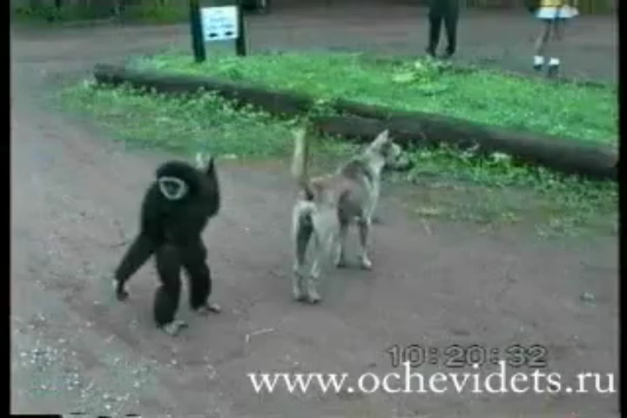
Image and Video Captioning
Produce a natural language sentence describing an image or a video clip.
A large brown bear walking through a forest.
A monkey pulls a dog’s tail and runs away.

Slide 6
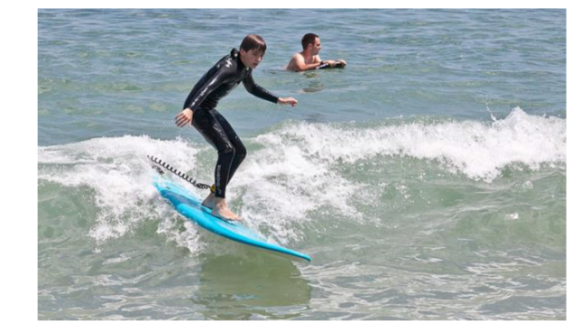
Visual Question Answering
Answer a natural language question about an image or video.
What is in the child’s mouth?
What color is the surfboard?

Slide 7
Natural Language Robot Navigation
Provide a (simulated) robot with natural language navigation instructions which it must follow.
Take your first left. Go all the way down until you hit a dead end.

Slide 8
Deep Multimodal Models for GNLP
Initially combinations of CNNs and RNNs (LSTMs, GRUs) were popular.
Now transformer models with cross-modal attention and pretraining on large multimodal corpora are SOTA.

Slide 9
Training Demands
Modern deep learning systems require enormous amounts of training data to be effective.
May still lack competence on the long-tail of rare language and concepts encountered in practice.
Ideally, a robot could continue to learn through natural interaction with human users while in operation, adapting to the demands of specific tasks and environments.

Slide 10
Lifelong Learning
Ability to continually learn and acquire new concepts from data naturally obtained during everyday deployment.
Natural-language dialog with ordinary human users is a great way to support lifelong learning.
  “Dialog as a Vehicle for Lifelong Learning,”Aishwarya Padmakumar & Raymond Mooney, Position Paper Track at the SIGDIAL Special Session on Physically Situated Dialogue (RoboDial 2.0), July 2020.

Slide 11
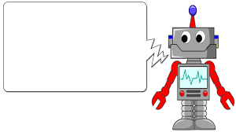

Lifelong Learning from Queries
Clarification queries: Questions that elucidate current user intents.
Active learning queries: Questions that provide useful supervision for system-selected training examples.
Did you want red or white wine?
Is this a “decanter”?

Slide 12
Active Learning
Query unlabeled examples that are most likely to improve the model.
Uncertainty sampling: Query example about which current model is most uncertain.
?

Slide 13
Robot Dialog for Lifelong Learning
We have developed robot dialog systems that integrate language grounding with clarification and active learning queries to support lifelong learning (Thomason, et al., JAIR 2020).
Demonstrated on natural language object retrieval using a real Segway-based mobile robot (SegBot) with a Kenova arm.

Slide 14
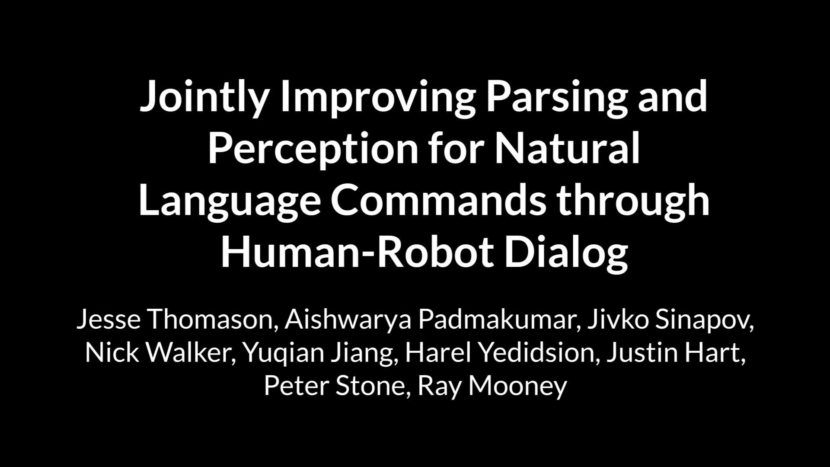

Slide 15
Learning from Dialog Clarifications
Infer training data for semantic parsing from answers to clarification questions.
Idea proposed by Artzi and Zettlemoyer (EMNLP 2011) for travel planning dialogs.
We (Thomason et al., IJCAI 2015) adapted it to robot object retrieval tasks and evaluated in both simulated and real environments.

Slide 16
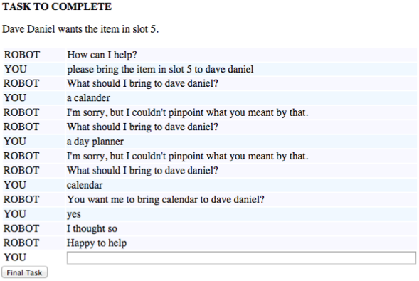
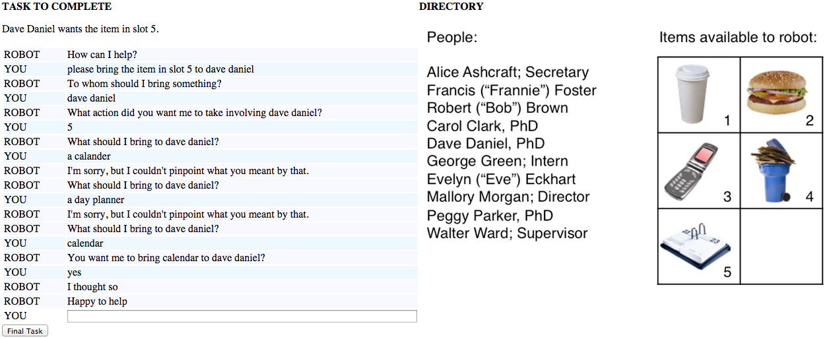
Inferring Training Data from Clarifications

Slide 17
Inferring Training Data from Clarifications

Slide 18
Inferring Training Data from Clarifications

Slide 19
Inferring Training Data from Clarifications

Slide 20
Inferring Training Data from Clarifications
Induced Training Pairs
“please bring the item in slot five to dave daniel”
bring(calender, dave)
Semantic Parser
“calander”
calendar
“a day planner”
calendar

Slide 21

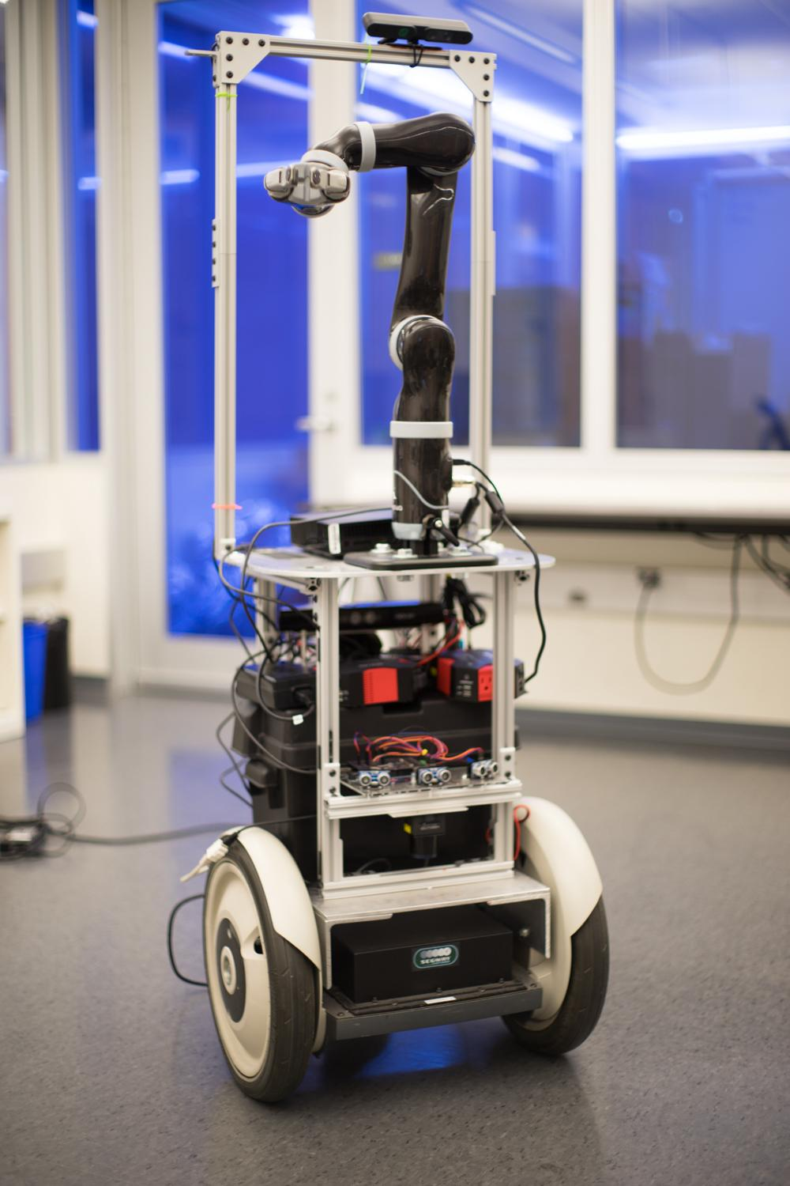
Experiments via Amazon Mechanical Turk
Induced Training Pairs
x 50
x 4
Semantic Parser

Slide 22
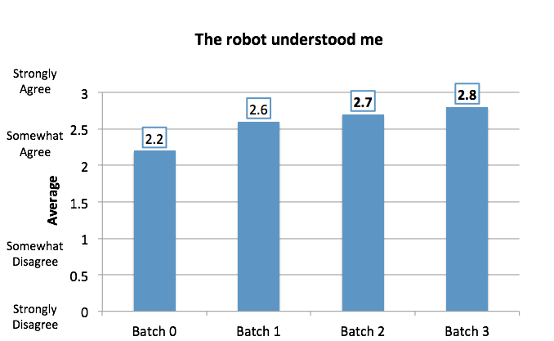
AMT Survey Responses

Slide 23
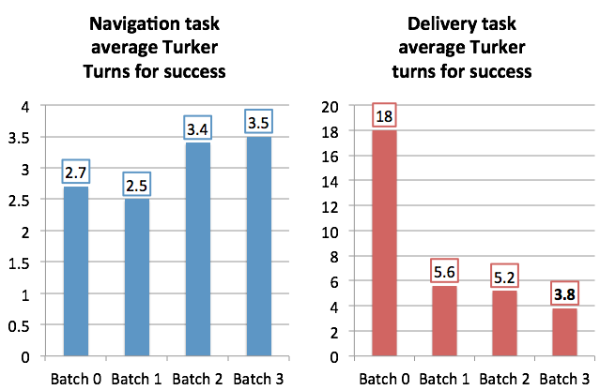
AMT Delivery Dialog Length in Turns
Qualitative: One user wrote “the robot even fixed my typo when I mispelled calendar!”

Slide 24
Segbot Experiment
Initial Test: 10 users with baseline system (no additional training).
Robot roamed the office for four days.
  34 conversations with users in the office ended with training goals.
  System re-trained after four days.
Final Test: 10 users with re-trained system.

Slide 25
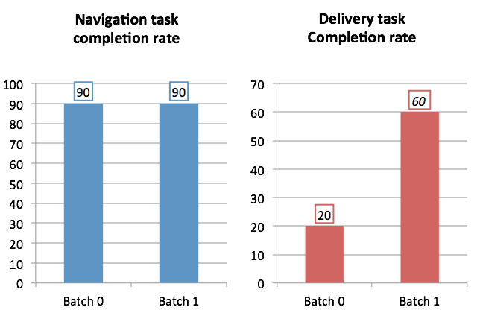
Segbot Dialog Success

Slide 26
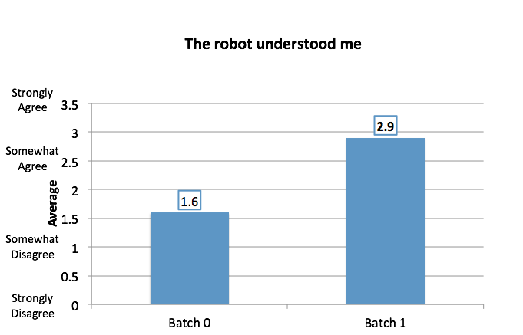
Segbot Survey Responses

Slide 27
Opportunistic Active Learning (OAL)
Active learning normally assumes continual access to a large body of unlabeled examples.
In a grounded robot setting, only a small number of nearby items are generally available for querying.
OAL asks locally convenient queries during an interactive task (Thomason et al., CoRL 2017).
OAL queries may not be useful for the current interaction but expected to help future tasks.

Slide 28
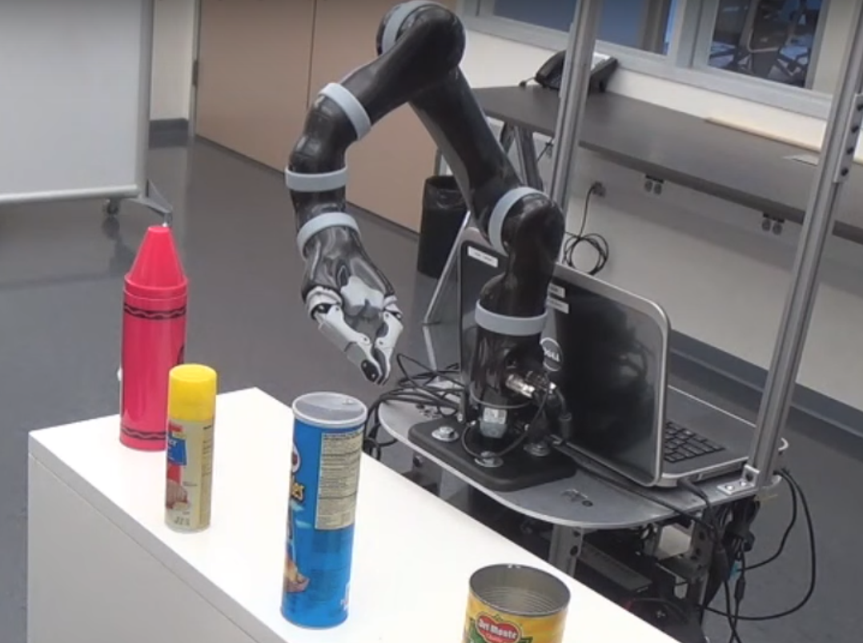

OAL “On Topic” Query
Bring the blue mug from Alice’s office
Would you use the word “blue” to refer to this object?
Yes
Notes:
An example would be when a robot is asked to bring a blue mug, it can point to a nearby object to ask whether a label such as blue applies to it.

Slide 29
OAL “Off Topic” Query
Bring the blue mug from Alice’s office
Would you use the word “tall” to refer to this object?
Yes
Notes:
The robot may also choose to query for less related labels such as ‘tall’ if these are more likely to be useful in future.

Slide 30
OAL Dialog Policy
Must decide when and what OAL queries to ask to properly trade-off immediate task completion and future task performance.
We (Padmakumar et al., EMNLP 2018) developed a reinforcement-learning (RL) approach to learn an effective OAL dialog policy.

Slide 31
RL for Dialog
Learning dialog policy using RL has a long history.
Early collaboration of ML and NLP researchers at AT&T Labs (Singh et al., NIPS 1999) initiated this approach.
Rewards based on user satisfaction survey at the end of a dialog, or a large positive reward for achieving a task-based goal, and a small negative reward for each system-initiated query.

Slide 32
RL for OAL
Evaluated on dialog for natural language object retrieval from images.
Allowed to ask queries on a small set of available training items to identify a target object from a set of test items.
Used labeled data from Visual Genome to provide oracle answers to queries in simulated dialogs.

Slide 33
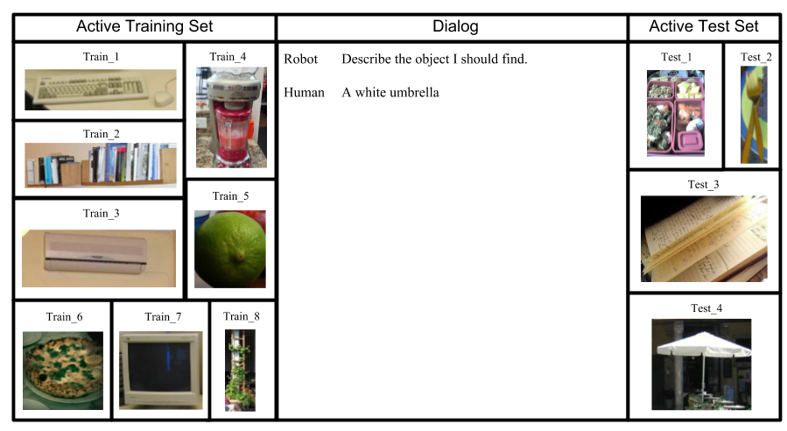
Sample Simulated Dialog
Target Description
Notes:
Since we need a large number of dialogs for policy learning, we simulate the task using the Visual Genome dataset. We sample images from the dataset to form the active training and test sets. And provide human annotated descriptions of images as the target descriptions.

Slide 34
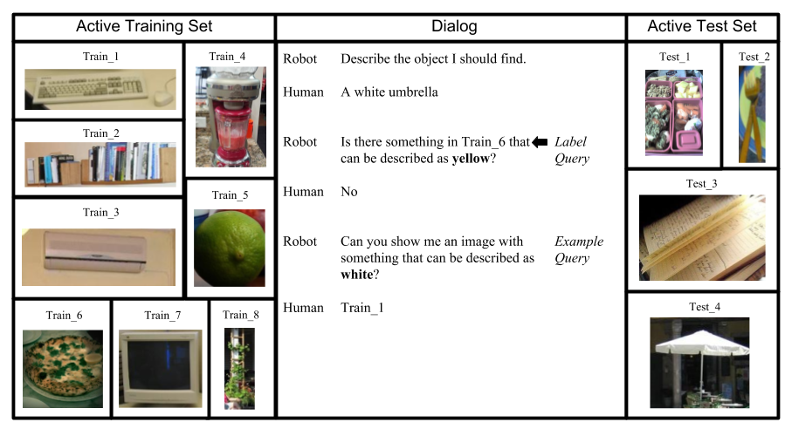
Sample Simulated Dialog
Notes:
The robot can ask label and example queries on the ative training set and we answer them using annotated objects and attributes.

Slide 35

Sample Simulated Dialog
Notes:
The robot finally makes a guess about the object that was described and is told whether or not this is correct.

Slide 36
RL for OAL Training Process
Agent starts with no classifiers for grounding lexical concepts.
Labeled examples are acquired through queries and used to train grounded lexical classifiers.
Agent needs to learn a policy that balances active learning with task completion.

Slide 37
RL Method
Version of REINFORCE algorithm that learns a policy from featural encodings of state-action pairs (to handle unbounded set of states and actions).
Features include:
  Query features: Active learning metrics used to determine whether a query is useful.
  Guess features: Features that use the predictions and confidences of classifiers to determine whether a guess will be correct.

Slide 38
Experimental Method
RL dialog policy learned from 2,000 simulated training dialogs.
Dialog policy is “frozen” and tested on 1,000 simulated dialogs which are guaranteed to contain concepts that were not seen during training and must be learned using OAL.

Slide 39
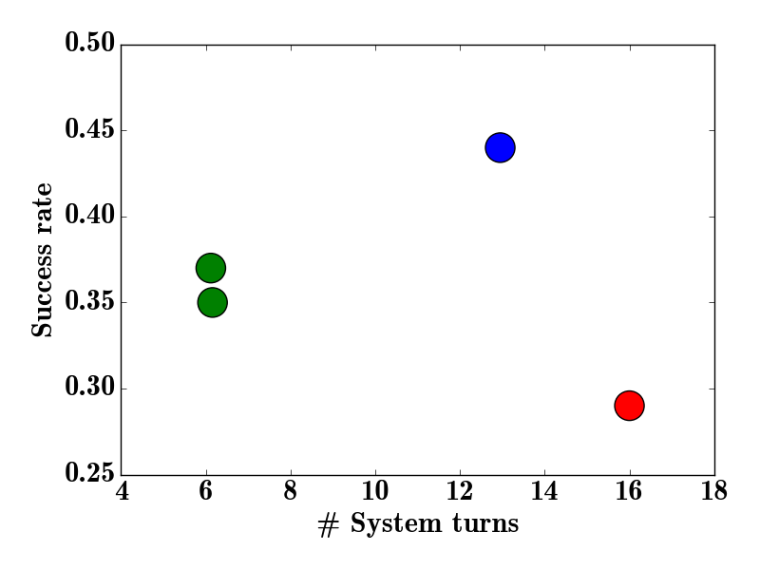
RL for OAL Results
Systems evaluated on dialog success rate and average dialog length.

Slide 40
RL for OAL Results
Systems evaluated on dialog success rate and average dialog length.
We prefer high success rate and low dialog length (top left corner)

Slide 41
RL for OAL Results
Learned policy is more successful than the baseline, while also using shorter dialogs on average.
Learned
Static

Slide 42
RL for OAL Results
If we ablate either group of features, the success rate drops considerably but dialogs are also much shorter.
In both cases, the system chooses to ask very few queries.
Learned
- Query
- Guess
Static

Slide 43
Integrating Clarification and OAL Queries
Finally, we (Padmakumar et al., AAAI-2021) developed an approach that uses RL to learn a dialog policy that includes both:
  Attribute-based clarification queries that elucidate current intent.
  OAL queries (both “on topic” and “off topic”).

Slide 44
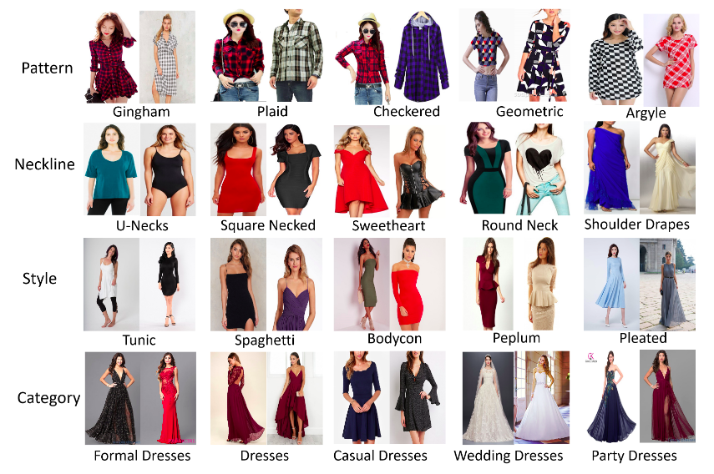
Image-Based Product Search Dataset
We simulate dialogs using the iMaterialist Fashion Attribute dataset.
Images have associated product titles and are annotated with binary labels for 228 attributes.
Attributes: Dress, Shirt, Red, Blue, V-Neck, Pleats, ...

Slide 45

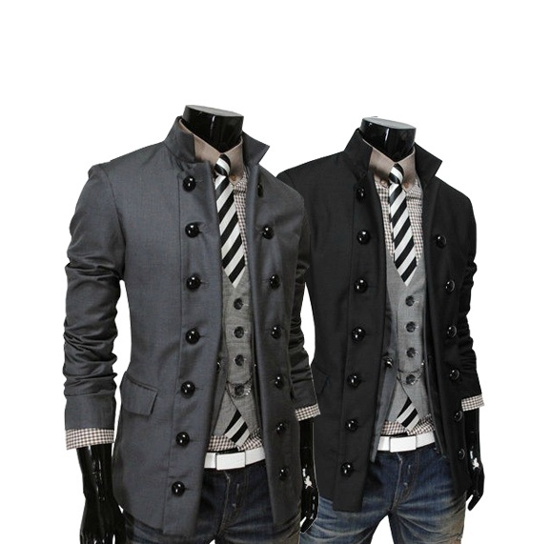

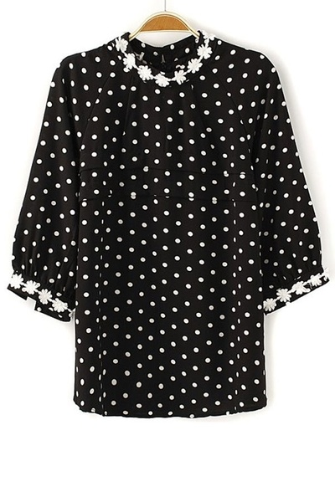
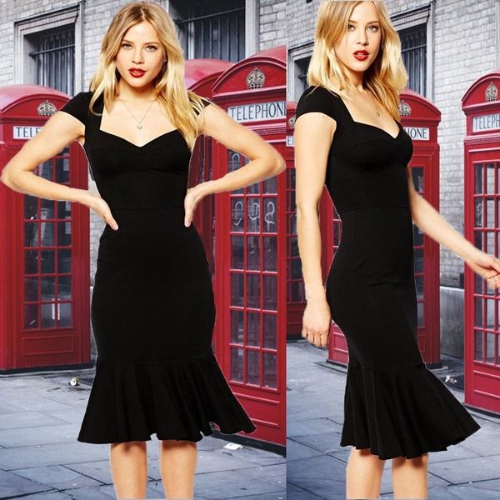
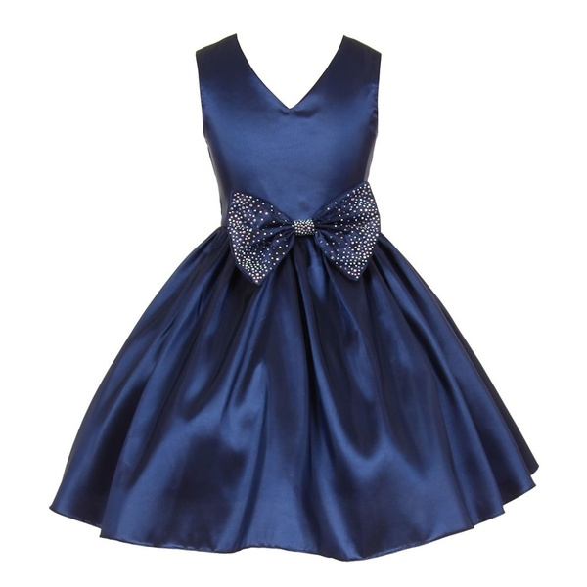
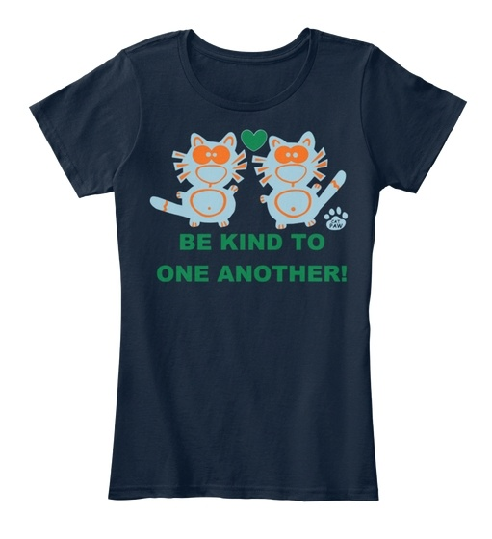
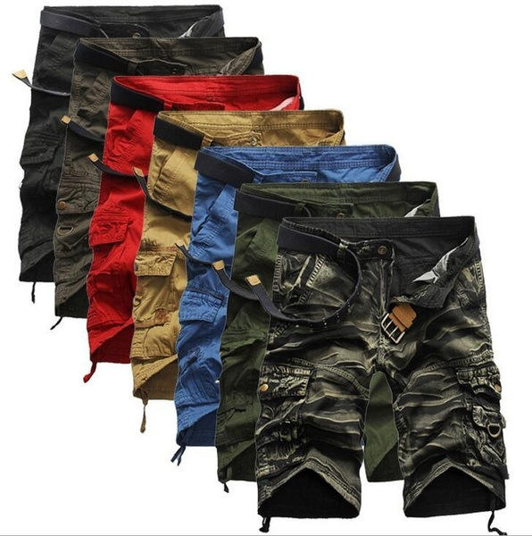
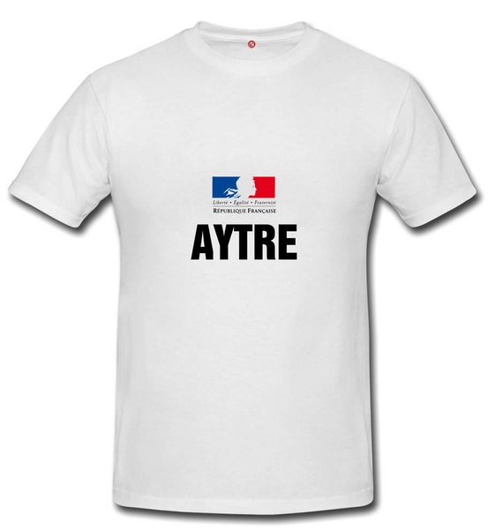
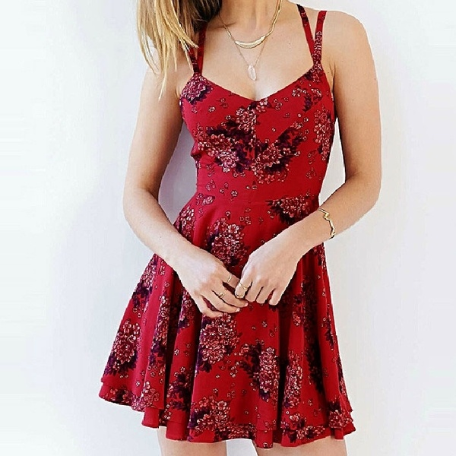




Sample Interaction
Active Training Set
Active Test Set
Notes:
Needs more text
In every interaction, we sample two sets of products to form what we call the active training and active test sets.

Slide 46
Sample Interaction
Active Training Set
Active Test Set
Target
Image
Notes:
Needs more text
We select an object from the active test set to be the target object the user is looking for

Slide 47
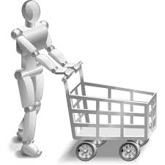
Sample Interaction
What can I help you find?
A Polka Dot Chiffon Blouse
Simulated User Query: Product title of target image
Notes:
Needs more text
We provide the product title associated with this image as the initial product description provided by the user.

Slide 48
Sample Interaction
Possible System Actions
Clarification
Label Query
Example Query
Guess
Notes:
Following this, the system can take one of the following actions.

Slide 49
Sample Interaction
Possible System Actions
Clarification
Label Query
Example Query
Guess
Notes:
Following this, the system can take one of the following actions.

Slide 50
Sample Interaction
What can I help you find?
A Polka Dot Chiffon Blouse
Would you like one which is black?
Yes
Clarification: Does selected attribute apply to target image?
Notes:
Label the system action
For a clarification, it can select another attribute, here “black”, and ask whether this applies to the target object.

Slide 51
Sample Interaction
What can I help you find?
A Polka Dot Chiffon Blouse
Would you like one which is black?
Yes
Yes/No Response: From attribute labels of target image
Notes:
Label the system action
For a clarification, it can select another attribute, here “black”, and ask whether this applies to the target object.

Slide 52
Sample Interaction
Possible System Actions
Clarification
Label Query
Example Query
Guess
Notes:
Following this, the system can take one of the following actions.

Slide 53
Sample Interaction
Active Training Set
Active Test Set
Select image for label query
Notes:
In every interaction, we sample two sets of products to form what we call the active training and active test sets.

Slide 54
Sample Interaction
What can I help you find?
A Polka Dot Chiffon Blouse
Would you describe this as sleeveless?
Yes
Label Query: Does selected attribute apply to selected image?
Notes:
Label the system action

Slide 55
Sample Interaction
What can I help you find?
A Polka Dot Chiffon Blouse
Would you describe this as sleeveless?
Yes
Yes/No Response: From attribute labels of selected image
Notes:
Label the system action

Slide 56
Sample Interaction
Possible System Actions
Clarification
Label Query
Example Query
Guess
Notes:
Following this, the system can take one of the following actions.

Slide 57
Sample Interaction
What can I help you find?
A Polka Dot Chiffon Blouse
Can you show me something you would describe as chiffon?
Example Query: Request positive example for selected attribute
Notes:
Label the system action

Slide 58
Sample Interaction
What can I help you find?
A Polka Dot Chiffon Blouse
Can you show me something you would describe as chiffon?
Example Image: From active training set, selected using attribute labels
Notes:
Label the system action

Slide 59
Sample Interaction
Active Training Set
Active learning queries reference images in the active training set so that the system is forced to learn generaliable classifiers.
Active Test Set
Notes:
Active learning queries reference images in the active training set so that the system is forced to learn generaliable classifiers.

Slide 60
Sample Interaction
Possible System Actions
Clarification
Label Query
Example Query
Guess
Notes:
Following this, the system can take one of the following actions.

Slide 61
Sample Interaction
What can I help you find?
A Polka Dot Chiffon Blouse
Is this what you were searching for?
Yes
Guess: Selects image from active test set
Notes:
Label the system action
Add a separate slide about task objective

Slide 62
Sample Interaction
What can I help you find?
A Polka Dot Chiffon Blouse
Is this what you were searching for?
Yes
0/1 Success: Compare guessed image with target image
Notes:
Label the system action
Add a separate slide about task objective

Slide 63
Sample Interaction
What can I help you find?
A Polka Dot Chiffon Blouse
Would you like one which is black?
Yes
Would you describe this as sleeveless?
Yes
Can you show me something you would describe as chiffon?
Is this what you were searching for?
Yes

Slide 64
Policy Learning
Hierarchical Dialog Policy:
  Clarification Policy: chooses best clarification.
  Active Learning Policy: chooses best active learning query.
  Decision Policy: chooses between guess, best clarification, and best active learning query.
Featurize state-action pairs
Q-Learning and A3C for policy learning

Slide 65
Policy Learning Features
Clarification Policy Features: Metrics about current beliefs, information gain estimated from classifier probabilities.
Active Learning Policy Features: Margin, Fraction of previous uses and successes.
Decision Policy Features: Metrics about current beliefs, information gain, margin, dialog length.

Slide 66
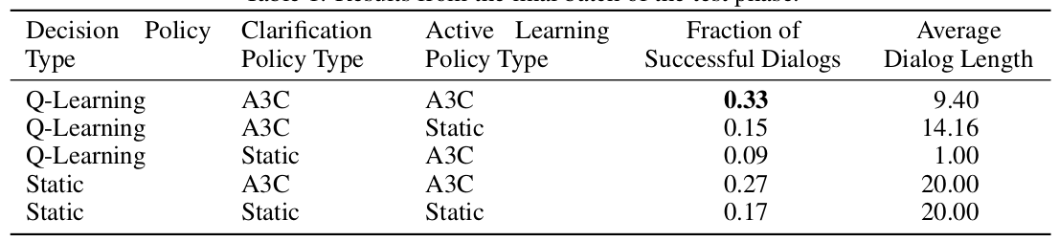
Results

Slide 67
Results
Fully learned policy is significantly more successful than the baseline, while also having significantly shorter dialogs on average

Slide 68
Results
If we replace either the clarification or active learning policies with static policies, we find that the success rate drops considerably.

Slide 69
Results
If we replace only the decision policy with a static policy, we find that it remains more successful than the baseline but is unable to shorten dialogs.

Slide 70
Future Work
Fully integrate existing methods and implement and test on real robots, tasks, and users.
Include NL dialog for teaching new tasks as well as concepts (e.g. Chai et al., IJCAI 2018).
  RL + NL for task learning (Goyal et al., IJCAI 2019, CoRL 2020).

Slide 71
Future Work
Add eye-tracking, gesture and disfluency interpretation and generation to improve robot dialog interaction (e.g. Yu et al., SIGDIAL 2015).
Use emotion and frustration detection to influence RL rewards and guide interaction.

Slide 72
Conclusions
Robot dialog is a challenging, high-impact problem that is attracting increasing attention.
Requires integrating substantial recent progress on deep-learning for language grounding and for dialog.

Slide 73
Conclusions
We have developed methods to allow lifelong learning for robot/visually-grounded dialog by acquiring knowledge from both clarification and opportunistic active learning queries.
Reinforcement learning can be used to acquire effective dialog policies that use such queries to optimize overall task performance.

