Slide 1
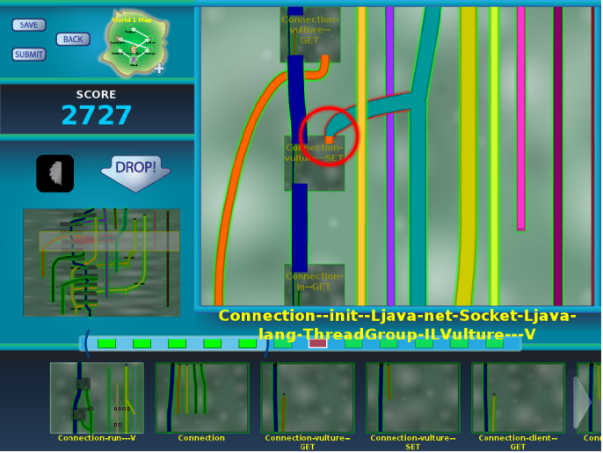
Verification Games: Making software verification fun
Michael D. Ernst
University of Washington
Notes:
My goal is to raise issues, not to present completed work.
Our community has a lot of work to do.
Ask questions!

Slide 2
Software engineering has been wildly successful
Software pervades every aspect of our lives
Try living a day without it!
Software provides the value in our gadgets
Huge economic impact
Increasingly sophisticated functionality
We always want to do more!
Notes:
If you don’t like it, try living a day without it!
Software provides (most of) the value in our gadgets. -- not to mention much value in our economy.
Today, a 500,000-line program is “medium”
And for this presentation, I’m running a 50,000,000-line program
It’s a measure of our success that we just assume we should be able to do more

Slide 3
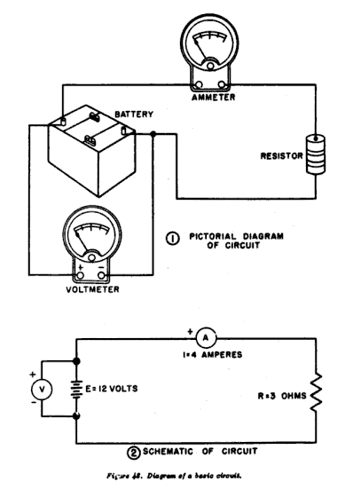
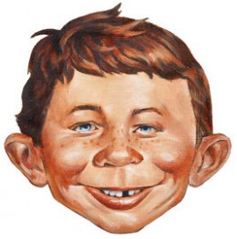
Software engineering is challenging
Mathematics:
Modeling
Analysis
A non-ideal component :
People!
Both aspects are intellectually deep
Notes:
Integration of the two parts is also deep

Slide 4
New slide??
SE has been a huge success – maybe the most of any computing field
(or just say it!)
SE encompasses technical and psychological/management [need better word!] boundaries

Slide 5
Hard problems in software engineering
Choosing modularity and abstractions
Task breakdown
Dividing tasks between people and tools
Transparent vs. powerful tools
Optimizing intractable problems
Cooperation, competition, and specialization
The role of training
Information overload
Making SE fun
Notes:
SE has been wildly successful, and will continue to be. I want to talk about some remaining problems.
* what sort and how?
* what are people good at. What about after training?
: big-picture view vs. focused tasks
: focus on problem, not program

Slide 6
Angry Birds

Slide 7
Software verification

Slide 8
Which is more fun?
Play games
Prove your program correct

Slide 9
Crowd-sourced software verification
Goal: Verify software while you wait for the bus
Make software verification easy and fun
Make the game accessible to everyone
Harness the power of the crowd

Slide 10
Programming is like a game
Fun puzzles that compel me to solve them:
minimize a test case
fix a bug
create a feature
refactor
When is it not fun?
What is usability in software engineering?
Notes:
We can learn from games.
A sense of progress and accomplishment
I love my work and I'm happy that I get paid to do it.

Slide 11
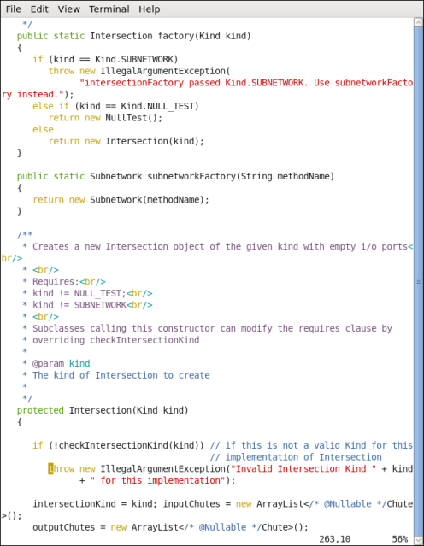
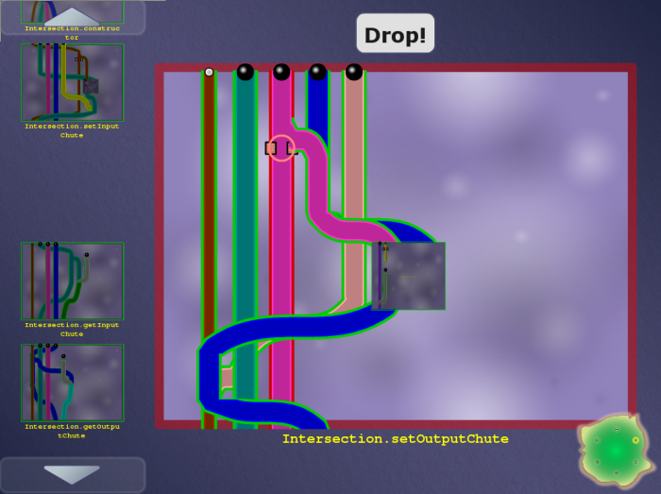
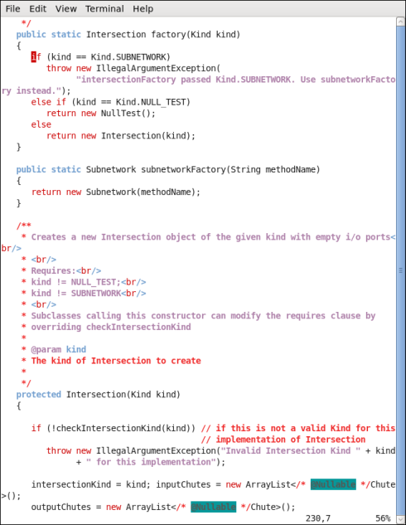
Code
Game
Automatic translation
Encodes a constraint system
Encodes a constraint system
Free labor
Highly-skilled, expensive labor
Verified software
(with proof/ annotations)
Completed game
Automatic translation

Slide 12
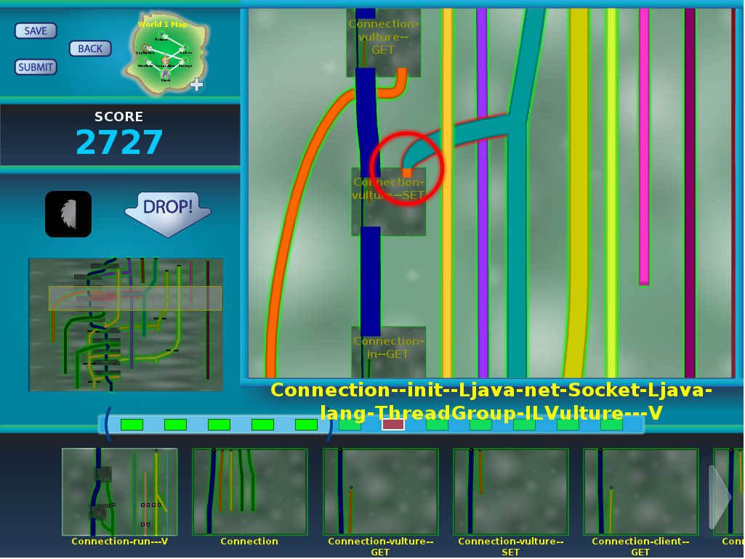
Pipe Jam game demo
Notes:
In the order: wind, earth, crash.

Slide 13
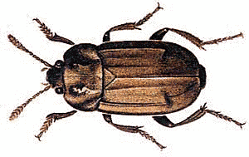
Code
Game
Automatic translation
Free labor
Highly-skilled, expensive labor
Bug detected, notify programmer
Completed game
with buzzsaws
Automatic translation

Slide 14
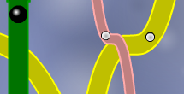
Example: encryption
Goal: no cleartext is sent over the network
Pipe ↔ a variable
Pipe width ↔ narrow: encrypted, wide: cleartext
Ball ↔ a value
Ball size ↔ small: encrypted, large: cleartext
Pinch point ↔ network communication
Unmodifiable pipe/ball ↔ cleartext from user

Slide 15
Example: null pointer errors
Goal: no dereference of null
Pipe ↔ a variable
Pipe width ↔ narrow: non-null, wide: maybe null
Ball ↔ a value
Ball size ↔ small: non-null, large: null
Pinch point ↔ dereference
Unmodifiable pipe/ball ↔ literal null

Slide 16
Program ↔ game correspondence
Intuition: dataflow
Pipe ↔ a variable
Pipe width ↔ a property of the variable (type)
Ball ↔ a value
Ball size ↔ a property of the value
Pinch point ↔ requirement
Unmodifiable pipe/ball ↔ requirement

Slide 17
Type flow vs. dataflow
Multiple flows per variable
A variable’s type may have multiple qualifiers
@Immutable Map<@English String, @NonNegative Integer>
Some variables are not represented at all
primitives (int, …) when analyzing null pointer errors
No loops
If program is verifiable, solvable in polynomial time
Human leverage: high-level pattern matching, placement of buzzsaws/casts
More accurate intuition: type constraints
Solving a game = type inference
Computers do a poor job

Slide 18
Other examples
SQL injection
unintended side effects
format string and regexp validation
incorrect equality checks
race conditions and deadlocks
units of measurement
aliasing
27 of the CWE/SANS Top 41 Most Dangerous Software Errors
…

Slide 19
Type systems for verification
Modular; local reasoning & understanding
Equally powerful as any other verification technology (theorem proving, model checking, …)
Less effective for correctness of numerical computations
Not good for full functional correctness
Not good for temporal properties (focus on data)
How do these properties help/hinder the game?

Slide 20
3-way collaboration: machines, players, verification experts
Machines: Inference and optimizations
Brute force is not feasible for large programs
Error messages from type inference systems are poor
Players do work that automated tools cannot
Use intuition & pattern-matching to place cheats
Verification experts do work that players cannot
Classify un-verifiable code as safe or insecure

Slide 21
Machine optimization
Simplify the challenge to its essence
Related to the program/problem duality
Optimization techniques:
Abstract interpretation
Type inference & constraint propagation
Heuristic solving
In Pipe Jam:
Remove multiple pinch points in a row
Remove pipes that suffer no conflicts
Set pipes to known values, forbid changes to them
Notes:
Don’t overoptimize!

Slide 22
Elide irrelevant information
Example: primitives (int), when proving lack of null pointer errors
Also loses documentation, program context!
Leave in some easy challenges so players feel good about progress

Slide 23
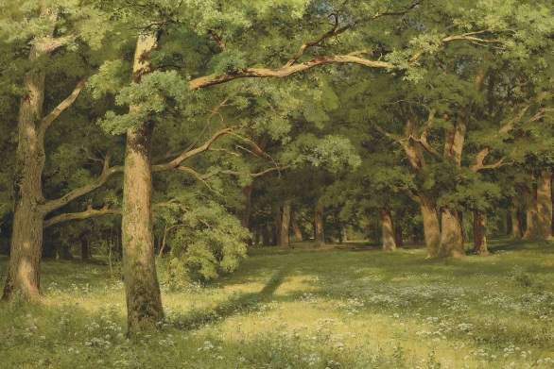
Information overload & relevance
Too much detail: player/user gets distracted
Too little detail: unable to produce useful result
Example: optimization
Example: hiding details

Slide 24
Avoiding the big picture
Novice users accomplished more when given less information but given guidance
[“Reducing the barriers to writing verified specifications”, Schiller & Ernst, OOPSLA 2012]

Slide 25
The gaming community
A potentially rich resource
Angry Birds: 5 million hours of play time per day
200,000 cumulative years spent (as of 2011)
How do gaming and developer communities differ?
Notes:
What is the best way to utilize a community?
Redundancy
Reconfigure games to adjust difficulty

Slide 26
Collaboration and competition
Collaboraton:
Teams solve challenges
Team scoring
Share solved levels, scripts
Interaction: chats, forums, …
Competition:
Leaderboards, badges, challenges

Slide 27
Managing multiple solutions
A player works on one level at a time
Score reflects effect on entire game world
Player can indicate need for changes on a different level
Player may accept a reduced score – avoid local maxima
A player/team works in its own universe
Can save, restore, merge
Best solutions made available to other players

Slide 28
Demo: Traffic Jam

Slide 29
Problem decomposition
Program design methodologies:
Procedural
Object-oriented
Functional
Logic programming
Design patterns
Lesson from software engineering:
No one organization is best for all tasks
Tradeoffs among competing desiderata
Notes:
A game design makes similar choices

Slide 30
GridWorld
Problem with Classic: action at a distance
Colored pipes are linked & have the same width
Represent different uses of the same variable
Game abstractions are same as the program’s
Goal: bring information together

Slide 31
Problem: action at a distance
Pipe colors indicate non-local dependences: uses of the same variable must be consistent

Slide 32
Organizing a program’s constraints
Programmer-supplied decomposition
Classes, methods
Programmer probably had a good reason
But: variables & calls cross-cut these structures
Alternate decomposition:
Bring together variables, split apart method bodies

Slide 33
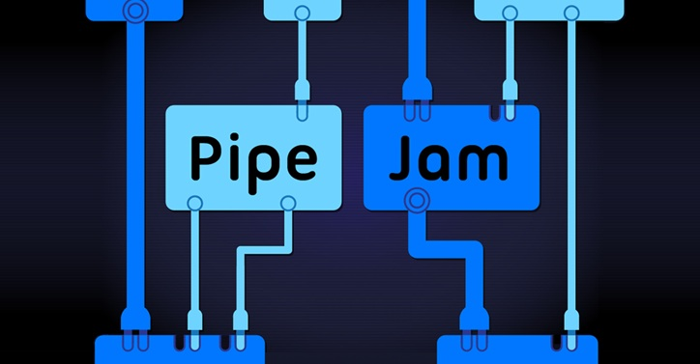
Demo: Flow Jam

Slide 34
Just a new skin for the same game
Pipes ⇒ boxes
One box for arbitrarily many pipes of the same color
Pipe connections ⇒ lines
Didn’t eliminate action at a distance, but made it explicit
Identical constraints and XML input file
Player is solving the same problem, but it feels like a different game
We plan A/B testing

Slide 35
Implications of Grid World’s variable-oriented layout
Fewer boards, but bigger ones
Lots of explicit links
Layout and navigation are more challenging
More compact representation
No traveling balls/cars, no sub-boards
See more on the screen
Two game-playing modalities: conflicts, layout

Slide 36
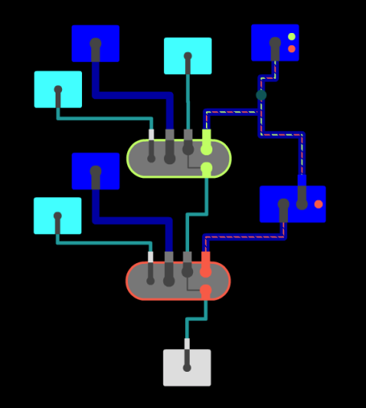
Type inference is challenging
Example: prove that myMap.get(someKey) returns a non-null value (recall: Map.get returns null if the key isn’t in the map)
myMap is declared as Map<KeyType, @NonNull valueType>
someKey is a key in myMap
Example: polymorphism (Java generics)
Notes:
Because the problem is harder than it looks

Slide 37
Design goals for a (software engineering) game
Address a hard problem
Connect players to the real work they are doing
Scale to (and be useful for) real problems
Fun
Use human skills
Minimal distractions from underlying problem
Allow and encourage collaboration

Slide 38
Designing a program analysis
(Examples: model checking, abstract interpretation)
Key problem: the abstraction
Capture the essence of the problem
Too much detail: infeasible analysis
Too little detail: does not prove desired properties
Designer insight and iteration are crucial
Each new successful abstraction is a breakthrough

Slide 39
Designing a machine learner
Key issues:
Learning algorithm (SVM, decision tree, neural network, genetic algorithm, …)
Feature space (problem representation): the information fed to the algorithm
State of the art:
Try lots of algorithms
Try lots of feature spaces
When one works, publish it

Slide 40
Designing a (software engineering) game
Goals:
Address a hard problem
Use human skills
Fun
A challenging task with no simple rules
Modularity and abstraction make it even harder

Slide 41
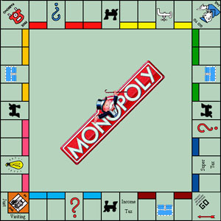
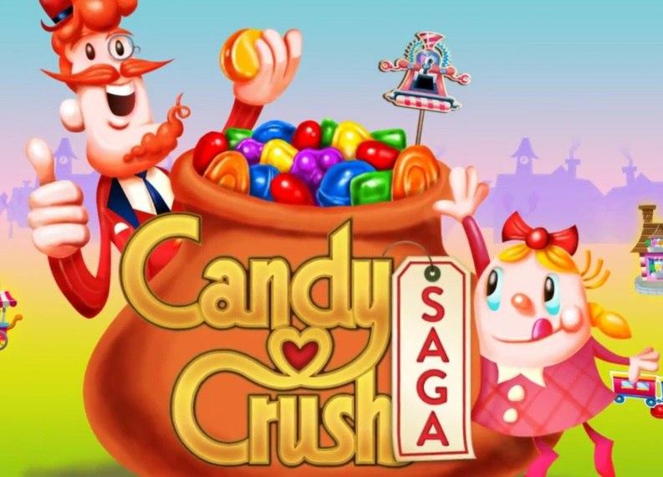
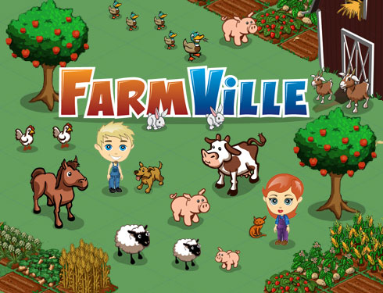
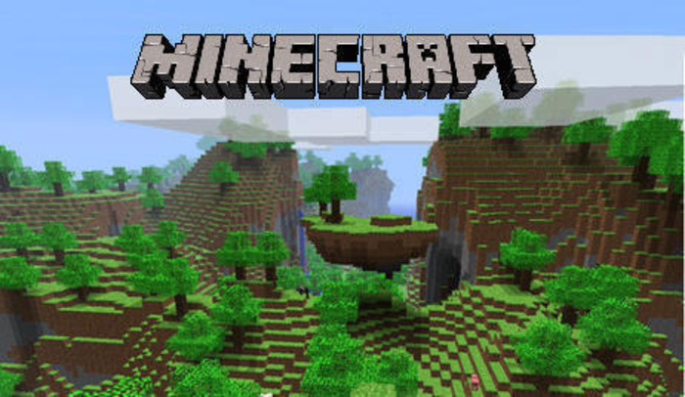
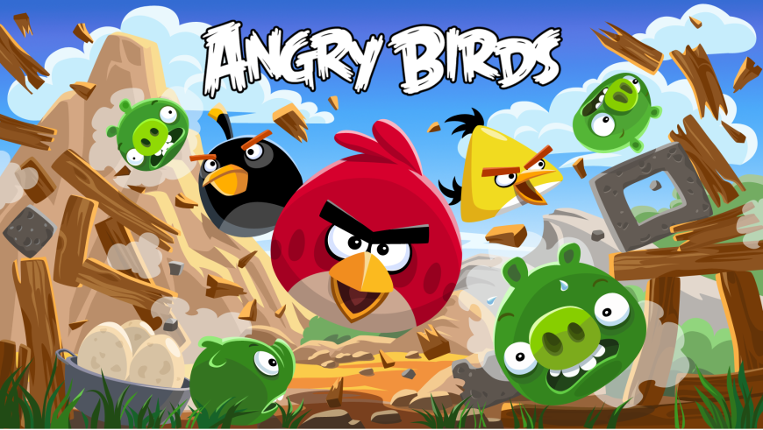
Some successful games

Slide 42
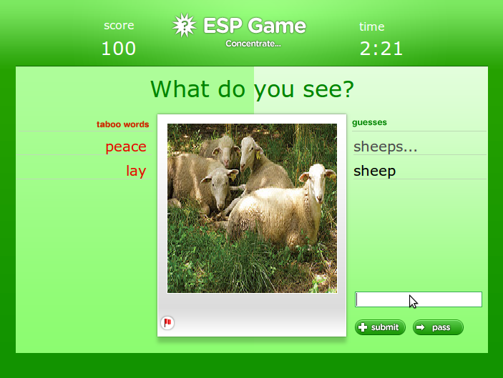
ESP game (image labeling)

Slide 43
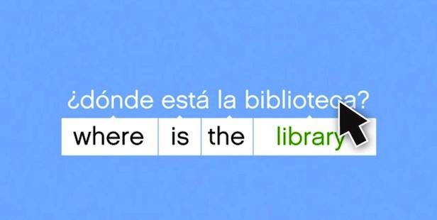
Duolingo (translation)

Slide 44
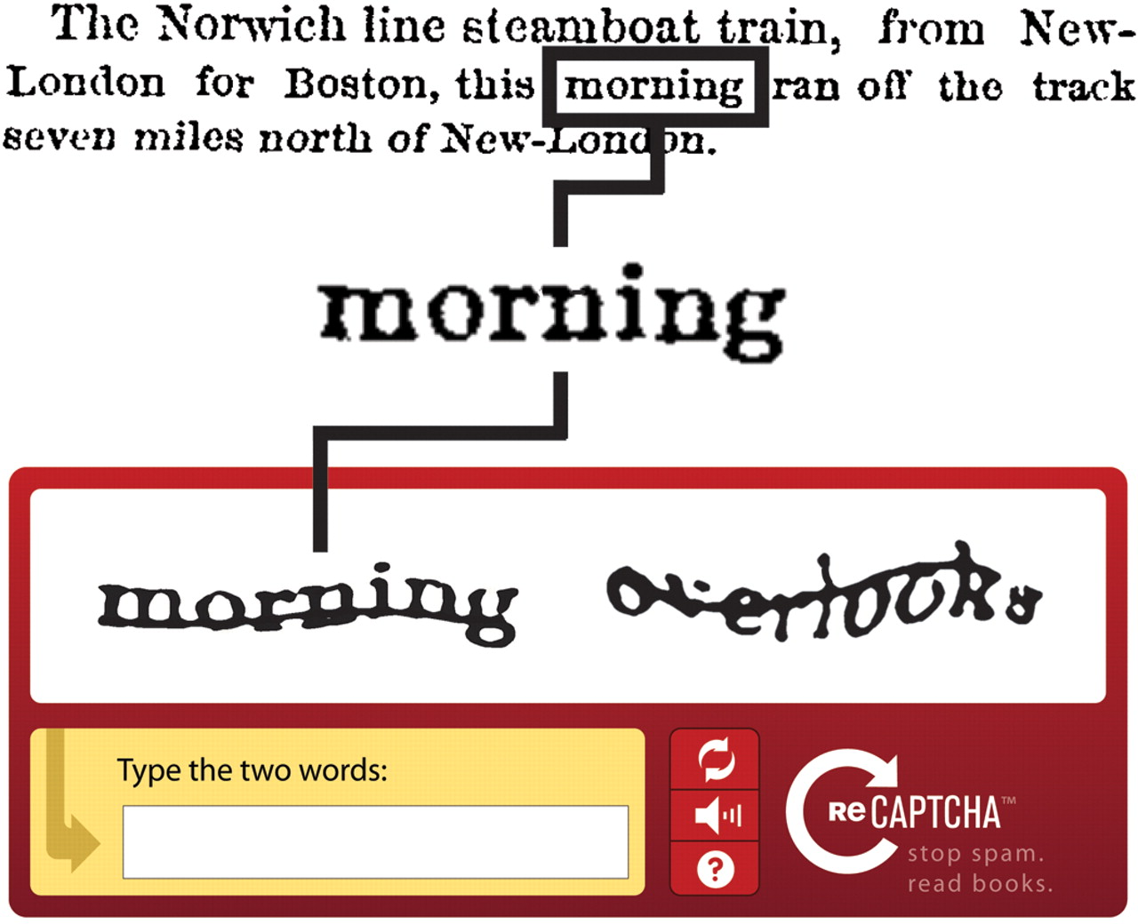
ReCAPTCHA (optical character recognition)

Slide 45
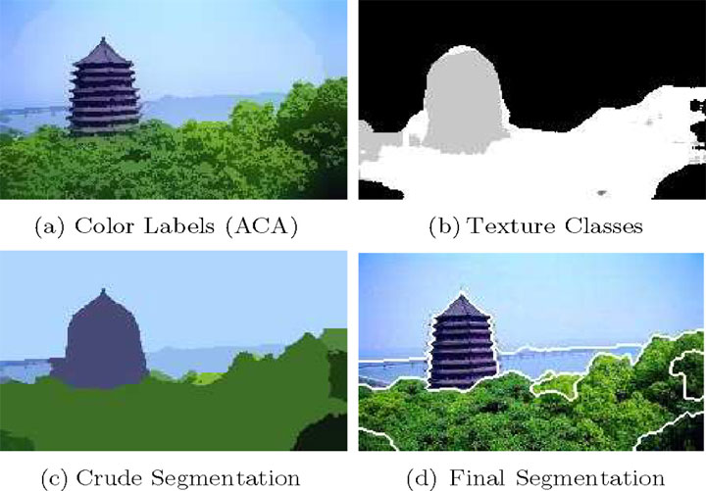
Image segmentation

Slide 46
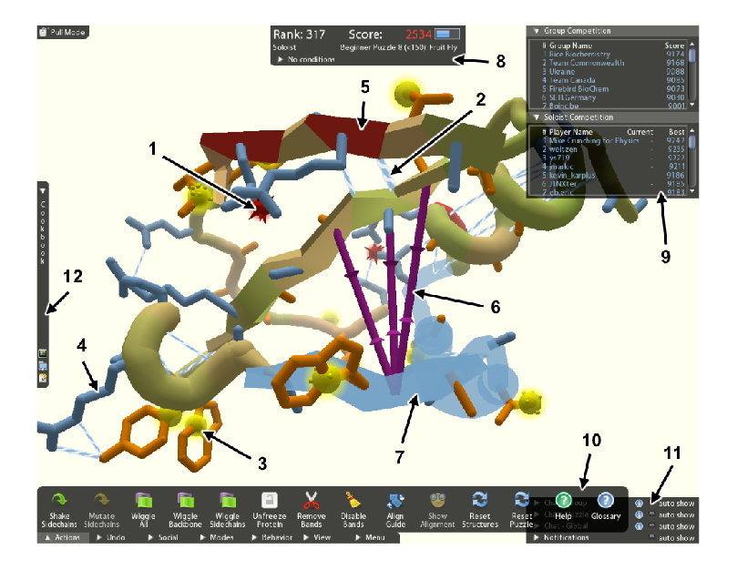
FoldIt (proteomics)
Notes:
3 Nature papers in under 2 years

Slide 47
FoldIt
Proteomics game at UW
Effectively created the genre of games that solve hard problems
Three Nature papers in under 2 years
Over 240,000 players, 200+ new per day

Slide 48
Comparison of games
Game | Abstraction? | Modularity?
Image labeling | ✗ | ✓
Translation | ✗ | ✓
OCR | ✗ | ✓
Image segmentation | ✗ | ✓
Protein folding | ✗ | ✗
Type inference | ✓ | ✓
Challenge: create more games that are abstract and modular

Slide 49
Abstraction and modularity in game design
Abstraction
Is the player doing the goal task directly?
In an abstracted game:
No need for expertise in the problem domain
No obvious connection to the real-world value
Modularity
Each player solves part of the overall problem
The system combines the contributions of different players
Programs have natural modularity, created by the programmer
In Pipe Jam:
World = program
Level = class
Board = method

Slide 50
Pipe Jam solves multiple problems
Anything that can be expressed as a type system:
null pointer errors
encryption
SQL injection
unintended side effects
format string and regexp validation
incorrect equality checks
race conditions and deadlocks
units of measurement
For a new type system:
Map type system into the Pipe Jam schema
Convert a program to a game instance
Pipe Jam also contains a layout game (different skill set)

Slide 51
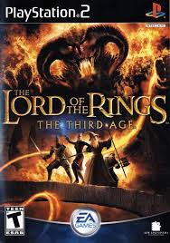
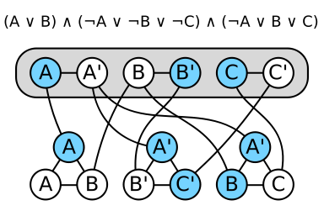
One game to rule them all?
Problem reduction: Many problems can be converted to SAT
Can we gamify all those problems simultaneously?

Slide 52
Don’t think about SAT
… when you play the game
… when you design the game
Translation to SAT:
Explodes problem size
Destroys problem structure, no human intuition

Slide 53
Casual gamers vs. trained experts
With time, players develop unique skills
A plumber might be a protein-folding savant
Our focus is not on casual gamers
Useful work comes from trained expert players
Notes:
Gaming is a gateway drug to SE

Slide 54
Human advantage
Do people outperform verification algorithms?
Inference is undecidable (human experts ≫ algorithms)
Hypothesis: no for correct, verifiable programs,
yes for incorrect or unverifiable programs
Location of buzzsaws is key to the whole approach
Game players only have to reduce overall verification cost, not fully verify the program

Slide 55
Player performs optimization
Type error (Jam): -75 (or -1000)
Wide inputs or narrow outputs: +25 (or +10)
Constant offset to make positive

Slide 56
Scoring
Score is influenced by:
Collisions (verifiability)
Use of buzzsaws (trusted assumptions)
Pipe widths, distinguishing input and output pipes (re-usability of modules)
Multiple solutions may be possible
Score is a proxy for quality of verification result
Have we just rephrased the hardest question?
Heuristics & search strategies for an optimization problem
Discover algorithms that may outperform players

Slide 57
Other games being built
Invariant detection (a la Daikon)
Model checking
Model merging
Register allocation
… your ideas here!
* These are not my ideas; many come from DARPA’s Crowd-Sourced Formal Verification Program (Dr. Drew Dean, PM)

Slide 58
Play now at Verigames.com

Slide 59
Creating test cases
Given a solved game, seek input balls that cause a conflict
This can be converted to a test case
Other games being built:
Model checking
Model merging
Register allocation

Slide 60
Pipe Jam status
Prototype exists
Tested on modest programs (~100,000 lines)
Players say it is “kind of fun”
Many challenges remain
Create tests (example failures, or counterexamples)
Scale to multiple players (parallelism, social aspects)
Make the game more fun

Slide 61
Gamification of SE (program verification)
Goal: cheaper verification ⇒ more verification
Pipe Jam and Flow Jam games…
encodes correctness condition
utilizes physical intuition & human insight
is playable by anyone
Play at http://verigames.com

Slide 62
Credits
Collaborators on Verification Games project:
Jonathan Barone, François Boucher-Genesse, Brian Britigan, Dan Brown, Jonathan Burke, Matthew Burns, Craig Conner, Seth Cooper, Werner Dietl, Stephanie Dietzel, Kate Fisher, Barb Krug, Marianne Lee, Bryan Lu, David McArthur, Nathaniel Mote, Zoran Popović, Tim Pavlik, Tyler Rigsby, Eric Reed, Eric Spishak, Brian Walker, Konstantin Weitz
Funding: DARPA

Slide 63
Hard problems in software engineering
Choosing modularity and abstractions
Task breakdown
Dividing tasks between people and tools
Transparent vs. powerful tools
Optimizing intractable problems
Cooperation, competition, and specialization
The role of training
Information overload
Making software enigneering fun
Games↔SE: A useful, if imperfect, analogy
Science benefits from:
A games perspective on SE
A SE perspective on games
May apply elsewhere

Slide 64
Disclaimer
This material is based on research sponsored by Defense Advanced Research Project Agency (DARPA) under agreement number FA8750-11-2-0221. The U.S. Government is authorized to reproduce and distribute reprints for Governmental purposes notwithstanding any copyright notation thereon. The views and conclusions contained herein are those of the authors and should not be interpreted as necessarily representing the official policies or endorsements, either expressed or implied, of Defense Advanced Research Project Agency (DARPA) or the U.S. Government.

