Slide 1
Distributed Graph-Word2Vec
Gurbinder Gill
Collaborators: Todd Mytkowicz, Saeed Maleki, Olli Saarikivi, Roshan Dathathri, and Madan Musuvathi

Slide 2
On-goining Projects

Slide 3
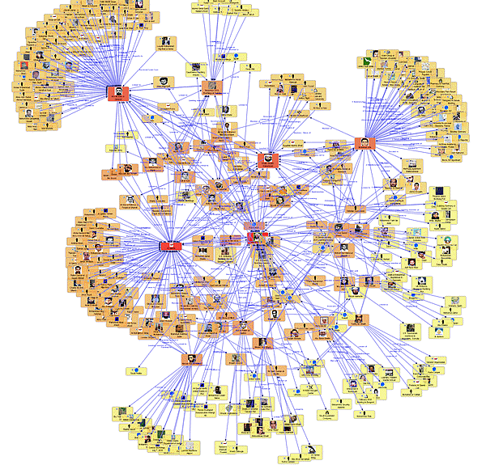
Graph analytics on large graphs
Graph are getting bigger (> 1TB in compressed format):
  Example: Web-Crawls: Cluebwe12 (1B nodes, 42B edges), Wdc12 (3.5B nodes and 128B edges)
Shared-memory graph analytics frameworks:
  Galois[UTA], Ligra[CMU], Giraph[Facebook], Pregel[Google] etc.
  Limited by the memory on a single machine
  Limited by the number of cores on a single machine
Need TBs of memory
Credits: Sentinel Visualizer

Slide 4
Graph analytics on large graphs
Distributed-memory graph analytics:
  Using distributed cluster of machines (Stampede2 at TACC, Amazon AWS, etc)
Out-of-core graph analytics:
  Store graph on external storage such as SSDs
  GraphChi[OSDI’12], Xstream[SOSP’13], GridGraph[ATC’15]
Using new memory technologies: Intel Optane
  Single machine with up to 6TB of memory
  Cheaper than DRAM and orders of magnitude faster than SSDs
Notes:
Xstream: EPFL
Gridgraph: Tsinghua university

Slide 5
Distributed Graph Analytics
Prefer Bulk Synchronous Parallel (BSP) style of execution:
  BSP round:
    Computation phase
    Communication phase
Overheads in distributed asynchronous are prohibitively high

Slide 6
Distributed Graph Analytics (BSP)
Existing distributed CPU-only graph analytics:
  Gemini [OSDI’16], PowerGraph [OSDI’12],
  Computation and communication is tightly coupled
  No way to reuse the infrastructure, such as to leverage GPUs

Slide 7
Gluon [PLDI’18]: A Communication Substrate
Novel approach to build distributed and heterogeneous graph analytics systems out of plug-and-play components
Novel optimizations that reduce communication volume and time
Plug-and-play systems built with Gluon outperform the state-of-the-art
GPU
IrGL/CUDA/...
Gluon Plugin
CPU
Gluon Comm. Runtime
Galois/Ligra/...
CPU
Gluon Plugin
Gluon Comm. Runtime
Gluon Comm. Runtime
Partitioner
Partitioner
Network (LCI/MPI)
Network (LCI/MPI)
Galois [SoSP’13]
Ligra [PPoPP’13]
IrGL [OOPSLA’16]
LCI [IPDPS’18]
5
Notes:
Exploits invariants in partitioning policy chosen at runtime
First multi-host multi-GPU framework

Slide 8
Vertex Programming Model
Every node has a label
  e.g., distance in single source shortest path (SSSP)
Apply an operator on an active node in the graph
  e.g., relaxation operator in SSSP
Operator: computes labels on nodes
  Push-style: reads its label and writes to neighbors’ labels
  Pull-style: reads neighbors’ labels and writes to its label
Applications: breadth first search, connected component, pagerank, single source shortest path, betweenness centrality, k-core, etc.
R
W
push-style
R
W
pull-style
6
Notes:
Neighborhood

Slide 9
Distributed Graph Analytics
Graph is partitioned among machines in the cluster
B
C
A
D
F
G
E
H
I
J
Original graph

Slide 10
Partitioning
Host h1
Host h2
B
C
A
D
F
G
E
H
I
J
Original graph
Partitions of the graph
7

Slide 11
Partitioning
Host h1
Host h2
Each edge is assigned to a unique host
B
C
A
D
F
G
E
H
I
J
Original graph
Partitions of the graph
7

Slide 12
Partitioning
Host h1
Host h2
Each edge is assigned to a unique host
All edges connect proxy nodes on the same host
B
C
B
C
B
C
D
A
D
A
F
G
F
G
F
G
E
H
E
H
I
J
I
J
J
Original graph
Partitions of the graph
7

Slide 13
Partitioning
Host h1
Host h2
Each edge is assigned to a unique host
All edges connect proxy nodes on the same host
A node can have multiple proxies: one is master proxy; rest are mirror proxies
B
C
B
C
B
C
D
A
D
A
F
G
F
G
F
G
E
H
E
H
I
J
I
J
J
: Master proxy
: Mirror proxy
Original graph
Partitions of the graph
7

Slide 14
CuSP Partitioner [IPDPS’19]
Host h1
Host h2
Each edge is assigned to a unique host
All edges connect proxy nodes on the same host
A node can have multiple proxies: one is master proxy; rest are mirror proxies
1
5
2
B
C
B
C
B
C
0
D
A
D
A
0
1
4
3
F
6
G
F
G
F
G
3
E
H
E
H
2
6
I
J
I
J
J
4
7
5
A-J: Global IDs
: Master proxy
0-7: Local IDs
: Mirror proxy
Original graph
Partitions of the graph
7
Notes:
CuSP: Customizable streaming edge partitioner

Slide 15
How to synchronize the proxies?
Distributed Shared Memory (DSM) protocols
  Proxies act like cached copies
  Difficult to scale out to distributed and heterogeneous clusters
Host h1
Host h2
B
C
B
C
A
D
F
G
F
G
E
H
I
J
J
: Master proxy
: Mirror proxy
8

Slide 16
How does Gluon synchronize the proxies?
Exploit domain knowledge
  Cached copies can be stale as long as they are eventually synchronized
Host h1
Host h2
1
8
B
C
B
C
0
A
8
D
F
G
F
G
1
8
E
8
H
I
J
J
: Master proxy
: Mirror proxy
: distance (label) from source A
9

Slide 17
How does Gluon synchronize the proxies?
Exploit domain knowledge
  Cached copies can be stale as long as they are eventually synchronized
Use all-reduce:
  Reduce from mirror proxies to master proxy
  Broadcast from master proxy to mirror proxies
Host h1
Host h2
1
B
C
B
C
0
8
A
1
D
F
G
F
G
1
1
E
8
H
I
J
J
: Master proxy
: Mirror proxy
: distance (label) from source A
9

Slide 18
Gluon Distributed Execution Model
Host h1
Host h2
CuSP partitioner
CuSP partitioner
Galois/Ligra on multicore CPU or
IrGL/CUDA on GPU
Galois/Ligra on multicore CPU or
IrGL/CUDA on GPU
Gluon comm. runtime
MPI/LCI
MPI/LCI
Gluon comm. runtime
Galois [SoSP’13]
Ligra [PPoPP’13]
IrGL [OOPSLA’16]
LCI [IPDPS’18]
11

Slide 19
Other projects:
A Study of Partitioning Policies for Graph Analytics on Large-scale Distributed Platforms [VLDB’19]
Phoenix: A Substrate for Resilient Distributed Graph Analytics [ASPLOS’19]
Abelian: A Compiler for Graph Analytics on Distributed, Heterogeneous Platforms [EuroPar’18]
Gluon-Async: A Bulk-Asynchronous System for Distributed and Heterogeneous Graph Analytics [PACT’19]
Single Machine Graph Analytics on Massive Datasets Using Intel Optane DC Persistent Memory [arXiv]

Slide 20
Distributed Graph-Word2Vec
Gurbinder Gill
Collaborators: Todd Mytkowicz, Saeed Maleki, Olli Saarikivi, Roshan Dathathri, and Madan Musuvathi

Slide 21
Word2Vec: Finding Embedding of Words
(Embedding)
Vocabulary (V)
Notes:
Unique words are mapped to contextually relevant words

Slide 22
Word2Vec: Finding Embedding of Words
Embeddings capture semantic and syntactic similarities for words
Vector representations are used for many downstream tasks:
  NLP, Advertisement, etc.
Notes:
Unique words are mapped to contextually relevant words

Slide 23
Training of Word2Vec family of algorithms
Problem:
  Takes long time, often measured in days.
  Difficult to parallelize and distribute:
    Updates are sparse
    Accuracy may drop
Contributions: GraphWord2Vec
  Formulated as a graph problem.
    Use state-of-the-art distributed graph analytics frameworks.
  Sound model combiner to preserve accuracy
  Training time from ~2 days to ~3 hours
    Without loss of accuracy
    ~14x over state-of-the-art shared memory
Notes:
Speeding up training of Word2Vec (finding word embeddings) family of algorithms
Distributing Word2Vec computation

Slide 24
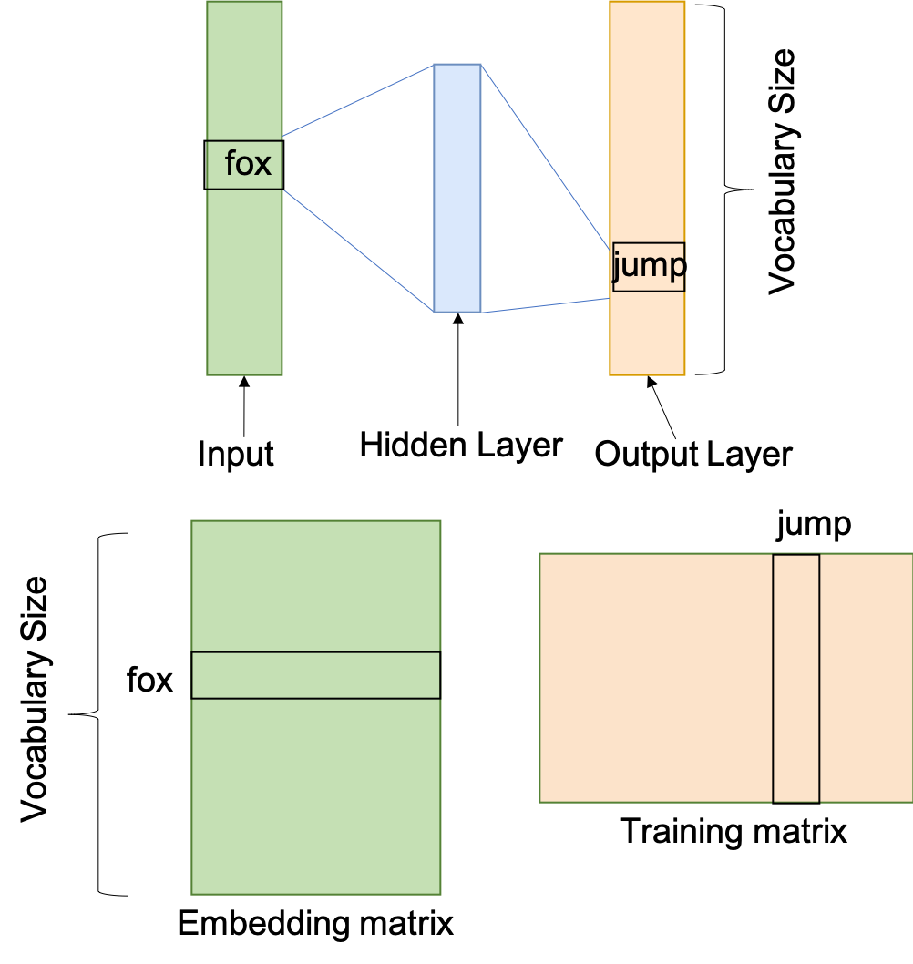
Word2Vec
Every unique word in the vocabulary has:
  Embedding vector (D-dimensional)
  Training vector (D-dimensional)
Positive samples: Words that appear close to each other (window size).
Negative samples: Randomly picked words from vocabulary.
Training task:
  Input: A word from training data corpus
  Task: Predict the neighboring words
Notes:
There are many techniques to get work embeddings: with deep neural networks with many layers.
The task given to neural network is of predicting the neighboring words: which

Slide 25
Word2Vec:
Positive
Training Samples
Negative
Training Samples
Window size: 2
Source Text
(fox, jumps)
(fox, over)
(fox, brown)
(fox, quick)
(fox, words)
(fox, cat)
(fox, pen)
(fox, chat) …
The quick brown fox jumps over the lazy dog.
(jumps, fox)
(jumps, brown)
(jumps, over)
(jumps, the)
…
The quick brown fox jumps over the lazy dog.
Label: 1
Label: 0

Slide 26
Word2Vec:
Vocabulary
Notes:
Sparse matrix : blank cells mean no edges
Sparcity in computation: use graph analytics

Slide 27
Word2Vec:
….
….
Training (t)
….
Embedding (e)
….
Notes:
Unlike matrix completion, Word2Vec has the nice property that it does not need human annotated labels.
Vectors are initialized to random values.
We do not explicitly construct the edges of the graph. Word2Vec generates edges on-the-fly using the worklist.
The edges generated in one epoch could be different from that in another (as they are generated based on random sampling)
Abstractly, the graph is treated as a dense matrix and Gluon optimizes communication when vertices are not touched in a particular
round.

Slide 28
GraphWord2Vec: Graph Analytics + Word2Vec
Nodes: Words in the vocabulary
Edges: Contextual relationships between words
Labels: 1 for words in the window and 0 for far off words
Node data: 2 D-dimensional vectors ( Embedding and training layer)
….
….

Slide 29
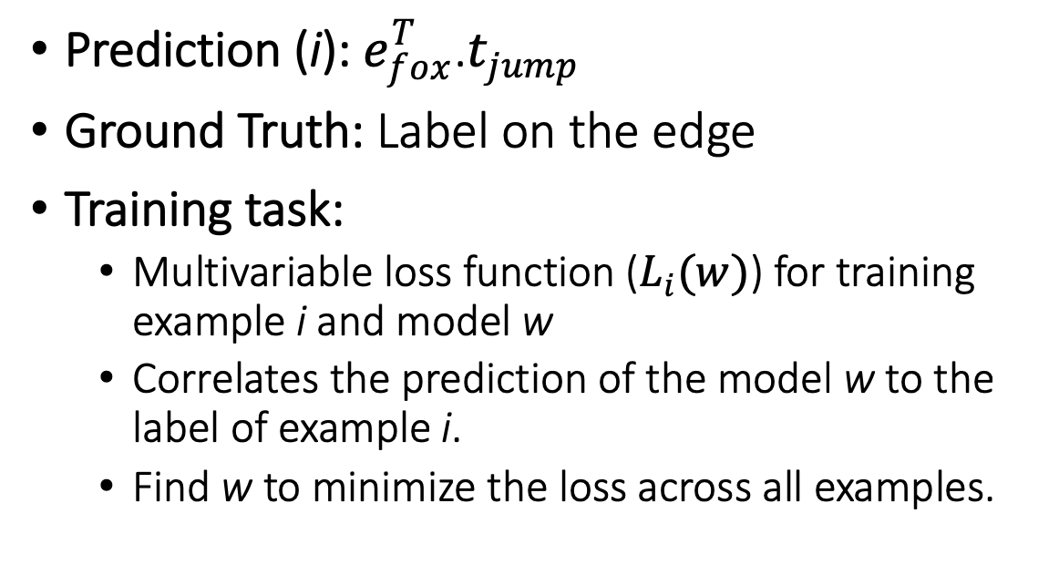
Updating Node Data
Prediction (i): $e_{fox}^{T}$.$t_{jump}$
Ground Truth: Label on the edge
Training task:
  Multivariable loss function ($L_{i}(w)$) for training example i and model w
  Correlates the prediction of the model w to the label of example i.
  Find w to minimize the loss across all examples.
e_{fox}
fox
t_{jump}
1
0
jump
t_{lazy}
lazy
Notes:
Multivariable loss function
Perfect prediction will have loss 0
Loss function penalizes more for incorrect prediction

Slide 30
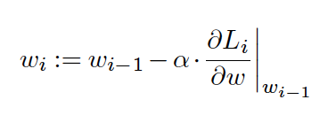
Updating Node Data
Stochastic Gradient Descent (SGD):
Learning Rate
Too small
Optimal
Too large
Parallel Stochastic Gradient Descent (SGD):
  Multiple threads work on different examples for shared memory
  Update model parameters in racy fashion (Hogwild!)
Notes:
SGD : is an iterative method for optimizing an objective function
S: coz selects the randomly selected samples to evaluate gradient
Alpha: Decays as we move towards convergence
1. Too small learning rate requires many updates before reaching the minimum point
2. The optimal learning rate switly reaches the minimum point
3. Too large of a learning rate causes drastic updates which leads to divergent behaviors
https://www.oreilly.com/library/view/statistics-for-machine/9781788295758/f7c6dca2-593c-449d-8901-b9a98e5fd1c4.xhtml
Another way to parallelize is use minibatch + generate updates and apply
Figure: alpha scales along the slope
Ipeople have shown it to work

Slide 31
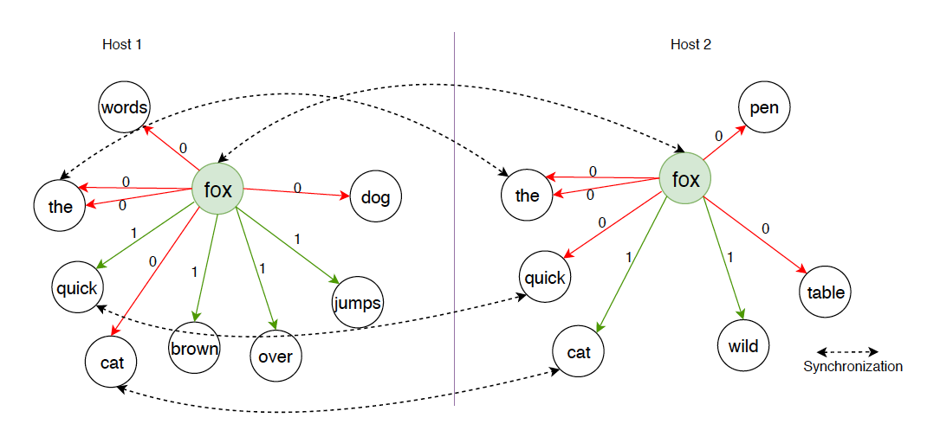
GraphWord2Vec
Training data corpus is divided among hosts
Same words can appear on different hosts
  Proxies are created on each host
  One is master and rest are mirrors
Host 1
Host 2
Host 1
Host 2
Notes:
Everyone can access the word

Slide 32
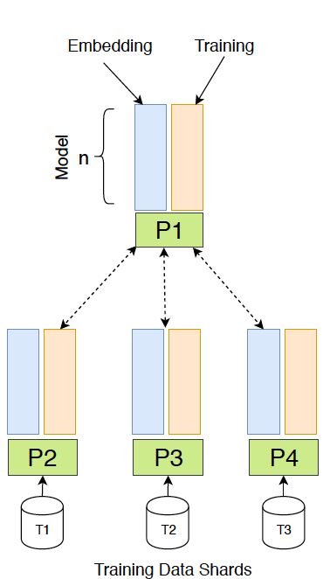
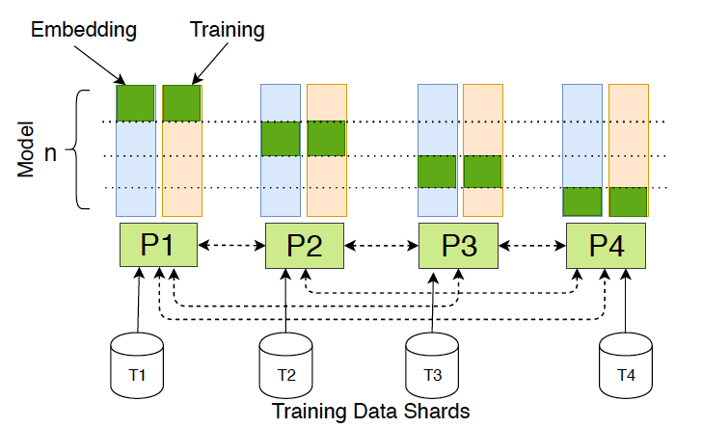
Synchronization models
Mirrors reduce on master
Master broadcasts to mirrors
Parameter Server Model
GraphWord2Vec Sync Model
Notes:
Clients/workers
Abstractly, this can be viewed as a generalization of the parameter server model where each host acts as a parameter
server for a partition of the model.

Slide 33
GraphWord2Vec
Implemented in D-Galois
  Galois[SOSP13] for local computation (Hogwild SGD)
    Worklist to store examples
    Large arrays for node data
  Gluon[PLDI18] for synchronization
    Handles sparse communication
    Only need to specify label and reduction operation
Bulk synchronous computation
Host 1
Host 2
Construct vocabulary and local graph
Construct vocabulary and local graph
Mini-Batch Computation on local graph
Mini-Batch Computation on local graph
Synchronize common words with each other
Synchronize common words with each other
Notes:
Multiple synchronization rounds within an Epoch (Mini-Batch)
Very epoch.. Edges changes. Positive and negative samples
Implicit local graph. Edges are changing every epoch

Slide 34
GraphWord2Vec: Combining Gradients
A good gradient combining method:
  Decreases the loss
  Avoid taking too large a step and diverge
Host 1
Host 2
e1_{fox}
e2_{fox}
fox
fox
Possible configurations:
Combine (e1_{fox} , e2_{fox} )
Average
(g1+g2)
/2
Model Combiner
Add
g1+g`2
g1+g2
g2
g2
g`2
g1
g2
g1
g1
(a) Parallel
(b) Grad projection
(c) Orthogonal
Notes:
Is very common in the beginning: Random initialized model all point in the same direction:
If 𝑔2 was computed
sequentially after applying 𝑔1, the magnitude of 𝑔2 would
have smaller since we already had moved in the 𝑔1 direction.
(b) quickly falls in category 2
(c) Gradient become orthogonal as it approaches the minima towards the end of execution
We project one the gradient in the orthogonal space and use that. Therefore, our approach is equivalent to a sequential execution
of SGD
We show in the paper that it is a direction to take as it fits our definition of good combiner.
Algorithmic overhead: Loss doesn’t decay as much as sequential execution
Can be extended to multiple gradients by applying induction.

Slide 35
Communication Optimizations
Naïve:
  Model is replicated on all hosts
  Send all mirror proxies to masters
  Broadcast all master proxies to all hosts
Push:
  Model is replicated on all hosts
  Only send updated mirror proxies to masters
    Bitset to track updates
  Broadcast only updated master proxies to all hosts
Notes:
(MPI collectives)
Not everything is updated. It will lead to more redundant communication
Gluon API use bit-vectors to track node updates

Slide 36
Communication Optimizations
Pull:
  Repartition model before every mini-batch (look-ahead)
    Only keep required nodes on the hosts
  Broadcast all master proxies to hosts with mirrors (look-ahead)
  Only send updated mirror proxies to masters
Notes:
(MPI collectives)
Not everything is updated. It will lead to more redundant communication
Gluon API use bit-vectors to track node updates

Slide 37
Evaluations:
Azure System:
  Intel Xeon E5-2667 with 16 cores
  220 GB of DRAM
  Up to 64 hosts
Datasets:
3rd Party:
  Word2Vec (C implementation)
  Gensim (Python implementation)
 | Vocabulary Words | Training Words | Size
1-billion | 399.0K | 665.5M | 3.7GB
news | 479.3K | 714.1M | 3.9GB
wiki | 2759.5K | 3594.1M | 21GB
Notes:
In order to measure the accuracy of trained models on different datasets, we used the analogical reasoning task outlined
by original Word2Vec
the syntactic analogies : (such as "calm" : "calmly" :: "quick" : "quickly")
The semantic analogies such as the country to capital city relationship

Slide 38
3rd Party Comparison
1 host
1 host
1 host
1 host
1 host
32 host
32 host
32 host
Word2Vec and Gensim 1 host vs GraphWord2Vec on 32 hosts
~14x overall speedup over Word2Vec
Less than <1% drop in any accuracy
Training time reduced from ~2 days to ~3 hours for Wiki with < 1% accuracy drop

Slide 39
Model Combiner on 32 hosts
AVG: Averaging gradient
MC : Model Combiner
SM: Shared memory
More than 10% accuracy drop with AVG

Slide 40
GraphWord2Vec Scaling
Synchronization frequency is doubled.
Scales up to 32 hosts.
Optimized Push performs the best at scale.
Notes:
Sparsity will increase with model size, which benefits opt
In general, we have observed that in order to maintain the desired accuracy, the synchronization frequency needs to be
increased (roughly) linearly with the number of hosts.

Slide 41
Computation Vs Communication on 32 hosts
Gluon is able to exploit sparsity in communication
Sparsity is likely to grow with model size and training data
news
wiki
Notes:
Just 32 hosts
Push and pull

Slide 42
Conclusion
ML algorithms like Word2Vec can be formulated as graph problem
  Can leverage state-of-the-art graph analytics frameworks
Implemented GraphWord2Vec:
  Word2Vec algorithm using D-Galois framework
Model Combiner:
  A novel way to combine gradients in distributed execution to maintain accuracy
GraphWord2Vec scales up to 32 hosts
Reduces training time from days to few hours without compromising the accuracy

Slide 43
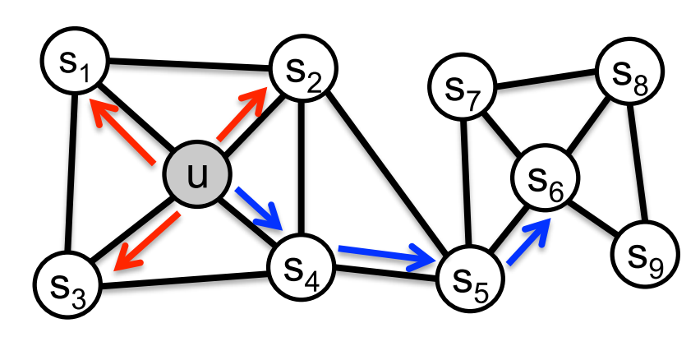
Other Any2Vec Models:
Node2Vec: Feature learning for networks
  Predicting interests of users in social networks
  Predicting functional labels of proteins in protein-protein interaction network
  Link prediction in the network (novel gene interactions)
Code2Vec: Learning distributed representation of code
  Embeddings representing snippets of code
  Captures semantic similarities among code snippets
  Predicting method names
  Method suggestion
Sequence2Vec, Doc2Vec, ….

Slide 44
~ Thank you ~
Email: Gill@cs.utexas.edu
Room No.: POB 4.112

