Slide 1
Essentials of AI for Life and Society
Peter Stone

Slide 2
Computational Foundations and Future Directions
Notes:
Title slide for lecture

Slide 3
Defining Artificial Intelligence
A science and a set of computational technologies that are inspired by, but typically operate quite differently from, the ways people use their nervous systems and bodies to sense, learn, reason, and take action
NOT one thing
More than just deep learning
RL, NLP, vision, planning, symbolic reasoning, algorithmic game theory, computational social choice, human computation
Getting Computers to do the things they can't do yet
Once it works, it's engineering

Slide 4
Some Context
We’ve covered AI Paradigms and Applications:
Planning and Search; Probabilistic Modeling; Machine Learning
Intelligent Robotics; Computer Vision; NLP
Then societal implications:
Bias and fairness; Mis/disinformation; Workplace, Economics, and Policy; Alignment and Existential Threats
Closing with some higher-level context on the relationship with the field of Computer Science
And a bit of philosophy and looking forward...
Notes:
Content slide

Slide 5
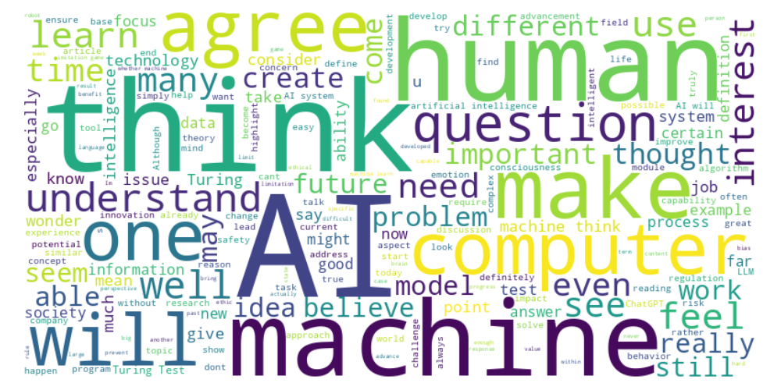
Perusall word cloud
Notes:
Content slide

Slide 6
“Thinking”
Remzy : “I think a lot from what we've learned is that we are having trouble defining what ‘thinking’ is, and how can we apply the definition to machines. ... At the end of the day, we don't fully understand the human brain enough to define how we think, or what thinking in general is, to be able to differentiate our current AI models like ChatGPT from us.”
Notes:
Content slide

Slide 7
“Understanding”
Abubakar : “How can we define ‘understanding’ in a machine, and is it actually comparable to human comprehension, or is it just an imitation?”
Notes:
Content slide

Slide 8
Weak vs. strong AI
Weak AI: computers can act intelligently
Strong AI: computers can actually think
Not narrow vs. general
Notes:
Content slide

Slide 9
Is it possible to program computers to act as intelligently as people? - Yes - No

Slide 10
Weak vs. strong AI
Weak AI: computers can act intelligently
Strong AI: computers can actually think
Not narrow vs. general
Russell and Norvig: "Most AI researchers take the weak AI hypothesis for granted, and don't care about the strong AI hypothesis."
Notes:
Content slide

Slide 11
Turing test
Joshua : “I would like to learn what Dr. Stone thinks is a near foolproof test to distinguish a human from a robot.”
Arthur : “I'm curious how AI's tendency to "lie" or hallucinate affects this. Would this be a dead giveaway in the current models?”
Edward - “Recent advancements in AI have also given them the capacity to converse with voices nearly indistinguishable to humans. What further advancements will make the Imitation game a more holistic test of indiscernibility?”
What would a computer need to be able to do to convince you that it can act as intelligently as people?
Discuss!
Notes:
Content slide

Slide 12
Upper limits
MacKena : “If AI is accelerating like it is today, where is it going to be in 30+ years?”
Maria : “Will we be able to fully understand what AI is capable of? and until when will we be able to keep growing?”
Notes:
Content slide

Slide 13
“Specialness” of Humans
Turing: “We like to believe that Man is in some subtle way superior to the rest of creation. It is best if he can be shown to be necessarily superior, for then there is no danger of him losing his commanding position. The popularity of the theological argument is clearly connected with this feeling. It is likely to be quite strong in intellectual people, since they value the power of thinking more highly than others, and are more inclined to base their belief in the superiority of Man on this power.”
Galileo: we’re not center of universe
Darwin: we’re just another animal
If we’re not the only intelligent entities, what’s left to make us special?
Notes:
Content slide

Slide 14
AI bioweapons
Weston : “While it may sound like the plot of a science fiction novel, AI bio-weapons may indeed be an area that requires more attention. While we have yet to see large-scale utilization of biological weapons in conflict contemporaneously, many countries appear to at least have resources devoted to their development and research”
Notes:
Content slide

Slide 15
Ten Priorities balancing short and long term implications
Scientific foundations: understand capabilities and limitations
Safety, reliability, and equity
Regulation
Disinformation
Resources: bridge the academia industry gap
Vibrancy of academy: mitigate “brain drain”
Jobs and economy
Diplomacy: global norms, protect human rights
Deep currents: monitory psychological, social, and cultural impacts
Catastrophic outcomes: existential threats
Notes:
Content slide

Slide 16
My hopes for your AI literacy
You know what AI really is (and isn’t) – beyond ChatGPT
You understand the main (possible) societal implications
You’ve expanded your vocabulary related to AI
If you never take another AI (or Comp. Sci.) course again, I provided a useful foundation for your career and your life
If you’re intrigued to learn more, it drives you to take more in-depth courses

Slide 17
This course will be taught again next year
What topics should I have covered that I didn’t?
What should I have skipped?
What should we do differently?
(It’s OK to also mention things you particularly liked)
Discuss!

Slide 18
Next Week: You’re on your own!
No more (assigned) readings
No more lectures
Final project due tomorrow!
Please complete both surveys – the one assigned in this week’s module, and the official university one.

