Slide 1
Essentials of AI for Life and Society
Peter Stone

Slide 2
Natural Language Processing (Large Language Models)
Notes:
Title slide for lecture

Slide 3
Defining Artificial Intelligence
A science and a set of computational technologies that are inspired by, but typically operate quite differently from, the ways people use their nervous systems and bodies to sense, learn, reason, and take action
NOT one thing
More than just deep learning
RL, NLP, vision, planning, symbolic reasoning, algorithmic game theory, computational social choice, human computation
Getting Computers to do the things they can't do yet
Once it works, it's engineering

Slide 4
Some Context
Natural Language Processing is the area that led to ChatGPT and other large language models
It’s been astounding how powerful it is to predict the next word from huge amounts of data.
Many surprising capabilities have emerged from simply scaling to more data and larger models
In many ways it has become the face of AI
Advances starting in language h
Notes:
Content slide

Slide 5
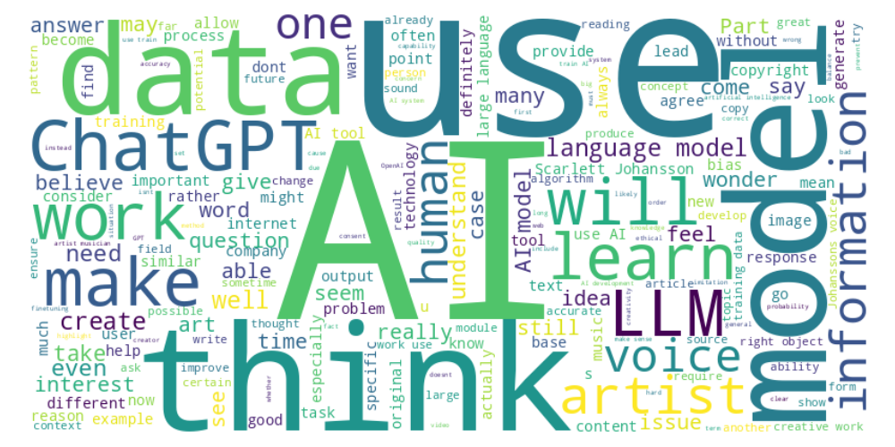
Perusal word cloud
Notes:
Content slide

Slide 6
Cost
Nathan : “Holy Cow! Why is it so expensive? Is it due to the computational power required to train these models? Is it due to the amount of servers needed for the testing?”
Robert : “For systems of billions of parameters, how do they reliably serve responses, even thousands of them, so quickly, per second?”
Notes:
Content slide

Slide 7
“Understanding”
Sindhu : “Does this mean that LMs are basically just reflections of patterns they've seen before in the training data? I guess this means that LMs don't really understand language in the same way humans do.”
Riya : “How does this work for writing code though? How can ChatGPT write excellent, perfect code based on just approximate pieces of information and then fill in the gaps? Is it true that ChatGPT is trained on several programming languages the way it is trained on English?”
Notes:
Content slide

Slide 8
Backpropagation
Alexander : “The one piece I'm not understanding here is how/when the model chooses to backpropagate.”
Notes:
Content slide

Slide 9
Hallucinations
Kevin : “At what point will we begin to shift the blame from artificial intelligence for ‘hallucinating’ towards humans? One of the primary reasons artificial intelligence is outputting wrongful answers with high confidence is because it has been fed wrongful information from the internet. Humans themselves put this information out on the internet so can we really blame artificial intelligence for hallucinating when it has been trained on data that includes humans' wrongful answers?”
Notes:
Content slide

Slide 10
Lossy Compression
Anh : “What can determine what needs to be discarded or not during the encoding process?”
Edward : Would the creation of methods to do lossless compression work better? Would they achieve the same effect with a better chance of “understanding” the information (not blurry).
Notes:
Content slide

Slide 11
Finetuning
Maya : “Since this is a smaller dataset compared to the normal gigantic dataset that the model trains on, is it given heavier weight when fine-tuning so that it's not undersaturated?” (Instruction Tuning LLMs, P19 The Full Story of LLMs)
Notes:
Content slide

Slide 12
RLHF
Satvik : “I wonder where these human annotators are selected from. It definitely seems like their biases could be injected into the model if they are not carefully chosen to be a diverse and representative group of annotators.”
Whose preferences represent “human preferences”?
Notes:
Content slide

Slide 13
Responsibility for misuse
Nathan : “I love this statement. It's not AI itself that is evil. It is evil people who use AI for evil. AI is not necessarily good or evil by itself. It is up to us to use AI for the greater good of society.”
Kevin : “What would happen if a user would bypass ...[an AI company’s safeguard] system and use their AI to create hate speech/misinformation? Would the responsibility be held on the developers of the AI or the person that used the AI for unethical purposes?”
Notes:
Content slide

Slide 14
Poll ”Is it the company’s responsibility, or the user’s?” - Company - User - Both - Neither

Slide 15
Forgetting
Isabelle : “With the policy of the right to be forgotten, how is that enacted in AI. Can AI actually forget anything?”
Notes:
Content slide

Slide 16
Uses in art
Sahil :”I think the implementation of AI into creative industries can have disastrous effects especially when it comes to the fields of art and writing where human thought and effort is massively important to the work itself. While I think AI should be implemented into fields that allow for automation of certain tasks, ideas such as AI art shouldn't be widespread.”
Should the use of generative AI by artists be banned?
Discuss!
Notes:
Content slide

Slide 17
Inspiration
Kevin : “Until artificial intelligence becomes aware enough to understand music itself and create its own works of art, will we be able to call it inspiration. To me, inspiration signifies that they have created their own new idea which AI is currently not doing.”
Sooyeon : “With how long music has been around in history, I wonder if there is ever going to be a point where it is ... possible to create new music that is not somehow a copy of any older music.”
Notes:
Content slide

Slide 18
Legal protections
Pranav : “It’s more important to protect individual creators’ rights because their livelihoods are directly impacted, but at the same time, we shouldn’t completely discourage AI-driven creativity. The key is finding a balance, allowing AI tools to thrive while ensuring fair compensation and consent from the original creators.”
Notes:
Content slide

Slide 19
Ethics Prompt
In the case of Scarlett Johansson's voice being imitated by an AI personal assistant, even if the AI was not trained directly on her voice, do you think she has a right to object or be compensated?
Similarly, assume you created an art website with a distinctive look and feel. If an AI company can prove that they didn’t train on your website, but the model produces something that looks similar anyway (maybe because both you and it got “inspiration” from the same sources), is the AI company at fault?
Where do you think the line should be drawn between inspiration and imitation? In the case of human artists, it's common to be inspired by others, but should AI be held to a different standard? Why or why not?
Discuss!
Notes:
Content slide

Slide 20
Next Week: Bias and Fairness in AI Models
One reading
Lecture by Craig Watkins
Homework 4 due tomorrow! Homework 5 due 11/8
Sign up to attend class in person
Do readings on perusall and submit ethics reflection!

Slide 21
Tesla robot
Alba : “I also would like to understand more about the new robot that was released by Elon Musk this month, and if the world should be afraid of the new changes happening.”
Notes:
Content slide

