Slide 1
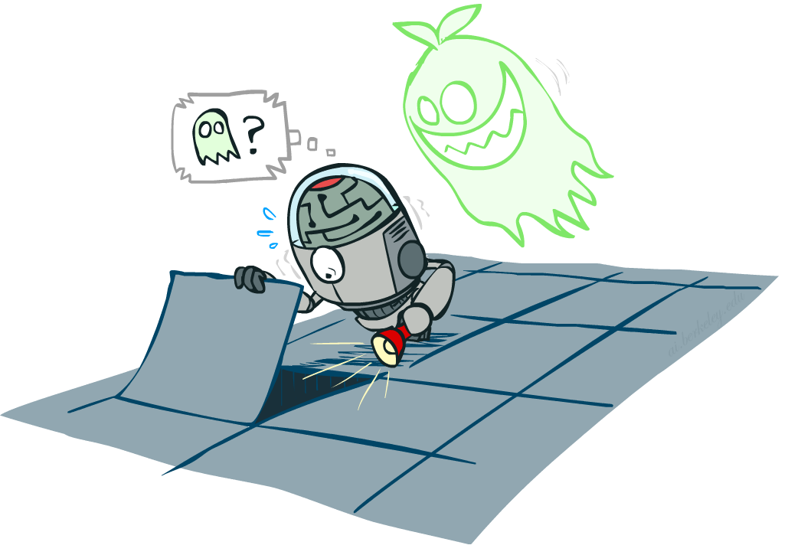
Our Status
We’re done with Part I Search and Planning!
Part II: Probabilistic Reasoning
  Diagnosis
  Speech recognition
  Tracking objects
  Robot mapping
  Genetics
  Error correcting codes
  … lots more!
Part III: Machine Learning
Notes:
Reference AI winter --- logic (exceptions, etc. + so much knowledge --- can learn)
Diagnosis: temperature, blood pressure, types of pain → disease
Speech: temporal signal of pressure variation → words and sentences
Tracking objects: e.g. helicopter you saw in last lecture, combines gps data with accelerometers, gyros and magnetic compass to infer its position and orientation using probabilistic reasoning
Robot mapping: turns out if you put a camera on the helicopter, it would not only be able to fly upside down, but also build a map of the environment!
Genetics: discovery of gene interactions from gene expression data
Error correcting codes: which we use on pretty much all our digital communication lines. They ensure that even in the presence of noise (which is everywhere) we can communicate reliably.
OK: how do we collect all that knowledge in general? --- Part III
Good news: We are going to learn about the tools that got us out of AI winter
The other news: It’s going to get very mathematical! Total shift in gears compared to what we have looked at before.
And yet other news: Time for a fresh start --- which might help if you fell behind in the past weeks.

Slide 2
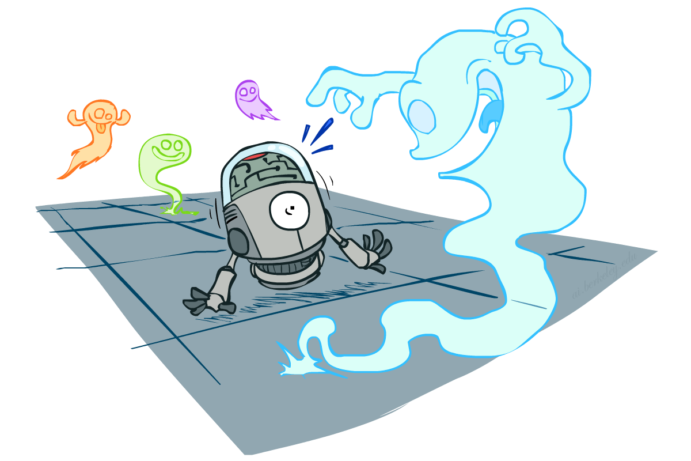
CS 188: Artificial Intelligence
Probability
Instructors: Dan Klein and Pieter Abbeel --- University of California, Berkeley
[These slides were created by Dan Klein and Pieter Abbeel for CS188 Intro to AI at UC Berkeley. All CS188 materials are available at http://ai.berkeley.edu.]
Notes:
Please retain proper attribution, including the reference to ai.berkeley.edu. Thanks!

Slide 3

Today
Probability
  Random Variables
  Joint and Marginal Distributions
  Conditional Distribution
  Product Rule, Chain Rule, Bayes’ Rule
  Inference
  Independence
You’ll need all this stuff A LOT for the next few weeks, so make sure you go over it now!
Notes:
Like “sort this list” or “add these two numbers”

Slide 4
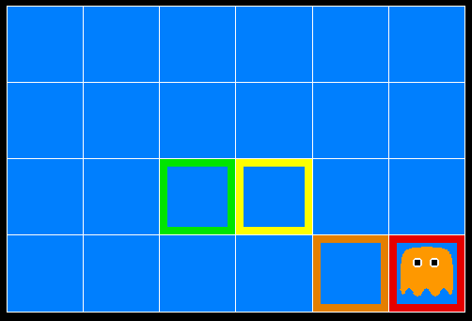
Inference in Ghostbusters
A ghost is in the grid somewhere
Sensor readings tell how close a square is to the ghost
  On the ghost: red
  1 or 2 away: orange
  3 or 4 away: yellow
  5+ away: green
Sensors are noisy, but we know P(Color | Distance)
P(red | 3) | P(orange | 3) | P(yellow | 3) | P(green | 3)
0.05 | 0.15 | 0.5 | 0.3
[Demo: Ghostbuster – no probability (L12D1) ]

Slide 5

Video of Demo Ghostbuster – No probability

Slide 6
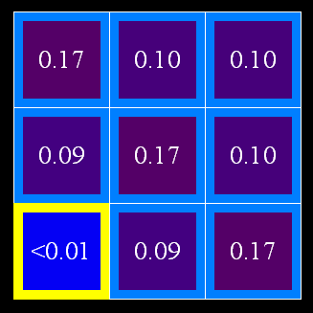
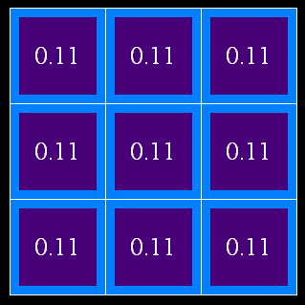
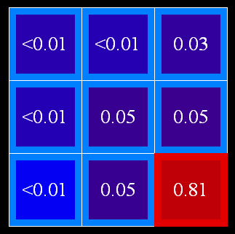
Uncertainty
General situation:
  Observed variables (evidence): Agent knows certain things about the state of the world (e.g., sensor readings or symptoms)
  Unobserved variables: Agent needs to reason about other aspects (e.g. where an object is or what disease is present)
  Model: Agent knows something about how the known variables relate to the unknown variables
Probabilistic reasoning gives us a framework for managing our beliefs and knowledge

Slide 7
Random Variables
A random variable is some aspect of the world about which we (may) have uncertainty
  R = Is it raining?
  T = Is it hot or cold?
  D = How long will it take to drive to work?
  L = Where is the ghost?
We denote random variables with capital letters
Like variables in a CSP, random variables have domains
  R in {true, false} (often write as {+r, -r})
  T in {hot, cold}
  D in [0, ∞)
  L in possible locations, maybe {(0,0), (0,1), …}

Slide 8
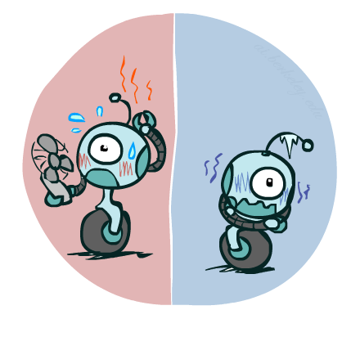

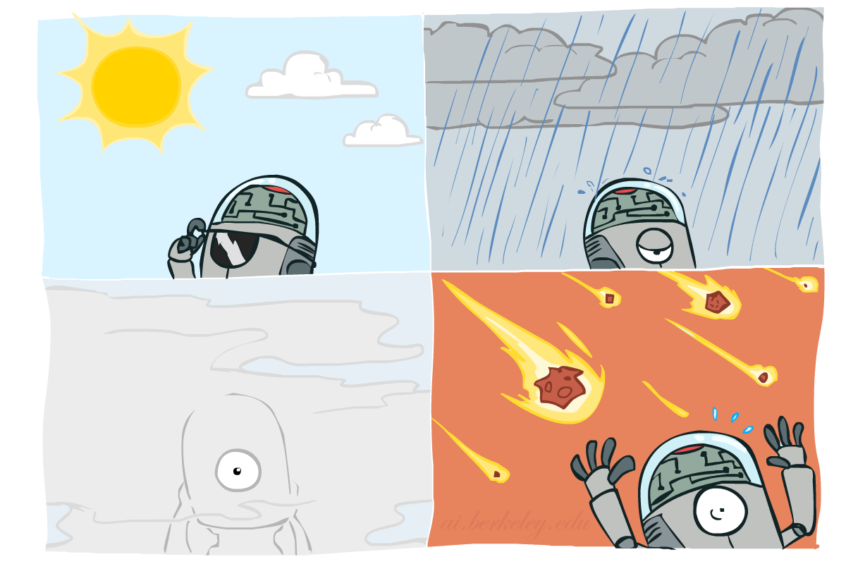

Probability Distributions
Associate a probability with each value
  Temperature:
  Weather:
W | P
sun | 0.6
rain | 0.1
fog | 0.3
meteor | 0.0
T | P
hot | 0.5
cold | 0.5

Slide 9


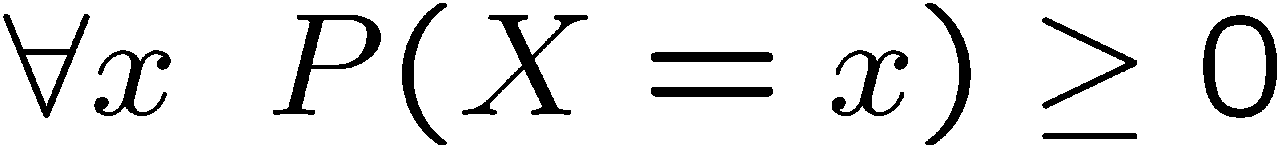
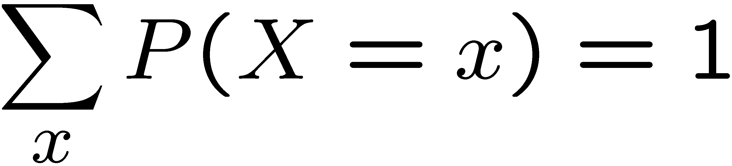
Probability Distributions
Unobserved random variables have distributions
A distribution is a TABLE of probabilities of values
A probability (lower case value) is a single number
Must have: and
Shorthand notation:
OK if all domain entries are unique
T | P
hot | 0.5
cold | 0.5
W | P
sun | 0.6
rain | 0.1
fog | 0.3
meteor | 0.0

Slide 10




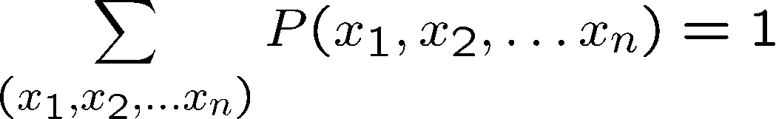
Joint Distributions
A joint distribution over a set of random variables:
specifies a real number for each assignment (or outcome):
  Must obey:
Size of distribution if n variables with domain sizes d?
  For all but the smallest distributions, impractical to write out!
T | W | P
hot | sun | 0.4
hot | rain | 0.1
cold | sun | 0.2
cold | rain | 0.3

Slide 11


Probabilistic Models
Distribution over T,W
A probabilistic model is a joint distribution over a set of random variables
Probabilistic models:
  (Random) variables with domains
  Assignments are called outcomes
  Joint distributions: say whether assignments (outcomes) are likely
  Normalized: sum to 1.0
  Ideally: only certain variables directly interact
Constraint satisfaction problems:
  Variables with domains
  Constraints: state whether assignments are possible
  Ideally: only certain variables directly interact
T | W | P
hot | sun | 0.4
hot | rain | 0.1
cold | sun | 0.2
cold | rain | 0.3
Constraint over T,W
T | W | P
hot | sun | T
hot | rain | F
cold | sun | F
cold | rain | T

Slide 12
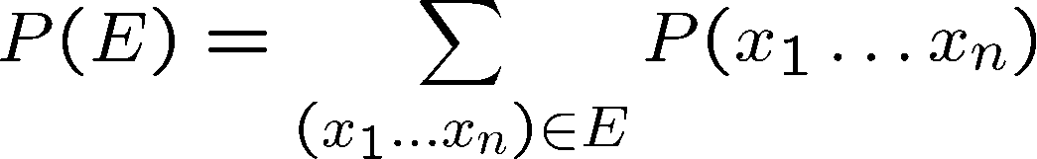
Events
An event is a set E of outcomes
From a joint distribution, we can calculate the probability of any event
  Probability that it’s hot AND sunny?
  Probability that it’s hot?
  Probability that it’s hot OR sunny?
Typically, the events we care about are partial assignments, like P(T=hot)
T | W | P
hot | sun | 0.4
hot | rain | 0.1
cold | sun | 0.2
cold | rain | 0.3

Slide 13
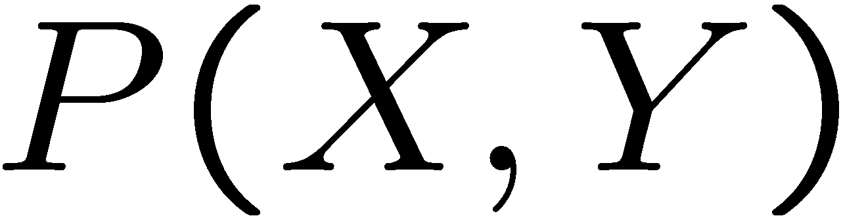
Quiz: Events
P(+x, +y) ?
P(+x) ?
P(-y OR +x) ?
X | Y | P
+x | +y | 0.2
+x | -y | 0.3
-x | +y | 0.4
-x | -y | 0.1

Slide 14
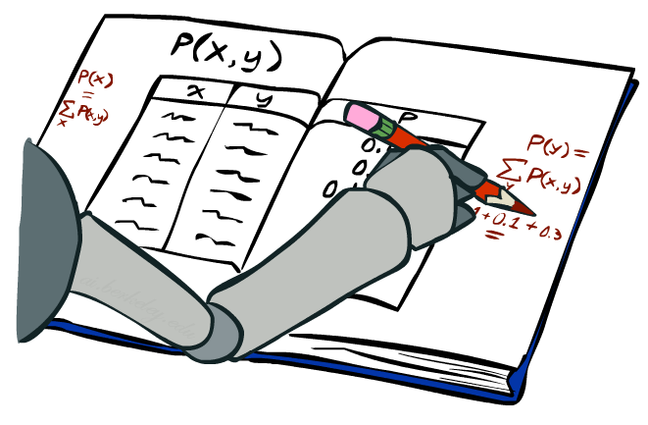
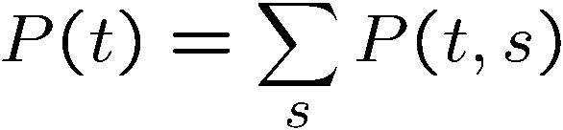
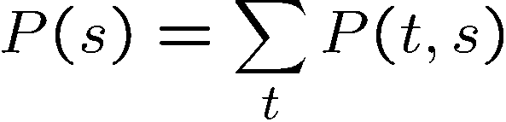
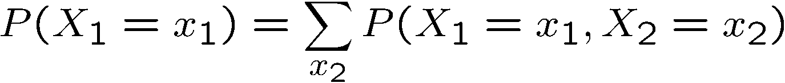
Marginal Distributions
Marginal distributions are sub-tables which eliminate variables
Marginalization (summing out): Combine collapsed rows by adding
T | P
hot | 0.5
cold | 0.5
T | W | P
hot | sun | 0.4
hot | rain | 0.1
cold | sun | 0.2
cold | rain | 0.3
W | P
sun | 0.6
rain | 0.4

Slide 15
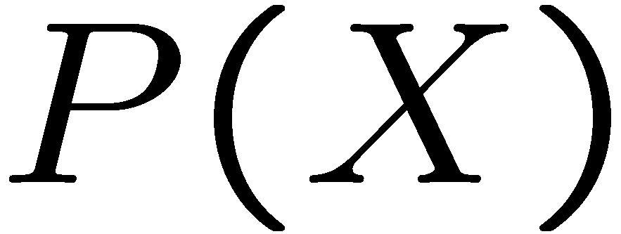
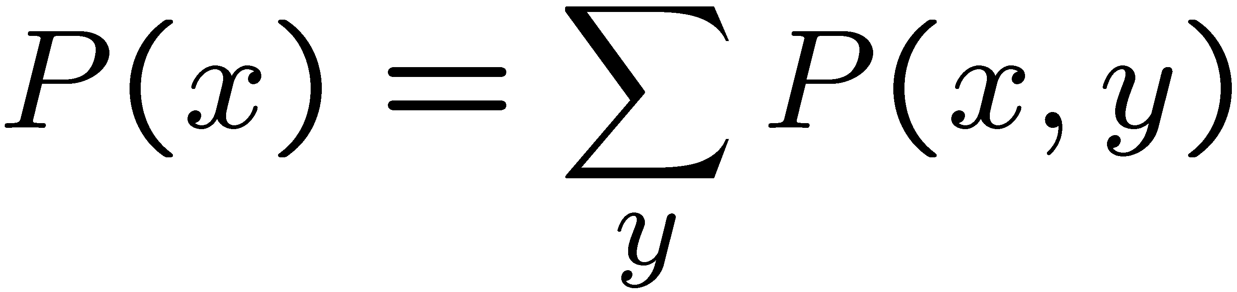
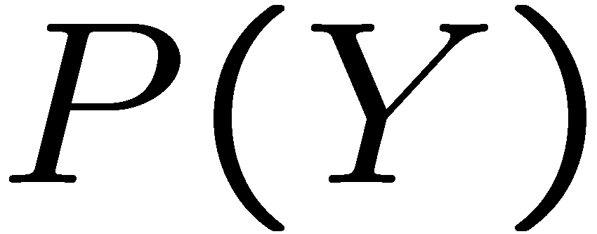
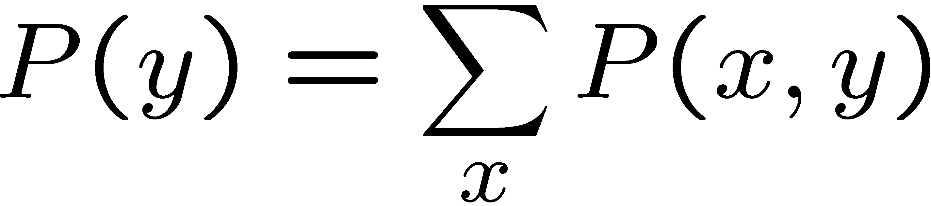
Quiz: Marginal Distributions
X | P
+x
-x
X | Y | P
+x | +y | 0.2
+x | -y | 0.3
-x | +y | 0.4
-x | -y | 0.1
Y | P
+y
-y

Slide 16
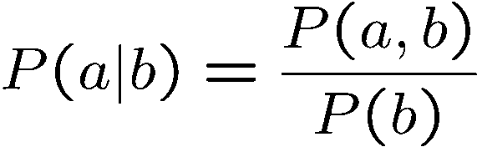
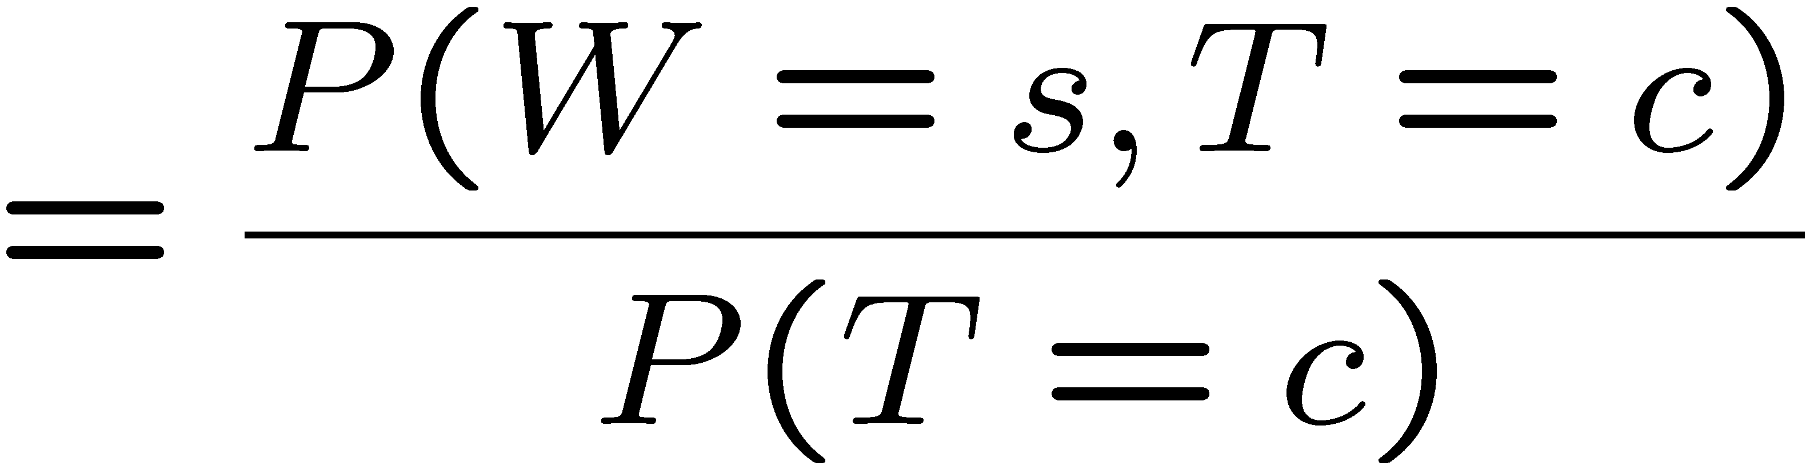
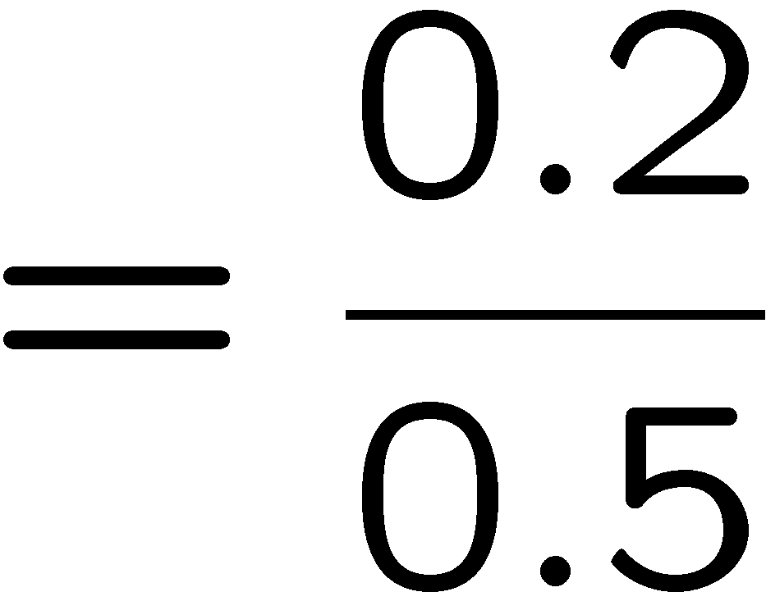



Conditional Probabilities
A simple relation between joint and conditional probabilities
  In fact, this is taken as the definition of a conditional probability
P(a,b)
P(a)
P(b)
T | W | P
hot | sun | 0.4
hot | rain | 0.1
cold | sun | 0.2
cold | rain | 0.3

Slide 17
Quiz: Conditional Probabilities
P(+x | +y) ?
P(-x | +y) ?
P(-y | +x) ?
X | Y | P
+x | +y | 0.2
+x | -y | 0.3
-x | +y | 0.4
-x | -y | 0.1

Slide 18



Conditional Distributions
Conditional distributions are probability distributions over some variables given fixed values of others
Conditional Distributions
Joint Distribution
W | P
sun | 0.8
rain | 0.2
T | W | P
hot | sun | 0.4
hot | rain | 0.1
cold | sun | 0.2
cold | rain | 0.3
W | P
sun | 0.4
rain | 0.6

Slide 19

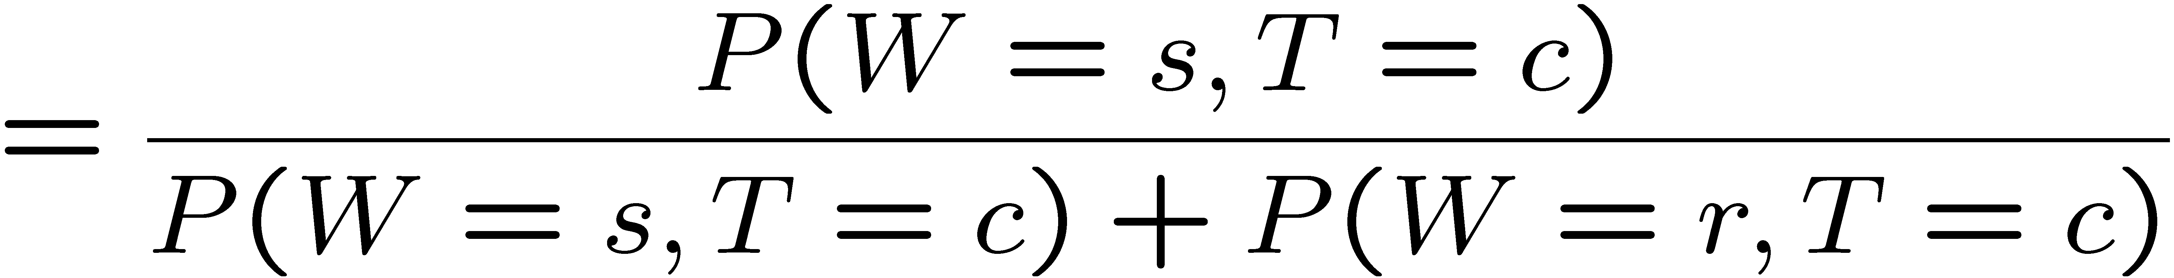
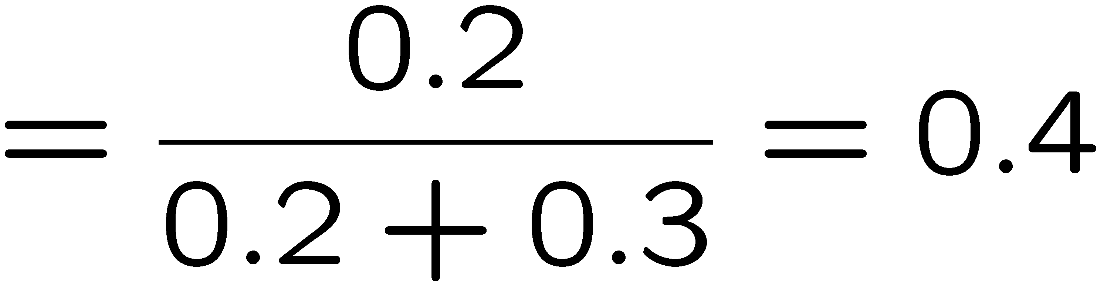

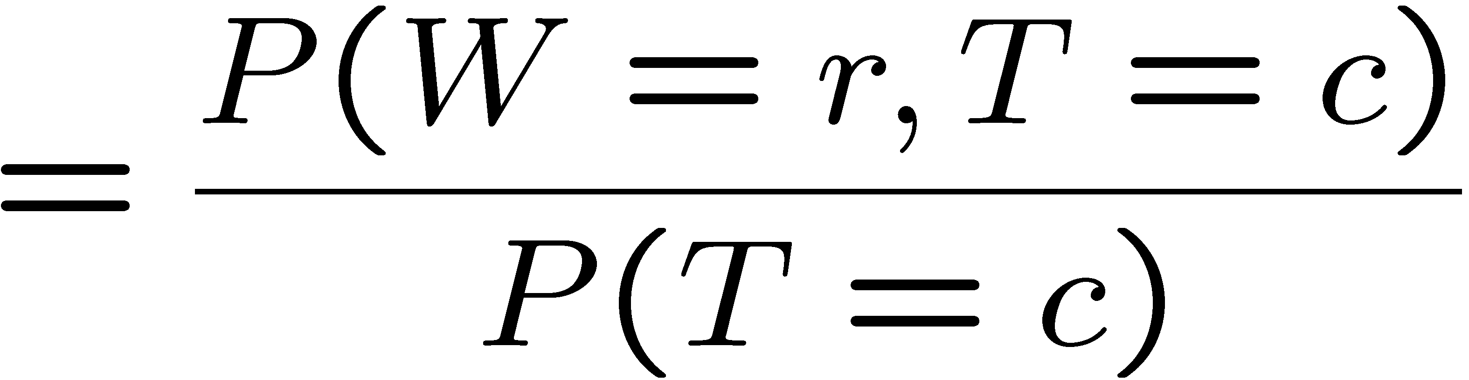

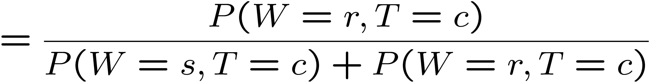
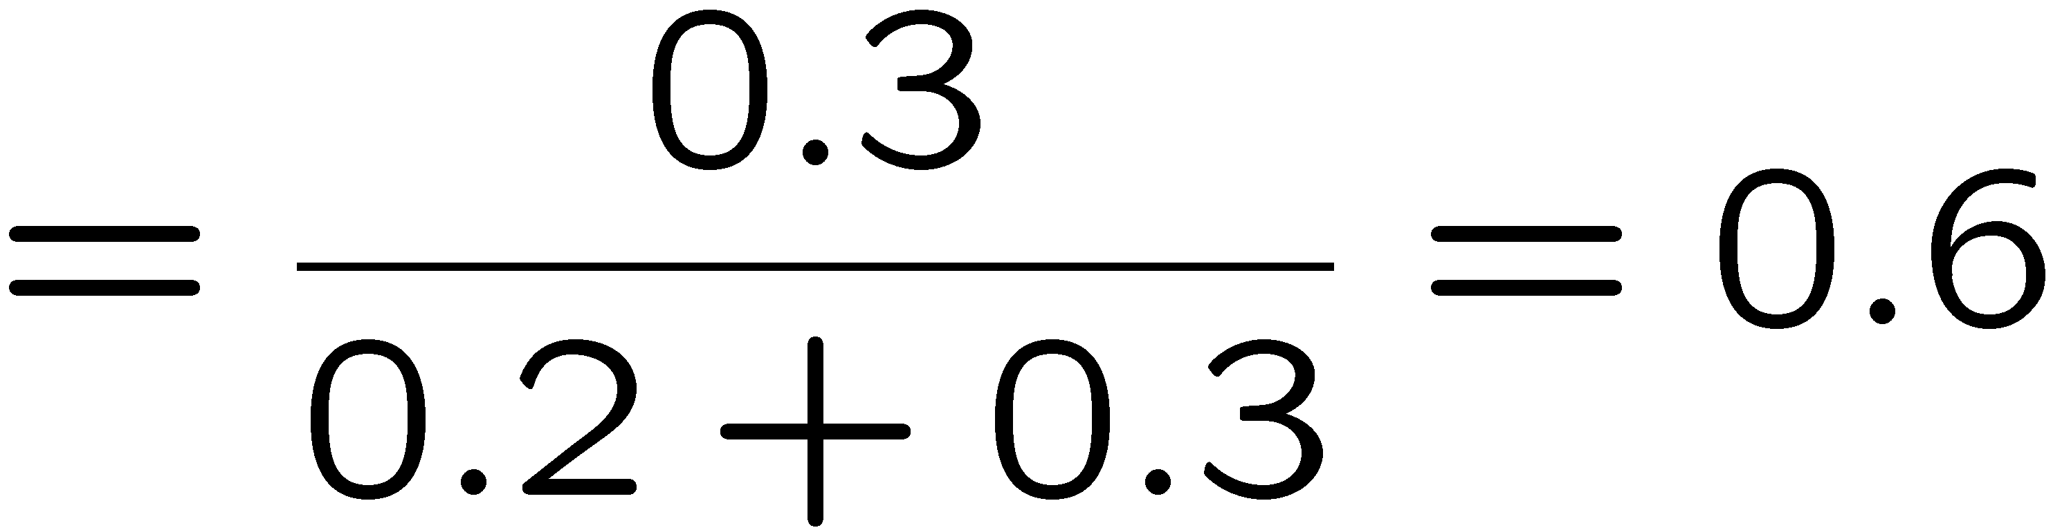
Normalization Trick
T | W | P
hot | sun | 0.4
hot | rain | 0.1
cold | sun | 0.2
cold | rain | 0.3
W | P
sun | 0.4
rain | 0.6

Slide 20

Normalization Trick
  SELECT the joint probabilities matching the evidence
  NORMALIZE the selection
  (make it sum to one)
T | W | P
hot | sun | 0.4
hot | rain | 0.1
cold | sun | 0.2
cold | rain | 0.3
T | W | P
cold | sun | 0.2
cold | rain | 0.3
W | P
sun | 0.4
rain | 0.6

Slide 21
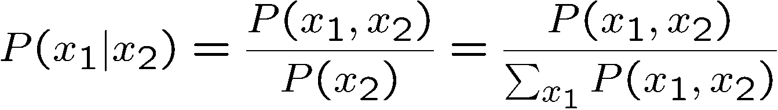
Normalization Trick
  SELECT the joint probabilities matching the evidence
  NORMALIZE the selection
  (make it sum to one)
T | W | P
hot | sun | 0.4
hot | rain | 0.1
cold | sun | 0.2
cold | rain | 0.3
T | W | P
cold | sun | 0.2
cold | rain | 0.3
W | P
sun | 0.4
rain | 0.6
Why does this work? Sum of selection is P(evidence)! (P(T=c), here)

Slide 22
Quiz: Normalization Trick
P(X | Y=-y) ?
  SELECT the joint probabilities matching the evidence
  NORMALIZE the selection
  (make it sum to one)
X | Y | P
+x | +y | 0.2
+x | -y | 0.3
-x | +y | 0.4
-x | -y | 0.1

Slide 23
To Normalize
(Dictionary) To bring or restore to a normal condition
Procedure:
  Step 1: Compute Z = sum over all entries
  Step 2: Divide every entry by Z
Example 1
All entries sum to ONE
Example 2
W | P
sun | 0.2
rain | 0.3
Normalize
W | P
sun | 0.4
rain | 0.6
T | W | P
hot | sun | 20
hot | rain | 5
cold | sun | 10
cold | rain | 15
T | W | P
hot | sun | 0.4
hot | rain | 0.1
cold | sun | 0.2
cold | rain | 0.3
Normalize
Z = 0.5
Z = 50

Slide 24


Normalization Trick
A trick to get a whole conditional distribution at once:
  Select the joint probabilities matching the evidence
  Normalize the selection (make it sum to one)
  Why does this work? Sum of selection is P(evidence)! (P(r), here)
T | W | P
hot | sun | 0.4
hot | rain | 0.1
cold | sun | 0.2
cold | rain | 0.3
T | R | P
hot | rain | 0.1
cold | rain | 0.3
T | P
hot | 0.25
cold | 0.75
Select
Normalize

Slide 25
Conditional Distributions
Conditional distributions are probability distributions over some variables given fixed values of others
Conditional Distributions
Joint Distribution
W | P
sun | 0.8
rain | 0.2
T | W | P
hot | sun | 0.4
hot | rain | 0.1
cold | sun | 0.2
cold | rain | 0.3
W | P
sun | 0.4
rain | 0.6

Slide 26

Probabilistic Inference
Probabilistic inference: compute a desired probability from other known probabilities (e.g. conditional from joint)
We generally compute conditional probabilities
  P(on time | no reported accidents) = 0.90
  These represent the agent’s beliefs given the evidence
Probabilities change with new evidence:
  P(on time | no accidents, 5 a.m.) = 0.95
  P(on time | no accidents, 5 a.m., raining) = 0.80
  Observing new evidence causes beliefs to be updated

Slide 27





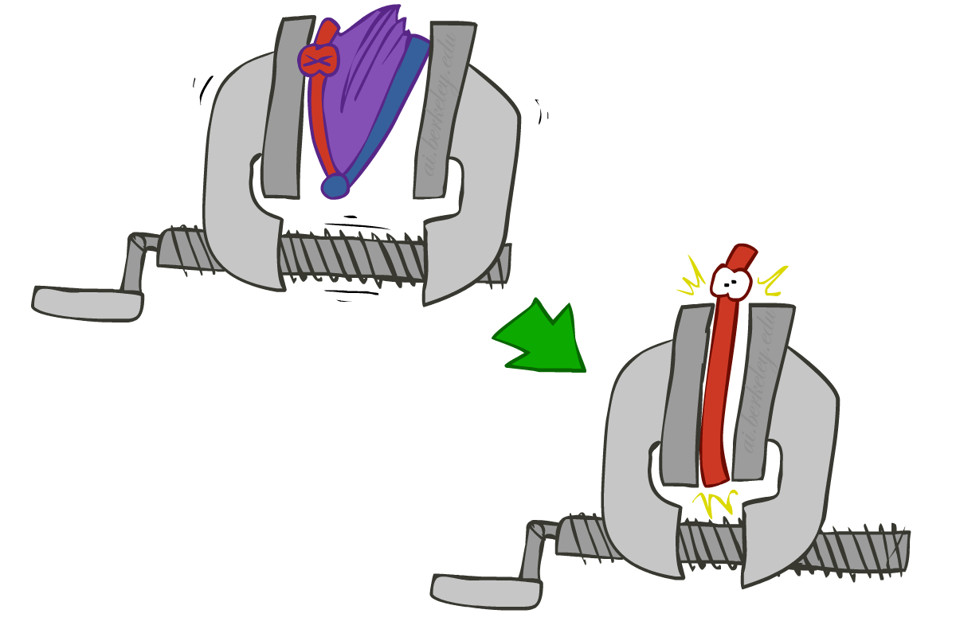
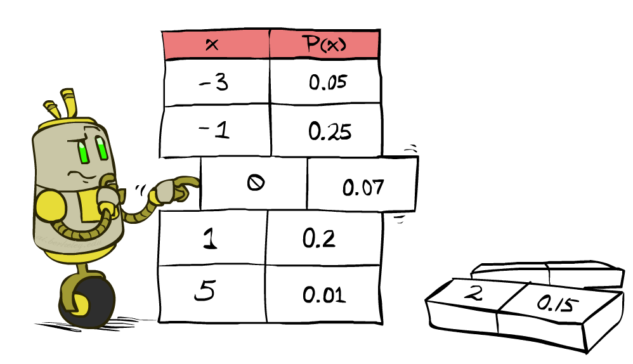


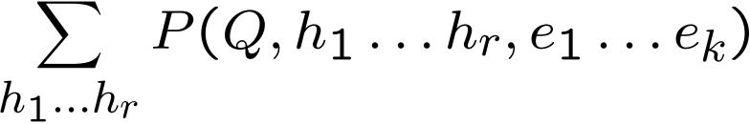
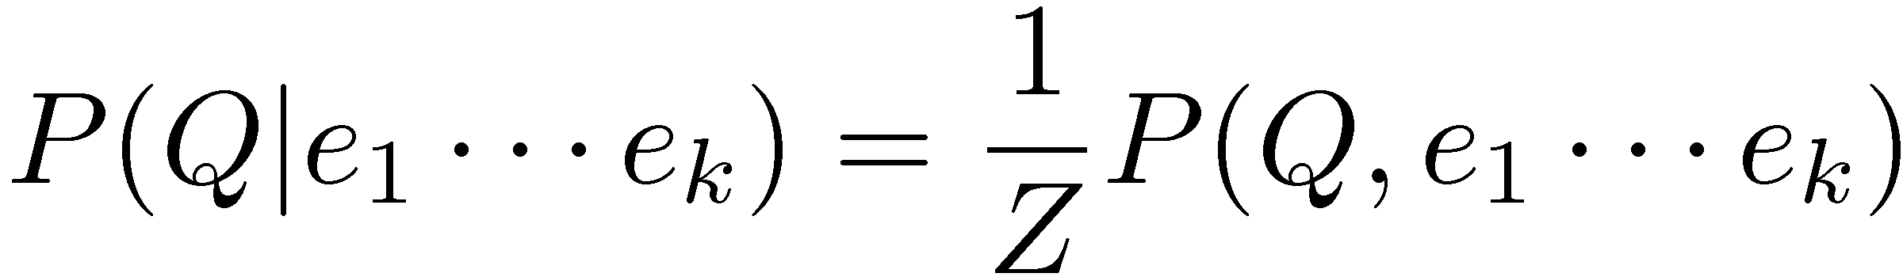
Inference by Enumeration
* Works fine with multiple query variables, too
General case:
  Evidence variables:
  Query* variable:
  Hidden variables:
We want:
All variables
Step 1: Select the entries consistent with the evidence
Step 2: Sum out H to get joint of Query and evidence
Step 3: Normalize

Slide 28
Inference by Enumeration
P(W)?
P(W | winter)?
P(W | winter, hot)?
S | T | W | P
summer | hot | sun | 0.30
summer | hot | rain | 0.05
summer | cold | sun | 0.10
summer | cold | rain | 0.05
winter | hot | sun | 0.10
winter | hot | rain | 0.05
winter | cold | sun | 0.15
winter | cold | rain | 0.20

Slide 29
Inference by Enumeration
Obvious problems:
  Worst-case time complexity O(d^{n})
  Space complexity O(d^{n}) to store the joint distribution

Slide 30
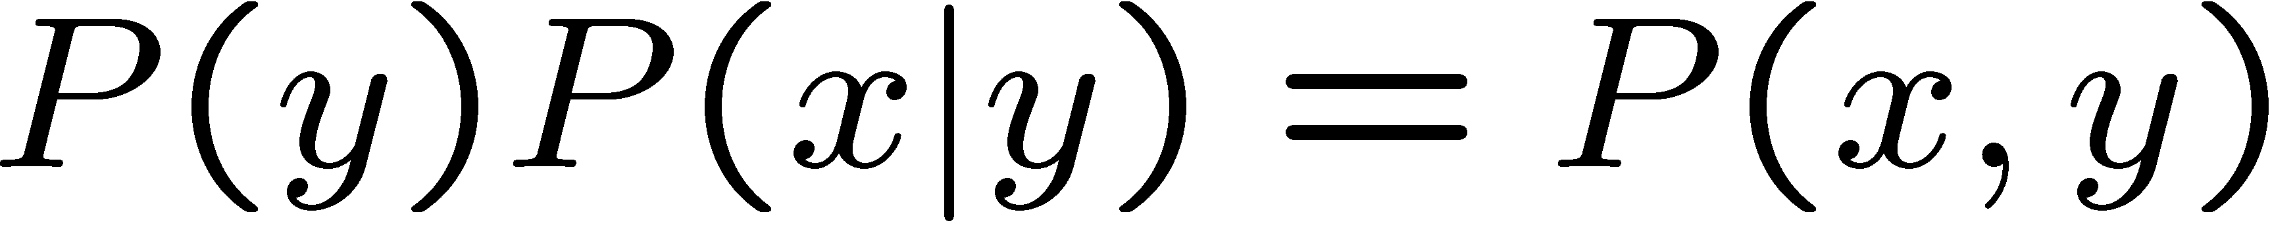

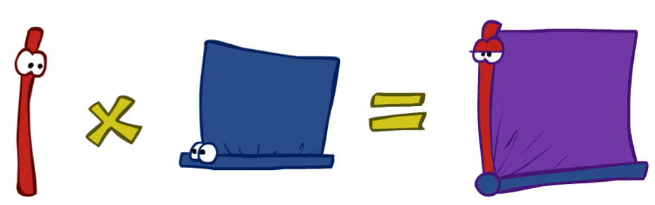
The Product Rule
Sometimes have conditional distributions but want the joint

Slide 31


The Product Rule
Example:
D | W | P
wet | sun | 0.1
dry | sun | 0.9
wet | rain | 0.7
dry | rain | 0.3
D | W | P
wet | sun | 0.08
dry | sun | 0.72
wet | rain | 0.14
dry | rain | 0.06
R | P
sun | 0.8
rain | 0.2

Slide 32
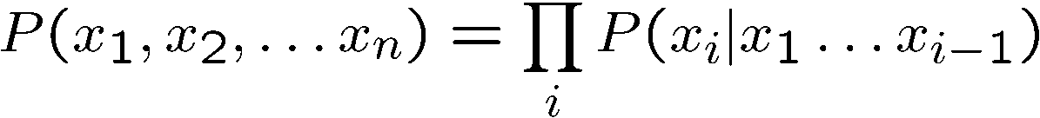
The Chain Rule
More generally, can always write any joint distribution as an incremental product of conditional distributions
Why is this always true?

Slide 33
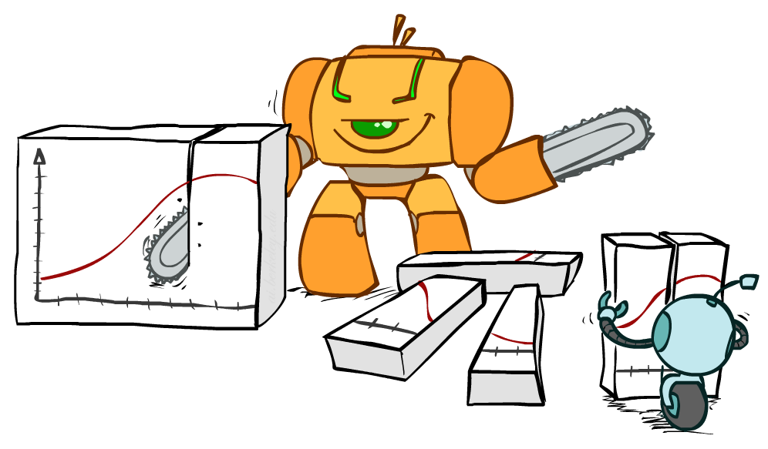
Bayes Rule

Slide 34



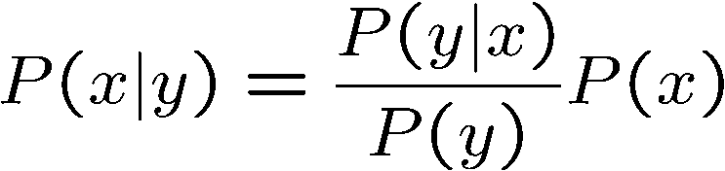
Bayes’ Rule
Two ways to factor a joint distribution over two variables:
Dividing, we get:
Why is this at all helpful?
  Lets us build one conditional from its reverse
  Often one conditional is tricky but the other one is simple
  Foundation of many systems we’ll see later (e.g. ASR, MT)
In the running for most important AI equation!
That’s my rule!

Slide 35
Inference with Bayes’ Rule
Example: Diagnostic probability from causal probability:
Example:
  M: meningitis, S: stiff neck
  Note: posterior probability of meningitis still very small
  Note: you should still get stiff necks checked out! Why?
Example
givens

Slide 36

Example: learning skin colors
We can represent a class-conditional density using a histogram (a “non-parametric” distribution)
Percentage of skin pixels in each bin
P(x|skin)
Feature x = Hue
P(x|not skin)
Feature x = Hue
Kristen Grauman

Slide 37

Example: learning skin colors
We can represent a class-conditional density using a histogram (a “non-parametric” distribution)
P(x|skin)
Feature x = Hue
Now we get a new image, and want to label each pixel as skin or non-skin.
What’s the probability we care about to do skin detection?
P(x|not skin)
Feature x = Hue
Kristen Grauman

Slide 38
Example: learning skin colors
Where might the prior come from?

Slide 39
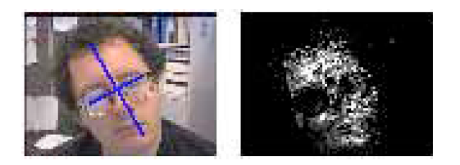
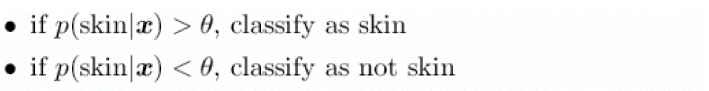
Example: learning skin colors
Now for every pixel in a new image, we can estimate probability that it is generated by skin.
Brighter pixels → higher probability of being skin
Classify pixels based on these probabilities
Kristen Grauman

Slide 40
Quiz: Bayes’ Rule
Given:
What is P(W | dry) ?
D | W | P
wet | sun | 0.1
dry | sun | 0.9
wet | rain | 0.7
dry | rain | 0.3
R | P
sun | 0.8
rain | 0.2

Slide 41

Ghostbusters, Revisited
Let’s say we have two distributions:
  Prior distribution over ghost location: P(G)
    Let’s say this is uniform
  Sensor reading model: P(R | G)
    Given: we know what our sensors do
    R = reading color measured at (1,1)
    E.g. P(R = yellow | G=(1,1)) = 0.1
We can calculate the posterior distribution P(G|r) over ghost locations given a reading using Bayes’ rule:
[Demo: Ghostbuster – with probability (L12D2) ]

Slide 42
Video of Demo Ghostbusters with Probability

Slide 43

CS 188: Artificial Intelligence
Bayes’ Nets
Instructors: Dan Klein and Pieter Abbeel --- University of California, Berkeley
[These slides were created by Dan Klein and Pieter Abbeel for CS188 Intro to AI at UC Berkeley. All CS188 materials are available at http://ai.berkeley.edu.]
Notes:
Please retain proper attribution, including the reference to ai.berkeley.edu. Thanks!

Slide 44

Probabilistic Models
Models describe how (a portion of) the world works
Models are always simplifications
  May not account for every variable
  May not account for all interactions between variables
  “All models are wrong; but some are useful.”
  – George E. P. Box
What do we do with probabilistic models?
  We (or our agents) need to reason about unknown variables, given evidence
  Example: explanation (diagnostic reasoning)
  Example: prediction (causal reasoning)
  Example: value of information
Notes:
George Box: All models are wrong; some of them are useful

Slide 45
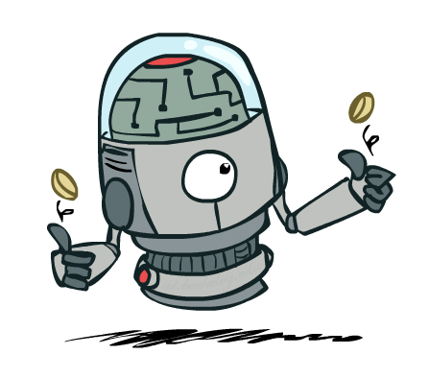
Independence

Slide 46
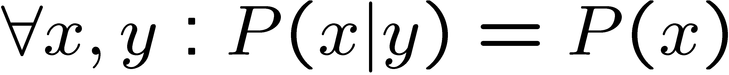

Independence
Two variables are independent if:
  This says that their joint distribution factors into a product two simpler distributions
  Another form:
  We write:
Independence is a simplifying modeling assumption
  Empirical joint distributions: at best “close” to independent
  What could we assume for {Weather, Traffic, Cavity, Toothache}?

Slide 47
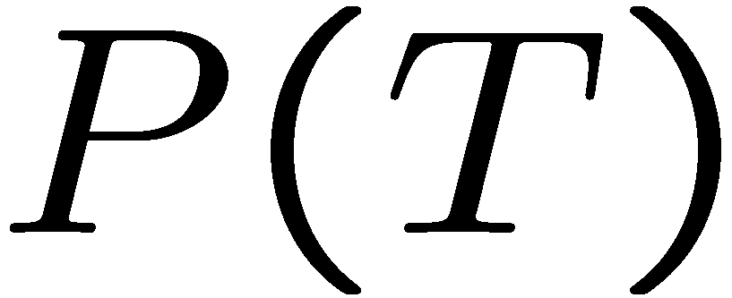
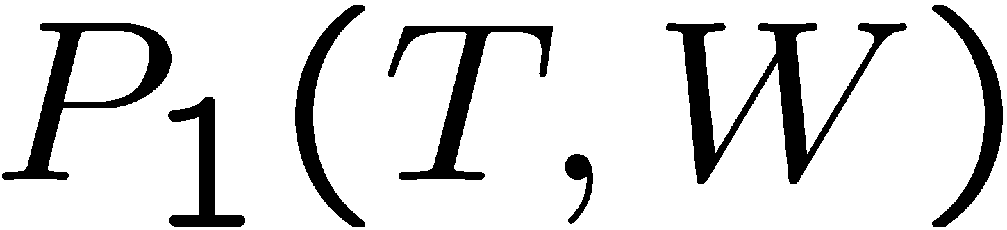
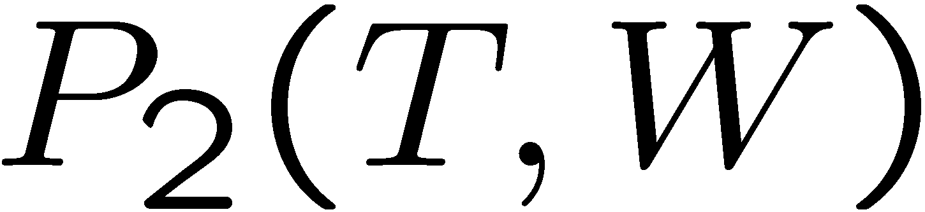
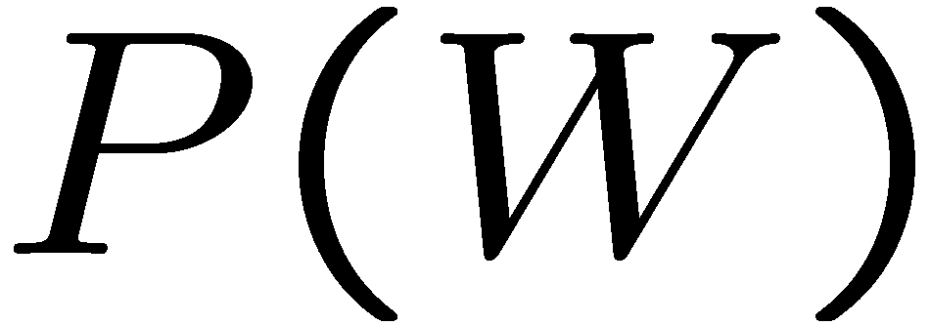
Example: Independence?
T | P
hot | 0.5
cold | 0.5
T | W | P
hot | sun | 0.4
hot | rain | 0.1
cold | sun | 0.2
cold | rain | 0.3
T | W | P
hot | sun | 0.3
hot | rain | 0.2
cold | sun | 0.3
cold | rain | 0.2
W | P
sun | 0.6
rain | 0.4

Slide 48


Example: Independence
N fair, independent coin flips:
H | 0.5
T | 0.5
H | 0.5
T | 0.5
H | 0.5
T | 0.5

Slide 49
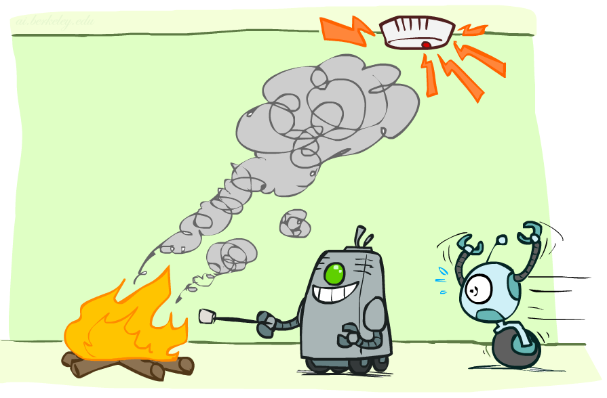
Conditional Independence

Slide 50
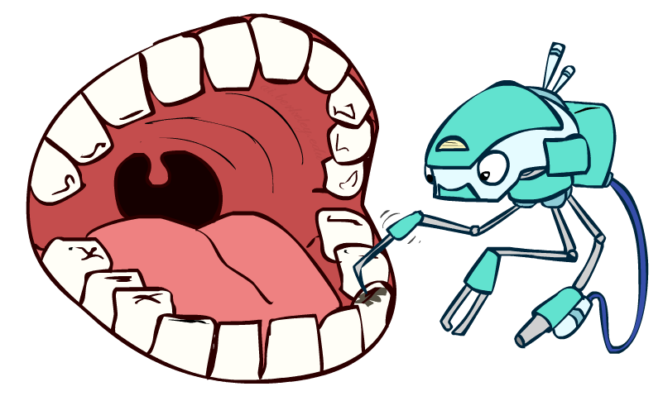
Conditional Independence
P(Toothache, Cavity, Catch)
If I have a cavity, the probability that the probe catches in it doesn't depend on whether I have a toothache:
  P(+catch | +toothache, +cavity) = P(+catch | +cavity)
The same independence holds if I don’t have a cavity:
  P(+catch | +toothache, -cavity) = P(+catch| -cavity)
Catch is conditionally independent of Toothache given Cavity:
  P(Catch | Toothache, Cavity) = P(Catch | Cavity)
Equivalent statements:
  P(Toothache | Catch , Cavity) = P(Toothache | Cavity)
  P(Toothache, Catch | Cavity) = P(Toothache | Cavity) P(Catch | Cavity)
  One can be derived from the other easily

Slide 51
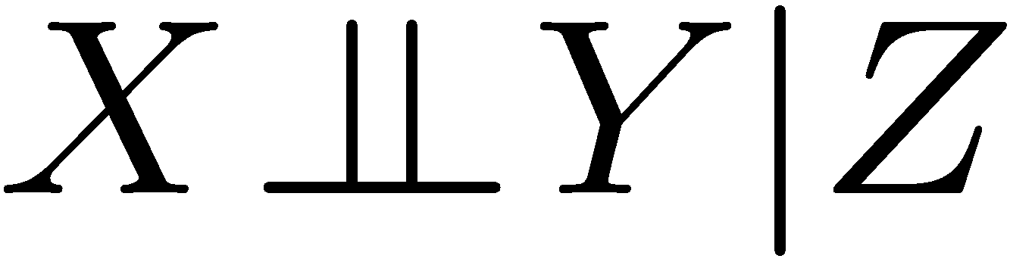
Conditional Independence
Unconditional (absolute) independence very rare (why?)
Conditional independence is our most basic and robust form of knowledge about uncertain environments.
X is conditionally independent of Y given Z
if and only if:
or, equivalently, if and only if

Slide 52

Conditional Independence
What about this domain:
  Traffic
  Umbrella
  Raining

Slide 53


Conditional Independence
What about this domain:
  Fire
  Smoke
  Alarm

Slide 54

Conditional Independence and the Chain Rule
Chain rule:
Trivial decomposition:
With assumption of conditional independence:
Bayes’nets / graphical models help us express conditional independence assumptions

Slide 55


Ghostbusters Chain Rule
Each sensor depends only
on where the ghost is
That means, the two sensors are conditionally independent, given the ghost position
T: Top square is red
B: Bottom square is red
G: Ghost is in the top
Givens:
P( +g ) = 0.5
P( -g ) = 0.5
P( +t | +g ) = 0.8
P( +t | -g ) = 0.4
P( +b | +g ) = 0.4
P( +b | -g ) = 0.8
P(T,B,G) = P(G) P(T|G) P(B|G)
T | B | G | P(T,B,G)
+t | +b | +g | 0.16
+t | +b | -g | 0.16
+t | -b | +g | 0.24
+t | -b | -g | 0.04
-t | +b | +g | 0.04
-t | +b | -g | 0.24
-t | -b | +g | 0.06
-t | -b | -g | 0.06

Slide 56

Bayes’Nets: Big Picture

Slide 57

Bayes’ Nets: Big Picture
Two problems with using full joint distribution tables as our probabilistic models:
  Unless there are only a few variables, the joint is WAY too big to represent explicitly
  Hard to learn (estimate) anything empirically about more than a few variables at a time
Bayes’ nets: a technique for describing complex joint distributions (models) using simple, local distributions (conditional probabilities)
  More properly called graphical models
  We describe how variables locally interact
  Local interactions chain together to give global, indirect interactions
  For about 10 min, we’ll be vague about how these interactions are specified

Slide 58

Example Bayes’ Net: Insurance

Slide 59
Example Bayes’ Net: Car

Slide 60


Graphical Model Notation
Nodes: variables (with domains)
  Can be assigned (observed) or unassigned (unobserved)
Arcs: interactions
  Similar to CSP constraints
  Indicate “direct influence” between variables
  Formally: encode conditional independence (more later)
For now: imagine that arrows mean direct causation (in general, they don’t!)

Slide 61
Example: Coin Flips
N independent coin flips
No interactions between variables: absolute independence
X₁
X₂
X_{n}

Slide 62


Example: Traffic
Variables:
  R: It rains
  T: There is traffic
Model 1: independence
Why is an agent using model 2 better?
Model 2: rain causes traffic
R
R
T
T

Slide 63

Example: Traffic II
Let’s build a causal graphical model!
Variables
  T: Traffic
  R: It rains
  L: Low pressure
  D: Roof drips
  B: Ballgame
  C: Cavity

Slide 64

Example: Alarm Network
Variables
  B: Burglary
  A: Alarm goes off
  M: Mary calls
  J: John calls
  E: Earthquake!

Slide 65


Example: Part-based object models
[Fischler and Elschlager, 1973]
Kristen Grauman

Slide 66
One possible graphical model:
Example: Part-based object models
Fully connected constellation model
x₁
x₆
x₂
x₅
x₃
x₄
e.g. Constellation Model
Parts fully connected
N image features, P parts in the model
Slide credit: Rob Fergus

Slide 67
Probabilistic constellation model
x₁
x₆
x₂
x₅
x₃
x₄
Part
descriptors
Part
locations
h: assignment of features to parts
Candidate parts
Source: Lana Lazebnik

Slide 68
Probabilistic constellation model
x₁
x₆
x₂
x₅
x₃
x₄
h: assignment of features to parts
Part 1
Part 3
Part 2
Source: Lana Lazebnik

Slide 69
Probabilistic constellation model
x₁
x₆
x₂
x₅
x₃
x₄
h: assignment of features to parts
Part 1
Part 3
Part 2
Source: Lana Lazebnik

Slide 70


Face model
Appearance: 10 patches closest to mean for each part
Recognition results
Fergus et al. CVPR 2003

Slide 71
Face model
Appearance: 10 patches closest to mean for each part
Recognition results
Test images: size of circles indicates score of hypothesis
Kristen Grauman
Fergus et al. CVPR 2003

Slide 72

Motorbike model
Appearance: 10 patches closest to mean for each part
Recognition results
Kristen Grauman
Fergus et al. CVPR 2003

Slide 73

Spotted cat model
Appearance: 10 patches closest to mean for each part
Recognition results
Kristen Grauman
Fergus et al. CVPR 2003

Slide 74
Two possible graphical models:
Example: Part-based object models
Fully connected constellation model
“Star” shape model
x₁
x₁
x₆
x₂
x₆
x₂
x₅
x₃
x₅
x₃
x₄
x₄
e.g. Constellation Model
Parts fully connected
Recognition complexity: O(N^{P})
e.g. implicit shape model
Parts mutually independent
Recognition complexity: O(NP)
N image features, P parts in the model
Slide credit: Rob Fergus

Slide 75

Star-shaped graphical model
x₁
x₆
x₂
x₅
x₃
x₄
Discrete set of part appearances are used to index votes for object position
Part with
displacement vectors
training image annotated with object localization info
B. Leibe, A. Leonardis, and B. Schiele, Combined Object Categorization and Segmentation with an Implicit Shape Model, ECCV Workshop on Statistical Learning in Computer Vision 2004

Slide 76

Star-shaped graphical model
x₁
x₆
x₂
x₅
x₃
x₄
Discrete set of part appearances are used to index votes for object position
test image
B. Leibe, A. Leonardis, and B. Schiele, Combined Object Categorization and Segmentation with an Implicit Shape Model, ECCV Workshop on Statistical Learning in Computer Vision 2004

Slide 77



Naïve Bayes model of parts
x₁
x₆
x₂
x₅
x₃
x₄
patches
Object class
decision
Prior prob. of
the object classes
Image likelihood
given the class

Slide 78

Bayes’ Net Semantics

Slide 79



Bayes’ Net Semantics
A set of nodes, one per variable X
A directed, acyclic graph
A conditional distribution for each node
  A collection of distributions over X, one for each combination of parents’ values
  CPT: conditional probability table
  Description of a noisy “causal” process
A₁
A_{n}
X
A Bayes net = Topology (graph) + Local Conditional Probabilities

Slide 80


Probabilities in BNs
Bayes’ nets implicitly encode joint distributions
  As a product of local conditional distributions
  To see what probability a BN gives to a full assignment, multiply all the relevant conditionals together:
  Example:

Slide 81

Probabilities in BNs
Why are we guaranteed that setting
results in a proper joint distribution?
Chain rule (valid for all distributions):
Assume conditional independences:
→ Consequence:
Not every BN can represent every joint distribution
  The topology enforces certain conditional independencies

Slide 82
Example: Coin Flips
X₁
X₂
X_{n}
h | 0.5
t | 0.5
h | 0.5
t | 0.5
h | 0.5
t | 0.5
Only distributions whose variables are absolutely independent can be represented by a Bayes’ net with no arcs.
Notes:
demo

Slide 83



Example: Traffic
R
+r | 1/4
-r | 3/4
+r | +t | 3/4
 | -t | 1/4
T
-r | +t | 1/2
 | -t | 1/2
Notes:
demo

Slide 84

Example: Alarm Network
B | P(B)
+b | 0.001
-b | 0.999
E | P(E)
+e | 0.002
-e | 0.998
Burglary
Earthqk
Alarm
B | E | A | P(A|B,E)
+b | +e | +a | 0.95
+b | +e | -a | 0.05
+b | -e | +a | 0.94
+b | -e | -a | 0.06
-b | +e | +a | 0.29
-b | +e | -a | 0.71
-b | -e | +a | 0.001
-b | -e | -a | 0.999
John calls
Mary calls
A | J | P(J|A)
+a | +j | 0.9
+a | -j | 0.1
-a | +j | 0.05
-a | -j | 0.95
A | M | P(M|A)
+a | +m | 0.7
+a | -m | 0.3
-a | +m | 0.01
-a | -m | 0.99
Notes:
demo

Slide 85

Example: Traffic
Causal direction
R
+r | 1/4
-r | 3/4
+r | +t | 3/16
+r | -t | 1/16
-r | +t | 6/16
-r | -t | 6/16
+r | +t | 3/4
 | -t | 1/4
T
-r | +t | 1/2
 | -t | 1/2

Slide 86


Example: Reverse Traffic
Reverse causality?
T
+t | 9/16
-t | 7/16
+r | +t | 3/16
+r | -t | 1/16
-r | +t | 6/16
-r | -t | 6/16
+t | +r | 1/3
 | -r | 2/3
R
-t | +r | 1/7
 | -r | 6/7

Slide 87

Causality?
When Bayes’ nets reflect the true causal patterns:
  Often simpler (nodes have fewer parents)
  Often easier to think about
  Often easier to elicit from experts
BNs need not actually be causal
  Sometimes no causal net exists over the domain (especially if variables are missing)
  E.g. consider the variables Traffic and Drips
  End up with arrows that reflect correlation, not causation
What do the arrows really mean?
  Topology may happen to encode causal structure
  Topology really encodes conditional independence

Slide 88
Bayes’ Nets
So far: how a Bayes’ net encodes a joint distribution
Next: how to answer queries about that distribution
  Today:
    First assembled BNs using an intuitive notion of conditional independence as causality
    Then saw that key property is conditional independence
  Main goal: answer queries about conditional independence and influence
After that: how to answer numerical queries (inference)

Slide 89

CS 188: Artificial Intelligence
Bayes’ Nets: Independence
Instructors: Dan Klein and Pieter Abbeel --- University of California, Berkeley
[These slides were created by Dan Klein and Pieter Abbeel for CS188 Intro to AI at UC Berkeley. All CS188 materials are available at http://ai.berkeley.edu.]
Notes:
Please retain proper attribution, including the reference to ai.berkeley.edu. Thanks!

Slide 90


Probability Recap
Conditional probability
Product rule
Chain rule
X, Y independent if and only if:
X and Y are conditionally independent given Z if and only if:

Slide 91

Bayes’ Nets
A Bayes’ net is an
efficient encoding
of a probabilistic
model of a domain
Questions we can ask:
  Inference: given a fixed BN, what is P(X | e)?
  Representation: given a BN graph, what kinds of distributions can it encode?
  Modeling: what BN is most appropriate for a given domain?

Slide 92



Bayes’ Net Semantics
A directed, acyclic graph, one node per random variable
A conditional probability table (CPT) for each node
  A collection of distributions over X, one for each combination of parents’ values
Bayes’ nets implicitly encode joint distributions
  As a product of local conditional distributions
  To see what probability a BN gives to a full assignment, multiply all the relevant conditionals together:

Slide 93

Example: Alarm Network
B | P(B)
+b | 0.001
-b | 0.999
B
E
E | P(E)
+e | 0.002
-e | 0.998
A
A | J | P(J|A)
+a | +j | 0.9
+a | -j | 0.1
-a | +j | 0.05
-a | -j | 0.95
A | M | P(M|A)
+a | +m | 0.7
+a | -m | 0.3
-a | +m | 0.01
-a | -m | 0.99
B | E | A | P(A|B,E)
+b | +e | +a | 0.95
+b | +e | -a | 0.05
+b | -e | +a | 0.94
+b | -e | -a | 0.06
-b | +e | +a | 0.29
-b | +e | -a | 0.71
-b | -e | +a | 0.001
-b | -e | -a | 0.999
J
M
Notes:
demo

Slide 94

Example: Alarm Network
B | P(B)
+b | 0.001
-b | 0.999
B
E
E | P(E)
+e | 0.002
-e | 0.998
A
A | J | P(J|A)
+a | +j | 0.9
+a | -j | 0.1
-a | +j | 0.05
-a | -j | 0.95
A | M | P(M|A)
+a | +m | 0.7
+a | -m | 0.3
-a | +m | 0.01
-a | -m | 0.99
B | E | A | P(A|B,E)
+b | +e | +a | 0.95
+b | +e | -a | 0.05
+b | -e | +a | 0.94
+b | -e | -a | 0.06
-b | +e | +a | 0.29
-b | +e | -a | 0.71
-b | -e | +a | 0.001
-b | -e | -a | 0.999
J
M
Notes:
demo

Slide 95


Size of a Bayes’ Net
How big is a joint distribution over N Boolean variables?
  2^{N}
How big is an N-node net if nodes have up to k parents?
  O(N * 2^{k+1})
Both give you the power to calculate
BNs: Huge space savings!
Also easier to elicit local CPTs
Also faster to answer queries (coming)

Slide 96

Bayes’ Nets
Representation
Conditional Independences
Probabilistic Inference
Learning Bayes’ Nets from Data

Slide 97


Conditional Independence
X and Y are independent if
X and Y are conditionally independent given Z
(Conditional) independence is a property of a distribution
Example:

Slide 98

Bayes Nets: Assumptions
Assumptions we are required to make to define the Bayes net when given the graph:
Beyond above “chain rule → Bayes net” conditional independence assumptions
  Often additional conditional independences
  They can be read off the graph
Important for modeling: understand assumptions made when choosing a Bayes net graph
Notes:
Important for modeling: understanding which assumptions you are making!

Slide 99
Example
X
Y
Z
W
Conditional independence assumptions directly from simplifications in chain rule:
Additional implied conditional independence assumptions?

Slide 100
Independence in a BN
Important question about a BN:
  Are two nodes independent given certain evidence?
  If yes, can prove using algebra (tedious in general)
  If no, can prove with a counter example
  Example:
  Question: are X and Z necessarily independent?
    Answer: no. Example: low pressure causes rain, which causes traffic.
    X can influence Z, Z can influence X (via Y)
    Addendum: they could be independent: how?
X
Y
Z

Slide 101

D-separation: Outline

Slide 102
D-separation: Outline
Study independence properties for triples
Analyze complex cases in terms of member triples
D-separation: a condition / algorithm for answering such queries

Slide 103

Causal Chains
This configuration is a “causal chain”
Guaranteed X independent of Z ? No!
  One example set of CPTs for which X is not independent of Z is sufficient to show this independence is not guaranteed.
  Example:
    Low pressure causes rain causes traffic,
    high pressure causes no rain causes no
    traffic
    In numbers:
    P( +y | +x ) = 1, P( -y | - x ) = 1,
    P( +z | +y ) = 1, P( -z | -y ) = 1
X: Low pressure Y: Rain Z: Traffic

Slide 104



Causal Chains
This configuration is a “causal chain”
Guaranteed X independent of Z given Y?
  Evidence along the chain “blocks” the influence
X: Low pressure Y: Rain Z: Traffic
Yes!

Slide 105

Common Cause
This configuration is a “common cause”
Guaranteed X independent of Z ? No!
  One example set of CPTs for which X is not independent of Z is sufficient to show this independence is not guaranteed.
  Example:
    Project due causes both forums busy
    and lab full
    In numbers:
    P( +x | +y ) = 1, P( -x | -y ) = 1,
    P( +z | +y ) = 1, P( -z | -y ) = 1
Y: Project due
X: Forums busy
Z: Lab full

Slide 106

Common Cause
This configuration is a “common cause”
Guaranteed X and Z independent given Y?
  Observing the cause blocks influence between effects.
Y: Project due
X: Forums busy
Z: Lab full
Yes!

Slide 107

Common Effect
Last configuration: two causes of one effect (v-structures)
Are X and Y independent?
  Yes: the ballgame and the rain cause traffic, but they are not correlated
  Still need to prove they must be (try it!)
Are X and Y independent given Z?
  No: seeing traffic puts the rain and the ballgame in competition as explanation.
This is backwards from the other cases
  Observing an effect activates influence between possible causes.
X: Raining
Y: Ballgame
Z: Traffic

Slide 108

The General Case

Slide 109

The General Case
General question: in a given BN, are two variables independent (given evidence)?
Solution: analyze the graph
Any complex example can be broken
into repetitions of the three canonical cases

Slide 110


Reachability
L
Recipe: shade evidence nodes, look for paths in the resulting graph
Attempt 1: if two nodes are connected by an undirected path not blocked by a shaded node, they are conditionally independent
Almost works, but not quite
  Where does it break?
  Answer: the v-structure at T doesn’t count as a link in a path unless “active”
R
B
D
T

Slide 111
Active / Inactive Paths
Question: Are X and Y conditionally independent given evidence variables {Z}?
  Yes, if X and Y “d-separated” by Z
  Consider all (undirected) paths from X to Y
  No active paths = independence!
A path is active if each triple is active:
  Causal chain A → B → C where B is unobserved (either direction)
  Common cause A ← B → C where B is unobserved
  Common effect (aka v-structure)
  A → B ← C where B or one of its descendents is observed
All it takes to block a path is a single inactive segment
Active Triples
Inactive Triples

Slide 112



D-Separation
?
Query:
Check all (undirected!) paths between and
  If one or more active, then independence not guaranteed
  Otherwise (i.e. if all paths are inactive),
  then independence is guaranteed

Slide 113



Example
Yes
R
B
T
T’
Notes:
T’: traffic report

Slide 114





Example
L
Yes
R
B
Yes
D
T
Yes
T’

Slide 115



Example
Variables:
  R: Raining
  T: Traffic
  D: Roof drips
  S: I’m sad
Questions:
R
T
D
S
Yes

Slide 116

Structure Implications
Given a Bayes net structure, can run d-separation algorithm to build a complete list of conditional independences that are necessarily true of the form
This list determines the set of probability distributions that can be represented

Slide 117

Computing All Independences
Y
X
Z
Y
X
Z
X
Z
Y
Y
X
Z

Slide 118
Topology Limits Distributions
Given some graph topology G, only certain joint distributions can be encoded
The graph structure guarantees certain (conditional) independences
(There might be more independence)
Adding arcs increases the set of distributions, but has several costs
Full conditioning can encode any distribution
Y
Y
X
Z
X
Z
Y
X
Z
Y
X
Z
Y
Y
Y
X
Z
X
Z
X
Z
Y
Y
Y
X
Z
X
Z
X
Z

Slide 119
Bayes Nets Representation Summary
Bayes nets compactly encode joint distributions
Guaranteed independencies of distributions can be deduced from BN graph structure
D-separation gives precise conditional independence guarantees from graph alone
A Bayes’ net’s joint distribution may have further (conditional) independence that is not detectable until you inspect its specific distribution

Slide 120
Bayes’ Nets
Representation
Conditional Independences
Probabilistic Inference
  Enumeration (exact, exponential complexity)
  Variable elimination (exact, worst-case
  exponential complexity, often better)
  Probabilistic inference is NP-complete
  Sampling (approximate)
Learning Bayes’ Nets from Data

