Slide 1
Autonomous Robots CS 393R
Professor: Peter Stone
TA: Josiah Hanna

Slide 2
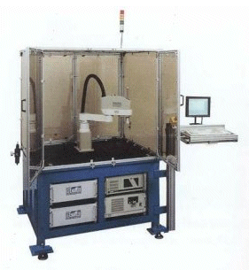
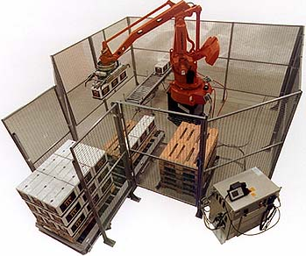
Robots
Slides Courtesy of
Benjamin Kuipers

Slide 3
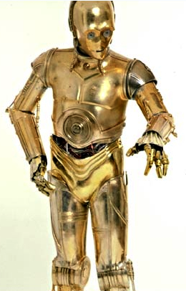
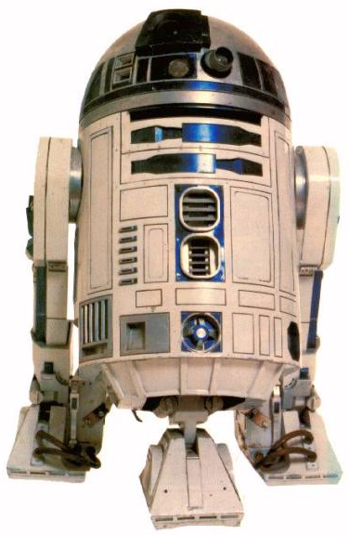
Robots

Slide 4
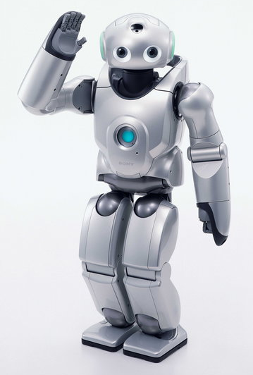
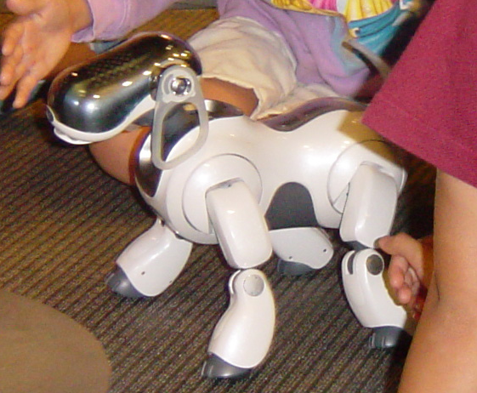
Robots

Slide 5
What is a robot?
A robot is an intelligent system that interacts with the physical environment through sensors and effectors.
Program module?
Web crawling ‘bot?
Robot
sensors
effectors
Environment

Slide 6
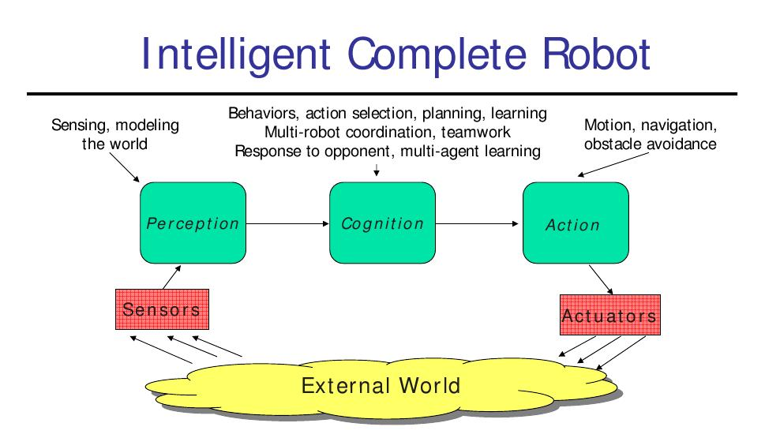
Slide by Manuela
Veloso (on web)‏

Slide 7
Is a human a robot?
By our definition, yes.
Humans interact with a complex physical environment via sensors and effectors.
We are not artificially manufactured, of course!
Does this diminish humans?
No!
Understanding the difficulties of robotics helps us appreciate how amazing humans are.

Slide 8
We will study robots that …
… function in (mostly) unmodified human environments.
(Well, in soccer fields, anyway.)‏
… that use, and perhaps even learn, useful models of the environment.
They have knowledge, and act on it.

Slide 9
What makes a good model of the environment?
A good model is a simplified description of the environment such that …
If the robot orients itself in the model,
and makes a plan using the model,
and executes that plan in the real environment,
then the plan has its intended effect.

Slide 10
What will we do in this course?
Our goal is to learn some methods for implementing this interactive loop.
We will spend a few weeks each on topics that often get entire graduate courses.
Robot
sensors
effectors
Environment

Slide 11
Subject Material Areas
Sensing and Perception (perception)‏
Range sensing, vision, filtering, sensor modeling, …
Motion and Control (action)‏
PID control, open/closed loop control, action modeling, walking, ...
Decision Making (cognition)‏
Behavior architectures, planning, AI, developmental psychology, ...

Slide 12
Major Topics and Projects
What is robotics?
Vision
Control theory
Observers and tracking
Localization
Behavior
Applications
Social implications
“Hello, World!” (9/7)‏
Vision (9/19)‏
Motion control (10/3)‏
Kalman filter (10/10)‏
Localization (10/24)
Behavior (10/31)
Final projects (12/12)‏
Proposal (10/17)‏
Literature survey (11/14)‏
Demonstration (12/4,6)‏

Slide 13
Control Laws and Behaviors
Rules for behaving in a qualitatively uniform environment.
Following walls, seeking open space or targets.
Rich theory based on differential equations and dynamical systems.
Reality outside the model is treated as noise.
Compose multiple control laws to make behaviors.
Task: Approach and kick a ball to a target.

Slide 14
Observers
Sensors don’t sense the world directly.
They just respond to its stimulation.
By gathering lots of sensor input over time, we can estimate what the world is like.
Assumes models of the nature of the world, and of sensor properties, such as error types.
Task: Implement Kalman Filters to track and block a rolling ball.

Slide 15
Social Implications
Robots may change our world dramatically
How? For better? Or for worse?
Science fiction writers have thought about a lot of important possibilities.
We will read and discuss a few.
Brief discussion. Few conclusions.
Questions are more important than answers.

Slide 16
Robot Lab Assignments
Six robot lab assignments.
Due roughly every 2 weeks (sometimes 1 week).
You demonstrate the techniques taught in class.
“In theory, there’s no difference between theory and practice, but in practice, there is.”

Slide 17
What Assignments Require
The point of the assignments is to implement the methods taught in class.
To turn in an assignment:
Demonstrate the behavior to Josiah before the due date.
Each team hands in a clear, concise memo describing the problem, your approach, and your results.
Append the code.
The memo describes the role of each individual on the team in accomplishing this assignment.
We will discuss each assignment in class on the due date.
Some teams will be selected to demonstrate the robots.
No assignments accepted after that class meeting.

Slide 18
Robot Assignments 1 - 6
Students will work in teams.
Each team has 2 or 3 people.
A single grade for each team.
Each team has one physical robot – a Nao.
These are expensive, fragile!
Take care of them!

Slide 19
Robot Assignments 4, 5
Under revision – will use the Nao robots
Probably still in pairs
Some parts in simulation – may be done individually.
Localization and vision.

Slide 20
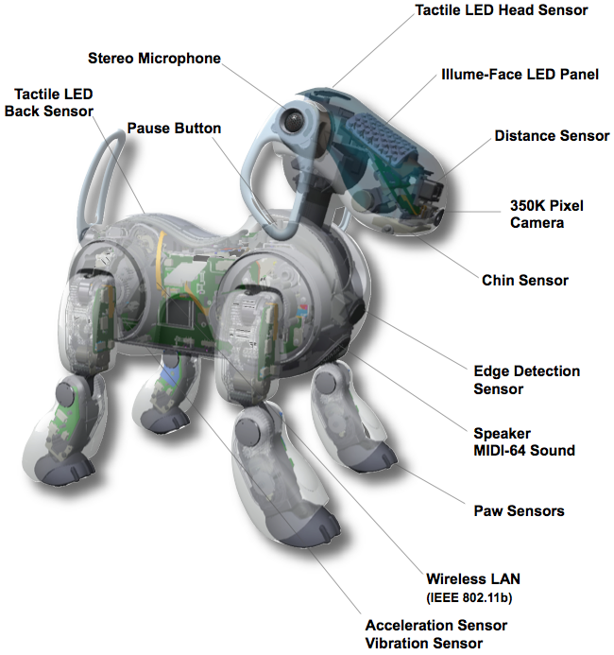
The old robot: Sony AIBO
Several sensors
20 degrees of freedom
Onboard computing

Slide 21
Entertainment Robot System 7
Sony designed the AIBO as an entertainment robot, with sophisticated built-in behaviors.
We won’t be using those.
You are welcome to explore them, but that’s not part of the course.
We are using the AIBO as a platform for implementing robotic capabilities.

Slide 22
Technical Details
CPU: 64 bit RISC
64 mb RAM
LAN: 802.11b
Degrees of freedom:
Head: 3 dof
Mouth 1 dof
Legs: 3 dof x 4
Ears: 1 dof x 2
Tail: 2 dof
Image input:
350,000 pixel CMOS camera
Stereo microphones
Infrared distance x 2
Acceleration
Vibration
Touch: head, back, chin, paw

Slide 23
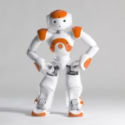
The robot: Nao
25 DOF
2 cameras, 4 microphones, sonar, IR, ...
Voice synthesizer, speakers, LEDs
Intel ATOM 1.6ghz CPU – linux

Slide 24
Shooting and Blocking
Past year's example videos...

Slide 25
Working in Teams
One of the goals of this course is to give you experience at working in teams.
Your team can be stronger than any one individual, but it is also vulnerable.
You are responsible for working effectively with your team
not just for doing your own job, but also
for helping the team work well together.

Slide 26
Grading
Robot Assignments
Hello, World! (5%)
Vision (9%)‏
Motion (9%)‏
Tracking (9%)‏
Localization (9%)‏
Behavior (9%)‏
These are never accepted late!
Participation (10%)‏
Reading responses ‏
Due day before class
(10%)‏
Projects (30%)‏
Proposal‏
Literature‏
Presentation‏
Report‏

Slide 27
Final Projects
Research one topic in greater depth.
Select a research goal (suggestions to be provided).
Survey the related literature.
Implement a prototype system and/or experiment.
Describe in detail what you did, how it worked out, what alternative approaches were.
Possibly prepare you for joining UT Austin Villa.

Slide 28
Syllabus overview
Official syllabus is online

Slide 29
This class is a lot of work.
Robotics includes many different concepts.
Control theory, logic, probability, search, etc.
Abstraction barriers are very strong in most of Computer Science, but weak in Robotics.
Programs are vulnerable to sensor and motor glitches.
Plan ahead, to put the time in to this course.
Your team will be depending on you.

Slide 30
Robotics
The topic is fundamentally important scientifically and technologically.
Building intelligent agents
Modeling the phenomenon of mind
It will be very demanding on all of us.
Be prepared, and start work early.
It’s also very exciting and lots of fun!
First assignment: Join and post on piazza TODAY!
Read and react to vision readings by Mon.
Get started with robots!

