Slide 1
RLBench: The Robot Learning Benchmark & Learning Environment
Stephen James, Zicong Ma, David Rovick Arrojo, Andrew J. Davidson
Presenter: Arjun Somayazulu
11/01/2022

Slide 2
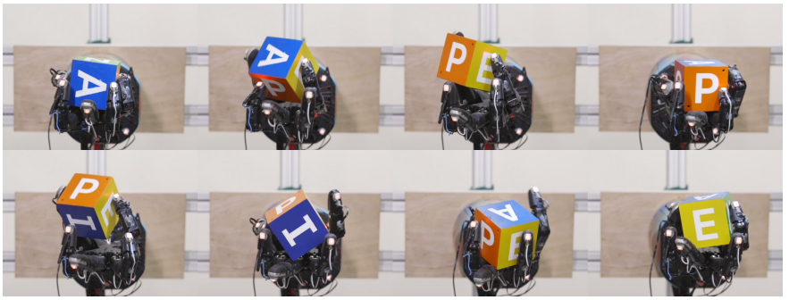
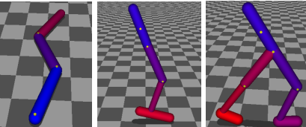
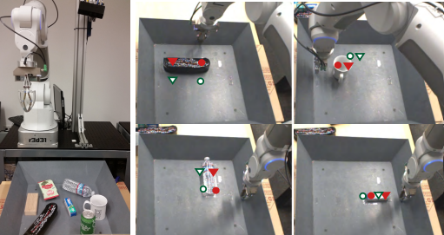
Motivation
Methods for robot learning have proliferated significantly in recent years
Reference: https://arxiv.org/pdf/1808.00177.pdf, https://arxiv.org/pdf/1610.00696.pdf, https://arxiv.org/pdf/1502.05477.pdf ,

Slide 3
Motivation
Methods for robot learning have proliferated significantly in recent years
The papers we have looked at evaluated their methods on a wide variety of tasks
Reference: https://arxiv.org/pdf/1808.00177.pdf, https://arxiv.org/pdf/1610.00696.pdf, https://arxiv.org/pdf/1502.05477.pdf ,

Slide 4
Motivation
Methods for robot learning have proliferated significantly in recent years
The papers we have looked at evaluated their methods on a wide variety of tasks
Comparing models/algorithms on a standard benchmark is difficult
Reference: https://arxiv.org/pdf/1808.00177.pdf, https://arxiv.org/pdf/1610.00696.pdf, https://arxiv.org/pdf/1502.05477.pdf ,

Slide 5
Motivation
Comparing few-shot learning performance is important for generalizability

Slide 6
Motivation
Comparing few-shot learning performance is important for generalizability
Robot manipulation tasks are poorly defined

Slide 7
Motivation
Comparing few-shot learning performance is important for generalizability
Robot manipulation tasks are poorly defined
Put red apple in green bowl vs Put green apple in red bowl

Slide 8
Motivation
Comparing few-shot learning performance is important for generalizability
Robot manipulation tasks are poorly defined
Put red apple in green bowl vs Put green apple in red bowl
Difficult to standardize tasks in zero-shot/few-shot learning frameworks

Slide 9
Motivation
Comparing few-shot learning performance is important for generalizability
Robot manipulation tasks are poorly defined
Put red apple in green bowl vs Put green apple in red bowl
Difficult to standardize tasks in zero-shot/few-shot learning frameworks
Evaluation / comparison of diverse robot learning algorithms (RL, IRL, IL) becomes difficult

Slide 10
Motivation
“Interesting” tasks are continually evolving

Slide 11
Motivation
“Interesting” tasks are continually evolving
High-quality demonstrations are expensive to generate

Slide 12
Motivation
“Interesting” tasks are continually evolving
High-quality demonstrations are expensive to generate
There are datasets for sub-problems in robot manipulation

Slide 13
Motivation
“Interesting” tasks are continually evolving
High-quality demonstrations are expensive to generate
There are datasets for sub-problems in robot manipulation
Perception (ILSVRC, COCO), Grasping (OpenGrasp, VisGraB)

Slide 14
Motivation
“Interesting” tasks are continually evolving
High-quality demonstrations are expensive to generate
There are datasets for sub-problems in robot manipulation
Perception (ILSCRV, COCO), Grasping (OpenGrasp, VisGraB)
Establishing a benchmark environment and dataset for robot manipulation will help accelerate innovation

Slide 15
Related Work
OpenAI Gym and DeepMind Control Suite (Brockman et al., 2016) (Tassa et al., 2018)

Slide 16
Related Work
OpenAI Gym and DeepMind Control Suite (Brockman et al., 2016) (Tassa et al., 2018)
focuses on “toy” tasks that don’t resemble real-world problems

Slide 17
Related Work
OpenAI Gym and DeepMind Control Suite (Brockman et al., 2016) (Tassa et al., 2018)
focuses on “toy” tasks that don’t resemble real-world problems
RoboCup@Home (Wisspeintner et al., 2009)

Slide 18
Related Work
OpenAI Gym and DeepMind Control Suite (Brockman et al., 2016) (Tassa et al., 2018)
focuses on “toy” tasks that don’t resemble real-world problems
RoboCup@Home (Wisspeintner et al., 2009)
Evaluates wide range of real-world robotic tasks

Slide 19
Related Work
OpenAI Gym and DeepMind Control Suite (Brockman et al., 2016) (Tassa et al., 2018)
focuses on “toy” tasks that don’t resemble real-world problems
RoboCup@Home (Wisspeintner et al., 2009)
Evaluates wide range of real-world robotic tasks
Lack of large-scale dataset makes end-to-end learning difficult

Slide 20
Related Work
OpenAI Gym and DeepMind Control Suite (Brockman et al., 2016) (Tassa et al., 2018)
focuses on “toy” tasks that don’t resemble real-world problems
RoboCup@Home (Wisspeintner et al., 2009)
Evaluates wide range of real-world robotic tasks
Lack of large-scale dataset makes end-to-end learning difficult
RoboTurk (Mandlekar et al., 2018)

Slide 21
Related Work
OpenAI Gym and DeepMind Control Suite (Brockman et al., 2016) (Tassa et al., 2018)
focuses on “toy” tasks that don’t resemble real-world problems
RoboCup@Home (Wisspeintner et al., 2009)
Evaluates wide range of real-world robotic tasks
Lack of large-scale dataset makes end-to-end learning difficult
RoboTurk (Mandlekar et al., 2018)
Crowd-sourced task data (overcomes issues with trajectory collection)

Slide 22
Related Work
OpenAI Gym and DeepMind Control Suite (Brockman et al., 2016) (Tassa et al., 2018)
focuses on “toy” tasks that don’t resemble real-world problems
RoboCup@Home (Wisspeintner et al., 2009)
Evaluates wide range of real-world robotic tasks
Lack of large-scale dataset makes end-to-end learning difficult
RoboTurk (Mandlekar et al., 2018)
Crowd-sourced task data (overcomes issues with trajectory collection)
Few tasks, extending to new tasks requires further crowd-sourced annotations

Slide 23
Related Work
Simitate (Memmesheimer et al., 2019)

Slide 24
Related Work
Simitate (Memmesheimer et al., 2019)
Combination of real-world trajectories meshed with simulated environment

Slide 25
Related Work
Simitate (Memmesheimer et al., 2019)
Combination of real-world trajectories meshed with simulated environment
Extending to new tasks requires collection of data

Slide 26
Related Work
Simitate (Memmesheimer et al., 2019)
Combination of real-world trajectories meshed with simulated environment
Extending to new tasks requires collection of data
Meta-World (Yu et al., 2019)

Slide 27
Related Work
Simitate (Memmesheimer et al., 2019)
Combination of real-world trajectories meshed with simulated environment
Extending to new tasks requires collection of data
Meta-World (Yu et al., 2019)
For multi-task and meta-RL algorithm evaluation

Slide 28
Related Work
Simitate (Memmesheimer et al., 2019)
Combination of real-world trajectories meshed with simulated environment
Extending to new tasks requires collection of data
Meta-World (Yu et al., 2019)
For multi-task and meta-RL algorithm evaluation
Limited set of tasks in dataset

Slide 29
Key Insights
Automated generation of high-quality demonstrations for each task
Establish a standardized benchmark challenge for few-shot evaluation
Allow users to easily create and validate their own tasks

Slide 30
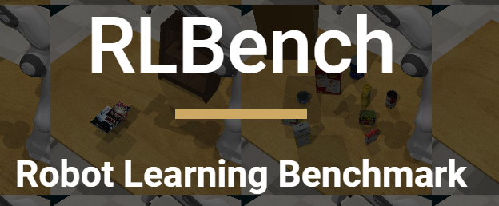
Problem Setting - RLBench
Benchmark of 100+ robot manipulation tasks in simulation
Designed for Reinforcement Learning and Imitation Learning
Learning environment built on PyRep interface
Reference: https://arxiv.org/pdf/1909.12271.pdf

Slide 31
Problem Setting
Authors define six core properties of RLBench :
Diversity – range of tasks

Slide 32
Problem Setting
Authors define six core properties of RLBench :
Diversity – range of tasks
Reproducibility – simulated environment for consistency

Slide 33
Problem Setting
Authors define six core properties of RLBench :
Diversity – range of tasks
Reproducibility – simulated environment for consistency
Scale – generate large dataset

Slide 34
Problem Setting
Authors define six core properties of RLBench :
Extensibility – add new tasks

Slide 35
Problem Setting
Authors define six core properties of RLBench :
Extensibility – add new tasks
Tiered Difficulty – range of task difficulties

Slide 36
Problem Setting
Authors define six core properties of RLBench :
Extensibility – add new tasks
Tiered Difficulty – range of task difficulties
Realism – facilitate sim2real generalization

Slide 37
Problem Setting
Paper makes distinction between “variation” and “task”
Authors group similar variations of a task together
trajectories are sampled from a variation:
Reference: https://arxiv.org/pdf/1909.12271.pdf

Slide 38
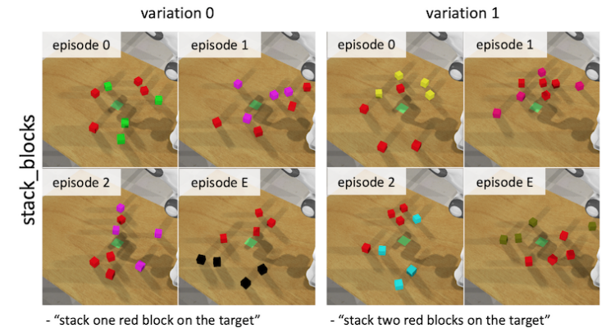
Problem Setting
Two variations of an (episodic) task:
Reference: https://arxiv.org/pdf/1909.12271.pdf

Slide 39
RLBench – Generating Demonstrations
RLBench allows infinite expert demonstrations to be generated for each Variation

Slide 40
RLBench – Generating Demonstrations
RLBench allows infinite expert demonstrations to be generated for each Variation
Each task has a V-REP file associated with it

Slide 41
RLBench – Generating Demonstrations
RLBench allows infinite expert demonstrations to be generated for each Variation
Each task has a V-REP file associated with it
Contains scene information and motion waypoints

Slide 42
RLBench – Generating Demonstrations
RLBench allows infinite expert demonstrations to be generated for each Variation
Each task has a V-REP file associated with it
Contains scene information and motion waypoints
OpenMotionPlanningLibrary (OMPL) is used to compute a motion plan using waypoints

Slide 43
RLBench – Generating Demonstrations
RLBench allows infinite expert demonstrations to be generated for each Variation
Each task has a V-REP file associated with it
Contains scene information and motion waypoints
OpenMotionPlanningLibrary (OMPL) is used to compute a motion plan using waypoints
Allows for generation of infinite trajectories for a variation

Slide 44
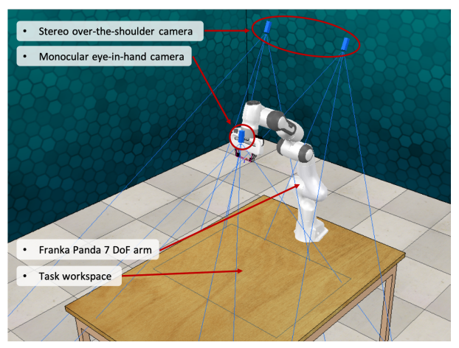
RLBench – Scene
7 DoF Franka Panda arm fixed to table
Reference: https://arxiv.org/pdf/1909.12271.pdf

Slide 45
RLBench – Scene
7 DoF Franka Panda arm fixed to table
Observation Information
RGBD images + segmentation masks (over-the-shoulder cam)
Image from monocular camera
Robot arm proprioceptive information
Reference: https://arxiv.org/pdf/1909.12271.pdf

Slide 46
RLBench – Scene
7 DoF Franka Panda arm fixed to table
Observation Information
RGBD images + segmentation masks (over-the-shoulder cam)
Image from monocular camera
Robot arm proprioceptive information
Rich Action Space
Joint velocities, positions, torques
End-effector positions, velocities, poses
Reference: https://arxiv.org/pdf/1909.12271.pdf

Slide 47
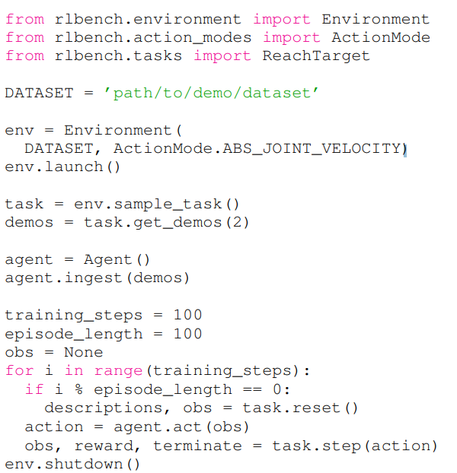
RLBench - Environment
Users interact with Environment class to generate environment instances

Slide 48
RLBench - Environment
Users interact with Environment class to generate environment instances
User can choose to use pre-generated dataset or generate new demonstrations

Slide 49
RLBench - Environment
Users interact with Environment class to generate environment instances
User can choose to use pre-generated dataset or generate new demonstrations
Every task has sparse reward of 1 given on task completion

Slide 50
RLBench – Adding Tasks
User creates new task with two files:

Slide 51
RLBench – Adding Tasks
User creates new task with two files:
V-REP (.ttm) file – defines scene information and waypoints

Slide 52
RLBench – Adding Tasks
User creates new task with two files:
V-REP (.ttm) file – defines scene information and waypoints
Python (.py) file - Specifies variations, success criteria, writes objects to RLBench backend

Slide 53
RLBench – Adding Tasks
User creates new task with two files:
V-REP (.ttm) file – defines scene information and waypoints
Python (.py) file - Specifies variations, success criteria, writes objects to RLBench backend
Validation tool provided to automatically validate task

Slide 54
RLBench – Adding Tasks
User creates new task with two files:
V-REP (.ttm) file – defines scene information and waypoints
Python (.py) file - Specifies variations, success criteria, writes objects to RLBench backend
Validation tool provided to automatically validate task
Ensures limited number of motion planning path failures

Slide 55
RLBench – Adding Tasks
User creates new task with two files:
V-REP (.ttm) file – defines scene information and waypoints
Python (.py) file - Specifies variations, success criteria, writes objects to RLBench backend
Validation tool provided to automatically validate task
Ensures limited number of motion planning path failures
Currently ~116 tasks on official documentation (100 were created in initial release)

Slide 56
Few-Shot Challenge v1.0
Most existing work only evaluates performance on a single task, without getting a sense of generalizability

Slide 57
Few-Shot Challenge v1.0
Most existing work only evaluates performance on a single task, without getting a sense of generalizability
Multi-task learning and Meta-learning are active areas of research exploring learned generalizability of tasks

Slide 58
Few-Shot Challenge v1.0
Most existing work only evaluates performance on a single task, without getting a sense of generalizability
Multi-task learning and Meta-learning are active areas of research exploring learned generalizability of tasks
A formally defined Benchmark challenge is necessary to standardize few-shot learning comparison

Slide 59
Few-Shot Challenge v1.0
Divide RLBench tasks into “Meta-train” set and “Meta-test” set:

Slide 60
Few-Shot Challenge v1.0
Divide RLBench tasks into “Meta-train” set and “Meta-test” set:
Meta-test set consists of 10% of total tasks in task suite

Slide 61
Few-Shot Challenge v1.0
Divide RLBench tasks into “Meta-train” set and “Meta-test” set:
Meta-test set consists of 10% of total tasks in task suite
Preserves wide range of task difficulty levels

Slide 62
Few-Shot Challenge v1.0
Divide RLBench tasks into “Meta-train” set and “Meta-test” set:
Meta-test set consists of 10% of total tasks in task suite
Preserves wide range of task difficulty levels
Model trains on Meta-train set (using existing dataset or trajectory generation)

Slide 63
Few-Shot Challenge v1.0
Divide RLBench tasks into “Meta-train” set and “Meta-test” set:
Meta-test set consists of 10% of total tasks in task suite
Preserves wide range of task difficulty levels
Model trains on Meta-train set (using existing dataset or trajectory generation)
At test time, Provide K demonstrations of task from meta-test set to model, report success rate on new episodes of that task

Slide 64
Few-Shot Challenge v1.0
Divide RLBench tasks into “Meta-train” set and “Meta-test” set:
Meta-test set consists of 10% of total tasks in task suite
Preserves wide range of task difficulty levels
Model trains on Meta-train set (using existing dataset or trajectory generation)
At test time, Provide K demonstrations of task from meta-test set to model, report success rate on new episodes of that task
Report 1-shot, 5-shot, 20-shot success rates

Slide 65
Limitations/Critiques
Automated trajectories may not resemble natural motion/paths, limiting generalizability
OMPL Planners are highly complex, but constrained to user-defined waypoints
Underlying scene is highly constrained
No ability to customize orientation of table surface, position of arm on table, lighting conditions, etc.
Benchmark lies entirely in simulation, no real-world generalizability experiments are performed
No baseline evaluation of their “Few-Shot Challenge v1.0” benchmark

Slide 66
Future Work for Paper / Reading
Robosuite (Zhu et al., 2020)
Highly modular simulation environment and benchmark that comes equipped with several arm models
Robo-Gym (Lucchi et al., 2020)
Provides software for transferring simulation training to real-world robot application
BulletArm (Wang et al., 2022)
Allows both open-loop and closed-loop end-effector control, and larger variation in underlying scene
DeepClaw (Wan et al., 2020)
Collection of algorithms, arm manipulation software designed for real-world robot manipulation

Slide 67
Future Work
Allow customizability in scene initialization (e.g. arm position on table, table orientation, lighting directions, etc.)
Allow human demonstrations collected via teleoperation to augment dataset of automated demonstrations
Enable teleoperation of real-world robot to evaluate sim2real performance
Establish Multi-Task Benchmark Challenge (and provide baseline results using off-the-shelf models)

Slide 68
Extended Readings
robosuite: A Modular Simulation Framework and Benchmark for Robot Learning
What Matters in Learning from Offline Human Demonstrations for Robot Manipulation
robo-gym -- An Open Source Toolkit for Distributed Deep Reinforcement Learning on Real and Simulated Robots
DeepClaw: A Robotic Hardware Benchmarking Platform for Learning Object Manipulation
RAVEN: A Dataset for Relational and Analogical Visual rEasoNing

Slide 69
Summary
Develop a benchmark and environment for standard learning and evaluation of robot manipulation algorithms
Important for evaluation of meta-learning / few-shot learning algorithms
Overcomes some issues with real-world applicability of prior learning suites (OpenAI Gym, DeepMind Control Suite)
environment automates generation of large amounts of labeled trajectories for each task
Defines a benchmark challenge for standardization of few-shot learning evaluation across methods
Allows users to easily create and validate their own tasks

Slide 70
Questions For Discussion (hidden)
Benchmark datasets have enabled great progress in fields like Vision and NLP. However, these datasets largely consist of “real” data. Given that most RL benchmarks are entirely in simulation, how useful are these datasets for generalizing to the real-world? What are the key differences between simulation and real-world tasks/scenes that contribute to this generalization gap?
Are large scale Robot Learning benchmarks like these more useful for Imitation Learning or RL algorithms? Why? Can RL algorithms leverage these demonstrations to reduce sample complexity and exploration (policy optimization using demonstrations)?
Will robot learning algorithms that are trained entirely in simulation and evaluated on real-world tasks always suffer a generalization gap compared to algorithms that are trained on real-world data, or do you think clever techniques can reconcile this gap? Other than domain randomization, what techniques can be used for this?

