Slide 1
Trust Region Policy Optimization
John Schulman, Sergey Levine, Philipp Moritz, Michael I. Jordan, Pieter Abbeel
Abayomi Adekanmbi
September 27,2022

Slide 2
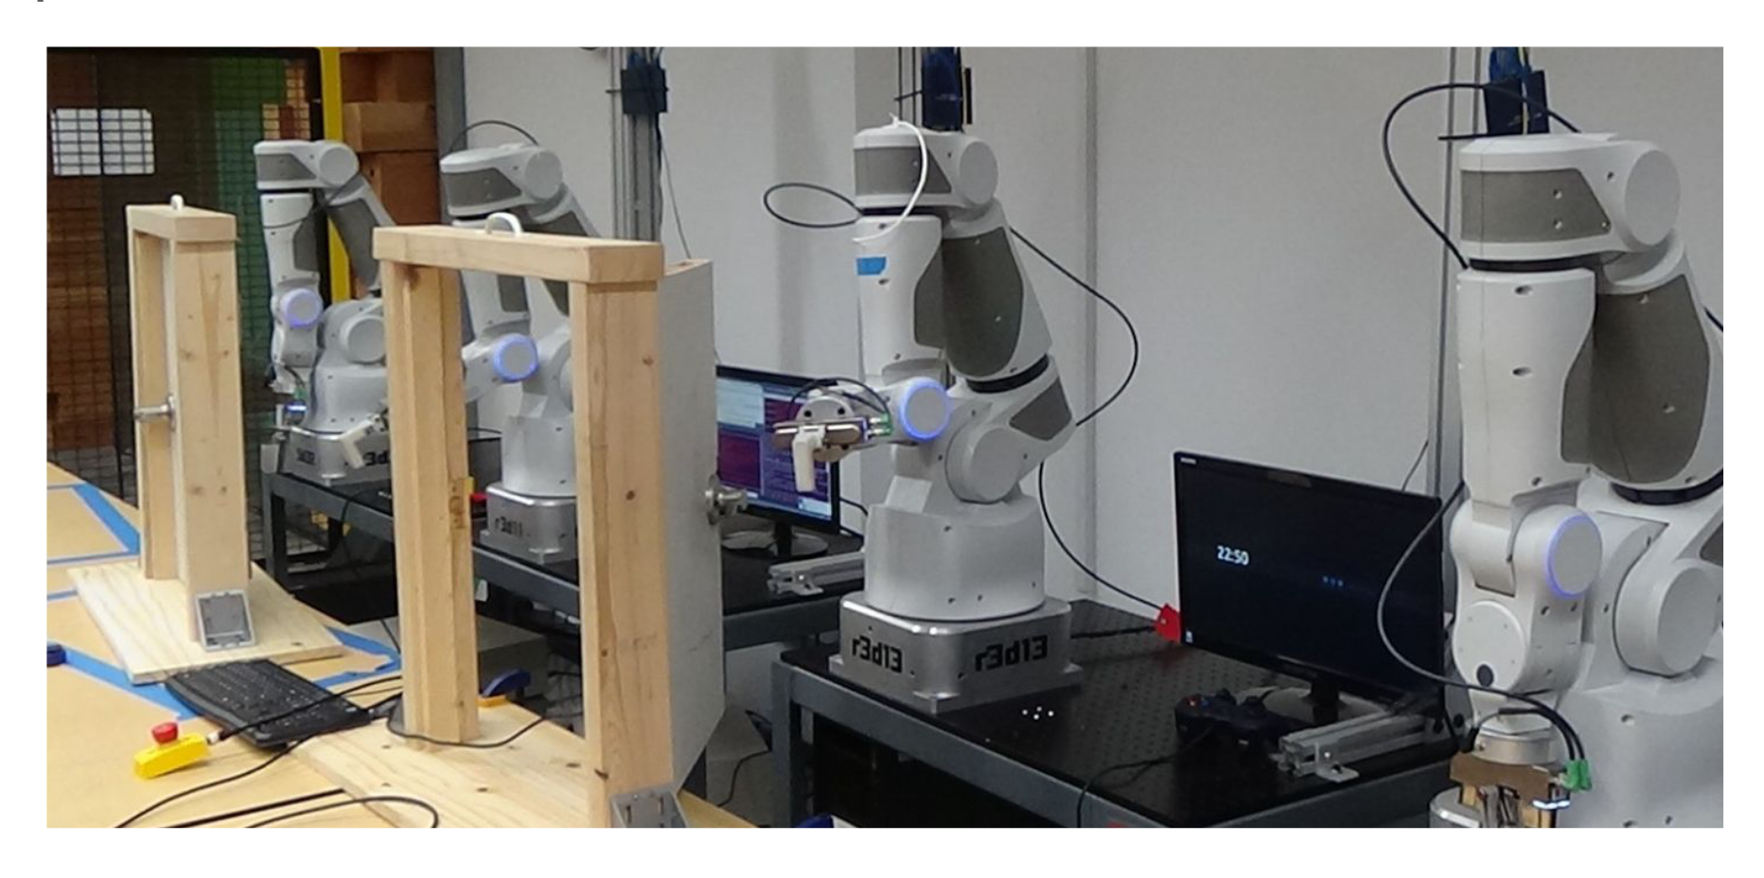
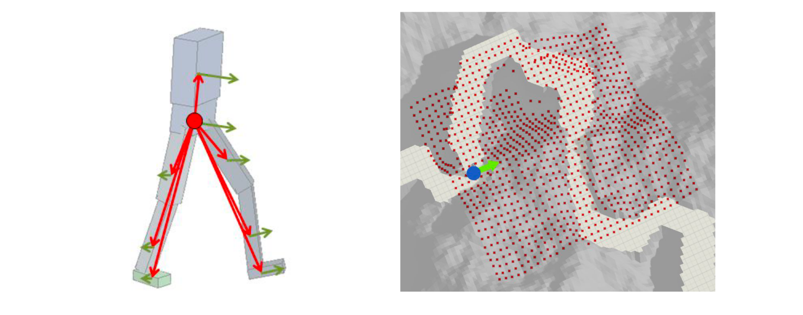
Background and Motivation
Reinforcement Learning in Robotics
Observation: Sensors, Camera images
Reward: Navigation without collision
Actions : Move Joints
Robot Manipulation
Robot Locomotion
Notes:
1. Deep Reinforcement Learning for Robotics Manipulation with Asynchronous Off-Policy Updates: Gu et al, 2016.
2. DeepLoco: Dynamic Locomotion Skills Using Hierarchical Deep Reinforcement Learning: Peng et al, 2017

Slide 3
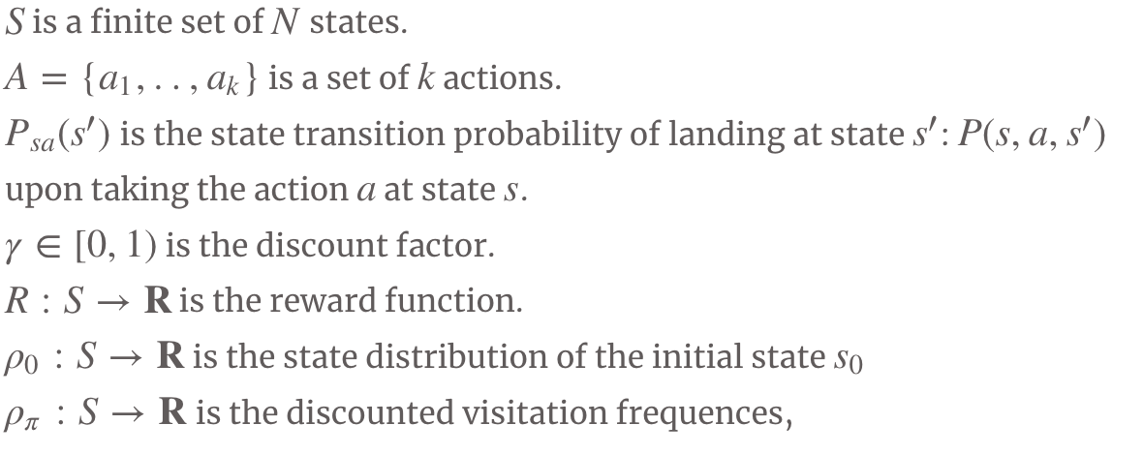
Problem Formulation
Markov Decision Process (MDP)
Goal : Maximise Expected Reward
Episodic or Continuous
Example of episodic
cs391 agent
Reward : maximise expected grade
Each class is an episode which terminates at the end.
Actions : come to class or not
Learns a policy (check syllabus )

Slide 4
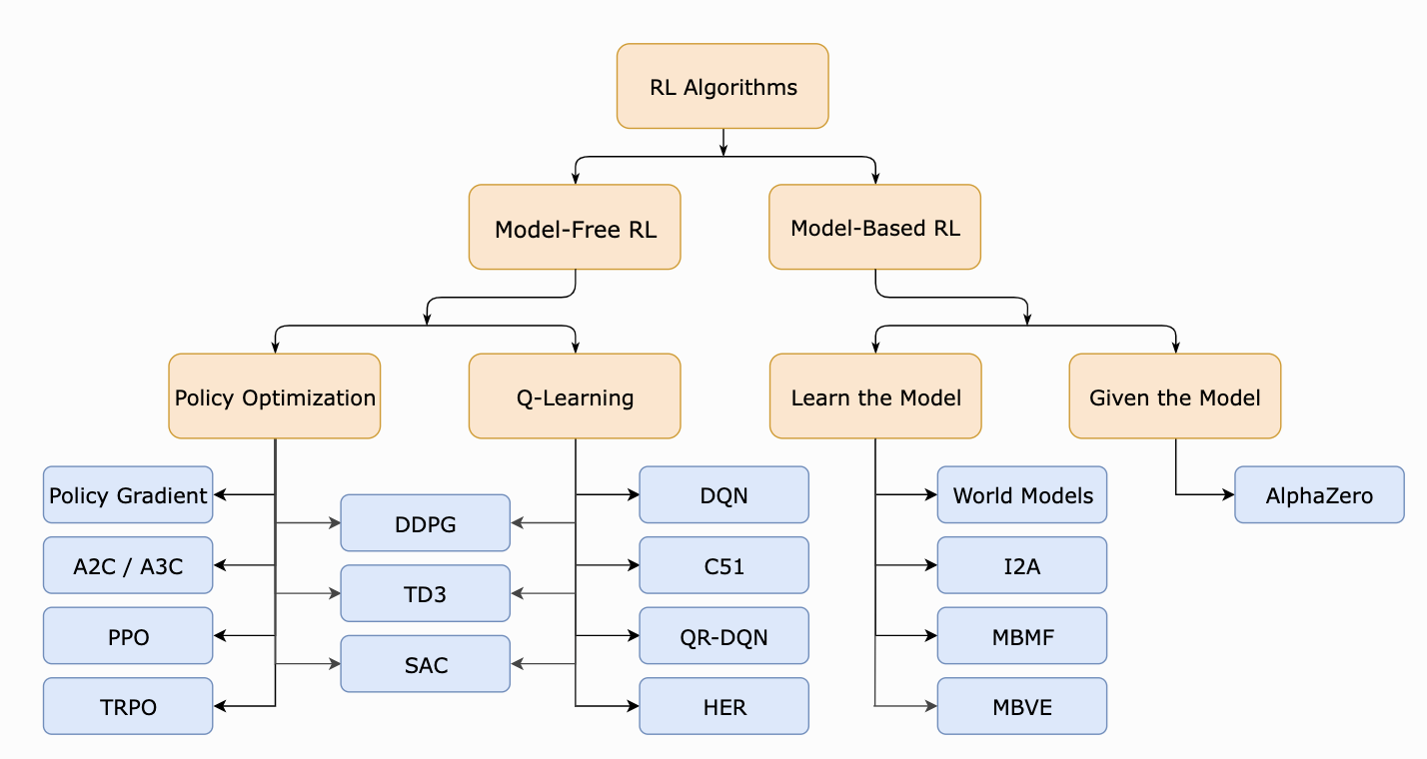
RL Taxonomy
source: OpenAI

Slide 5
Prior Work
Policy Gradient Method
Learns a parameterized policy without a value function.
Notes:
Give an overview of RL and MDPs

Slide 6
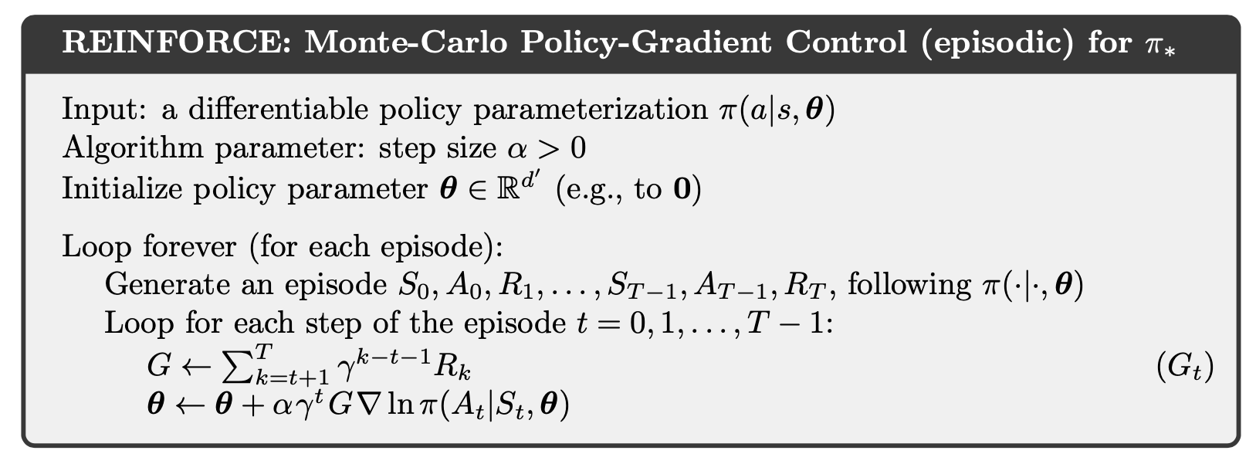
More Details on Policy Gradient
Large step size - may not recover from taking a bad step and cause a cycle of bad policy samples
Small step size - underutilization of data

Slide 7
Policy Gradient Limitations
Poor sample efficiency
Difficult to choose learning rate
High Variance

Slide 8
Proposed Approach
Trust Region Policy Optimization
Large improvement step
Constrained by KL-Divergence (not really)
Notes:
1-5 slides

Slide 9
Trust Region Policy Optimization
Local approximation - when visitation frequency is unknown
Importance Sampling
Notes:
Include the reasons for both approaches

Slide 10
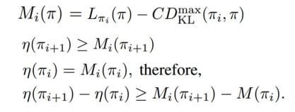
Monotonic Improvement Theory
Guarantee to always find the best policy ?
Find the performance lower bound
Majorize - Maximization wrt objective
maximize wrt new policy
Notes:
Learn more about MM algorithm

Slide 11
Optimization of Parameterized Policies
Recall the penalty term C, then a constrained optimization problem is defined
Constraint bounded by the KL- Divergence between the old and new policy

Slide 12
Optimization of Parameterized Policies
Solve expansion Taylor`s Polynomial Approximation
L are eliminated because of small changes between old and new policy
Use Natural Policy gradient

Slide 13
Trust Region Policy Optimization Algorithm

Slide 14
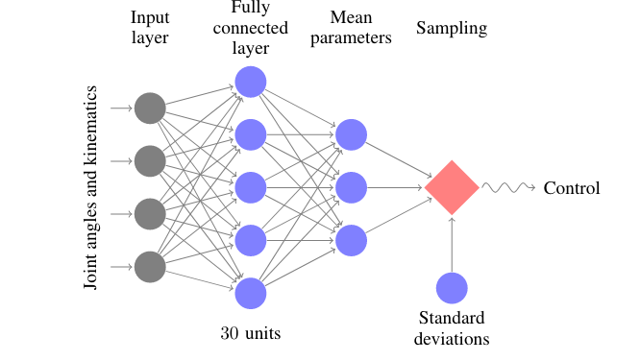
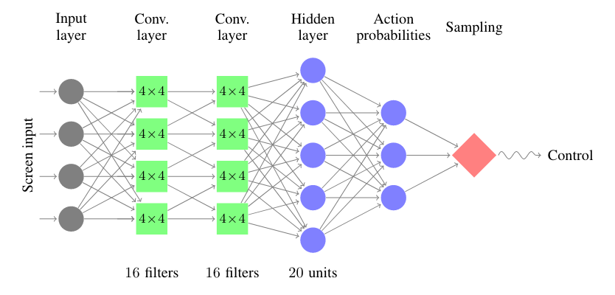
Experimental Setup
Simulated Robot Locomotion(MuJoCo)
Summers - 10D state space
Walkers - 18D state space
Hooper - 12D state space
Atari
Learns from raw image inputs
Continuous State space
Discrete actions e.g dodging bullets

Slide 15
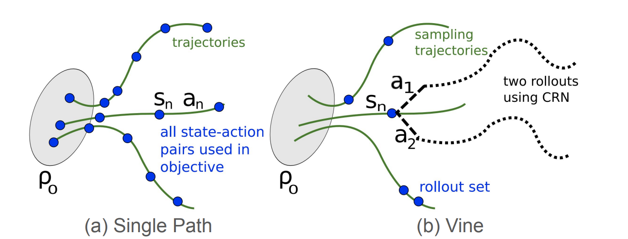
Experimental Results
Sample-based estimation of advantage functions
Single Path - sample from __ and generate trajectories from old policy
Vine - roll-out and sample multiple actions and trajectories

Slide 16
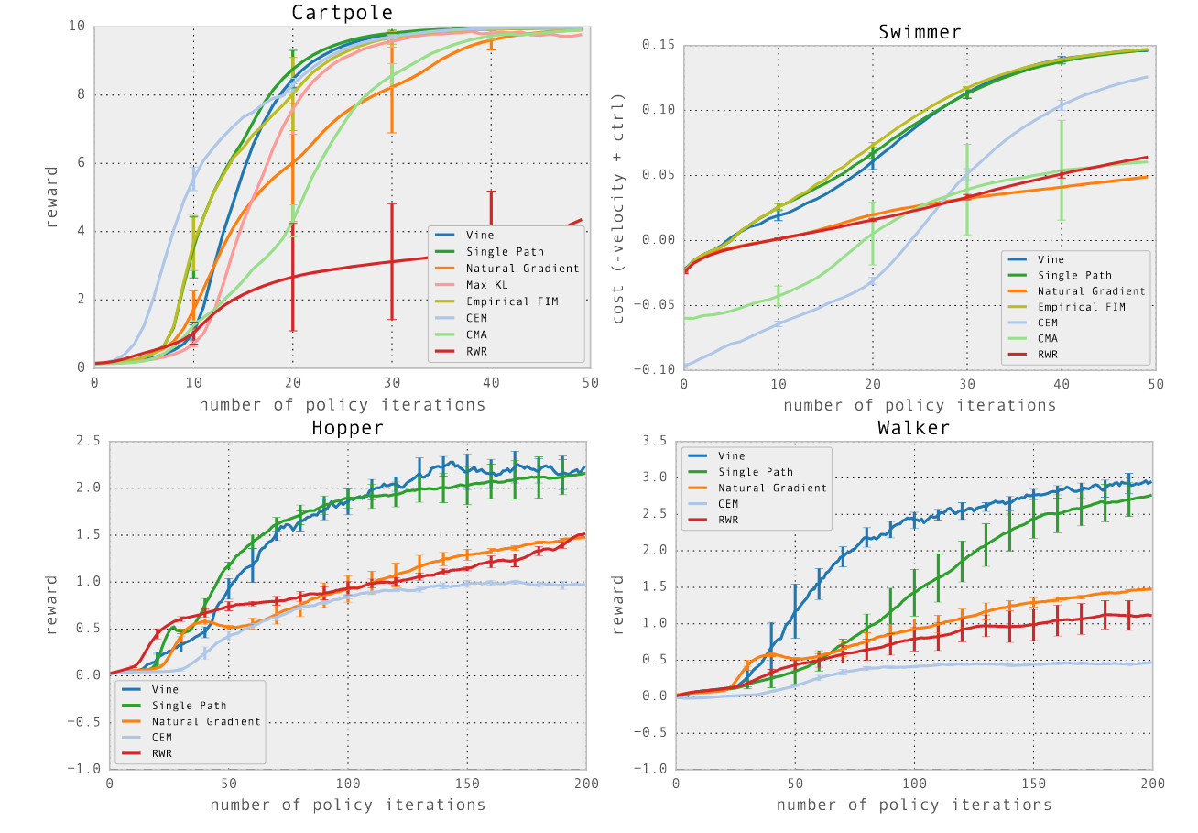
Experimental Results
Simulated Robotic Locomotion tasks
Hopper: 12-dim state space -
Walker: 18-dim state space
rewards
encourage fast and stable running (hopper)
encourage smooth walker (walker)

Slide 17
Experimental Results
Atari games
discrete action space : 0 / 1

Slide 18
Discussion of Results
Theoretical guarantees of monotonic improvement
Policy learned in robot locomotion was generalisable across subtasks
Policy can be used for perception and control.
Modification to recurrent policies with hidden state could be useful for roll out estimation in a partially observed setting.
Notes:
What conclusions are drawn from the results by the authors?
What insights are gained from the experiments?
What strengths and weaknesses of the proposed method are illustrated by the results?
Are the stated conclusions fully backed by the results and references?
If so, why? (Recap the relevant supporting evidences from the given results + refs)
If not, what are the additional experiments / comparisons that can further support/repudiate the conclusions of the paper?

Slide 19
Critique / Limitations / Open Issues
Hard to use with architectures with multiple outputs, e.g., policy and value function (need to weight different terms in distance metric)
Performs poorly on tasks requiring deep CNNs and RNNs
Conjugate gradients approach is more complicated than SGD

Slide 20
Future Work for Paper / Reading
TRPO does not always work well in practice and is computationally inefficient.
What comes next?
Proximal Policy Optimization Schulman, J., Wolski, F., Dhariwal, P., Radford, A., & Klimov, O. (2017). Proximal Policy Optimization Algorithms. arXiv. https://doi.org/10.48550/arXiv.1707.06347
Actor-Critic based Kronecker-Factored Trust Region Wu, Y., Mansimov, E., Liao, S., Grosse, R., & Ba, J. (2017). Scalable trust-region method for deep reinforcement learning using Kronecker-factored approximation. arXiv. https://doi.org/10.48550/arXiv.1708.05144
Notes:
1-2 slides
What interesting questions does it raise for future work?
Your own ideas for future work
Others’ ideas (if others have already built on this idea)

Slide 21
Extended Readings
S. Kakade. “A Natural Policy Gradient.” NIPS, 2001.
S. Kakade and J. Langford. “Approximately optimal approximate reinforcement learning”. ICML, 2002. [3] J. Peters and S. Schaal. “Natural actor-critic”. Neurocomputing, 2008.
J. Schulman, F. Wolski, P. Dhariwal, A. Radford, and O. Klimov. “Proximal Policy Optimization Algorithms”. 2017.
Notes:
1-2 slides
Pointers to papers that use this paper as a reference and/or other very related papers that others may want to read
Point classmates to where they can go for further reading on this paper/reading

Slide 22
Summary
Trust region optimization guarantees the monotonic policy improvement.
Key ideas of TRPO
Minorization-Maximization
Trust region
Notes:
Approximately one bullet for each of the following
Problem the reading is discussing
Why is it important and hard
What is the key limitation of prior work
What is the key insight(s) (try to do in 1-3) of the proposed work
What did they demonstrate by this insight? (tighter theoretical bounds, state of the art performance on X, etc)

