Slide 1
You Only Look Once:
Unified, Real-Time Object Detection
Presenter: Taijing Chen
08/30/2022

Slide 2
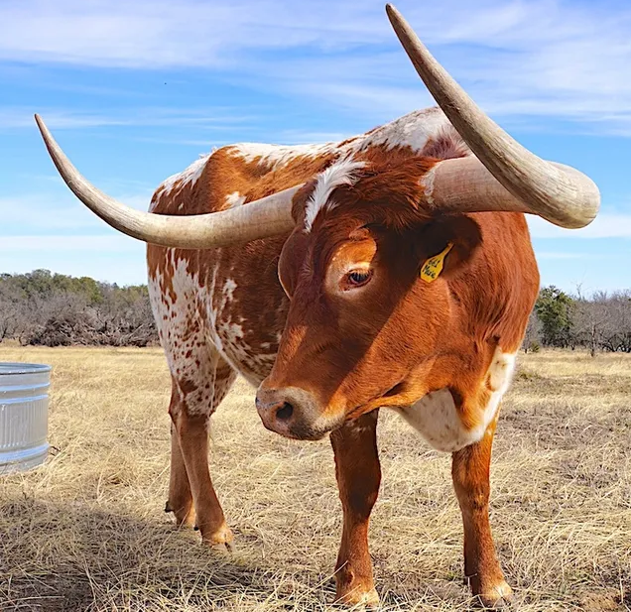
Object Detection: Localization & Classification
longhorn
longhorn
classification
localization
bbox detection
output
class
(xyxy) or (xywh)
(xyxy, cls) or (xywh, cls)

Slide 3
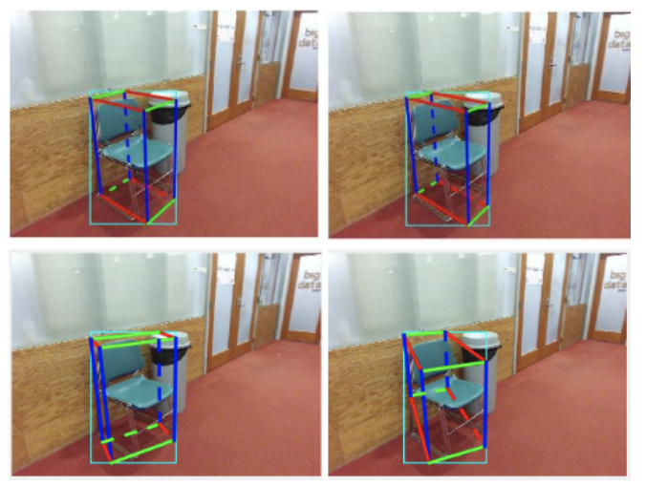
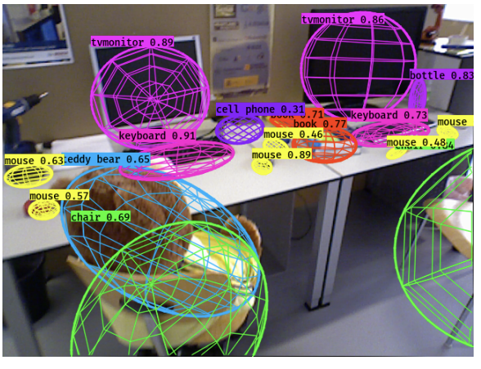
Object Detection: Why it’s important to robotics?
Example Applications:
3D object pose proposals
estimate 3D object poses
semantic class
3D scene interaction
neural symbolic programming
…
Cubic Proposals
CubeSLAM
Yang & Scherer. (2019)
Constrain Quardrics
QuardricSLAM
Nicholson, Milford & Sunderhauf. (2018)

Slide 4
Object Detection: What makes a detector good for robots?
Fast
(Real-time)
Robust (Real-world)

Slide 5
2D BBox Detection: Prior Work Examples
Main Idea: use classifiers to perform detection; multi-stage detector
DPM
Localization: sliding window
Main Idea: classifier runs at evenly spaced locations over the entire image
Drawbacks: slow
R-CNN and its variants (See Lecture from 231n, Stanford for more details)
Localization: Regional Proposal
Main Idea:
generate potential bbox proposals
classify bbox proposals
post-procession
Drawbacks: slow & hard to optimize

Slide 6
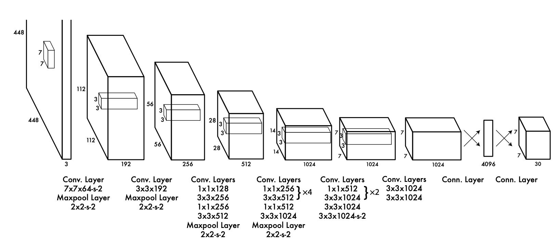
YOLO: Proposed Approach
Proposal: an end-to-end (image→2d-bbox) regression problem (“unified detection”); one-stage detector
BBox (xywh)
Image
Convolution
Layers
FC Layers
See Figure 3
Confidence Score
Useful for robotics applications:
Fast simple architecture; can be run in real-time systems
More Robust encodes contextual info → less mistakes at background

Slide 7
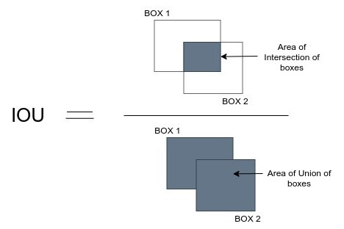
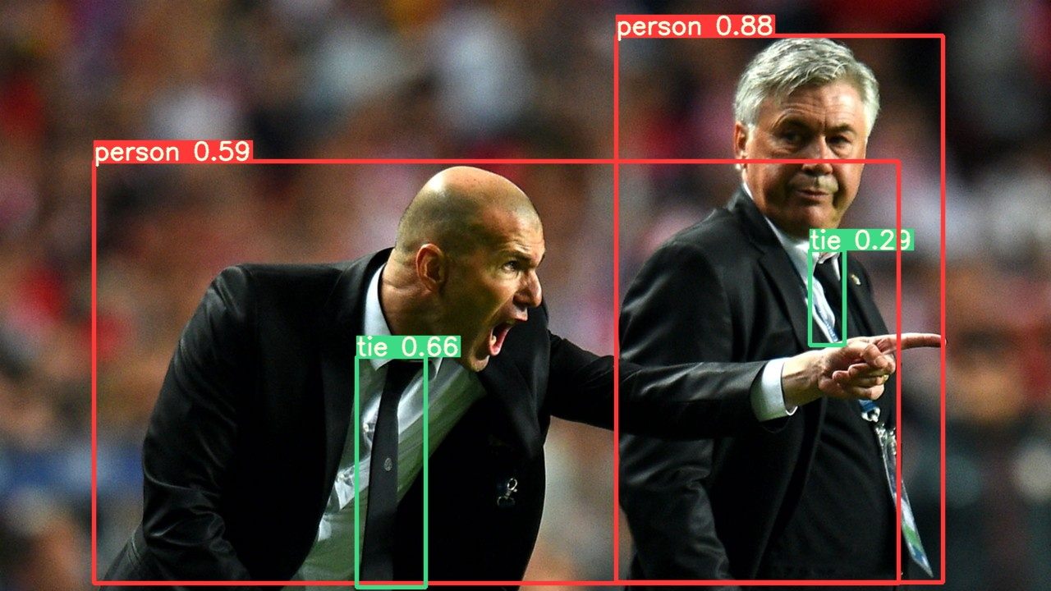
YOLO: Confidence
BBox (xywh)
Image
Convolution Layers
FC Layers
Confidence Score
Confidence := Pr(Object) * IOU_{pred}^{truth}
“intersection over union”
how likely the box contains an (ANY) object
how accurate is the bbox
argmax and max of class-specific confidence
Class-Specific Confidence
:= Pr(Class_i|Object) * Pr(Object) * IOU_{pred}^{truth}
= Pr(Class_i) * IOU_{pred}^{truth}

Slide 8
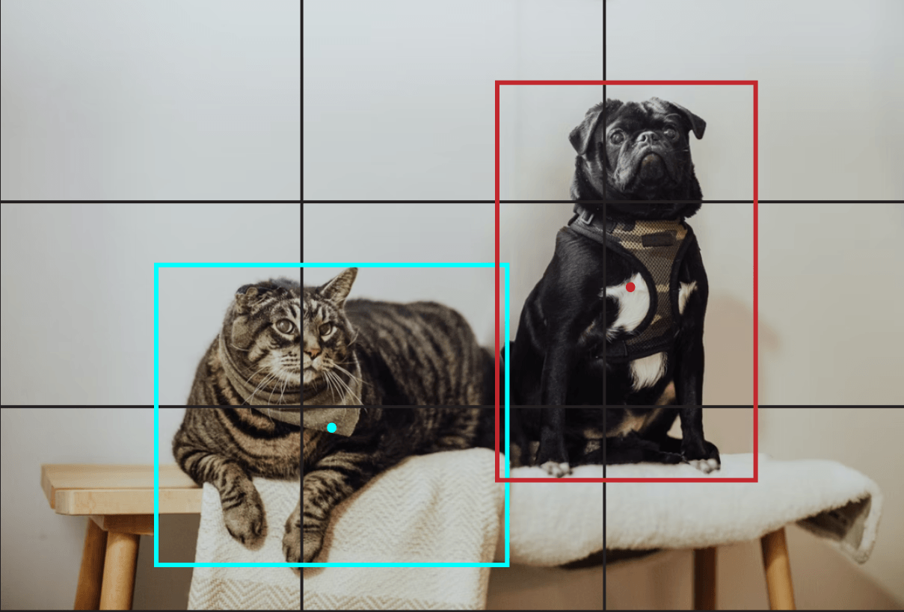
YOLO: Input & Output
BBox (xywh)
Image
Convolution Layers
FC Layers
C = #classes
S = grid size
B = #bboxes
Confidence Score
Output:
Each grid predicts B bboxes and their confidence
e.g., if we only predict 1 bbox, we have a vector [x, y, w, h, conf, cls1, cls2, …]
If we predict B bboxes: [x1, y1, w1, h1, conf1, x2, y2, w2, h2, …, cls1, cls2, …]
In total, final prediction is a S x S x (B*5+C) tensor
Input:
Divide input image into an SxS grid
Each grid is responsible for detecting objects whose centers lie in that grid
5
+
C
(5+C)x1
(B*5+C)x1

Slide 9
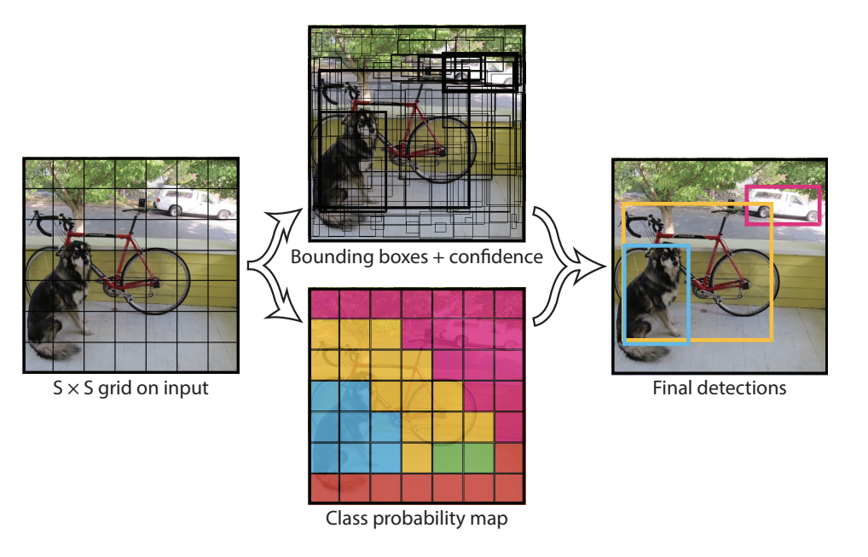
To summarize what’ve been discussed by far…
See Figure 2
[x1, y1, w1, h1, conf1]
[x2, y2, w2, h2, conf2]
…
[xB,yB,wB,hB, confB]
Pr(Object) * IOU
Class-Specific Confidence
[cls1, cls2, …, clsC]
Pr(Class|Object)

Slide 10
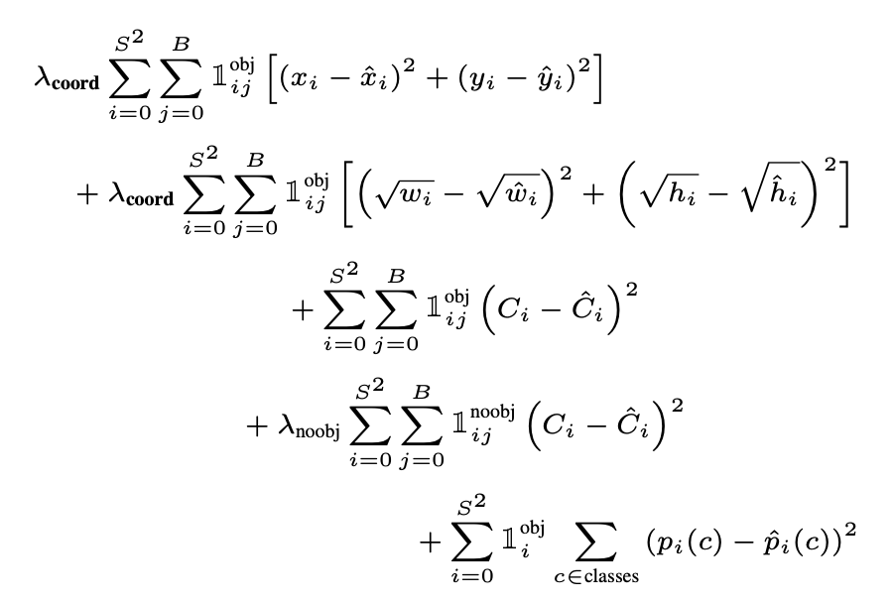
YOLO Training: MSE Loss Function for Regression
bbox location
bbox dimension
(small objects are a lot more sensitive to dimension errors)
over all grids
(SxS)
confidence
over all boxes for each grid (B)
class probability

Slide 11
YOLO Training: Loss Function (Cont’d)
bbox location
(penalize only when the predictor is “responsible” for the ground truth box)
bbox dimension
j-th bbox predictor in cell i is “responsible” for this prediction
confidence
(condition both on having objects & background)
class probability
(only penalizes classification error if an object is present in that grid cell)
if object appears in cell i

Slide 12
YOLO Training: Loss Function (Cont’d)
NOTE: model may not converge if these two weights are equal.
Why?
weight on bbox locations + dimensions (coordinates) more
weight on confidence predictions for boxes with no object less

Slide 13
YOLO Training: Loss Function (Cont’d)
NOTE: model may not converge if these two weights are equal.
Many are background
→ “overpowering the gradient from cells that do contain objects”
5
weight on bbox locations + dimensions (coordinates) more
.5
weight on confidence predictions for boxes with no object less

Slide 14
YOLO Final Step: NMS (Non-Max Suppression)
Problem: Sometimes the network predicts multiple bounding boxes for one object (e.g. objects lies at the borders of multiple cells). How to select the best one?
0.9
0.9
0.9
0.9
0.7
0.7
0.7
1. Select BBox with highest score
2. Calculate IOU
3. Remove BBox if IOU > threshold
0. Before NMS

Slide 15
YOLO: Experimental Setup
Dataset:
VOC 2007 & 2012
Artwork: Picasso Dataset, the People-Art Dataset
Metrics:
FPS: frames per second - the higher, the faster
mAP: mean average precision - the higher, the better
YOLO Models:
YOLO
Fast-YOLO: less convolution layers & filters
VGG16-YOLO: slower, but higher accuracy (for fair comparison)
Some features of the models for comparison:
DPM: use sliding window; strong spatial models
R-CNN and its variants: 2-stage; regional proposals

Slide 16
YOLO Result Highlights: Real-time Performance
>= 30 FPS
Table 1
DPM:
speed-accuracy trade-off
YOLO:
decent accuracy
much faster
fewer convolution layers
fewer filters

Slide 17
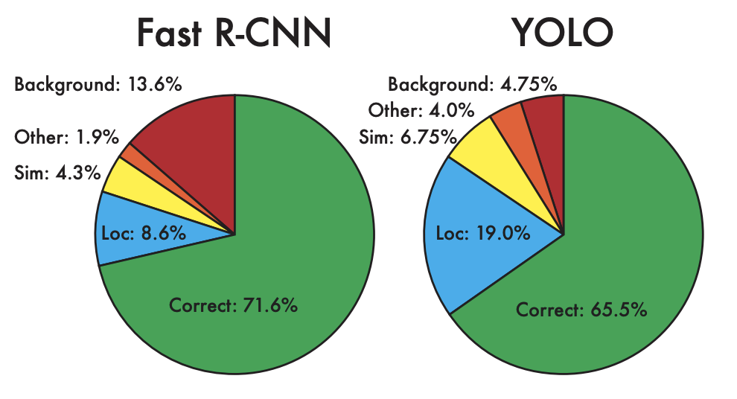
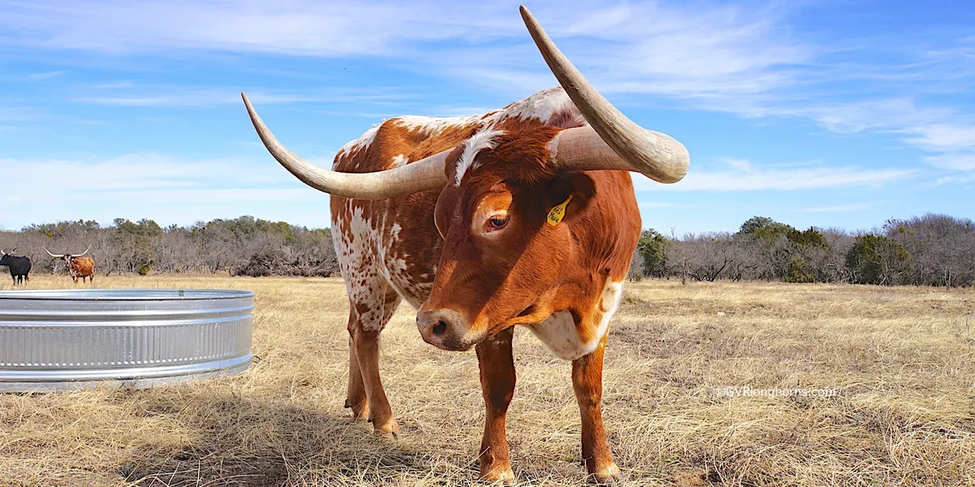
YOLO Result Highlights: R-CNN variants vs YOLO
mAP
FPS
more background errors
less localization errors
less background errors
more localization errors
background error
localization error

Slide 18
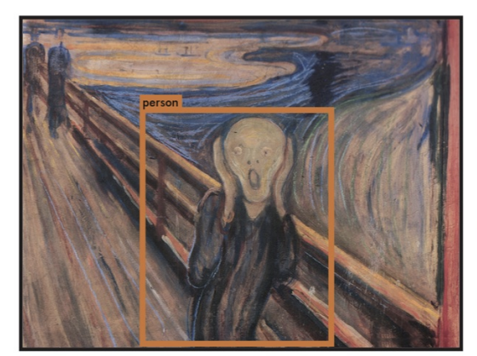
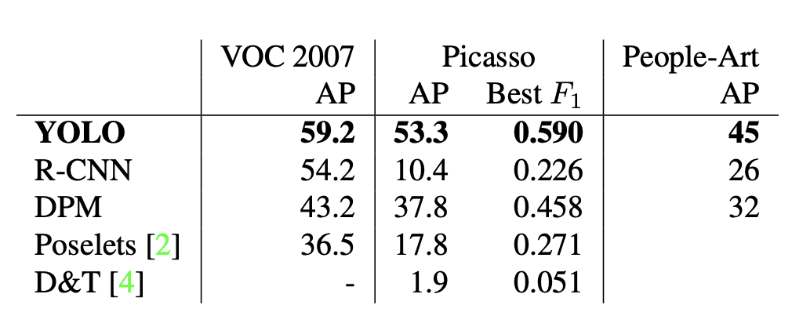
YOLO Result Highlights: Generalizability
Trained on VOC; Tested on Artwork dataset
measures the balance between precision and recall - the higher the better (see this for details)

Slide 19
YOLO Result Summary
Fastest, can be run in real-time
Better speed-accuracy trade off
More localization errors, less background errors
Performance degrades less when applied to out-of-domain testing set

Slide 20
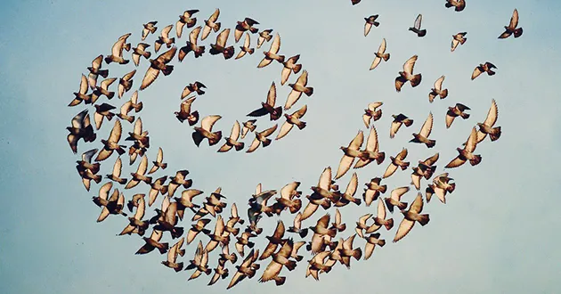
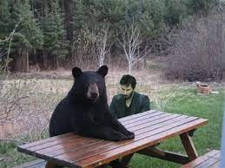
Limitations of YOLO when it first published:
Spatial constraints on bbox prediction
Hard to generalize to bboxes with new/unusual aspect ratio
Loss function: treats errors the same in small bboxes vs larger ones
Other general limitations: small object detection, small dataset learning
E.g. Many birds in one grid, but one grid can only generate a fixed, limited number of bbox predictions
E.g. [xyhw, conf, xyhw, conf, cls1, cls2, …]
It has to pick one of the two directions to output

Slide 21
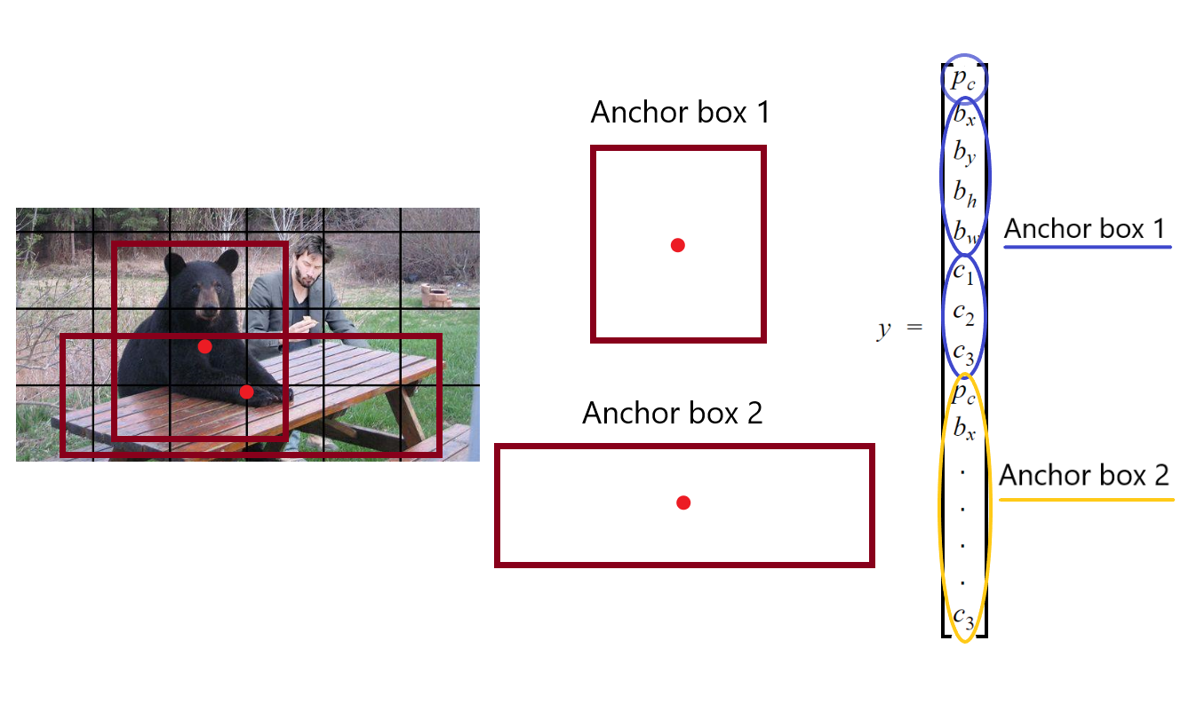
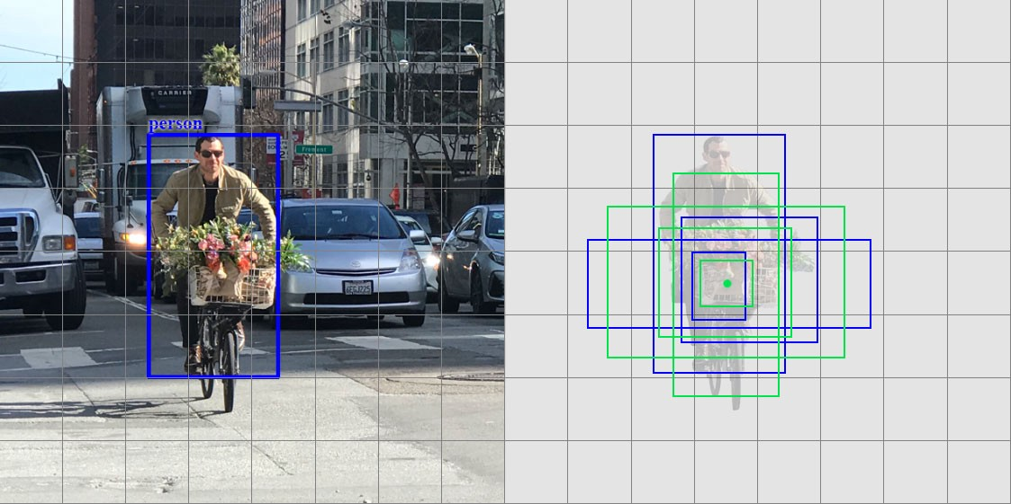
Improvements of YOLO since then…
YOLOv2 YOLO9000:Better, Faster, Stronger. Joseph Redmon & Ali Farhad. (2017)
use batch normalization on all convolution layers → increase 2% mAP
high resolution classifiers → increase 4% mAP
multi-stage training → help with new/usual aspect ratio
remove the fully connected layers from YOLO and use anchor boxes to predict bounding boxes → decreases mAP slightly & increase recall 7%
→ help with spatial constraints
and many others (see paper for details)...
anchor boxes:

Slide 22
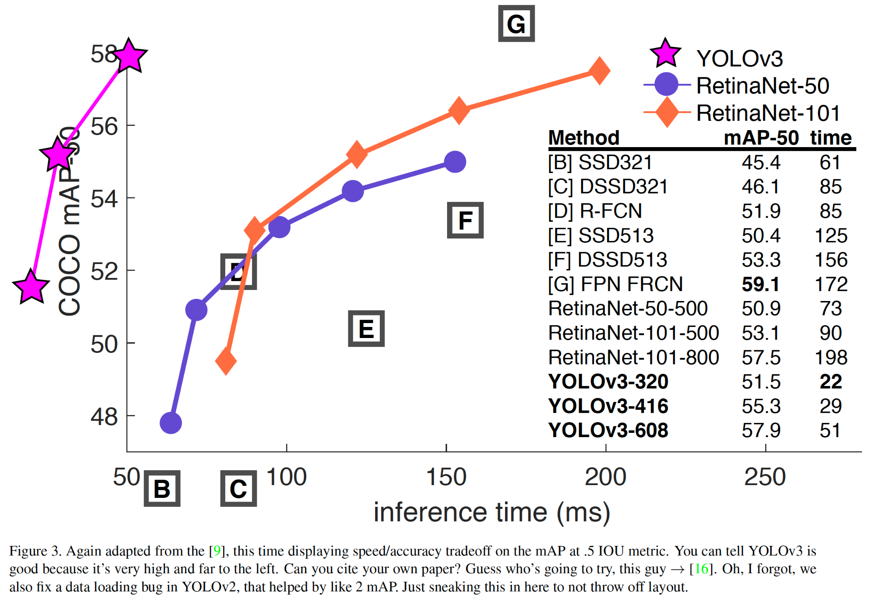
Improvements of YOLO since then…
YOLOv2 YOLO9000:Better, Faster, Stronger. Joseph Redmon & Ali Farhad. (2017)
YOLOv3 YOLOv3: An Incremental Improvement. Joseph Redmon & Ali Farhad. (2018)
BBox Prediction: predicts an objectness score for each bounding box using logistic regression
Class Prediction: each box predicts the classes the bounding box may contain using multilabel classification.
Prediction across scales: similar concept to feature pyramid networks
Feature Extractor: performing feature extraction
See paper for what they’ve tried that didn’t work

Slide 23
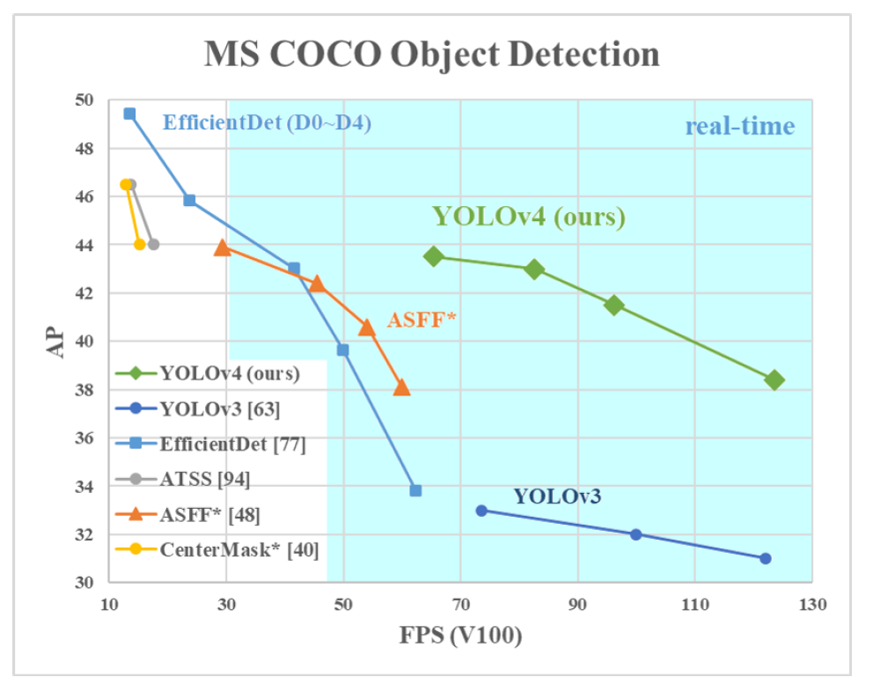
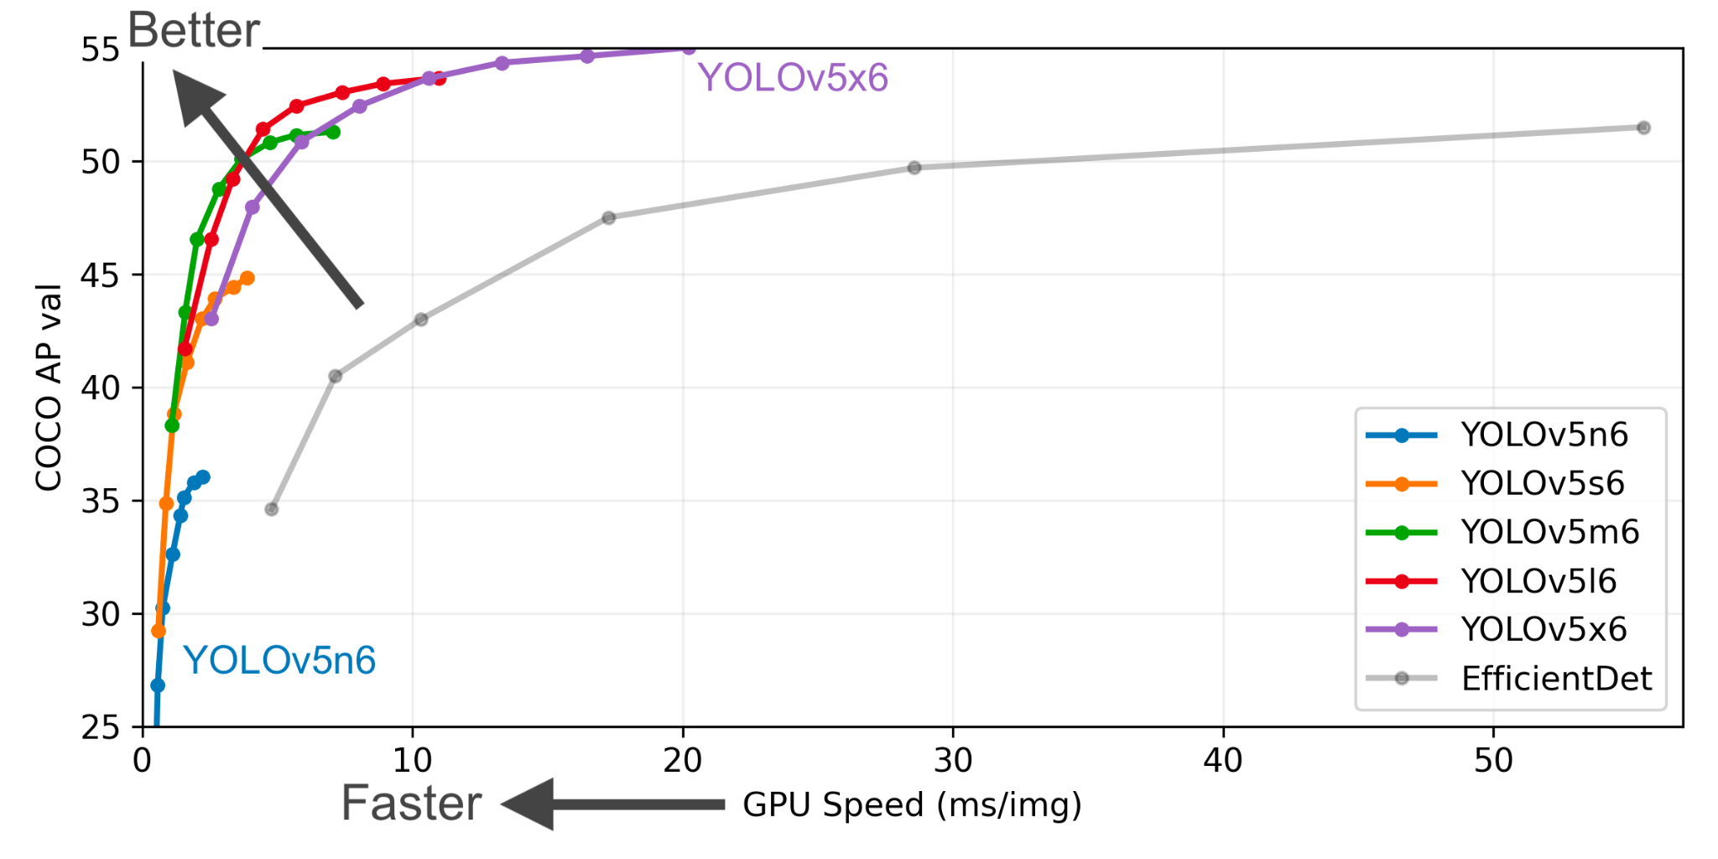
Improvements of YOLO since then…
YOLOv2 YOLO9000:Better, Faster, Stronger. Joseph Redmon & Ali Farhad. (2017)
YOLOv3 YOLOv3: An Incremental Improvement. Joseph Redmon & Ali Farhad. (2018)
YOLOv4 YOLOv4: Optimal Speed and Accuracy of Object Detection. Alexey Bochkovski, Chien-Yao Wan & Hong-Yuan Mark Liao. (2020)
new features: WRC, CSP, CmBN, SAT, Mish activation, Mosaic data augmentation, CmBN, DropBlock regularization, and CIoU loss, etc.
YOLOv5 (GitHub)

Slide 24
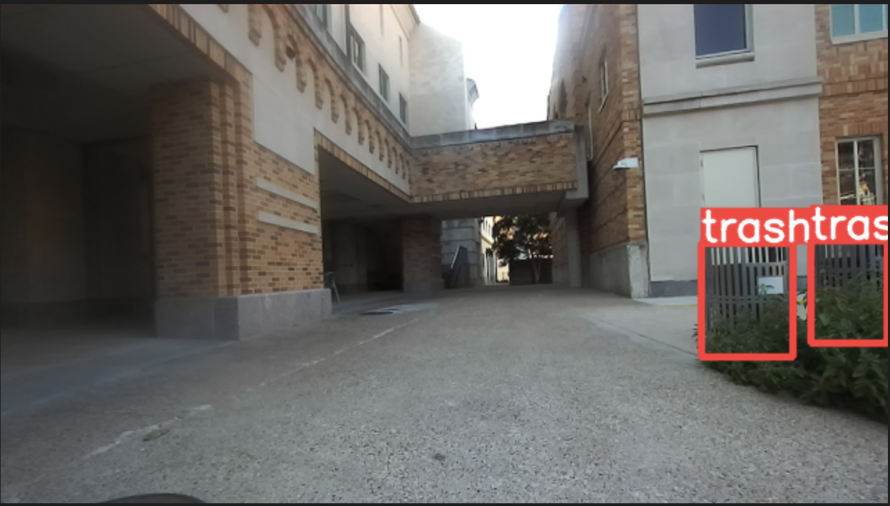
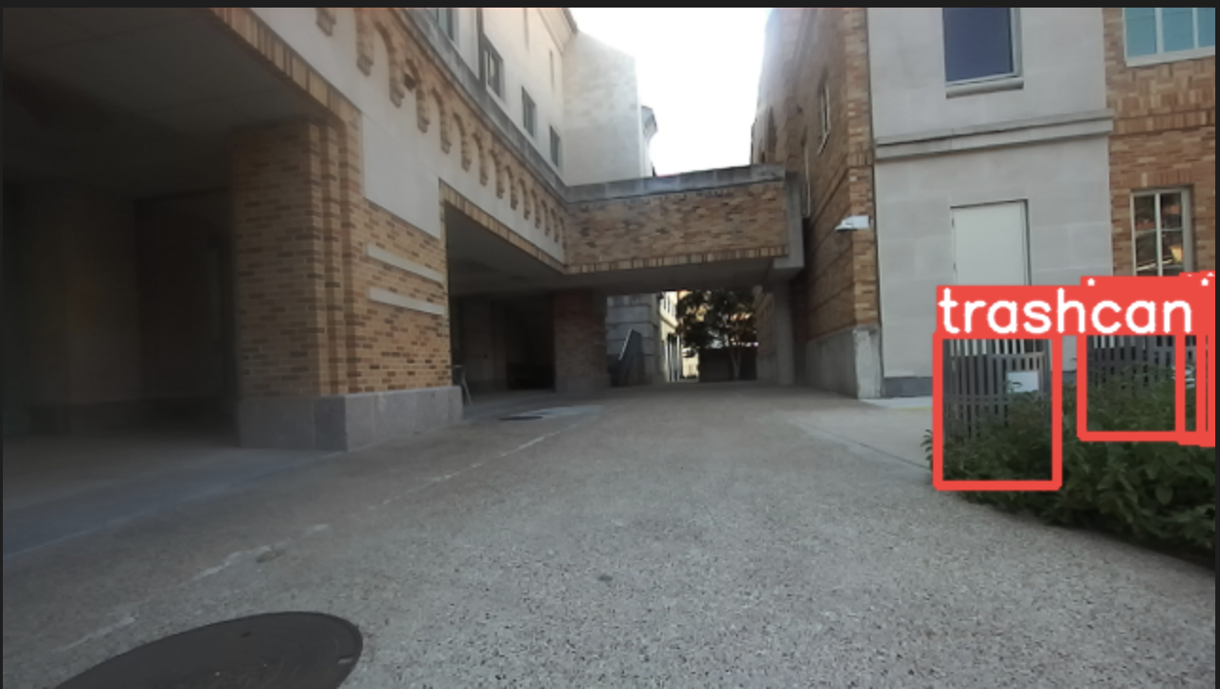
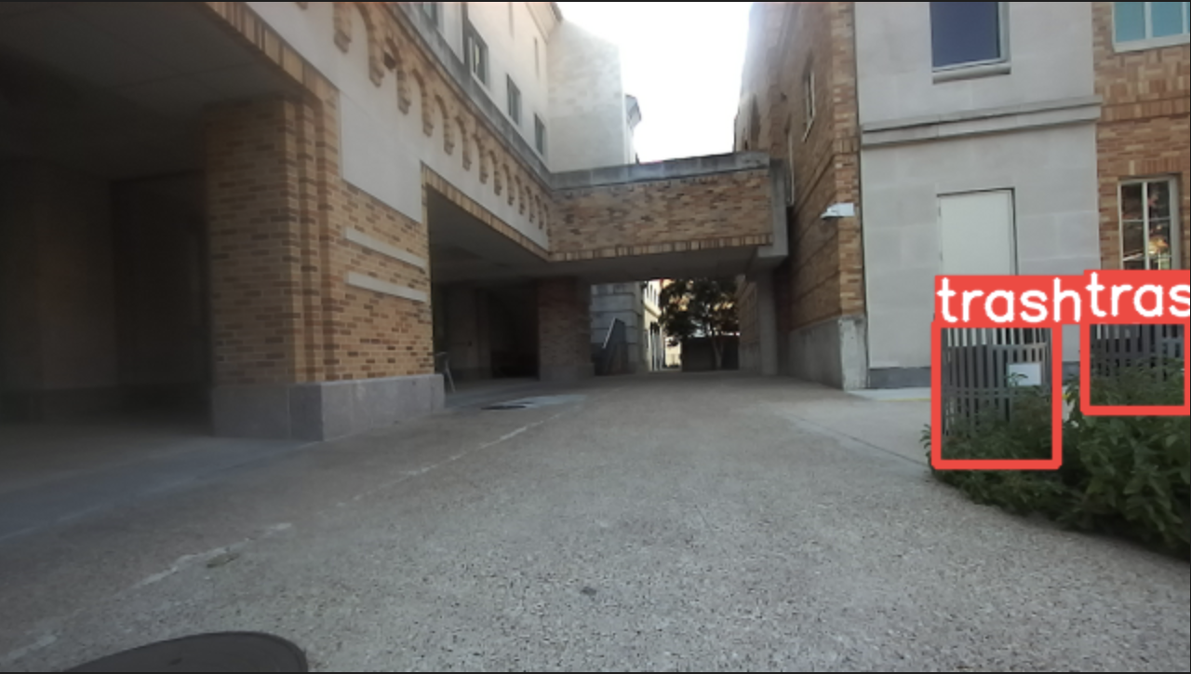
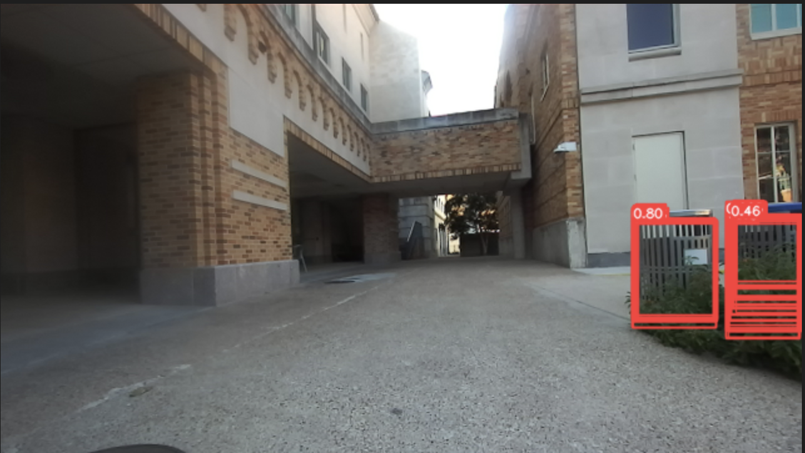
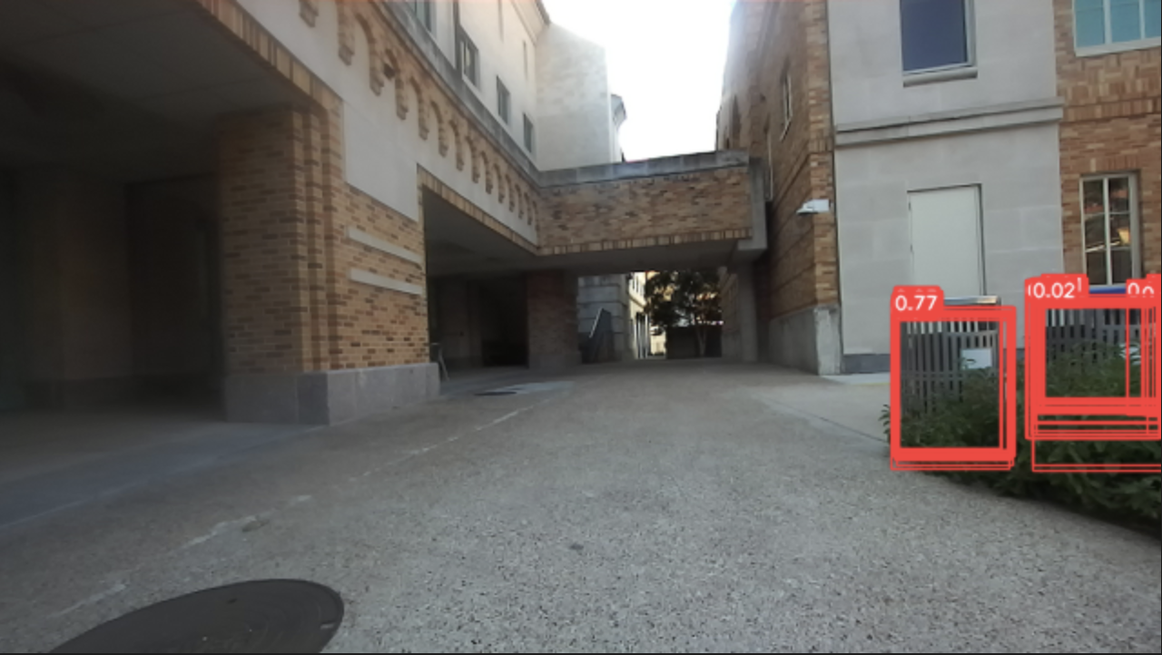
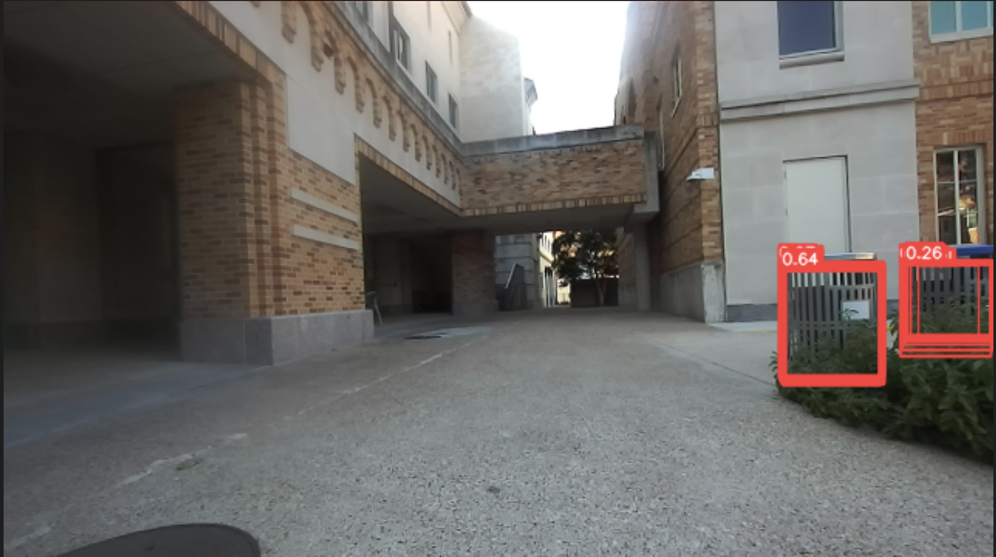
Open problems for 2D BBox Detection in Robotics:
Occlusion & Uncertainty
correct size & labeling
wrong labeling
wrong size

Slide 25
Open problems for 2D BBox Detection in Robotics:
Occlusion & Uncertainty
Related Works:
Bounding Box Regression with Uncertainty for Accurate Object Detection. He et al. (2018)
Localization Uncertainty-based Attention for Object Detection. Park et al. (2021)
Learning an Uncertainty-Aware Object Detector for Autonomous Driving. Meyer & Thakurdesai. (2020)

Slide 26
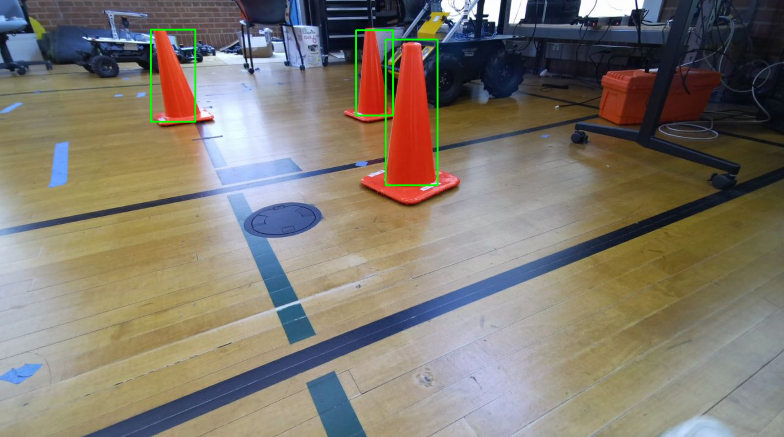
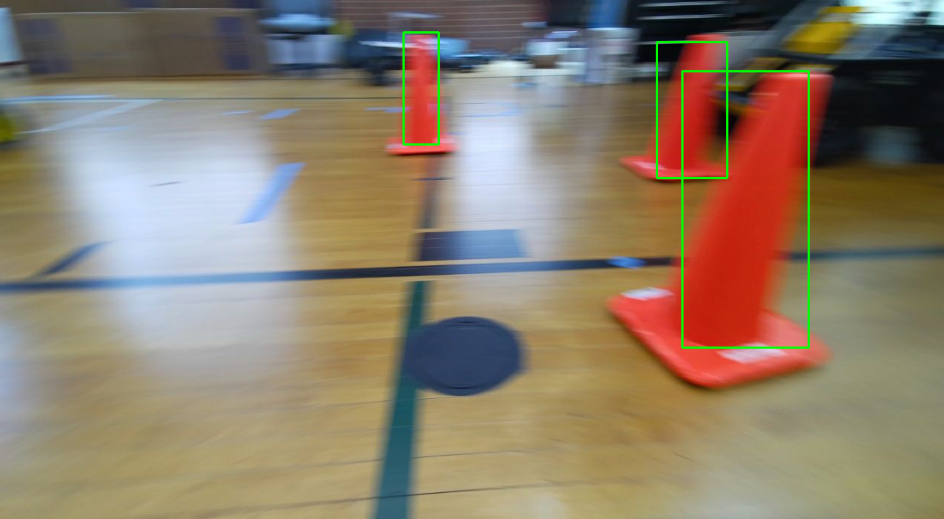
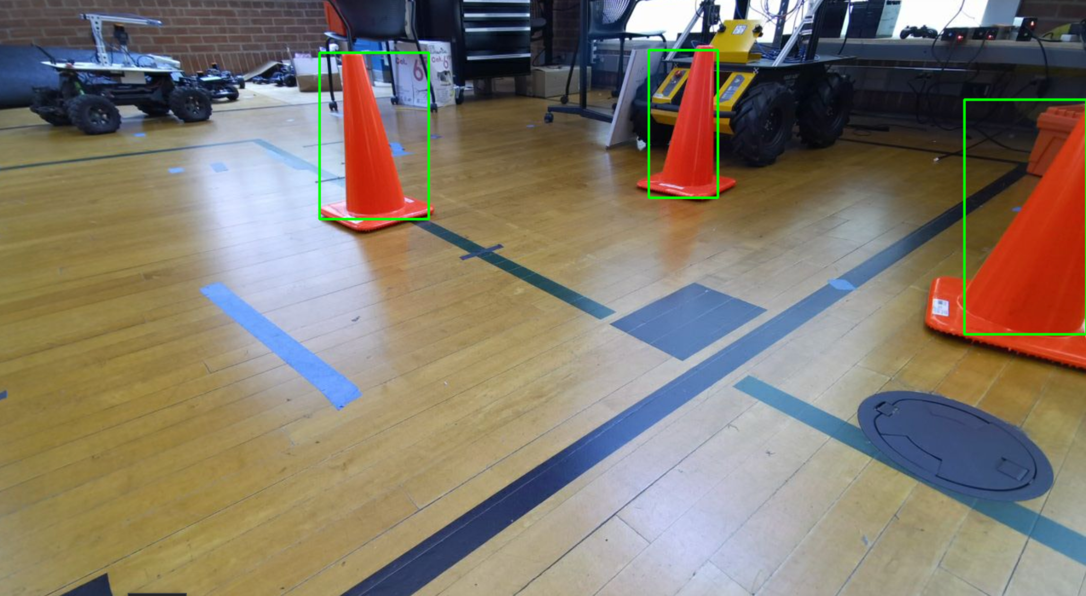
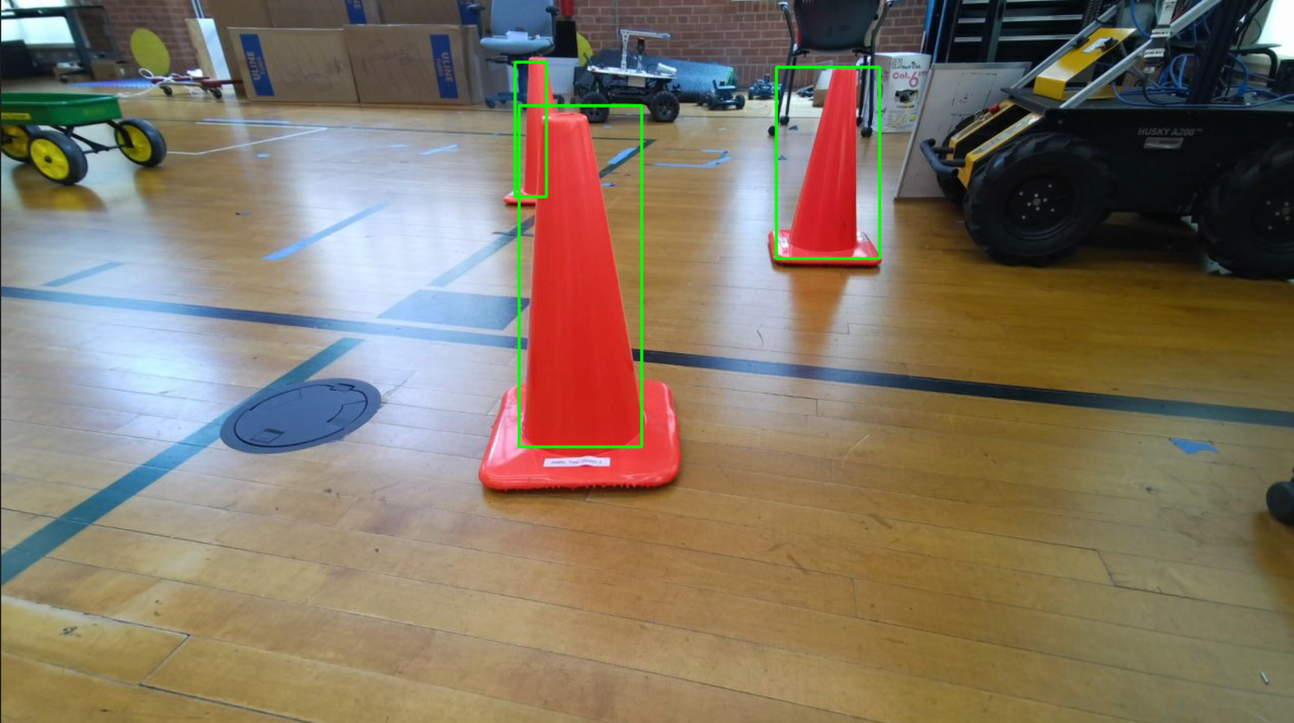
Other Future Work Example: How can we use robots to help object detection?
stationary
moving
partial
occluded

Slide 27
Other Future Work Example: How can we use robots to help object detection?
Related Works:
Learning to Detect Mobile Objects from LiDAR Scans Without Label. You et al. (2022)
WS-OPE: Weakly Supervised 6D Object Pose Regression using Relative Multi-Camera Pose Constraints. Li et al. (2022)
OSSID: Online Self-Supervised Instance Detection by (and for) Pose Estimation. Gu, Okorn & Held. (2022)
How to Build a Curb Dataset with LiDAR Data for Autonomous Driving. Bai et al. (2022)

Slide 28
Summary
Motivation: object localization & classification with 2D bounding boxes
Problem: prior frameworks have poor speed-accuracy trade-offs
Solution: YOLO - a single-stage, real-time 2D bounding box detector
Main Contributions/Results:
“unified detection” (unlike classifier-based approaches)
very fast (with fair accuracy)
generalize well to new domains

