Slide 1
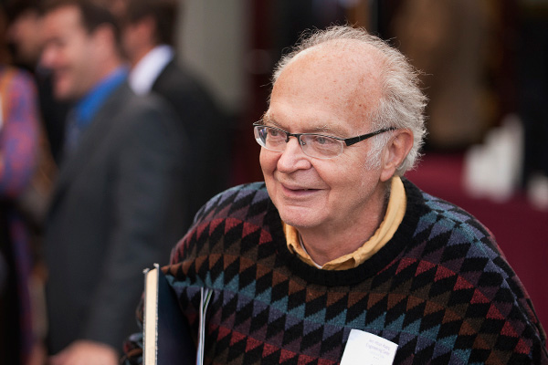
CS312 Course Introduction
"Computers are good at following instructions, but not at reading your mind."
-Donald Knuth, Tex p. 9
Mike Scott, Gates 6.304 scottm@cs.utexas.edu www.cs.utexas.edu/~scottm/cs312

Slide 2
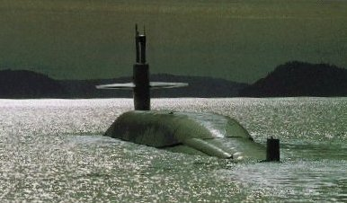
Who Am I
Lecturer in CS department since 2000
Undergrad Stanford, MSCS RPI
US Navy for 8 years, submarines
2 years Round Rock High School

Slide 3
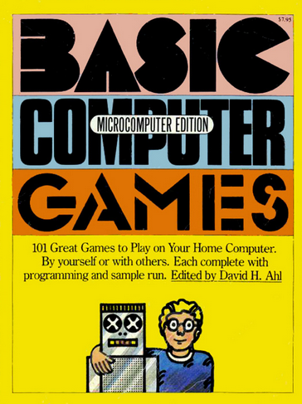
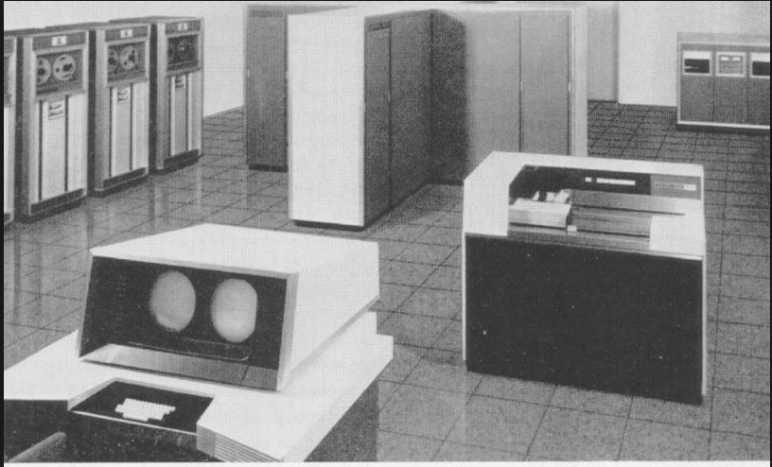
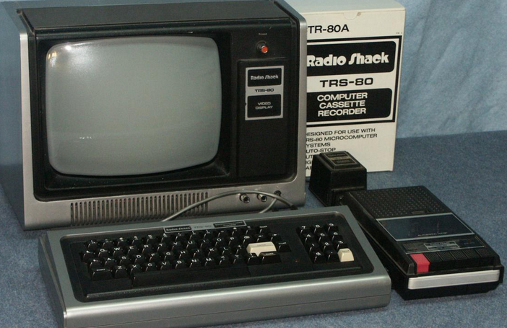
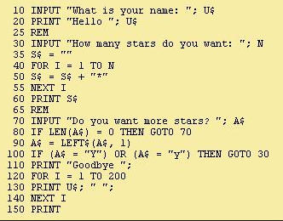
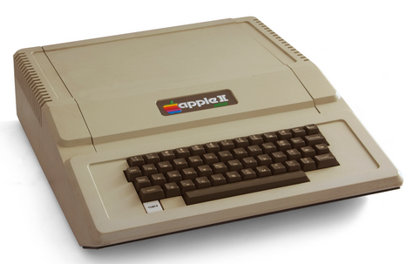
My Path to CS

Slide 4
What We Will Do Today
Introductions and administrative details
Start Java Basics

Slide 5
Intro to Programming
Learn to design and implement computer programs to solve problems.
course Intro
basic Java
static methods
expressions & variables
for loops
more loops, constants
parameters
2d graphics
more graphics
return values, Math methods
conditional statements
cumulative algorithms
Strings
while loops
random numbers
Boolean logic
assertions
file input 1
file input 2
file input 3
arrays
more arrays
tallying algos
sorting, searching
more array algos
2d arrays
classes and objects
methods
constructors
creating classes, Enums
inheritance
polymorphism
ArrayList
recursion

Slide 6
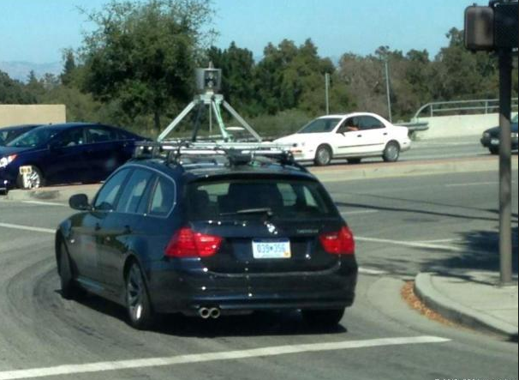
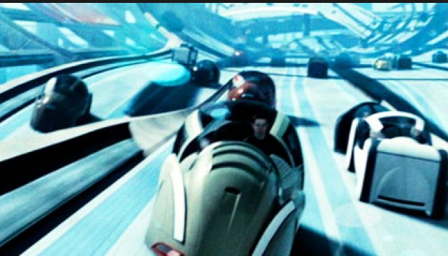
Programing and CS
A tool for doing the cool stuff in CS
You can't create a self driving vehicle without the software to control the vehicle

Slide 7
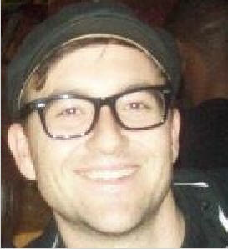
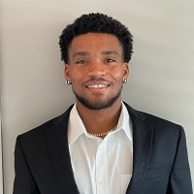
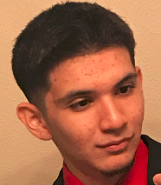
The Parable of the 500 Problems.
I assume no prior programming experience.
You are limited to what you can use on assignment to what we have covered in the book.
I will defer questions that are well past what we are currently covering.
Programming is not a spectator sport.
The only way to learn to program is to program
Aaron D, Anthony C, Armel T, and the 500 problems.

Slide 8
Startup
If you have not already done so …
… complete the items on the class start-up page
http://www.cs.utexas.edu/~scottm/ cs312/handouts/startup.htm

Slide 9
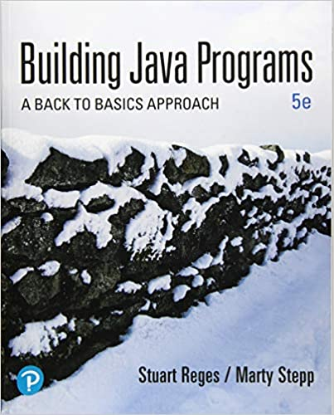
Books and software
book is required - we follow it quite closely
Java for programming
IDE for programming
Canvas for turning in assignments, grades, Perusall
Course Overview
9

Slide 10
Clicker 1
Which of these best describes you?
A. first year at UT and first year college student
B. first year at UT, transferring from another college or university
C. in second year at UT
D. in third year at UT
E. other

Slide 11
Graded Course Components
Programming projects
11 graded projects, 20 points each: 220 points total
Perusall reading assignments
6 reading assignments, 5 points each, 30 points total
Background survey on Canvas, 10 points
Academic Integrity quiz on Canvas, 10 points
Exams: Outside of class
Exam 1, Wednesday, 2/23, approx. 6:45 – 9:15 pm, 250 points
Exam 2, Wednesday, 4/6, approx. 6:45 – 9:15 pm, 250 points
Exam 3, Tuesday, 5/3, approx. 6:45 – 9:15 pm, 250 points
eCIS completion, Instructor and TA, 10 points
220 + 30 + 10 + 10 + 250 + 250 + 250 + 10 = 1030
clicker, Quizzes, Programming Assignments capped at 250 pts
30 points of “slack” among those 3 components

Slide 12
Grades and Performance
No points added! Grades based on 1000 points, not 1030
Final grade determined by final point total and a 900 – 800 – 700 – 600 scale
plusses and minuses if within 25 points of cutoff: 875 – 899: B+, 900 – 924: A-
historically my CS312 classes (~2000 Students)
80% C- or higher:
38% A's,
28% B's
12% C's
10% D or F
10% Q or W (drop)

Slide 13
Assignments
Start out easy but get much, much harder
Individual – do your own work
Programs checked automatically with plagiarism detection software
Turn in the right thing - correct name, correct format or you will lose points / slip days
Slip days
8 for term, max 2 per assignment
don’t use frivolously

Slide 14
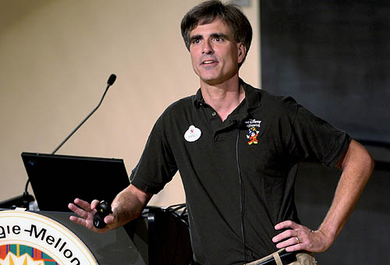
Succeeding in the Course
Randy Pausch, CS Professor at CMU said:
"When I got tenure a year early at Virginia, other Assistant Professors would come up to me and say, 'You got tenure early!?!?! What's your secret?!?!?' and I would tell them, 'Call me in my office at 10pm on Friday night and I'll tell you.' "
“A lot of people want a shortcut. I find the best shortcut is the long way, which is basically two words: work hard.”

Slide 15
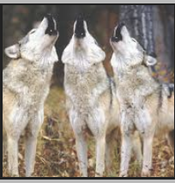
Succeeding in the Course - Meta
“Be the first penguin”
Ask questions!!!
lecture, section, Piazza, lab hours
“It is impossible to be perfect”
Mistakes are okay.
That is how we learn.
Trying to be perfect means not taking risks.
no risks, no learning
“Find a Pack”
Make friends.
Study with them!
Notes:
Be the first penguin, Professor Randy Pausch
It is impossible to be perfect, Captaim Tim Symons
Find a Pack, Quellcrist Falconer

Slide 16
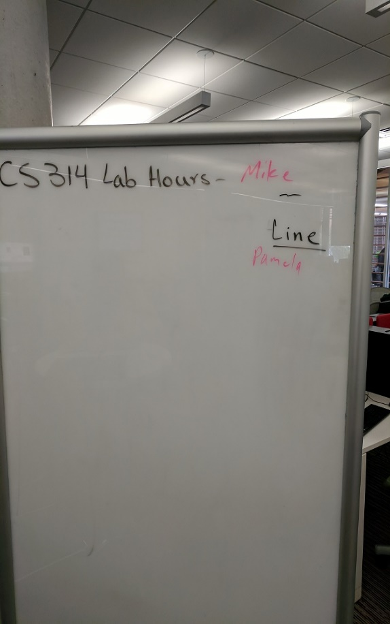
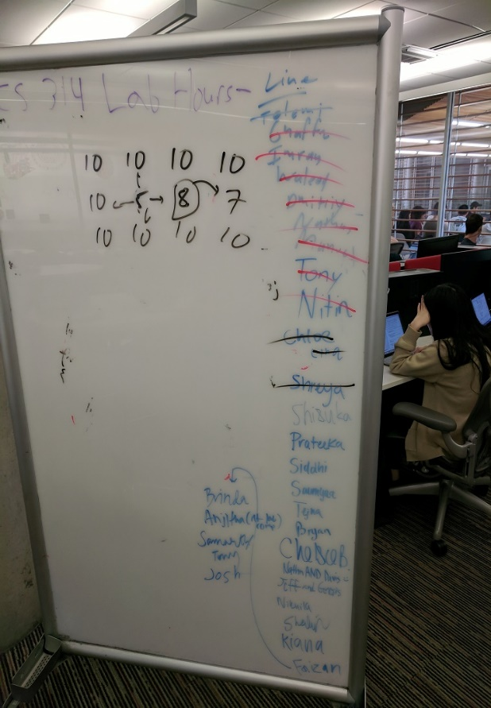
How to Get Help
Piazza Post
Help Hours in person or via Zoom
SI Sessions
Email instructor or TAs
Prefer Piazza
Class examples
Examples from book
Discuss with other students at a high level
MONDAYS
WEDNESDAY & THURSDAY

Slide 17
Succeeding in the Course - Concrete
Whole course is cumulative!
Material builds on itself
failure to understand a concept leads to bigger problems down the road, so …
do the readings
start on assignments early
get help from the teaching staff when you get stuck on an assignment
attend lecture and discussion sections
participate on the class discussion group
do extra problems (Practice It! http://practiceit.cs.washington.edu/)
study for tests using the old tests
study for tests in groups
ask questions and get help when needed

Slide 18
Succeeding in the Course
Cannot succeed via memorization.
The things I expect you to do are not rote.
Learn by doing.
If you are brand new to programming or have limited experience I strongly recommend you do lots and lots of practice problems.
Practice It! web site
JavaBat

Slide 19
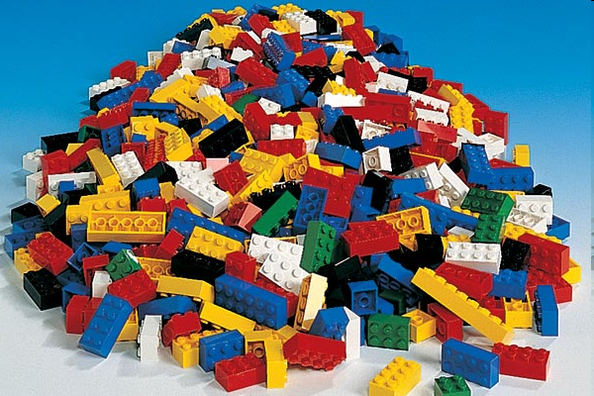
Programming is like Legos…

Slide 20
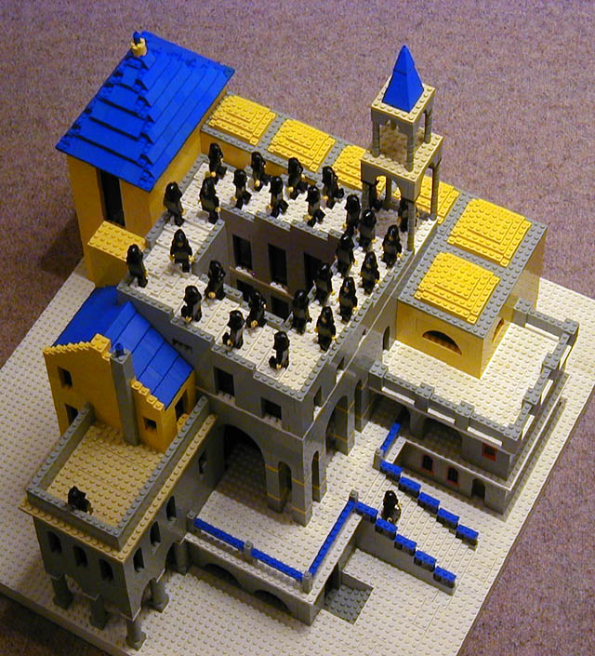

Slide 21
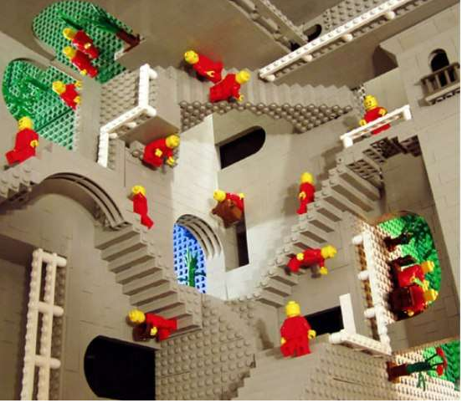

Slide 22
Legos and Programming
With Legos and Programming you have a small number of primitives. (basic tools or pieces)
But you build huge, elaborate structures out of those simple pieces.

Slide 23
A Brief Look at Computer Science
This class, like most first classes in Computer Science, focuses solving problems and implementing those solutions as computer programs.
you learn how to program
… and yet, computer science and computer programming are not the same thing!
So what is Computer Science?

Slide 24
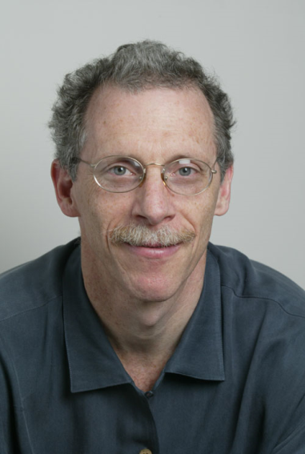
What is Computer Science?
Poorly named in the first place.
It is not so much about the computer as it is about Computation.
“Computer Science is more the study of managing and processing information than it is the study of computers.” -Owen Astrachan, Duke University
learn to program
programming a key tool in later courses

Slide 25
Computer Programming and Computer Science
Generally the first thing that is studied in Chemistry is stoichiometry.
Why? It is a skill necessary in order to study more advanced topics in Chemistry
The same is true of problems solving / programming and computer science.

Slide 26
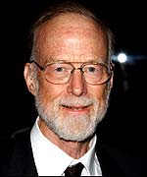
“What is the linking thread which gathers these disparate branches into a single discipline? …it is the art of programming a computer. It is the art of designing efficient and elegant methods of getting a computer to solve problems, theoretical or practical, small or large, simple or complex.” - C. A. R. Hoare
Sir Tony Hoare. Turing Award Winner. Inventor of the quicksort algorithm

Slide 27
“Programming is unquestionably the central topic of computing. In addition to being important, programming is an enormously exciting intellectual activity. In its purest form, it is the systematic mastery of complexity. For some problems, the complexity is akin to that associated with designing a fine mechanical watch, i.e., discovering the best way to assemble a relatively small number of pieces into a harmonious and efficient mechanism. For other problems, the complexity is more akin to that associated with putting a man on the moon, i.e, managing a massive amount of detail. In addition to being important and intellectually challenging, programming is a great deal of fun. Programmers get to build things and see them work.. What could be more satisfying? “ - John V. Guttag, Professor at MIT research in AI, medical systems, wireless networking

Slide 28
Computer Programming
a skill and tool that are applied to all other areas of computer science
artificial intelligence, networks, cpu architecture, graphics, systems (programming languages, operating systems, compilers), security, and on and on …
We will be using solving problems and implementing solutions in a programming language called Java
problem solving and computational thinking are key

Slide 29
What do Computer Scientists do?
Computer Scientists solve problems
creation of algorithms
Some examples
you
Kurt Dresner, Intersection Control
Austin Villa, Robot Soccer
Doug and Steve, the TRIPS processor

Slide 30
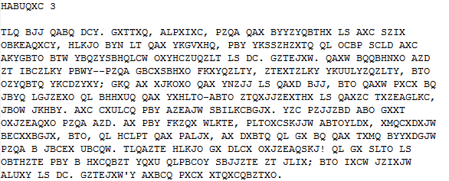
You!
Encryption and Decryption
Ever entered your credit card number to a website? game company?

Slide 31
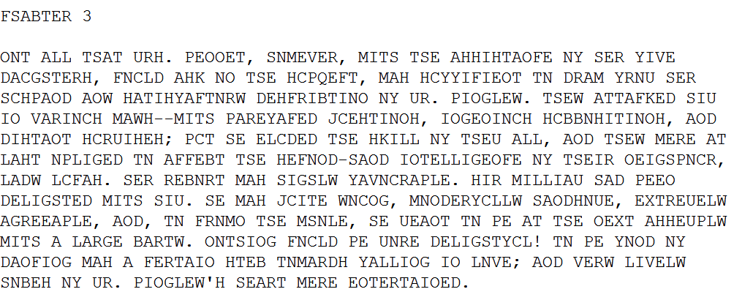
After a Little Computation:
Apply some human smarts:

Slide 32
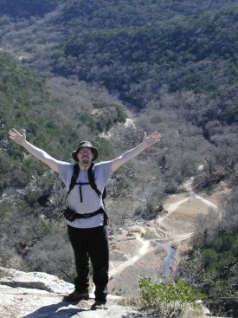
Kurt Dresner – Intersection Control
Former PhD student in UTCS department
working at Google now
area of interest artificial intelligence
Multiagent Traffic Management: A Reservation-Based Intersection Control Mechanism
how will intersections work if and when cars are autonomous?
Simulator

Slide 33
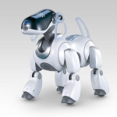
Austin Villa – Robot Soccer
Multiple Autonomous Agents
Get a bunch of Sony Aibo robots to play soccer
Problems:
vision (is that the ball?)
localization (where am I?)
locomotion (I want to be there!)
coordination (I am open! pass me the ball!)
http://www.cs.utexas.edu/~AustinVilla/
Video Video2

Slide 34
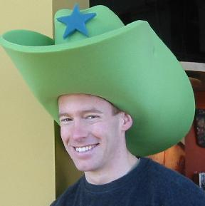
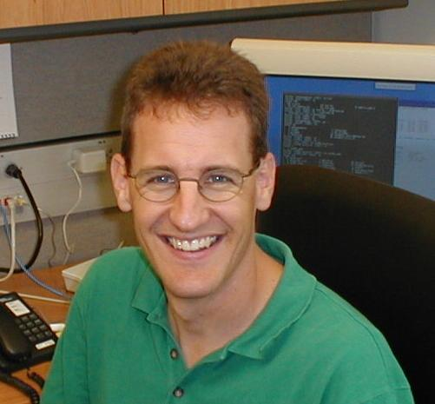
Doug and Steve
Doug Burger and Steve Keckler
and many, many others ....
TRIPS
what has happened to processor speeds the past 5 years?
what is a super computer?
http://www.cs.utexas.edu/users/cart/trips/

Slide 35
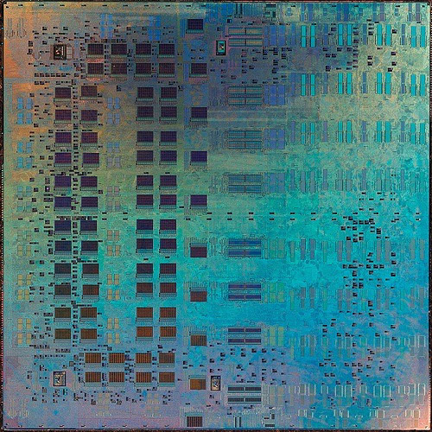
The Trips Chip Prototype

Slide 36
Google Trends
http://www.google.com/trends
Try these:
computer science
Mumford and Sons
computer science, Mumford and Sons
facebook, computer science, Mumford and Sons
binary search tree
recursion
linked lists, binary search tree
AP
super bowl

Slide 37
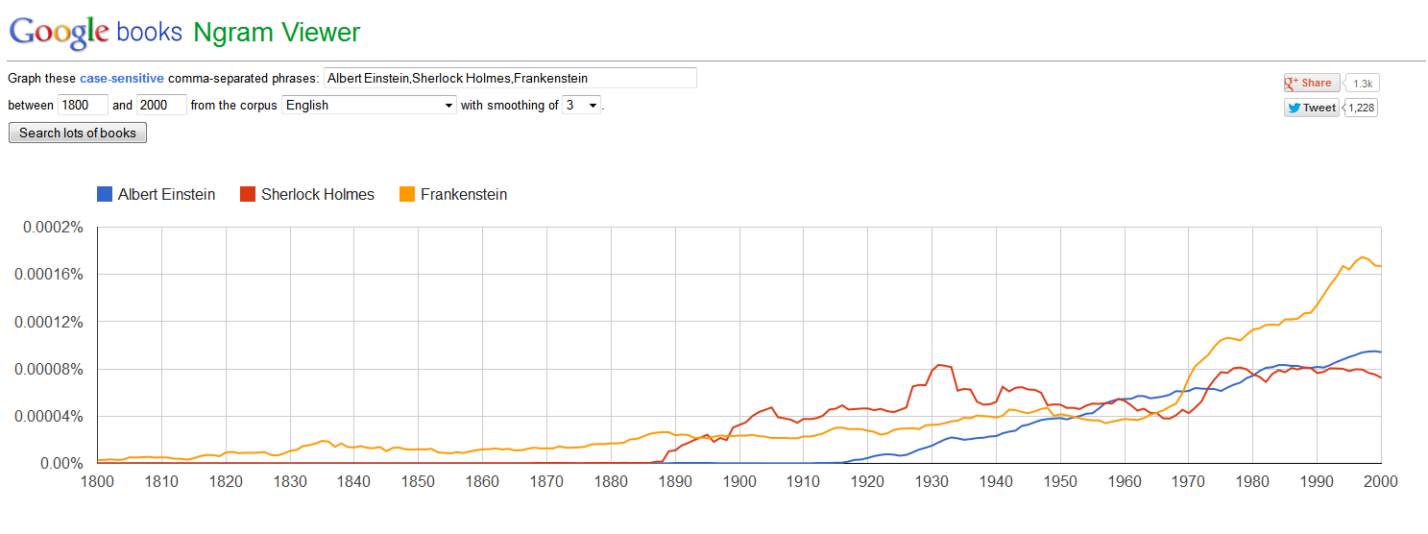
Goolge N Grams
http://books.google.com/ngrams

