Slide 1
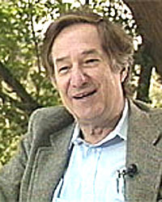
Topic 25 Tries
“In 1959, (Edward) Fredkin recommended that BBN (Bolt, Beranek and Newman, now BBN Technologies) purchase the very first PDP-1 to support research projects at BBN. The PDP-1 came with no software whatsoever.
Fredkin wrote a PDP-1 assembler called FRAP (Free of Rules Assembly Program);”
Tries were first described by René de la Briandais in File searching using variable length keys.

Slide 2
Clicker 1
How would you pronounce “Trie”
“tree”
“tri – ee”
“try”
“tiara”
something else

Slide 3
Tries aka Prefix Trees
Pronunciation:
From retrieval
Name coined by Computer Scientist Edward Fredkin
Retrieval so “tree”
… but that is very confusing so most people pronounce it “try”

Slide 4
Predictive Text and AutoComplete
Search engines and texting applications guess what you want after typing only a few characters

Slide 5
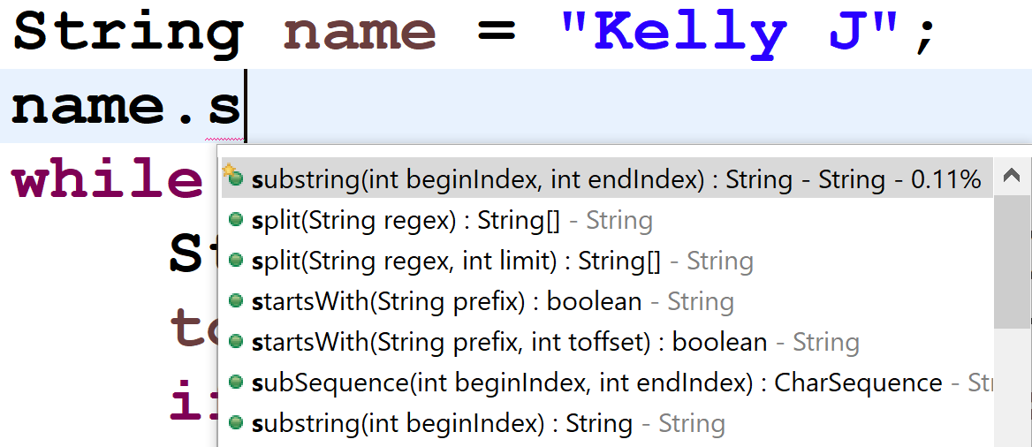
AutoComplete
So do other programs such as IDEs

Slide 6
Searching a Dictionary
How?
Could search a set for all values that start with the given prefix.
Naively O(N) (search the whole data structure).
Could improve if possible to do a binary search for prefix and then localize search to that location.

Slide 7
Tries
A general tree
Root node (or possibly a list of root nodes)
Nodes can have many children
not a binary tree
In simplest form each node stores a character and a data structure (list?) to refer to its children
Stores all the words or phrases in a dictionary.
How?

Slide 8
René de la Briandais Original Paper

Slide 9
????

Slide 10
????
Picture of a Dinosaur

Slide 11
Fall 2022 - Ryan P.
Created with Procreate: https://procreate.art/

Slide 12
Can

Slide 13
Candy

Slide 14
Fox

Slide 15
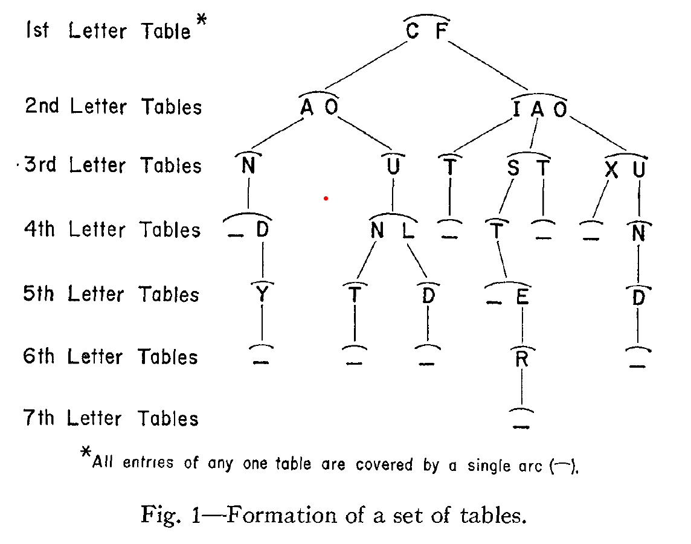
Clicker 2
Is “fast” in the dictionary represented by this Trie?
No
Yes
It depends

Slide 16
Clicker 3
Is “fist” in the dictionary represented by this Trie?
No
Yes
It depends

Slide 17
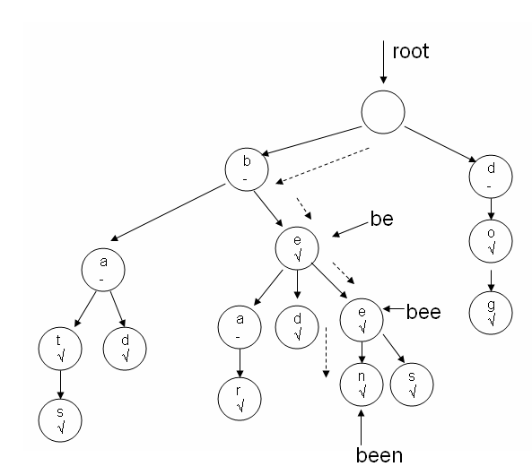
Tries
Another example of a Trie
Each node stores:
A char
A boolean indicating if the string ending at that node is a word
A list of children

Slide 18
Predictive Text and AutoComplete
As characters are entered we descend the Trie
… and from the current node …
… we can descend to terminators and leaves to see all possible words based on current prefix
b, e, e -> bee, been, bees

Slide 19
Tries
Stores words and phrases.
other values possible, but typically Strings
The whole word or phrase is not actually stored in a single node.
… rather the path in the tree represents the word.

Slide 20
Implementing a Trie
public class Trie {
private TNode root;
private int size; // number of words
private int numNodes;
public Trie() {
root = new TNode();
numNodes = 1;

Slide 21
TNode Class
Basic implementation uses a LinkedList of TNode objects for children
Other options?
ArrayList?
Something more exotic?
private static class TNode {
private boolean word;
private char ch;
private LinkedList<TNode> children;

Slide 22
Basic Operations
Adding a word to the Trie
Getting all words with given prefix
Demo in IDE

Slide 23
Compressed Tries
Some words, especially long ones, lead to a chain of nodes with single child, followed by single child:
b
s
e
t
e
i
u
l
o
a
l
d
o
y
c
p
l
r
l
y
k

Slide 24
Compressed Trie
Reduce number of nodes, by having nodes store Strings
A chain of single child followed by single child (followed by single child … ) is compressed to a single node with that String
Does not have to be a chain that terminates in a leaf node
Can be an internal chain of nodes

Slide 25
Original, Uncompressed
b
s
e
t
e
i
u
l
o
a
l
d
s
y
c
p
l
r
l
y
k

Slide 26
Compressed Version
b
s
ell
to
e
id
u
ck
p
ar
ll
sy
y
8 fewer nodes compared to uncompressed version
s – t – o – c - k

Slide 27
Data Structures
Data structures we have studied
arrays, array based lists, linked lists, maps, sets, stacks, queues, trees, binary search trees, graphs, hash tables, red-black trees, priority queues, heaps, tries
Most program languages have some built in data structures, native or library
Must be familiar with performance of data structures
best learned by implementing them yourself

Slide 28
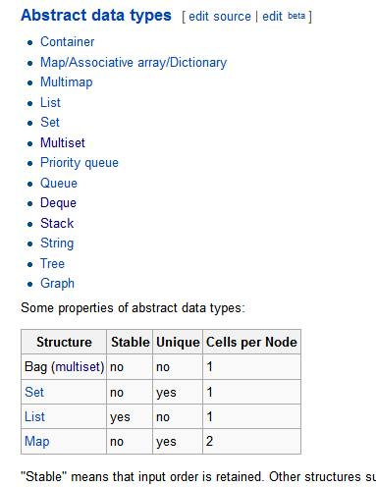
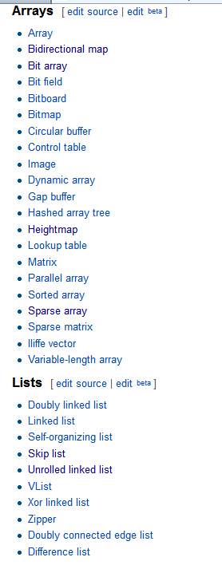
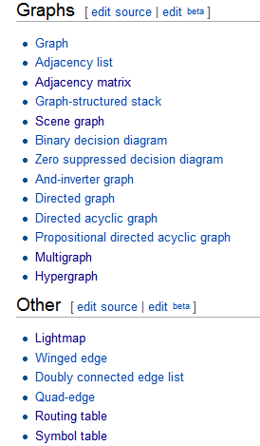
Data Structures
We have not covered every data structure
http://en.wikipedia.org/wiki/List_of_data_structures

Slide 29
Data Structures
deque, b-trees, quad-trees, binary space partition trees, skip list, sparse list, sparse matrix, union-find data structure, Bloom filters, AVL trees, 2-3-4 trees, and more!
Must be able to learn new and apply new data structures

