Slide 1
CS371m - Mobile Computing
Persistence - Web Based Storage
CHECK OUT https://developer.android.com/training/sync-adapters/index.html

Slide 2
The Cloud ……….

Slide 3
Backend
No clear definition of backend
front end - user interface
backend - data, server, programs the user does not interact with directly
With 1,000,000s of mobile and web apps …
rise of Backend as a Service (Baas)
Sometimes MBaaS, M for mobile

Slide 4
Back End As a Service - May Provide:
cloud storage of data
integration with social networks
push notifications
server initiates communication, not the client
messaging and chat functions
user management
user analysis tools
abstractions for dealing with the backend

Slide 5
Clicker
How many Mobile Backend as a Service providers exist?
1 or 2
about 5
about 10
about 20
30 or more
https://github.com/relatedcode/ParseAlternatives

Slide 6
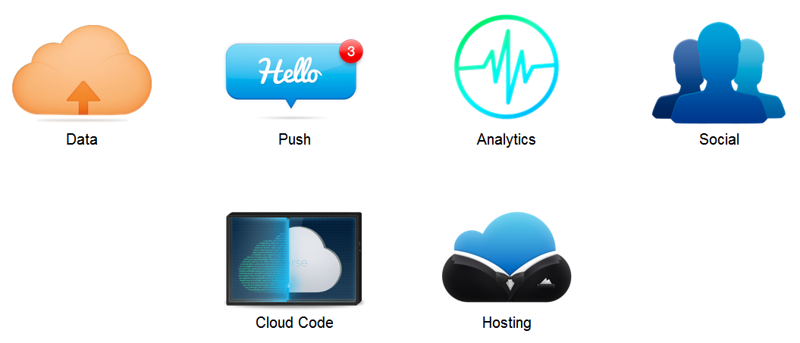
MBaaS

Slide 7
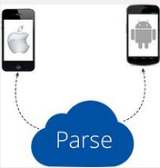
Some Examples of MBaas
Parse
Firebase (Google)
Amazon Web Services
Google Cloud Platform
Heroku
PythonAnywhere
Rackspace Cloud
BaasBox (Open Source)
Usergrid (Open Source)

Slide 9
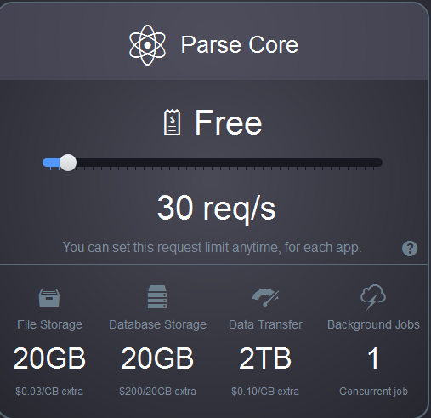
Examples of Using a MBaaS
Parse
www.parse.com
various pricing models
relatively easy to set up and use
Going away 1/28/2017

Slide 10
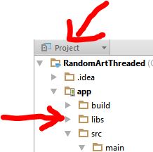
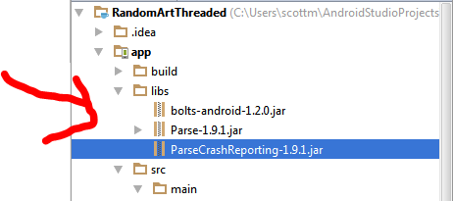
Parse Set Up in AndroidStudio
request api key
Download Parse SDK
Unzip files
Create libs directory in app directory (select Project view)
Drag jar files to libs directory

Slide 11
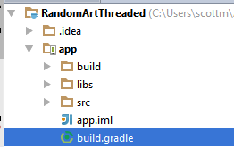
Parse Set Up in AndroidStudio
add dependencies to gradle build file under app like so:
https://www.parse.com/apps/quickstart# parse_data/mobile/android/native/new

Slide 12
Testing Parse
Add permissions to manifest to access network state and use internet
initialize Parse in onCreate method
keys for account and app

Slide 13
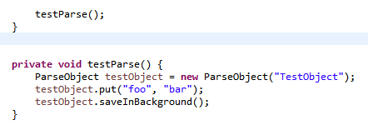
Testing Parse
at the end of onCreate()
create and send a test object to Parse
abstraction
handles doing this in the background, off the UI thread

Slide 14
Result of Test
JSON
JavaScript Object Notation

Slide 15
ParseObject
Local representation of data (on the device) that can be saved and retrieved from the Parse
String in constructor is class name
like a table in a data base
put to add key - value pairs
String - Object
keys must be alphanumerics
like a column in the row

Slide 16
ParseObject
saveInBackground method saves object to Parse in a background thread
multiple options for saving
saveAll(List)
saveEventually() - if server or network not available
saveInBackground(SaveCallback)

Slide 17
Parse and RandomArt
add ability to save equations
save to parse database
allow multiple users to save equations
functionality to display a random equation others liked
up and down votes

Slide 18
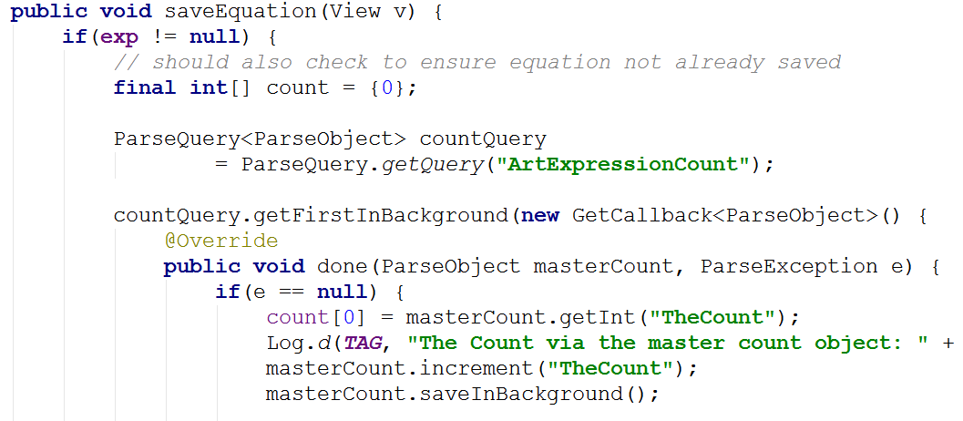
onClick for Keep This

Slide 19
onClick for Save Equation - cont.
ParseObject allowed addition of any key value pair.
Keys must be Strings.

Slide 20
saveEquation
Makes a query to get the number of rows in the expression table
uses another table with one row with one column (GACK, no auto increment function)
callback method for completed query
checks the count
creates new ParseObject
makes the index for this new expression the count (0 based indexing)
saves the object and updates count object

Slide 21
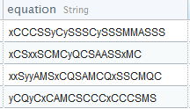
Parse Dashboard
Examine data uploaded from apps

Slide 22
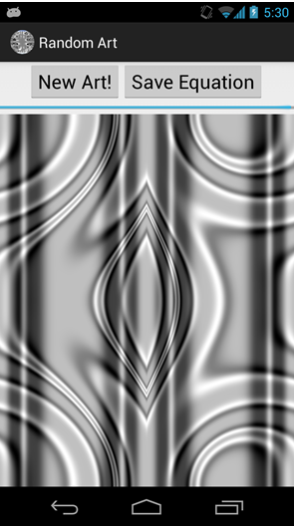
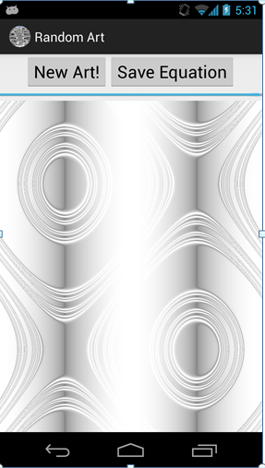
demo Saving an Equation

Slide 23
Get Random Saved Art
When user presses button pick a random saved expression and render that image
We just save the expression so we must recreate image
time vs. space trade off
check count of values and pick random index

Slide 24
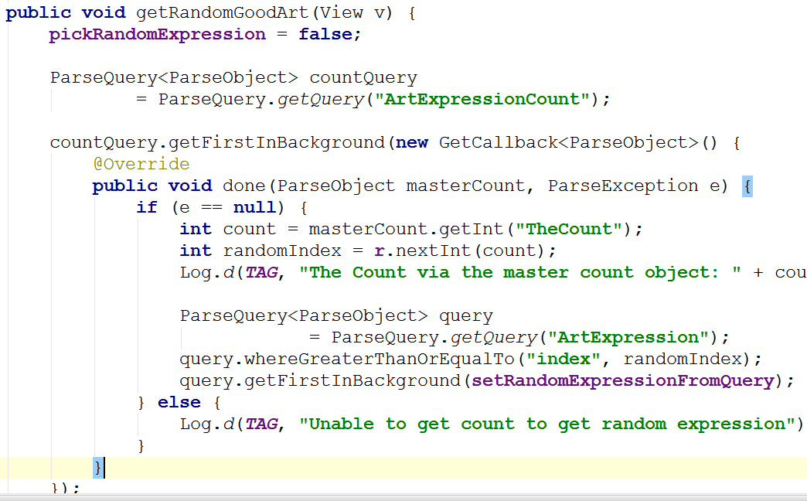
getRandomGoodArt

Slide 25
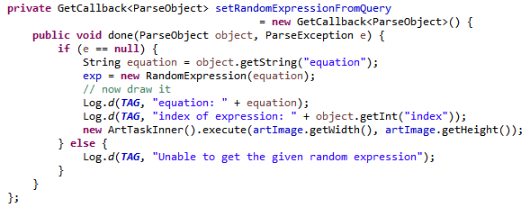
callback object
pull out the String from the returned object and build expression based on equation

Slide 26
good one logcat

Slide 27
More Parse
Includes capability to do local data store
save objects on device, save to cloud later
abstracts away a lot of the details
Kyle Norton from Pariveda: "Assume you WON'T be connected to the network."
Parse objects meant to be "small"
less than 128 kb
not for images
Parse files for large pieces of data
Past semesters many groups used Parse successfully

Slide 28
Firebase

Slide 29
Firebase
Yet another Backend as a Service (Baas)
Designed for web and mobile
Founded in 2011
Initial product was backend so websites could easily host chat as part of site
discovered developers were sending non chat data (such as game state) via the tool

Slide 30
Firebase for Android
Devices with Android 4.0 (ice cream sandwich) or higher
Google play services SDK
same as fused location
Android Studio 1.5 or higher
Your Android studio project and package name
Firebase Assistant in Android Studio 2.2 or higher
Tools -> Firebase

Slide 31
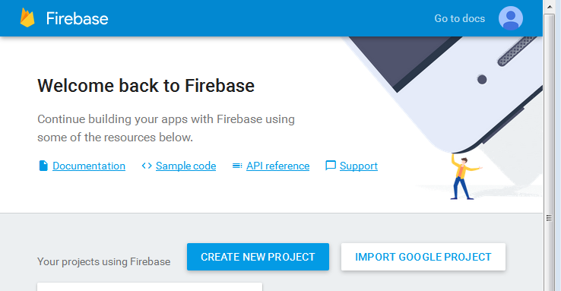
Firebase Project Set up
Create Firebase project in console
Just needs name and country

Slide 32
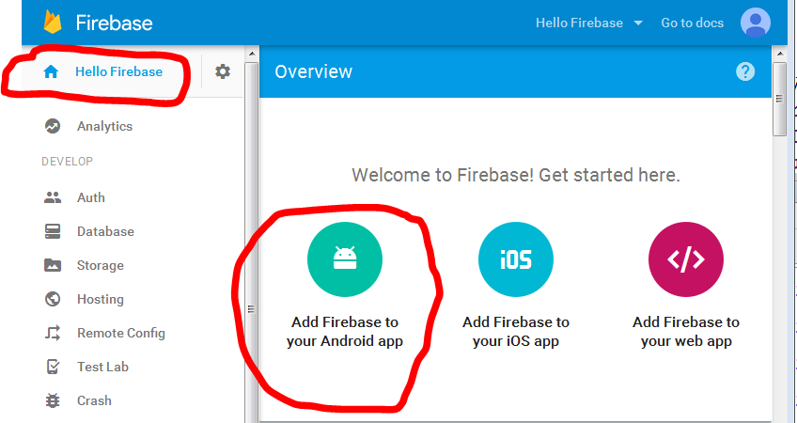
Firebase Project Console
After creating project, overview page:

Slide 33
Firebase for Android Project
Adding Firebase to Android app
Need package name (easy)
Debug signing certificate SHA-1 hash (for use of some Firebase features)
Uses the keytool program included with Java
"Manages a keystore (database) of cryptographic keys, X.509 certificate chains, and trusted certificates. "

Slide 34
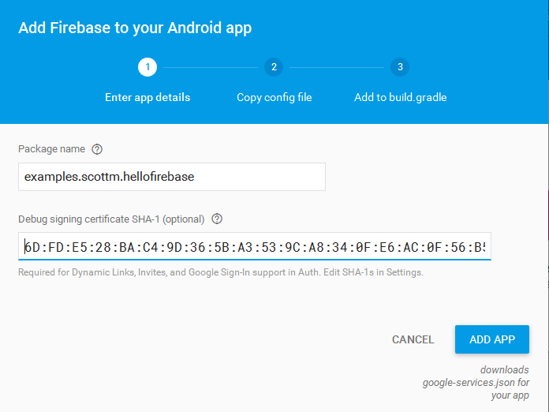
Adding Firebase to Android App

Slide 35
Using keytool
Varies from system to system
need location of debug signing certificate
created automatically when Android Studio installed
typically, <USER>/.android/debugkeystore

Slide 36
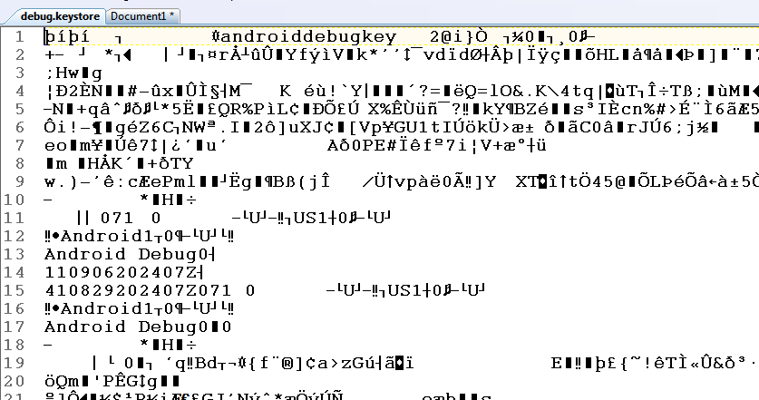
Debug Signing Certificate
certificate not human readable

Slide 37
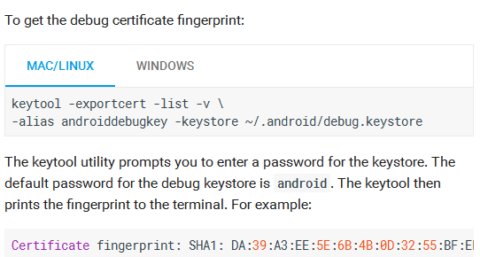
Running keytool
Specifics vary from system to system

Slide 38
Firebase Config File for App
After providing package name and SHA-1 fingerprint ...
Firebase generates a JSON file named google-services.json specific for this project
multiple projects / apps -> repeat steps
Download and add file to project

Slide 39
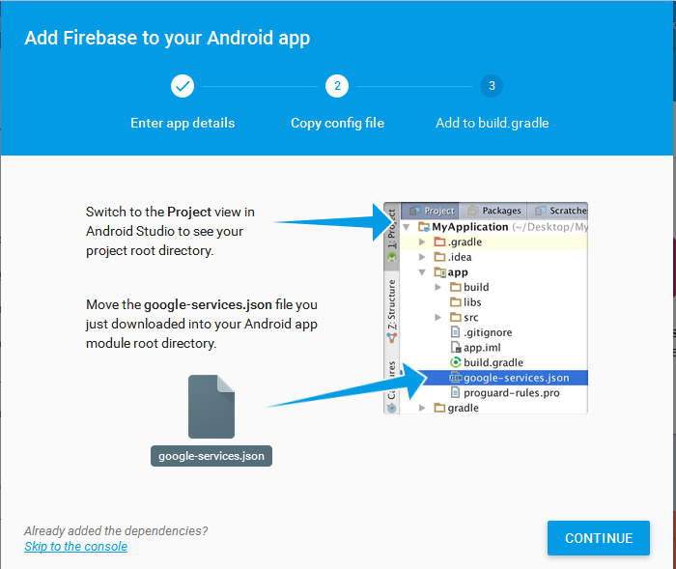
Firebase Config File for App

Slide 40
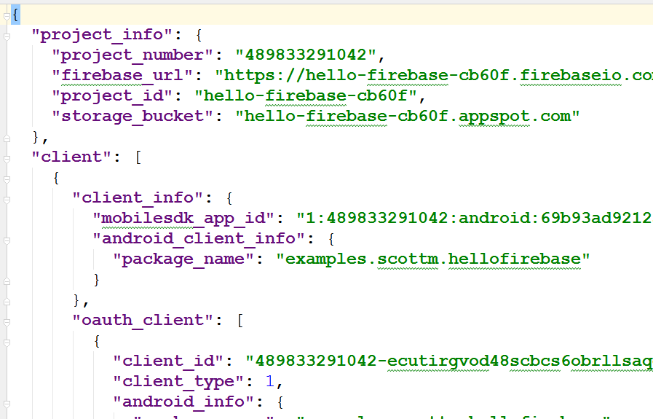
google-services.json

Slide 41
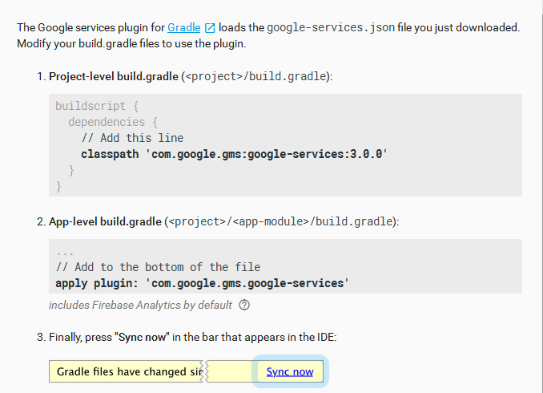
Update Gradle Files

Slide 42
Firebase Capabilities
Firebase has a host of capabilities
User authorization
database storage
storage for larger files
cloud messaging
push notifications
analytics
hosting of web content

Slide 43
Firebase Database
With Parse offline, migrated Random Art database to Firebase
The roots of the chat room are somewhat apparent
lots of chat examples
realtime updates
emphasis on authorized users

Slide 44
One More Setup Step
To use Firebase databases in app, after previous setup steps:

Slide 45
Firebase Database Rules
Firebase database rules
Defines:
How data should be structured
How data should be indexed
When data can be read or written
Who can read and write data

Slide 46
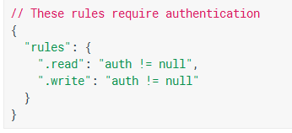
Firebase Database Rules

Slide 47
Hello Firebase
In app, called from onCreate of Activity

Slide 48
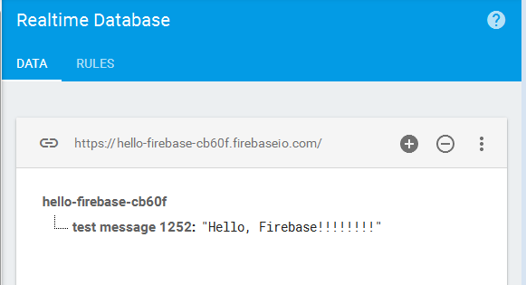
Result When App Run
Immediately writes to database if network connections exists:

Slide 49
Firebase database
Not traditional tables
"Everything is a JSON! tree"
Children of main tree are like "tables" in traditional database
Children of children are typically (but not always) like rows in a traditional table

Slide 50
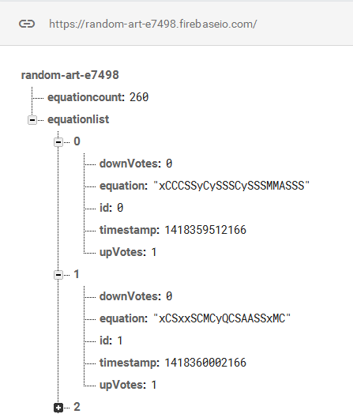
Random Art Data on Firebase
equation count child to assign ids and pick random equation
equation list with children for each equation

Slide 51
Random Art
App keeps track of current equation count
First value from database and listener so whenever count changes, local copy is updated

Slide 52
Random Art
Keep references to parts of JSON tree
Update values (equation count)
add children (new, good equations)
pull random children (old, good equations)
In main Random Art Activity

Slide 53
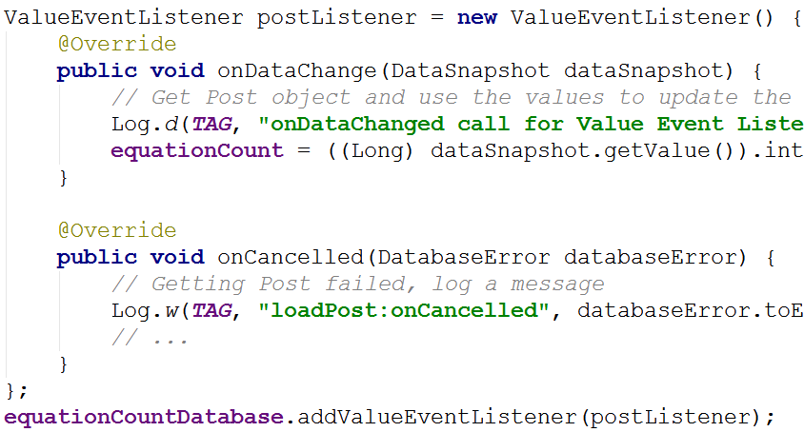
Random Art - Count Listener

Slide 54
Random Art - Save Equation
setValue method to add child
Firebase data: String, Long, Double, Boolean, Map<String, Object>, List<Object>
any custom object with 0 argument constructor and public getters for properties

Slide 55
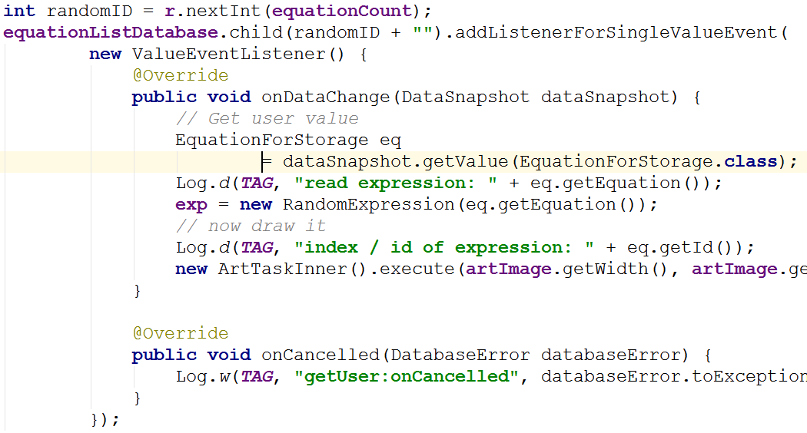
Random Art - Get Equation
Pick random child based on current number of equations

Slide 56
JSON

Slide 57
JSON
JavaScript Object Notation
a way to represent JavaScript objects as Strings
alternative to XML for passing data between servers and clients
designed for data interchange format that humans can also read and write

Slide 58
JSON Format
Built on two structures
collection of name-value pairs: a.k.a. objects, records, structs, etc.
an ordered list of values: a.k.a. an array
objects

Slide 59
JSON Format
arrays
values
string, number, object, array, true, false, null

Slide 60
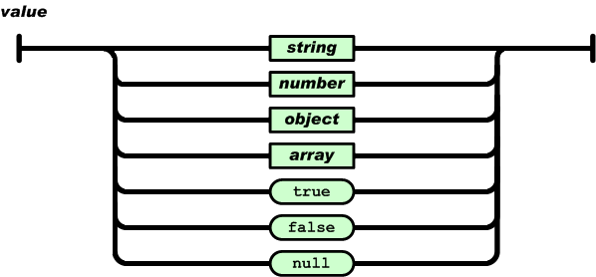
JSON Values
Syntax Diagrams for string and number: http://www.json.org/

Slide 61
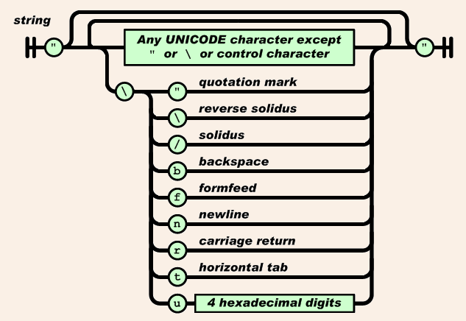
JSON Strings

Slide 62
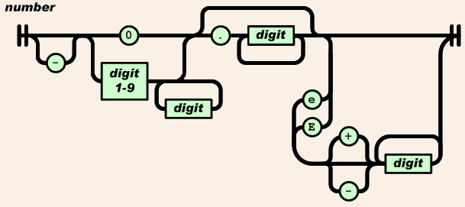
JSON Numbers

Slide 63
JSON Examples
value (String):
"Round Rock"
array:
["Round Rock", "Dallas", "Houston"]
object
{"height":70,"weight":165}

