Slide 1
Game Making with Alice
Mike Scott
University of Texas at Austin

Slide 2
What is Alice?
Alice is a visual programming language.
Alice is designed to teach you how to program
The output of Alice programs are movies.
The movies can be interactive

Slide 3
Alice and Visual Programming
Programming is done by pointing and clicking, dragging and dropping, selecting from menus, and some typing
Download Alice for free:
www.alice.org

Slide 4
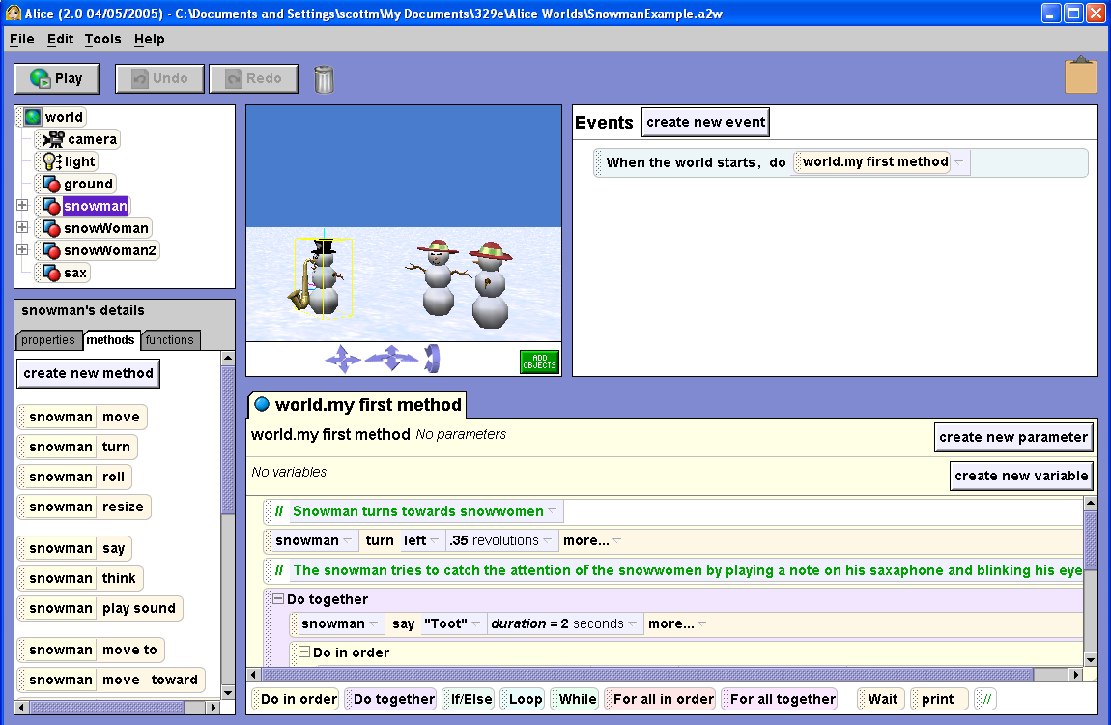
Object Tree
World View
Event Editor
Details Panel
Control Primitives
Code Editor

Slide 5
Alice Models
Main programming data are 3d models
Many built in and more on web

Slide 6
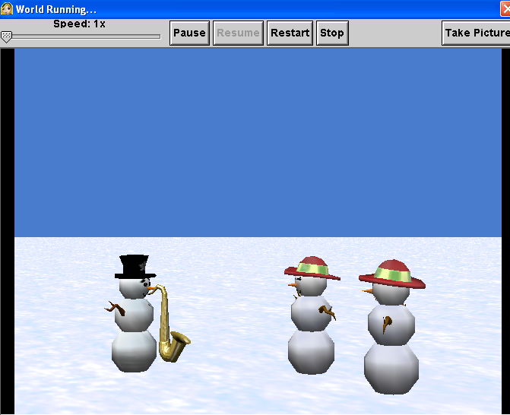
Output
Output are 3d movies
run the program, play a movie
can also add sound to programs
A lot easier to recognize logic errors
"Why do my ninja's arms keep flying away?"

Slide 7
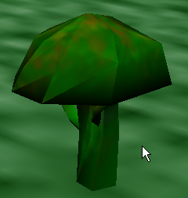
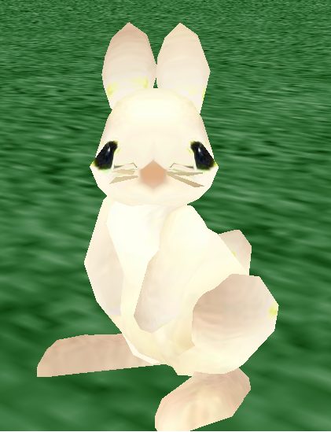
Sample Program - Bunny and Broccoli

Slide 8
Click the Cow

Slide 9
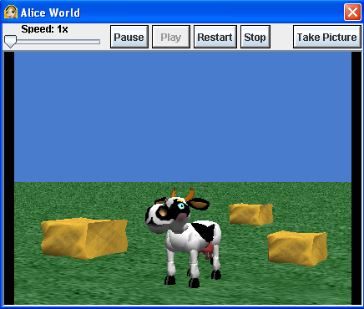
Eat the Hay

Slide 10
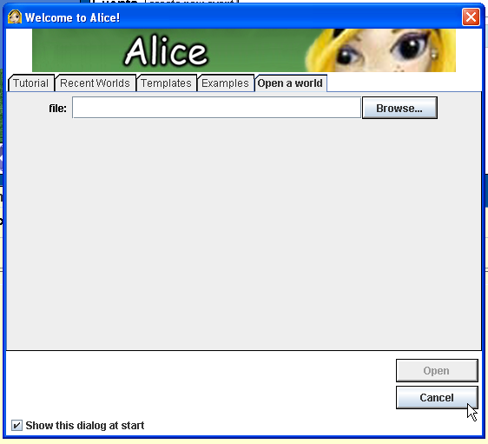
Start Alice
Double click on the Alice icon to start Alice
It may take a minute to start up
Cancel the opening dialog screen

Slide 11
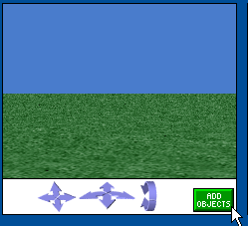
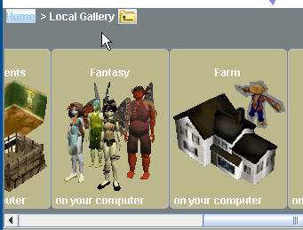
Build the Scene
Click on the add objects button at the bottom right of the scene
Scroll to the Farm category and clock on Farm

Slide 12
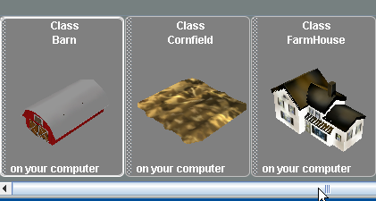
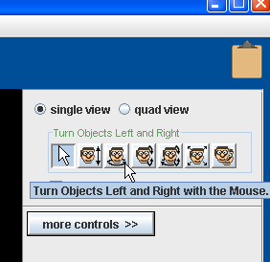
Add Objects to Scene
Click and Drag some objects into the scene
Once in the scene objects can be positioned with the mouse
Object can be rotated by selecting the proper option from the menu in the upper right
If you want to get rid of an object right click it and select delete

Slide 13
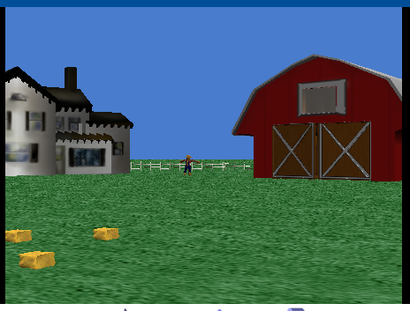
A Farm Background
Yours can be different.

Slide 14
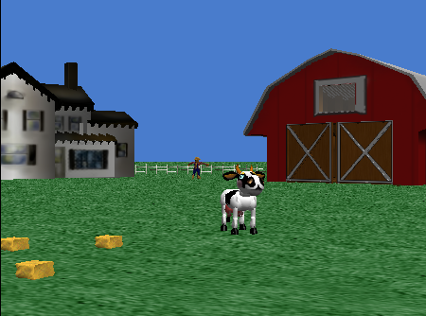
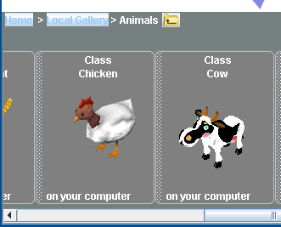
Add The Cow
Click on the Local Gallery to get back to the list of categories
Open the Animals Category
Scroll over to the Cow and add one to the world

Slide 15
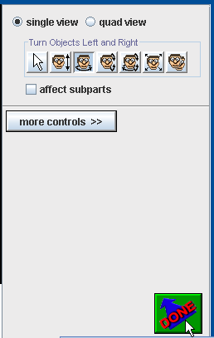
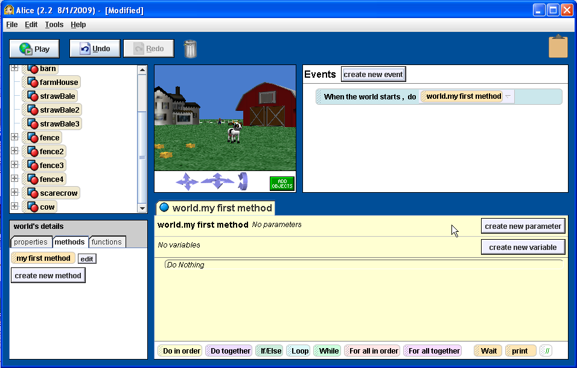
Back to Programming
Exit the scene editor by clicking the done button

Slide 16
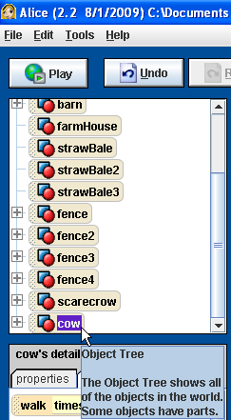
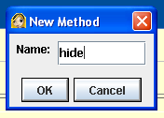
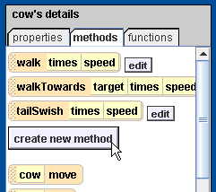
Make a method to hide the cow
Click on the cow in the object tree.
Click on the methods in the details window
Click on the create new method button
Name the method hide

Slide 17
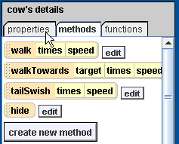
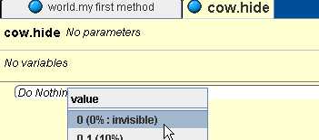
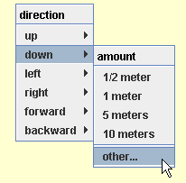
Add commands to the hide method
Click on the properties tab in the detail window
Drag the opacity = 1(100%) icon into the window for hide
Change the opacity to 0(0%)
Click on the methods tab in the details window
Drag over the cow move command
Select down for the direction and other for the amount.
Set to 2

Slide 18
The completed hide method

Slide 19
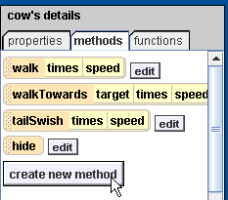
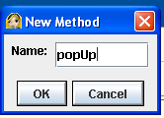
Create the pop up method
Click the cow in the object tree
Click on methods
Click the create new method button
name the method popUp

Slide 20
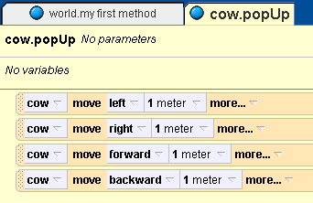
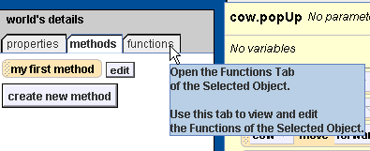
Move the cow randomly
Start by dragging out cow move tiles
one for each of left, right, forward, and backward
Click on world in the object tree to select it
Click on functions in the details window
Drag out random number and drop it on the 1 meter
select more and change max to 2
Notes:
Be sure to drop the random number on the 1 meter when the 1 meter is in a green box. The green box shows where the dropped tile will go.

Slide 21
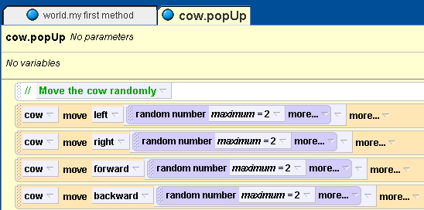
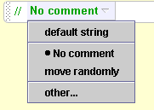
Add a comment
You can add a comment to explain what you are doing in English
Drag a // tile from the bottom of the method editing window to where you wish to place the comment
Click on the down arrow
Select other
Type in the comment

Slide 22
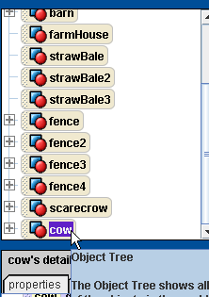
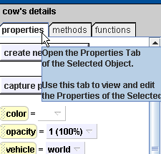
Showing the cow
Click on cow in the object tree to select it
Click on methods in the details window
Drag out a cow move tile
select up 2 meters
Click on properties in the details window
Drag out opacity = 0
change to 1 (100%)

Slide 23
Completed popUp method

Slide 24
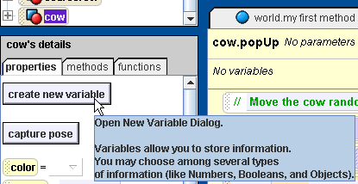
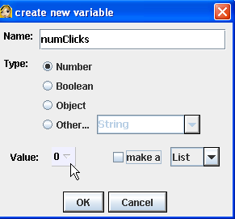
Adding a property (field)
We need to store the number of time the cow has been clicked
Click the cow in the object tree
Click on the properties tab
Click the create new variable button
name the variable numClicks
set the value to 0
Notes:
By default the type of the new variable is a number which is fine since we will use this field to record the number of hits.

Slide 25
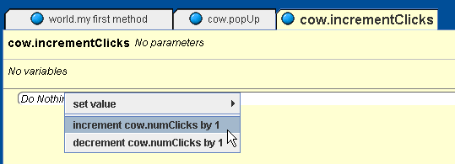
Increment the number of hits
If the user clicks on the cow we want to add 1 to the number of clicks so far
Create a method that does this
It should be a new cow method (cow selected in object tree)
Drag numClicks variable into method and select the increment cow.numClicks by 1 option

Slide 26
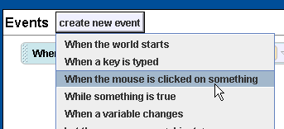
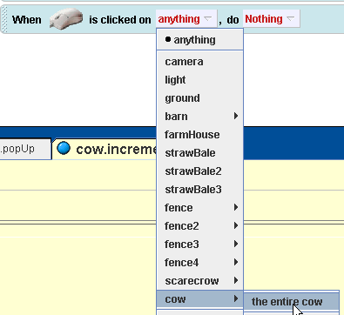
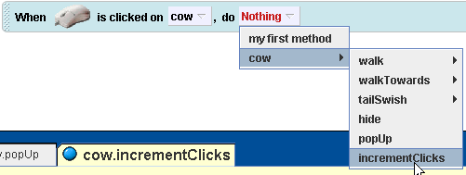
Respond to mouse click on cow
In the events window click the create new event button
select When the mouse is clicked on something
Change the anything to the cow (the entire cow)
Change the nothing to cow incrementClicks

Slide 27
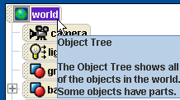
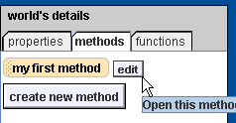
Method to run the game
Click on world in the object tree
Select methods and edit the my first method
Pull up a while tile from the bottom of the editor window and drop into the my first method
select true

Slide 28
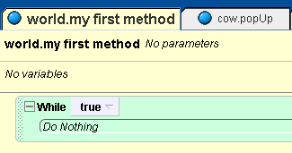
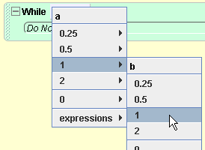
Change while loop
Click on functions tab
drag out a < b and drop it on true
select 1 and 1

Slide 29
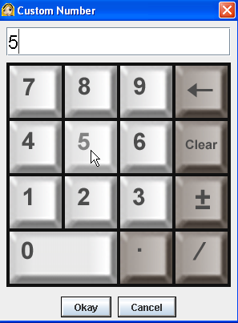
While number of hits < 5
Click on cow in the object tree
Click on properties
drag out numClicks = 0 and drop on the first 1
Change the second 1 to 5
click on other and enter 5

Slide 30
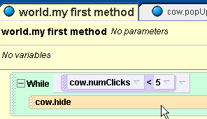
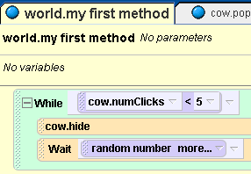
Hide and wait a random amount of time
Click on cow and then the methods
Drag out hide
Drag up a wait tile from the bottom of the editor window
select 1 second
Click on world in the object tree
click on functions
drag out random number and drop on the 1 second

Slide 31
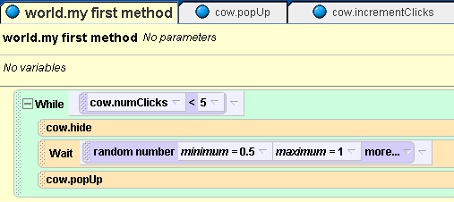
pop up and wait for 1 second
Change random number on wait to a min of 0.5 seconds
Drag out a cow popUp
Try it out!
What happens after you click on the cow 5 times?

Slide 32
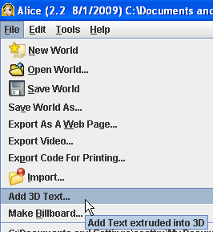
Tell the user they won
Add some 3D text that tells the user she or he won
Click on File and then on Add 3D Text
Type in the text
you can change the font
Place it where you want it to appear
Click on add objects to get to the mouse controls
Click on done when done

Slide 33
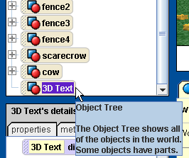
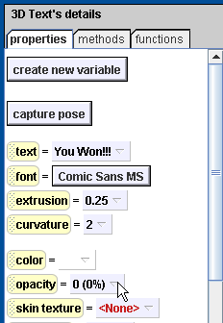
Make the text invisible to start
Click on the text in the object tree
Click on properties
Modify opacity to 0 (0%)

Slide 34
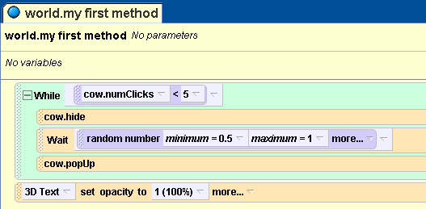
When the user wins show the text
Drag out opacity = 0 to the my first method
change to 1 (100%)
Play the game!

Slide 35
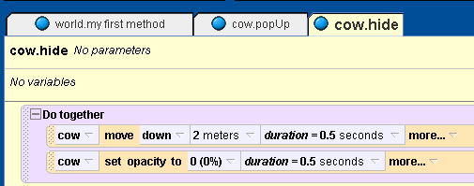
Speeding things up in hide method
All animation commands takes 1 second by default
you can change this using the more…
Drag a Do together block from the bottom and then drag both commands into it
Notes:
Do the same thing for the popUp method.

Slide 36
Speeding things up in popUp method
Remove the random move left and forward
Right click commands and select delete
Change minimum on random move right and back to -2
Set duration on random moves to 0
Put move up and set opacity to 1 commands to a do together block and change duration to 0.5 seconds

Slide 37
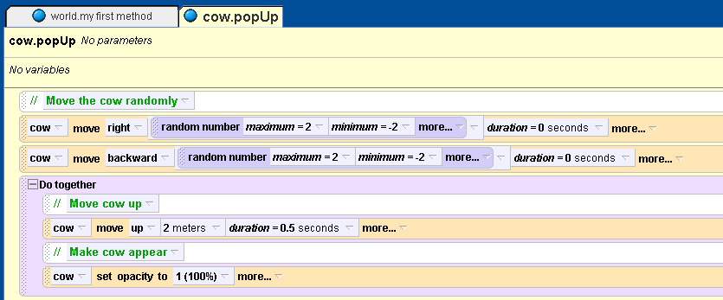
Finished popUp method

Slide 38
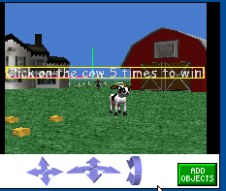
Add instructions
Create 3D text that tells the user what to do in the game
When the game starts wait for 1 second
then make the text invisible
can set opacity to 0

Slide 39
Show the number of hits
Create 3D text that says Hits and one that says 0
Use the mouse controls to position the text
Click on Add Objects to see the mouse controls
when done click on done

Slide 40
Create World incrementClicks method
Add an incrementClicks method to the world
call the cow incrementClicks method
click on the 0 3dText object then properties
drag out text = 0
select default string
replace the default string with the what as string function in the world to convert the number to a string
choose expressions and pick cow numClicks as what to convert
Notes:
Why should we add the incrementHits method to the world and not just modify the cow increment hits? The problem is that we need to modify the 0 text which is not part of the cow put part of the world. In order to make reusable pieces we can't access things in cow methods that are not part of the cow. But, in the world incrementHits method we can call the cow increment hits method.

Slide 41
Change when mouse clicked
Modify then when mouse is clicked on the cow to call the world's incrementClicks method
Try it!

Slide 42
Other Ideas
Have the cow play a sound when hit
modify cow incrementClicks method
use play sound in methods
you can also record your own sounds
click on properties for the cow
click on the + next to Sounds
and record a sound and name it
Count the number of times the cow has appeared
Add a way to lose
maybe it will only run till it appears 10 times
maybe add a timer and a time limit
maybe add other cows that if you click on these you lose, change color of target cow to something like orange
Make the amount of time you give the user to click on the cow a random amount from 0.5 to 1 second

Slide 43
Summary
Alice can be used to create simple 3D games
Concepts covered
creating methods
creating a property (field)
creating a variable
using a while loop
creating a comment

